Slide 1
Supplier Payments Using Virtual Payables
October 25, 2017

Slide 2

Your Presenter
Eunicia Pop
Contract Management Specialist DOAS – State Purchasing Division
404.657.6879 virtual.payables@doas.ga.gov

Slide 3
AGENDA
INTRODUCTIONS
WHAT IS VIRTUAL PAYABLES?
Virtual Payables
The Virtual Credit Card
HOW DOES VIRTUAL PAYABLES WORK?
HOW TO UTILIZE SECURE EMAIL
Option 1
Option 2
COMMON ERROR MESSAGES
WHAT TO EXPECT
WHO TO CONTACT AND WHEN
QUESTIONS AND ANSWERS

Slide 4
What is Virtual Payables
The State of Georgia will begin making electronic payments to suppliers using Bank of America's Virtual Payables credit card product starting October 25, 2017.
Virtual Payables:
  Allows the supplier to accept payments by utilizing virtual credit card information it has stored on file. If the supplier chooses to not store the credit card information on file, the credit card account number and expiration date can be included in each remittance advice and sent via secure email.
  Once an invoice has been approved for payment, the State will:
  Fund the virtual credit card
  E-mail the supplier a remittance advice detailing the invoices that have been funded/paid
  The virtual credit card MUST be charged, for the exact amount, by the supplier
  The virtual credit card returns to a $0 balance
The Virtual Credit Card:
    The virtual credit card will expire every three years
    When renewed, both the virtual credit card number and CVV code will remain the same.

Slide 5
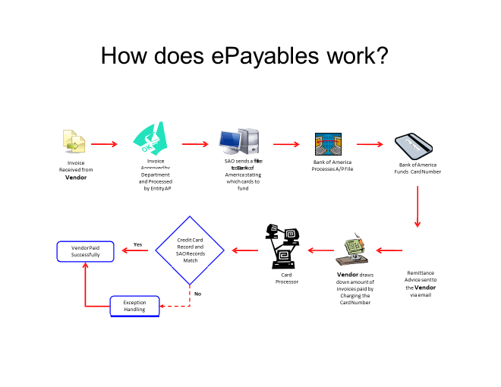
How Does Virtual Payables Work?
Invoice Received from supplier
Invoice Approved by Department and Processed by
Entity AP
SAO Sends a File to Bank of America Listing Cards To Be Funded
Bank of America Processes A/P File
Bank of America Funds Card Number
Credit Card Records and SAO Records Match
Supplier Paid Successfully
Remittance Advice
Card Processor
Supplier Charges the Credit Card for the Exact Amount Funded
Remittance Advice Sent To supplier via email
Exception Handling
Source: Bank of America Flowchart, as modified by DOAS
Note: SAO denotes State Accounting Office

Slide 6
How to Utilize Secure Email
It is highly recommended that the supplier creates a secondary secure email account (backup).
The first time a supplier receives a remittance advice, they will need to register and set up a password.
To retrieve a secure message from Bank of America, a supplier must be registered with Proofpoint Encryption. If not already registered, supplier will need to register by opening a secure message sent by Bank of America.
Go to https://secmail.bankofamerica.com/compose (save to Favorites). Fill in your Email Address, click Continue.

Slide 7
OPENING A SECURE MESSAGE
There are two options for opening a Secure Message:
Option #1 (Recommended):
Click the link labeled “Click here” to open the secure message prior to the date displayed. Depending on your operating device, you may need to double click the link to open the secure message.

Slide 8
Option #2:
Open the SecureMessageATT.html attachment followed by “Click to read message” button. Depending on your browser, the location of the SecureMessageATT.html attachment may vary.
Note: Some email and webmail clients, like Mozilla Thunderbird, display the Proofpoint Encryption secure message attachment inline. When you click the “Click to read message” link, you will see an error message. The solution is to first save the attachment to disk (not to the desktop) before opening it.

Slide 9
(Password Policy requirements display when setting the password), Confirm Password, select your security Question, security Answer and click Continue. Depending on whether Option #1 or #2 was used to complete registration, the secure message will either open or a message will be displayed confirming your registration has been completed.

Slide 10
The next time you access a secure message, you will be prompted to log into Proofpoint Encryption using the email address and password previously created. (see login slide 9)
If you forget your password, click the Forgot Password link on the Login page.
You will be prompted to Answer the security question created during registration and click Continue.

Slide 11
COMMON ERROR MESSAGES
ACCOUNT TEMPORARILY LOCKED OUT
You will receive this message after three (3) failed password attempts. Use the Forgot Password feature to reset the password.

Slide 12
KEY EXPIRED
The secure message is more than 90 days old and has expired. Contact DOAS for assistance.
COMMON ERROR MESSAGES (Cont’d)

Slide 13
MESSAGE NOT FOUND
An attempt to view the secure message after the “Click here” displayed date will return the following message. To access the secure message, open the SecureMessageATT.html attachment.
COMMON ERROR MESSAGES (Cont’d)

Slide 14
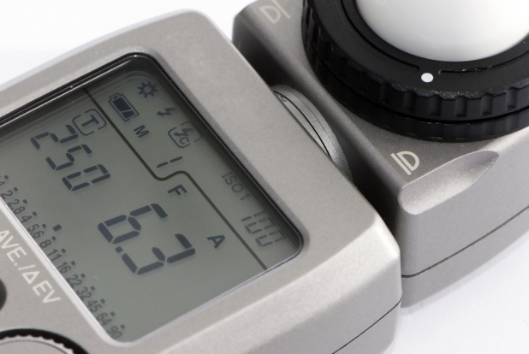

What to Expect
Remittance Advice
  Bank of America will send an email notification to the supplier’s email on record (can send to up to 2 unique email addresses)
  Supplier MUST immediately take payment upon receipt of remittance advice.
  If payment has not been taken within 5 days, a second email notification will be sent to the supplier. A third email notification will be sent if the supplier has not taken payment within 10 days.

Slide 15
What to expect (Cont’d)
- When a supplier receives a secured remittance advice, they will be required to click on the link contained within the email to access the virtual credit card account number and expiration date.
- Once the supplier logs out of the site, the supplier must re-authenticate in order to gain access to the virtual credit card information.
- Supplier MUST immediately take payment upon receipt of remittance advice.

Slide 16
Who to Contact and When
Contact DOAS
Welcome email not received
Remittance email issues
Update supplier profile (contacts, email)
Key Expired
Contact (Under evaluation during pilot test)
Need CVV Number
Contact Agency or College
Payment not received
Amount incorrect
Contact Bank of America
Password Reset
Bank of America Secure Messaging Assistance
http://securemsg.bankofamerica.com/

Slide 17
Contact
For Supplier Questions:
For Agency Questions:
Department of Administrative Services
State Accounting Office
Eunicia Pop
Contract Management Specialist DOAS – State Purchasing Division
404.657.6879
virtual.payables@doas.ga.gov
SAO Customer Service Center
404.657.3956
Choose Option 2
then Option 3
virtualpayables@sao.ga.gov

Slide 18


