Slide 1
GPC 2023 Planning Procurement’s Future Exhibitor Logistics and Communications Webinar
GPC EXPO Team
April 5, 2023

Slide 2
Tick, Tock, Tick, Tock

Slide 3
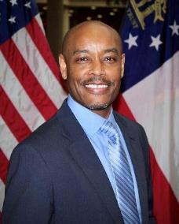
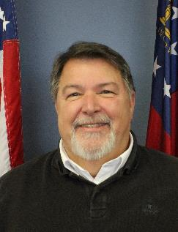
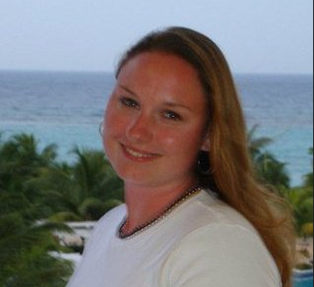
Your GPC EXPO Team
Osborne Johnson
DOAS SPD
404-232-1929
Gpc.expo@doas.ga.gov
Gary Craft
DOAS SPD
404-656-2287
Gpc.expo@doas.ga.gov
Danielle Murnieks
PRX Exposition Services
803-926-5300 prx@prexposition.com
Notes:
Good Afternoon and Welcome! UPDATE

Slide 4
AGENDA Welcome Logistics Registration Engineerica Housekeeping and Handy Reminders Open Forum for Questions

Slide 5
Where Do I Go? Where do I Start?

Slide 6
Loading Dock Entrance
Main Convention Center Entrance
Loading Dock Hours
Monday 4pm-6pm
Tuesday 7am-1pm
Loading Dock

Slide 7
Porte Cochere and Loading Dock

Slide 8
PARKING OPTIONS TO UNLOAD

Slide 9
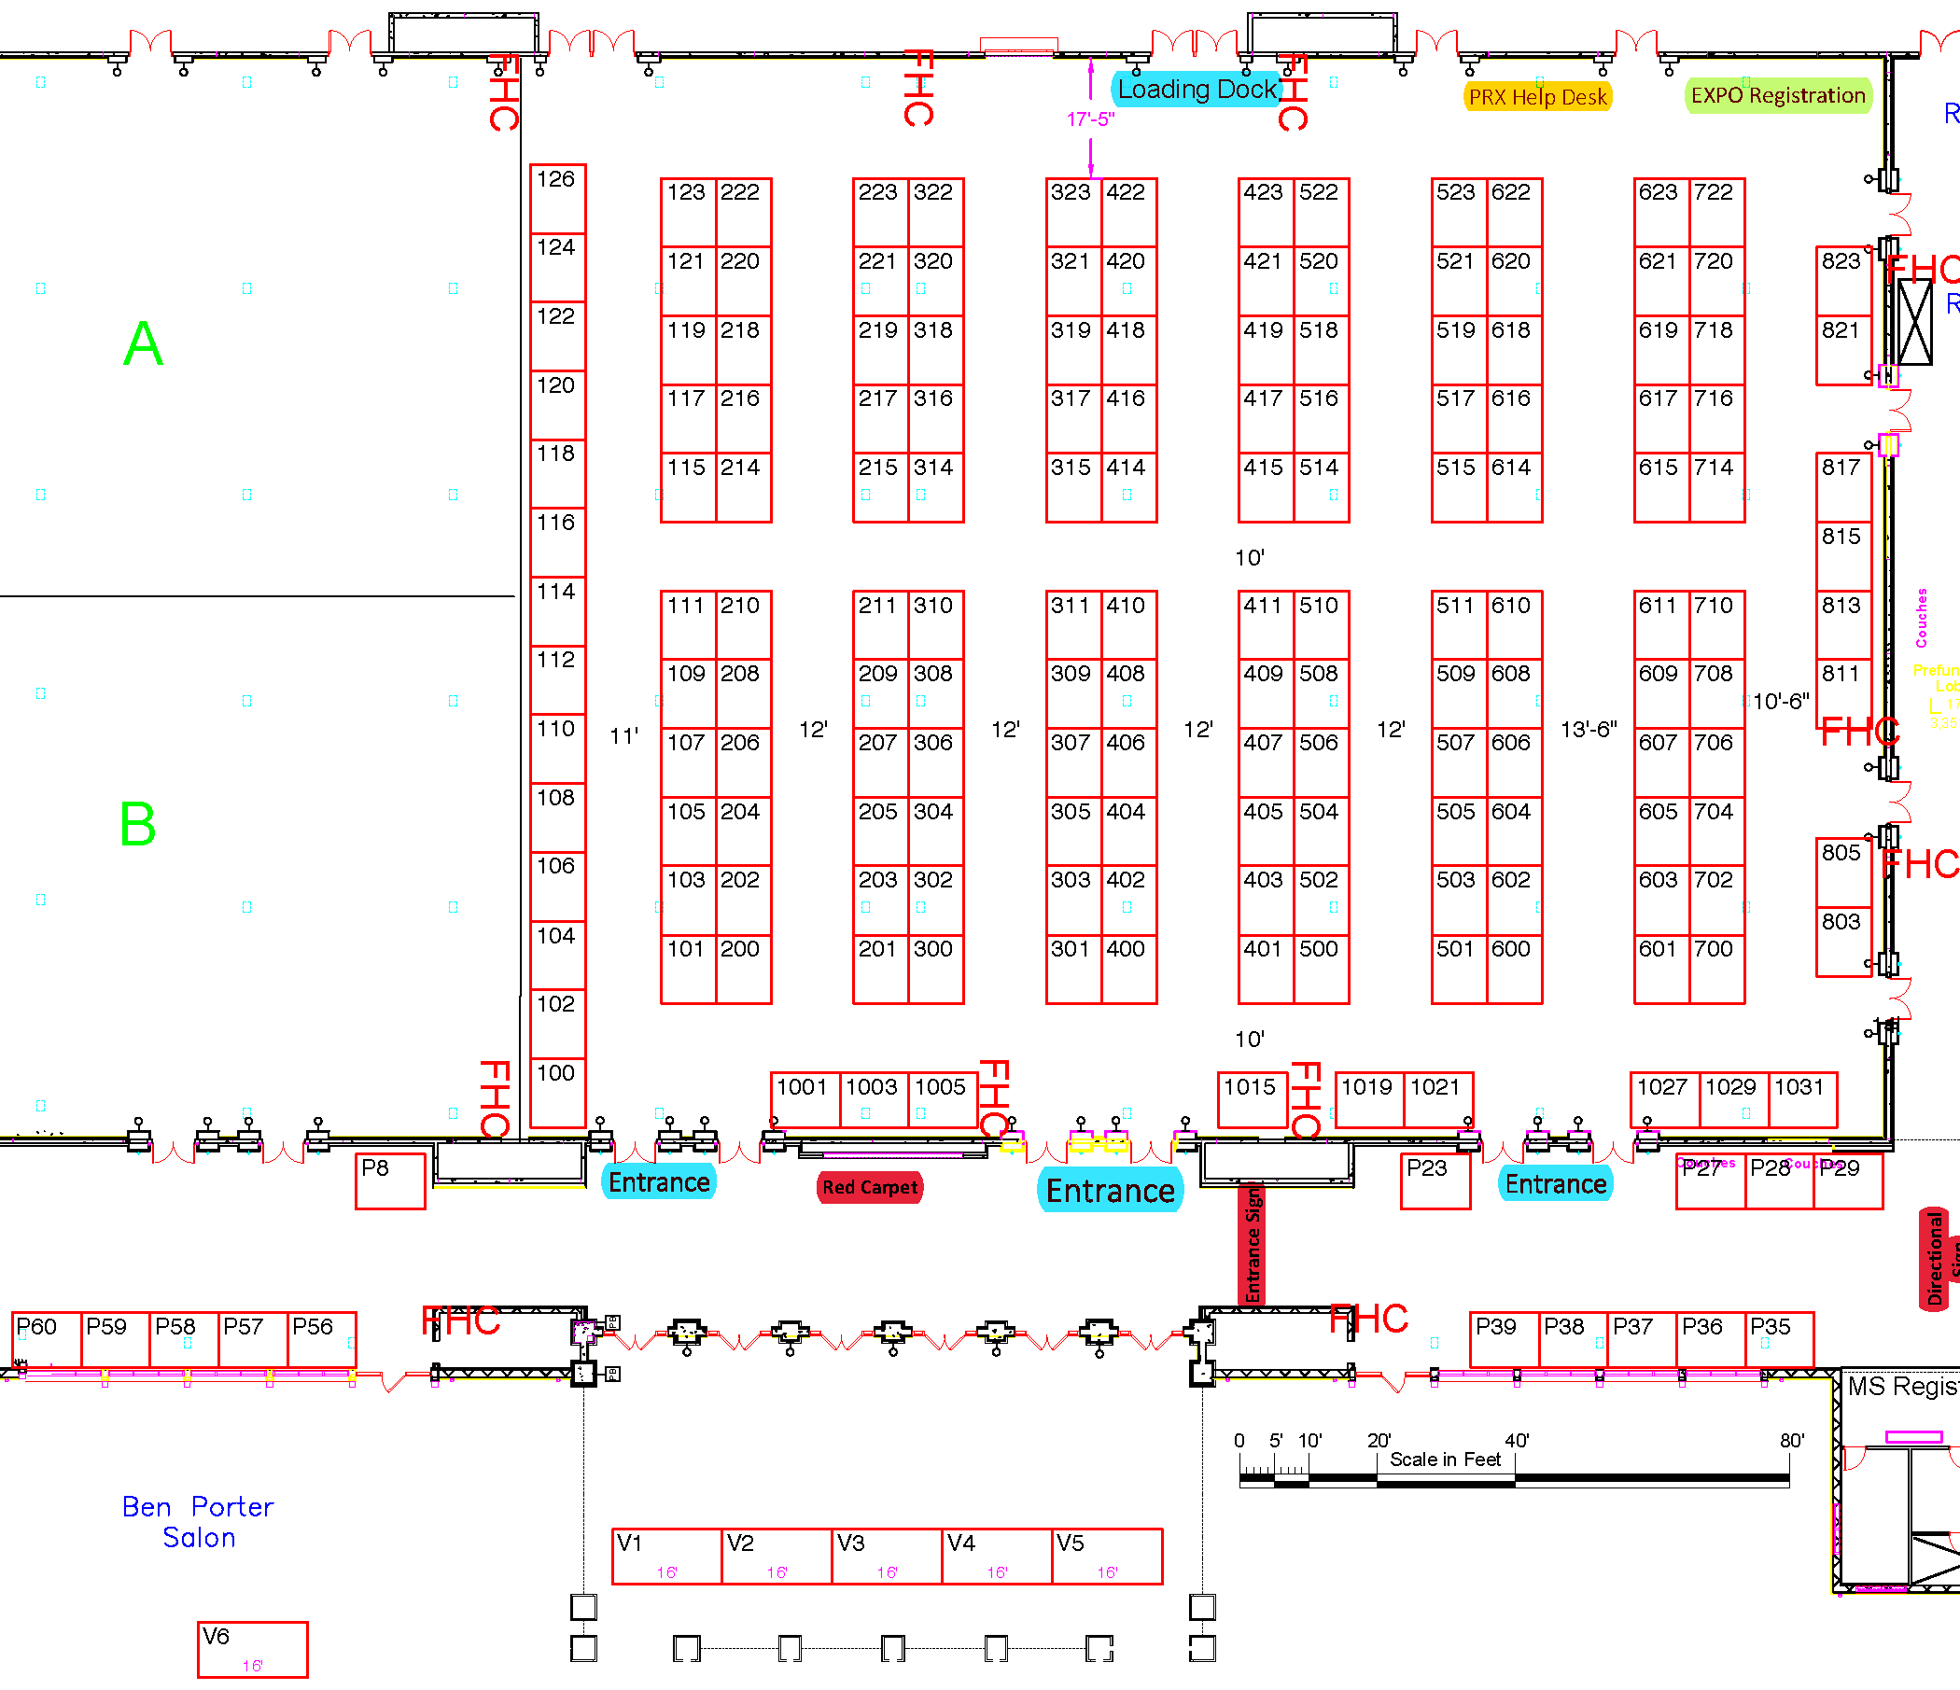
Supplier Load In and Out
Supplier Access

Slide 10
Supplier Check-in for Training and Registration
Ben Porter Oceanside Salon (Training)
Main Expo Hall – Enter Atlantic Hall

Slide 11
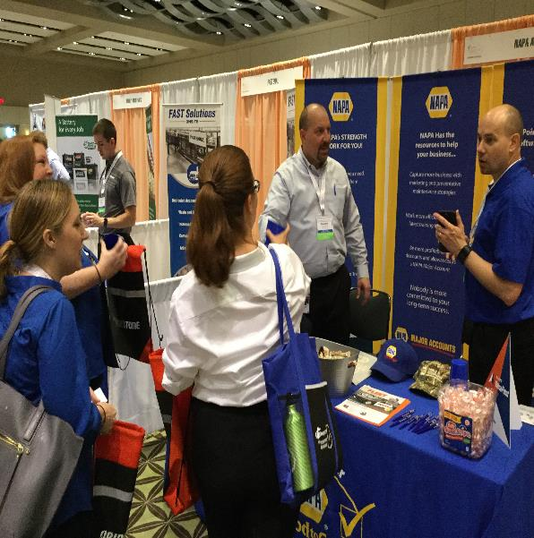
Engineerica
Conference Leads:
Each Booth includes one (1) Engineerica Conference Leads License.
This license will allow you to scan the attendee’s badge barcode to your phone as they visit your booth and receive key data during and for 60 days following the conference.
Suppliers may purchase additional Conference Leads licenses through Engineerica directly.
Additional information is available at https://www.engineerica.com/conferenceleads
Email: conftrac@engineerica.com
Phone: (407) 542-4982
(888) 249-7227

Slide 12
Engineerica and Leads App
Top Features and Benefits
Spend less time collecting contact information, and more time on the conversation
Add notes to each lead to remember significant details later on
Retrieve your leads from the cloud at any point
Scan leads without an internet connection and upload contacts later
Quick capture through badge scanning
Push ads can be sent to the attendee app
Random name drawing ability for giveaways
Email list of collected leads
Customizable qualifying questions
Exporting capabilities
Notes section per lead
Cloud-based storage
Data analyzing reps and individual lead generation

Slide 13
How Do I Update My Company Page?
Live demonstration

Slide 14
SUPPLIER TRAINING SESSIONS
DATE | SUPPLIER TRAINING SESSION | TIME
Monday, April 24, 2023 | Georgia's New Small Business and Supplier Diversity Initiative. Join this session to learn more about the State's new initiative for small and diverse businesses, including recommendations to make the State's procurement process easier to access. Small and Diverse Businesses; All Suppliers | 2:00 - 2:50 pm
Monday, April 24, 2023 | Catch the Wave and Get on Board! This session is specifically designed for incumbent suppliers holding Statewide Contracts with SPD. We realize that improved onboarding of our Statewide Contract suppliers is critical to building a successful relationship with the State. All Suppliers | 2:00 - 2:50 pm
Monday, April 24, 2023 | Hidden Gems. Join this session for tips and tricks from the subject matter experts (SMEs) for the State's procurement process. All Suppliers | 3:00 - 3:50 pm
Monday, April 24, 2023 | Financing Alternatives for Small Business. This session discusses traditional and non-traditional options on how to finance a start-up or growing business. Small and Diverse Businesses | 3:00 - 3:50 pm
Monday, April 24, 2023 | Getting Information on Doing Business with the State of Georgia. Georgia is ranked the #1 State for Business! Join this session for informational resources for all small businesses from the Georgia Department of Economic Development. Small & Diverse Businesses; All Suppliers | 4:00 - 4:50 pm
Monday, April 24, 2023 | Don't Sink, Swim! Using Useful Data for Leads Generation. Who, what, when, where? This presentation will equip you with useful resources to develop sales leads to do business with various levels of government in the State of Georgia. All Suppliers | 4:00 - 4:50 pm
Tuesday, April 25, 2023 | Statewide Contract Pipeline and Future Opportunities. This supplier focused session reviews upcoming statewide contract solicitations. All Suppliers | 5:45 - 6:45 pm

Slide 15
Housekeeping and Handy Reminders
DATE | EVENTS | TIME
Monday, April 24, 2023 | SUPPLIER REGISTRATION | 1:00 p.m. - 2:00 p.m.
Monday, April 24, 2023 | TRAINING SESSIONS | 2:00 p.m. – 5:15 p.m.
Monday, April 24, 2023 | EXHIBITOR BOOTH SET UP | 4:00 p.m. - 6:00 p.m.
Tuesday, April 25, 2023 | EXHIBITOR BOOTH SET UP | 7:00 a.m. - 1:00 p.m.
Tuesday, April 25, 2023 | GPC 2023 EXPO OPEN | 3:00 p.m. - 5:30 p.m.
Tuesday, April 25, 2023 | PROCUREMENT/PIPELINE DISCUSSION WITH STATE PURCHASING STAFF | 5:30 p.m. – 6:30 p.m.
Tuesday, April 25, 2023 | MEET AND GREET WITH STATE PURCHASING STAFF | 7:00 p.m. - 8:30 p.m.
Wednesday, April 26, 2023 | GPC 2023 EXPO OPEN | 10:00 a.m. - 4:00 p.m.
Wednesday, April 26, 2023 | NETWORKING RECEPTION | 5:15 p.m. – 6:30 p.m.
Thursday, April 27, 2023 | EXHIBITOR BOOTH BREAK DOWN | 7:00 a.m. - 12:00 p.m.
Thursday, April 27, 2023 | PRX BREAK DOWN | 7:00 a.m. - 11:59 p.m.

Slide 16
Housekeeping and Handy Reminders Cont.
To register for Supplier training, the survey must be completed by April 6, 2023
Credential Replacement Process at JICC
There will be no onsite registration for suppliers
Confirmation of Exhibitors
JICC Vendor Guidelines
Prizes
Lunch – Please plan accordingly during times when the attendees are at lunch
SWC flags
Please update your Company logo and profile on the Conference tracker application
Agenda will be included with your booth but it is also on the doas.ga.gov website

Slide 17
Do’s and Don’ts – Tradeshow Etiquette
DO – Greet & Engage
DO – Be positive and upbeat
DO – Be prepared
DO – Take a break
DON’T – Talk from your seat
DON’T – Get distracted by your phone
DON’T – Forget to network with other exhibitors
DON’T – Breakdown early

Slide 18
OPEN FORUM

Slide 19
THANK YOU AND SEE YOU AT THE GPC!!

