Slide 1



DOAS
Policy Unit
Pre-Employment Drug Testing
Notes:
Hello and welcome to the educational resource on Pre-employment drug testing. This training is being presented by the D.O.A.S. Policy Unit.

Slide 2
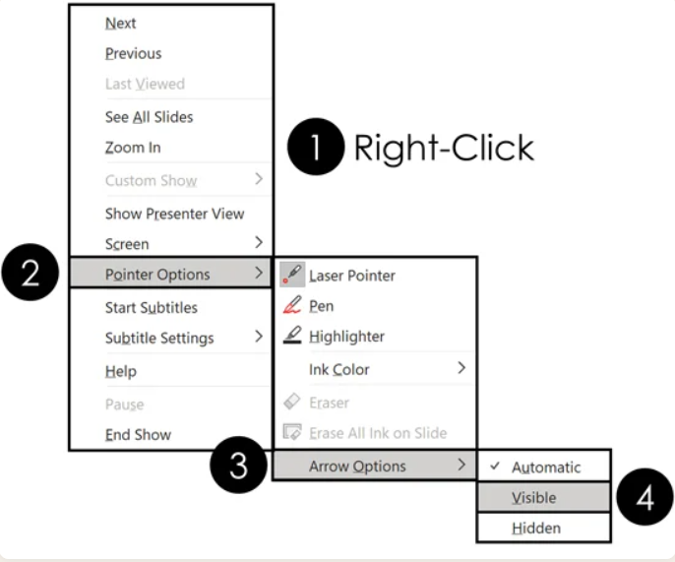
Navigation Controls
Notes:
Before we begin, you’ll see on the screen how to access a helpful feature that will make navigating this presentation easier. To make the mouse pointer and control panel remain visible, right-click anywhere on the slide. A shortcut menu will appear. Hover over Pointer Options, then Arrow Options, and select Visible.

Slide 3
Drug Free & Alcohol Workplace
The General Assembly found that unlawful drug activity is a serious threat to the public health, safety, and welfare and declared that the public workforce must be free of any person who would knowingly engage in such activity.
The State is committed to maintaining a drug-free and alcohol-free workplace. In support of this commitment, the State conducts substance abuse testing. Employees who violate workplace expectations are subject to disciplinary action, up to and including dismissal and disqualification from employment, as outlined
in Rule 21 and in Sub-Rules 478-1-.21A through 478-1-.21G.
Notes:
The State is committed to maintaining a drug-free and alcohol-free workplace. The General Assembly found that unlawful drug activity is a serious threat to the public health, safety, and welfare and declared that the public workforce must be free of any person who would knowingly engage in such activity.

Slide 4
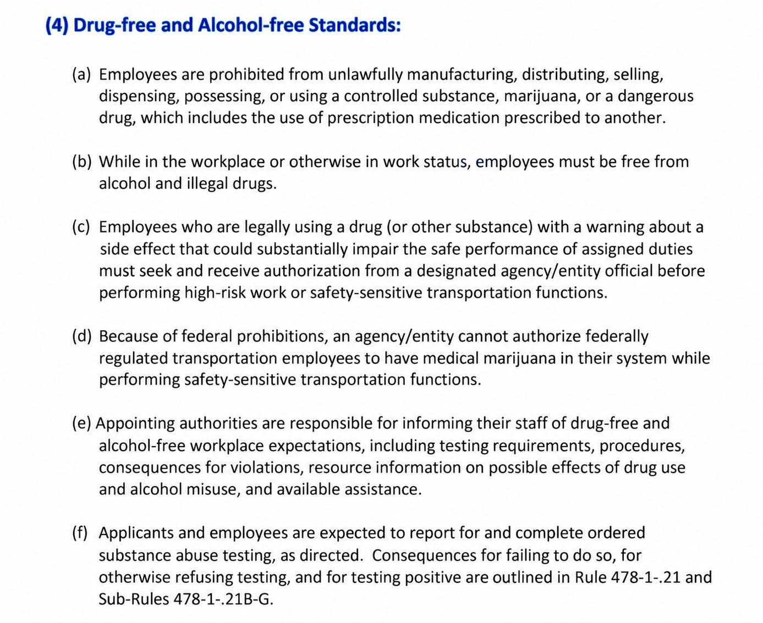
Drug and Alcohol Free Standards:
Notes:
Here is a screenshot of the drug and alcohol-free standards in State Personnel Board Rule 21, which is titled Drug and Alcohol Free Workplace Program. While in the workplace or otherwise in work status, employees must be free from alcohol and illegal drugs. Appointing authorities are responsible for informing their staff of drug- and alcohol-free workplace expectations.

Slide 5
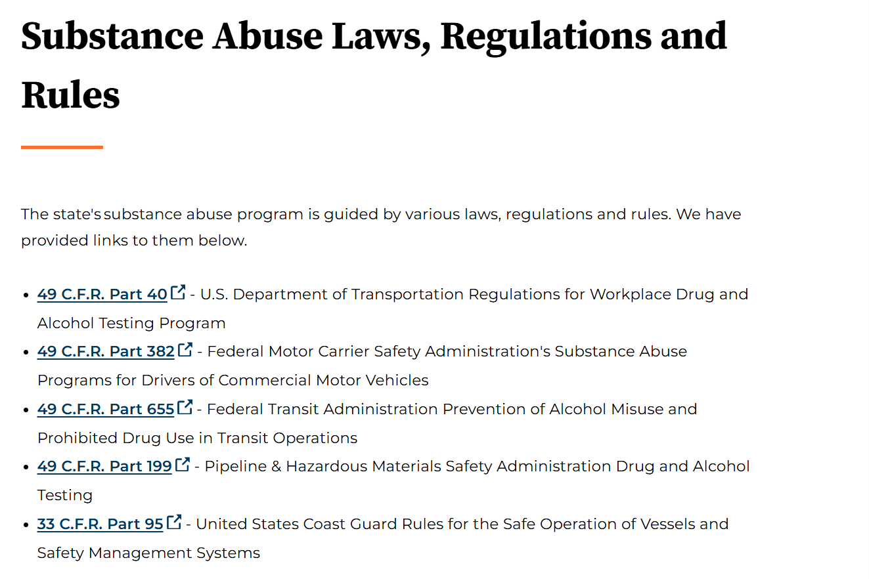
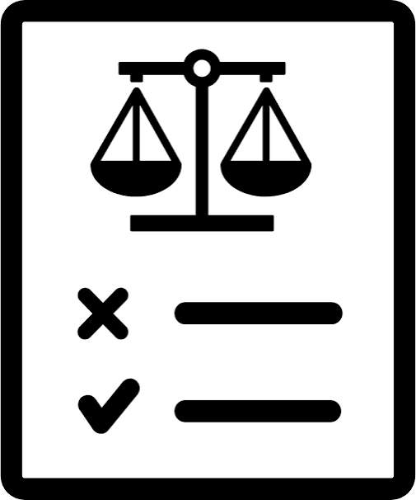
Regulations, Rules, & Laws
Reference: Substance Abuse Laws, Regulations and Rules | Georgia Department of Administrative Services - DOAS
Notes:
The text on your screen provides information about federal laws that govern the State of Georgia’s drug and alcohol testing program. The state’s substance abuse testing program is not only guided by Rule 21 and it’s subrules, but also by various laws and regulations. The Federal laws can also be found on the D.O.A.S website – specifically on the Substance Abuse Testing Program page.

Slide 6
Subject Definition
Pre-Employment Drug Testing is conducted after an offer of employment. A negative test result must be received before the individual begins employment in the high-risk or safety-sensitive position. In no case may the drug test be conducted more than ten (10) business days after the individual begins employment in the position.
Notes:
Pre-employment testing is one of six approved types of testing listed in Rule 21.
- This type of testing is to occur for both high-risk and safety-sensitive federally-regulated transportation positions.
- Let’s take a look at what you’ll find in our State Personnel Board sub-rules about this test type.

Slide 7
Pre-Employment
High-Risk Definition
High-Risk Position refers to a position in which the incumbent regularly performs work that involves a high level of risk. Examples include, but are not limited to, positions requiring the incumbent to carry a firearm; medical professionals; non-federally regulated drivers; in-home care providers; firefighters; heavy equipment operators; pilots; and aircraft mechanics. High-Risk Position does not include positions subject to federal transportation regulations.
High-Risk Work means duties for which inattention or errors in judgment could result in significant harm to the individual performing the duties or to others.
Click on the link: SPB Sub-Rule 21B
Notes:
High-risk work, as defined in State Personnel Board Sub-Rule 21b, refers to job duties where lapses in attention or poor judgment may create a substantial risk of injury or harm to the employee or to others. Examples include, but are not limited to, officers required to carry a firearm, medical professionals, non–federally regulated drivers, in-home care providers, firefighters, heavy equipment operators, pilots, and aircraft mechanics. It’s important to understand what qualifies as a high-risk position and what constitutes high-risk work. The term high-risk position does not include federally regulated transportation positions.

Slide 8
Pre-Employment Safety Sensitive Definition
Safety-Sensitive Transportation Function or Duties refers to transportation-related work that requires an employee, or selected applicant for a position with such work, to undergo drug and/or alcohol testing, pursuant to United States Department of Transportation (US DOT) or United States Coast Guard regulations.
Click on the link: SPB Sub-Rule 21D
Notes:
State Personnel Board Sub-Rule 21D explains that safety sensitive transportation functions is work that requires alcohol and drug testing pursuant to the US Coast Guards and US DOT regulations. The US DOT states that an employee performing safety-sensitive functions in the transportation industry is responsible for providing a safe work environment for co-workers and the traveling public. Examples of safety-sensitive positions are Maintenance Workers, Construction Specialists, and Transportation Techs.

Slide 9
Getting Started
Determination of Positions Subject to Pre-Employment Drug Testing
Administration of Program
Notes:
Each appointing authority shall determine which positions within the agency or entity are high-risk or safety-sensitive and designate them for pre-employment drug testing. Drug and alcohol testing must be conducted in accordance with applicable federal and state laws and regulations and established procedures upon creating a new position, reallocating an existing position to a different function, or changing the duties of a position. To better assist in determining a position's designation, the Automated Position Analysis Tool, also called APAT, can be used; we will discuss this further on the next slide.

Slide 10
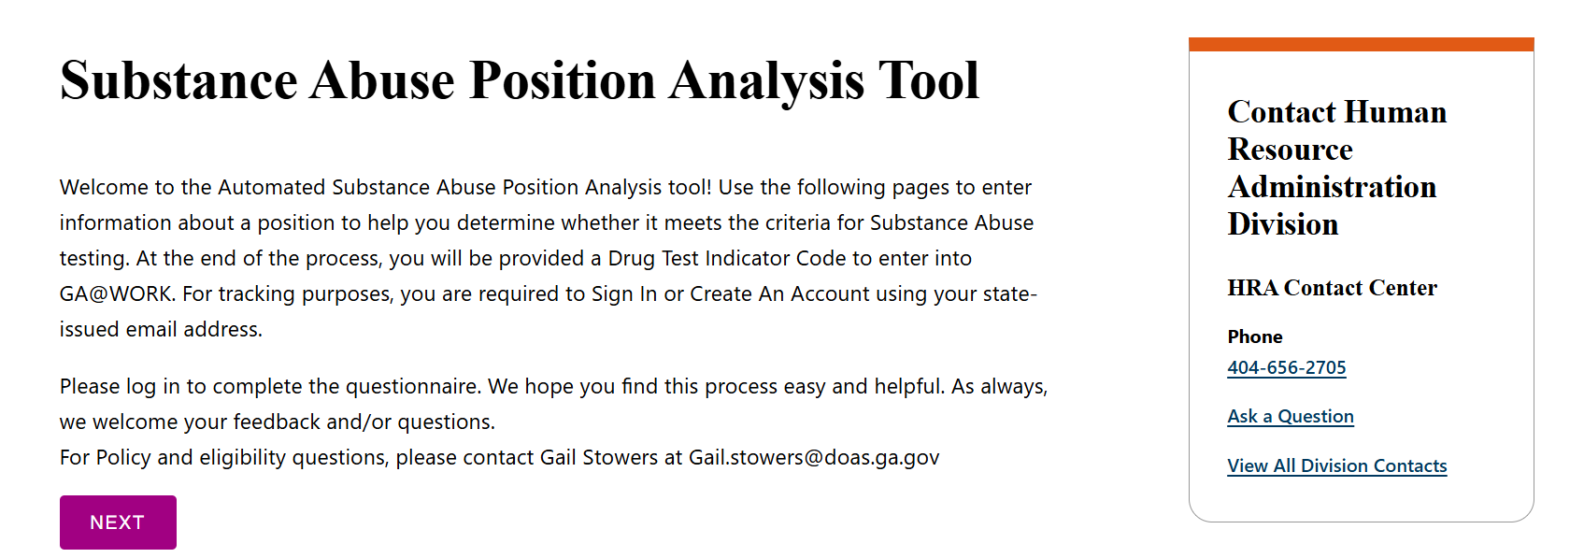
Click on the link: APAT
Notes:
APAT, is used to identify positions that meet the criteria for high-risk or federally regulated transportation duties and ensure they are included in the appropriate pre-employment testing programs. To help agencies get started, employees with Human Resources or 'HR' in their job title are automatically granted access to create an APAT account. If you do not have access or need further assistance with logging in, please contact the DOAS HRA Call Center for assistance. To begin using APAT, click the APAT link at the bottom of the screen.

Slide 11
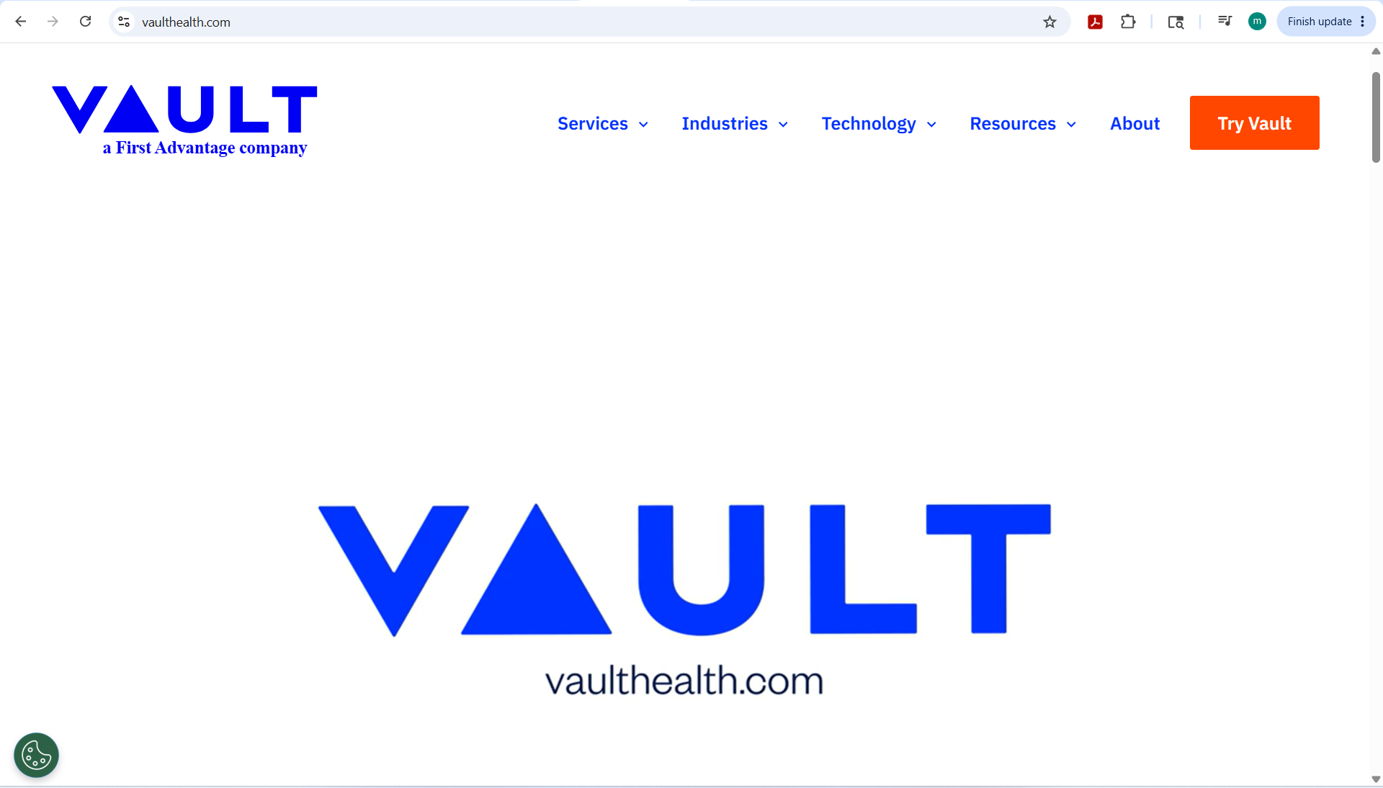
Applicant Verification Portal
Applicant Verification Portal (AVP) Training
Notes:
Once an offer of employment has been made, it is necessary that agency-designated staff use the Applicant Verification portal (also known as the AVP) during the screening process. The AVP is a centralized platform that lists all state employees who have tested positive or refused to undergo drug testing in the last two years.
When using the AVP, designated staff are to enter the applicant’s social security number or CDL number to view results showing whether there has been a positive drug test result in the past two years.

Slide 12

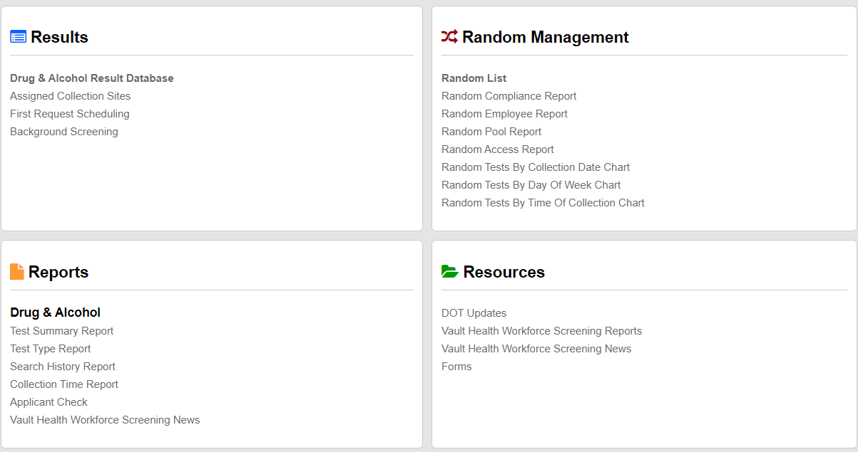
Applicant Verification Portal
Located in the Vault Health Database
Applicant Verification Portal (AVP) Training
Notes:
This is a screenshot of the first page of the Vault Health database. There are four quadrants here. To access the applicant Verification Portal, click on the link in the bottom left quadrant labeled “Applicant Check” which is found next to the red arrow.

Slide 13

Consequences
Any applicant or employee whose pre-employment drug test result is reported by the Medical Review Officer (MRO) as positive, adulterated, or substituted, or who otherwise refuses a pre-employment test, will be disqualified from State employment for a period of two (2) years from the date of testing or refusal to test.
Notes:
As the slide indicates, a positive, adulterated, or substituted pre-employment drug test, or a refusal to test, results in a two-year disqualification from employment in covered positions. An adulterated specimen has been altered or contains a substance that is not normally found in human urine. A substituted specimen has laboratory values that are not consistent with normal human urine, indicating it may not be a valid specimen. If the individual has not yet started employment, the agency must withdraw the job offer in writing. If the individual has already begun working in the high-risk or safety-sensitive position, employment must be terminated immediately. If the individual works for another agency or entity, DOAS must be notified so the employing agency can be informed of the disqualification.

Slide 14

5 Panel Drug Test
Marijuana
Cocaine
Amphetamines
Opioids
Phencyclidine (PCP)
Notes:
The state of Georgia tests for five panels: marijuana, cocaine, amphetamines, opioids, and PCP.

Slide 15

Types of Drug Test
Urine
“Drug Testing” or “Drug Test” means the collection and testing of urine administered as required by applicable regulations for the testing program. Testing of substances other than urine is permitted only when authorized by such governing regulations.
Notes:
When testing for the five panels, the State of Georgia administers urine drug tests. A urine drug test is a common, non-invasive screening method that analyzes a urine sample for the presence of specific illegal drugs, prescription medications, and their metabolites.

Slide 16
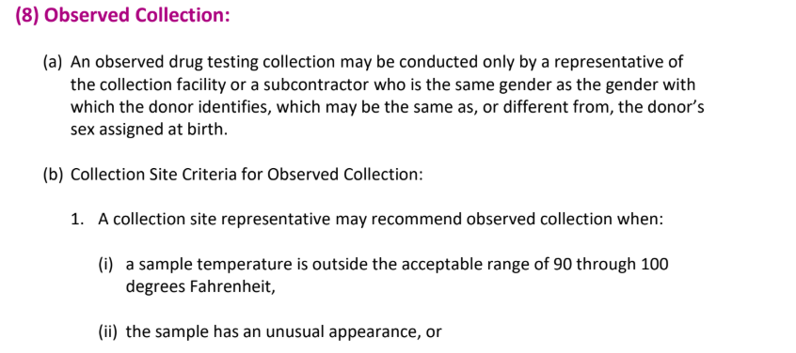
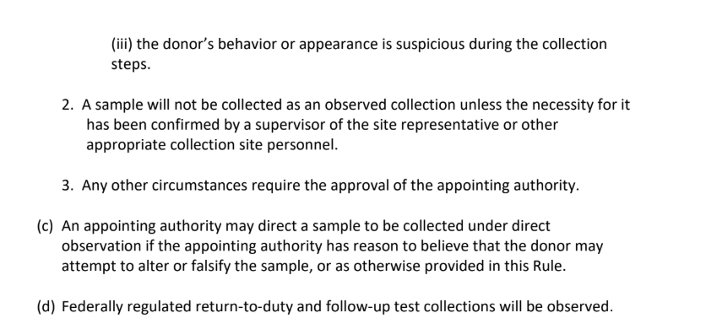
Collection Process
Notes:
During the drug testing process, the donor is required to report to an approved collection site to have the observed collection performed by a representative of the collection facility or an approved subcontractor who is the same gender with which the donor identifies, which may be the same as or different from the donor’s sex assigned at birth.

Slide 17

Medical Review Officer (MRO) Review Procedure
Notes:
The Medical Review Officer or MRO receives and reviews the results of drug tests and evaluates those results. A donor whose sample is rejected or determined to be unsuitable by the testing laboratory is subject to retesting. A donor whose sample is determined by the MRO to be adulterated or substituted is considered to have refused substance abuse testing. Upon receiving a negative test result, the applicant or employee fulfills the applicable testing condition of employment. An applicant or employee who tests positive for alcohol or use of illegal drugs is subject to disqualification from the position or disciplinary action, up to and including termination from employment.

Slide 18
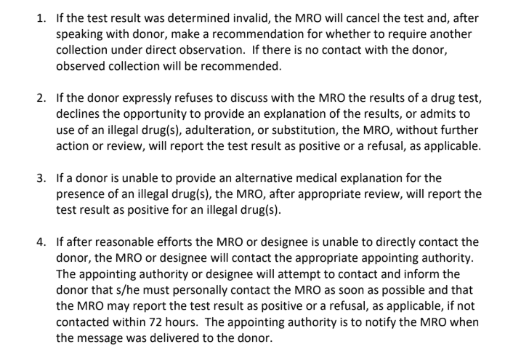

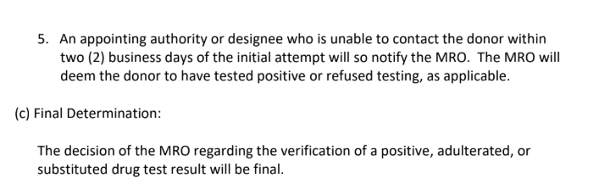
MRO Contact Process
Notes:
Upon receiving a positive, adulterated, substituted, or invalid laboratory test result, the MRO follows a five-step process displayed on the screen. This process includes contacting the donor using the phone numbers listed on the chain of custody form or CCF to determine whether the donor wishes to discuss the result, as well as attempting to identify any alternative medical explanation for the test outcome.

Slide 19
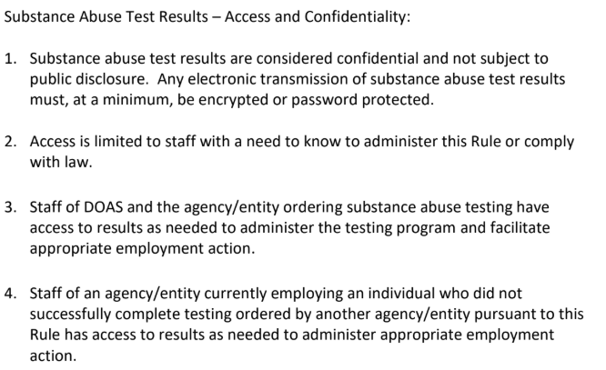
Privacy & Confidentiality
Notes:
Substance abuse test results are considered confidential and not subject to public disclosure. Any electronic transmission of substance abuse test results must, at a minimum, be encrypted or password protected.

Slide 20

Americans with Disabilities Act (ADA) Considerations
An individual who is currently engaging in the illegal use of drugs is not an individual with a disability when the employer acts based on such use.
An employer may not discriminate against a person who has a history of drug addiction, but who is not currently using drugs and who has been rehabilitated.
An employer may prohibit the illegal use of drugs and the use of alcohol at the workplace. It is not a violation of the ADA for an employer to give tests for the illegal use of drugs.
An employer may discharge or deny employment to persons who currently engage in the illegal use of drugs.
Employees who use drugs or alcohol may be required to meet the same standards of performance and conduct that are set for other employees.
Employees may be required to follow the Drug-Free Workplace Act of 1988 and rules set by federal agencies pertaining to drug and alcohol use in the workplace.
Notes:
The Americans with Disabilities Act (ADA) has very specific rules about drug use and workplace obligations. It balances workplace safety and employer authority with anti-discrimination protections for individuals with addiction or recovery histories. On the screen is a breakdown of current requirements and other important information to consider for both employers and employees under the ADA.

Slide 21
Challenges
Substance Abuse Testing Refusal
Shy Bladder
Notes:
There are many challenges that can occur during the substance abuse testing process, such as an applicant or employee refusing to test. Rule 21 lists what’s considered a substance abuse testing refusal. Shy bladder is also a challenge that refers to a situation in which an individual is unable to provide enough urine for a drug test often because of a medical condition.

Slide 22
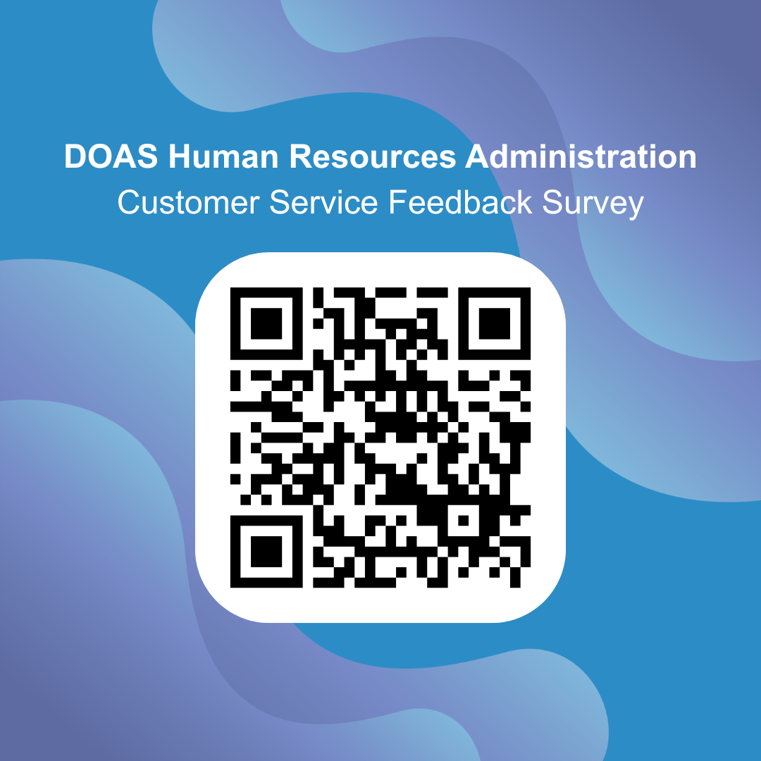

Use the QR Code above or click on the link below:
Take the survey
Notes:
Before we conclude this presentation, we ask that you please take a moment to complete our feedback survey by scanning the QR code or clicking on the link found at the bottom of the slide. Your feedback is extremely valuable to us and helps ensure that our training materials continue to meet the needs of agencies across the State. We appreciate your participation and commitment to maintaining a safe, compliant, and drug-free workplace.

Slide 23
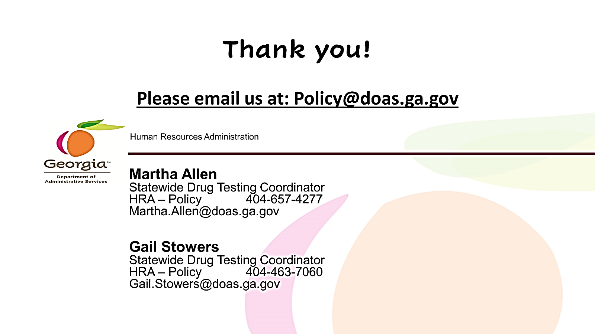
Notes:
Thank You! This concludes the Pre-Employment educational resource. If you have questions or need further assistance, please contact the HR-Policy unit or one of the Policy Analysts listed on the screen.

