Slide 1
Create a Request for Qualified Contractors (RFQC)
DESCRIPTION
This guide will show Sourcing Event Buyers how to create a Request for Qualified Contractors.
OVERVIEW
The key steps in the process are below:
Navigate to Sourcing Module.
Select Create New Event.
Select the eRFQC Template and complete the necessary fields.
Submit the Sourcing Event.
Navigate to Sourcing Module
Select Create New Event
Utilize the eRFQC Template
Submit the Sourcing Event

Slide 2


Create a Request for Qualified Contractors (RFQC) (Part 1 of 52)
INSTRUCTIONS
Click the Global Navigation Menu.
Note: University System of Georgia (USG) and GDOT users complete local logon and then proceed to Step 4.
Click Sourcing, Contracts & Supplier Management.

Slide 3

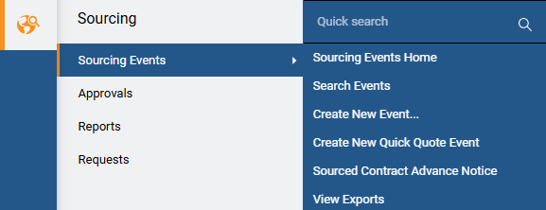
Create a Request for Qualified Contractors (RFQC) (Part 2 of 52)
INSTRUCTIONS
Click Sign On.
Note: The system utilizes Single Sign-On (SSO) capabilities and no log in information is required.
Select Sourcing.
Select Sourcing Events.
Select Create New Event.
4
5
6

Slide 4
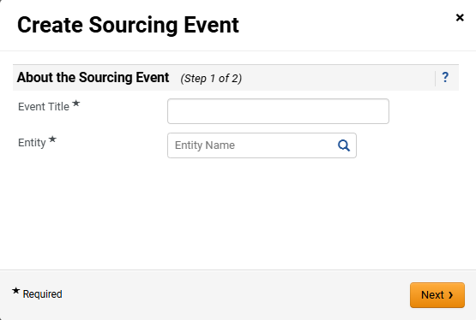
Create a Request for Qualified Contractors (RFQC) (Part 3 of 52)
INSTRUCTIONS
Enter the Event Title*.
Note: Including the State Entity Name in Event Title will assist in Search Sourcing Events as there is no column to display state entity’s name (e.g. UGA Consulting Services).
Select Entity*.
Click Next.
7
8
9

Slide 5
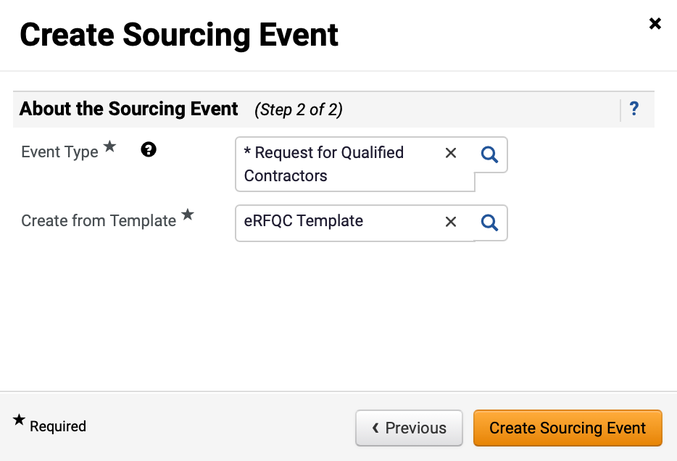
Create a Request for Qualified Contractors (RFQC) (Part 4 of 52)
INSTRUCTIONS
Select Request for Qualified Contractors as the Event Type*.
Select eRFQC Template for Create from Template*.
Note: eRFQC Template will auto-populate in the Create from Template field once Request for Qualified Contractors is selected.
12. Click Create Sourcing Event.
10
11
12

Slide 6
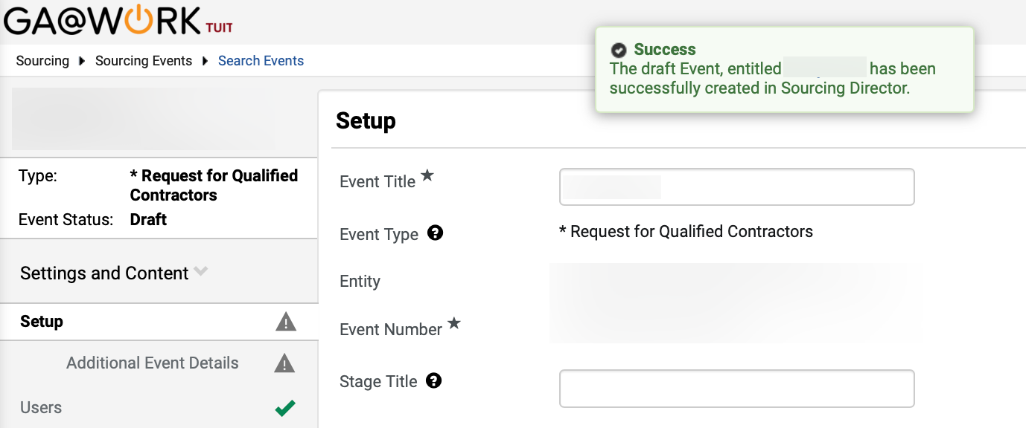
Create a Request for Qualified Contractors (RFQC) (Part 5 of 52)
INSTRUCTIONS
Review Success Draft Event notification and populated Event information.
Note: Event Title can be edited, however, the Event Type and Entity cannot be changed once the draft is created.
Enter Stage Title.
Note: Stage Title is used to distinguish different versions if an event goes to a second stage and beyond during the evaluation process, such as a round of cost negotiations. It is recommended to enter “Original Solicitation” as the Stage Title for all events during initial set-up. Stage Title and Event Title can be edited; however, the other fields are read-only.
13
14

Slide 7
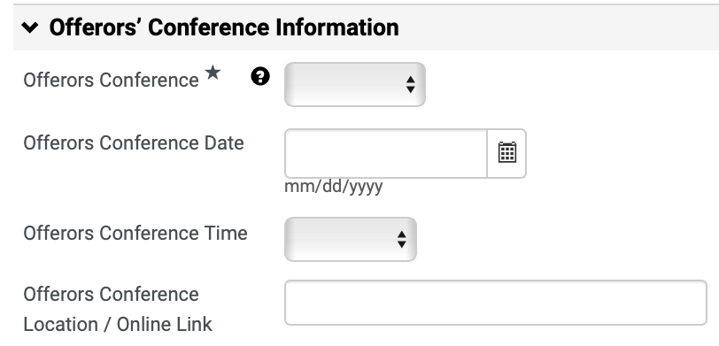
Create a Request for Qualified Contractors (RFQC) (Part 6 of 52)
INSTRUCTIONS
Select Offerors Conference*.
Note: If Mandatory or Optional is selected, follow Steps 16 – 23 to complete the fields in this section. If Offerors Conference is N/A, skip to Step 24. This information will appear in the Georgia Procurement Registry as part of the public notice. The issuing officer must also upload the SPD-SPR010 Bidders/Offerors’ Conference Announcement in the Buyers Attachments section.
Enter Offerors Conference Date.
Select Offerors Conference Time.
Enter Offerors Conference Location / Online Link.
Note: Indicate whether the conference will be held virtually, and if so, use the link option to provide the virtual meeting information.
15
16
17
18

Slide 8
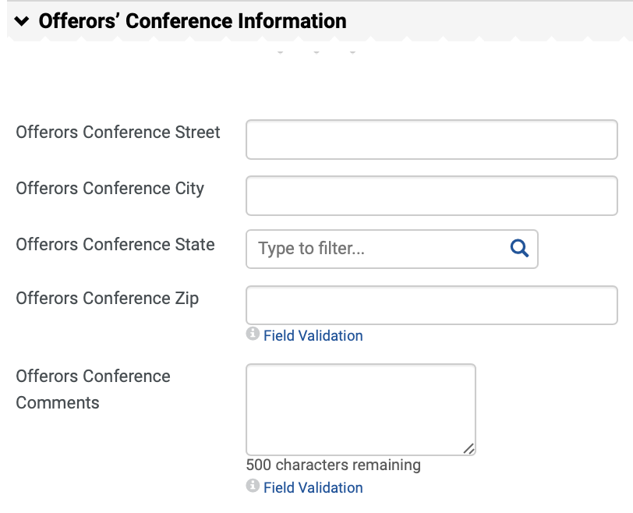
Create a Request for Qualified Contractors (RFQC) (Part 7 of 52)
INSTRUCTIONS
Enter Offerors Conference Street.
Enter Offerors Conference City.
Select Offerors Conference State.
Note: Click Magnifying Glass to view more options.
Enter Offerors Conference Zip.
Enter Offerors Conference Comments.
19
20
21
22
23

Slide 9
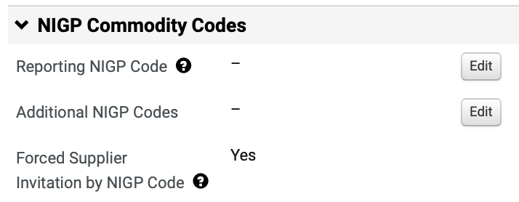
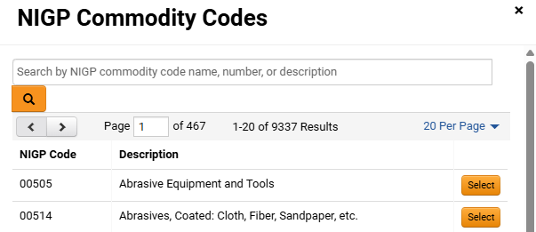
Create a Request for Qualified Contractors (RFQC) (Part 8 of 52)
INSTRUCTIONS
Click Edit to add the Reporting NIGP Code.
Enter or search for the Commodity Code.
Note: Search by Name, Code or Description. Commodity Code can be removed by clicking Remove.
Click Select.
25
26

Slide 10
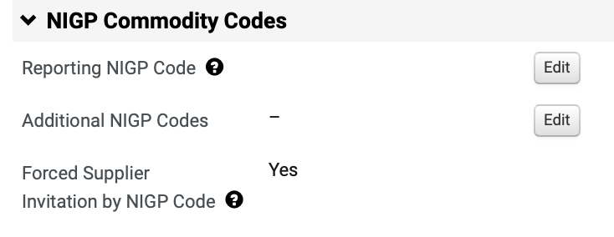
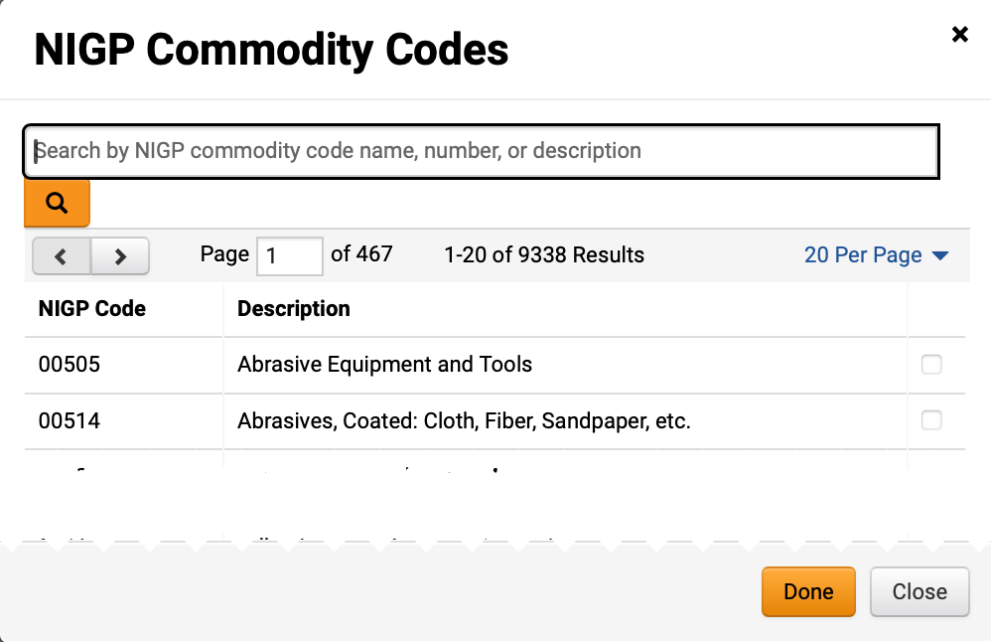
Create a Request for Qualified Contractors (RFQC) (Part 9 of 52)
INSTRUCTIONS
Review added Reporting NIGP Code.
To add Additional NIGP Commodity Codes, click Edit.
27
28
Check the NIGP Commodity Code box.
Note: Multiple codes can be selected.
Click Done.
29
30

Slide 11
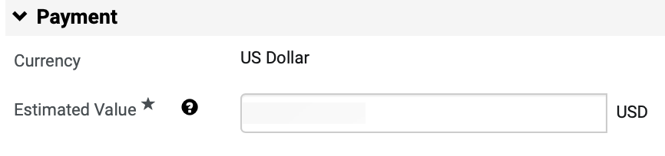
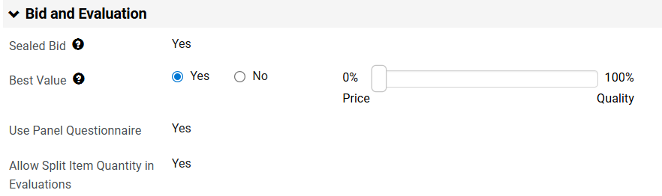
Create a Request for Qualified Contractors (RFQC) (Part 10 of 52)
INSTRUCTIONS
Enter the Estimated Value for the event.
Note: The Estimated Value field is also used for DPA Approvals and NOIA/NOA protest period.
Select checkbox for Best Value and drag slider bar to 100% for Quality.
Note: The fields in this section are read-only based on the template selection and default to Yes, except Best Value, which defaults as No. Sealed Bid ensures supplier responses remain confidential to the Sourcing Event Buyer until after the event closes.

Slide 12
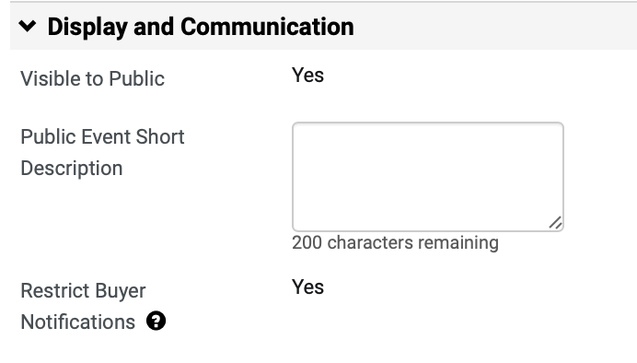
Create a Request for Qualified Contractors (RFQC) (Part 11 of 52)
INSTRUCTIONS
Enter Public Event Short Description.
Note: The Public Event Short Description will be displayed on the GA@WORK Marketplace. It is highly recommended to include the state entity’s full name in the description. Restrict Buyer Notification is set to Yes so that only the Sourcing Event Buyer will receive event related notifications.

Slide 13
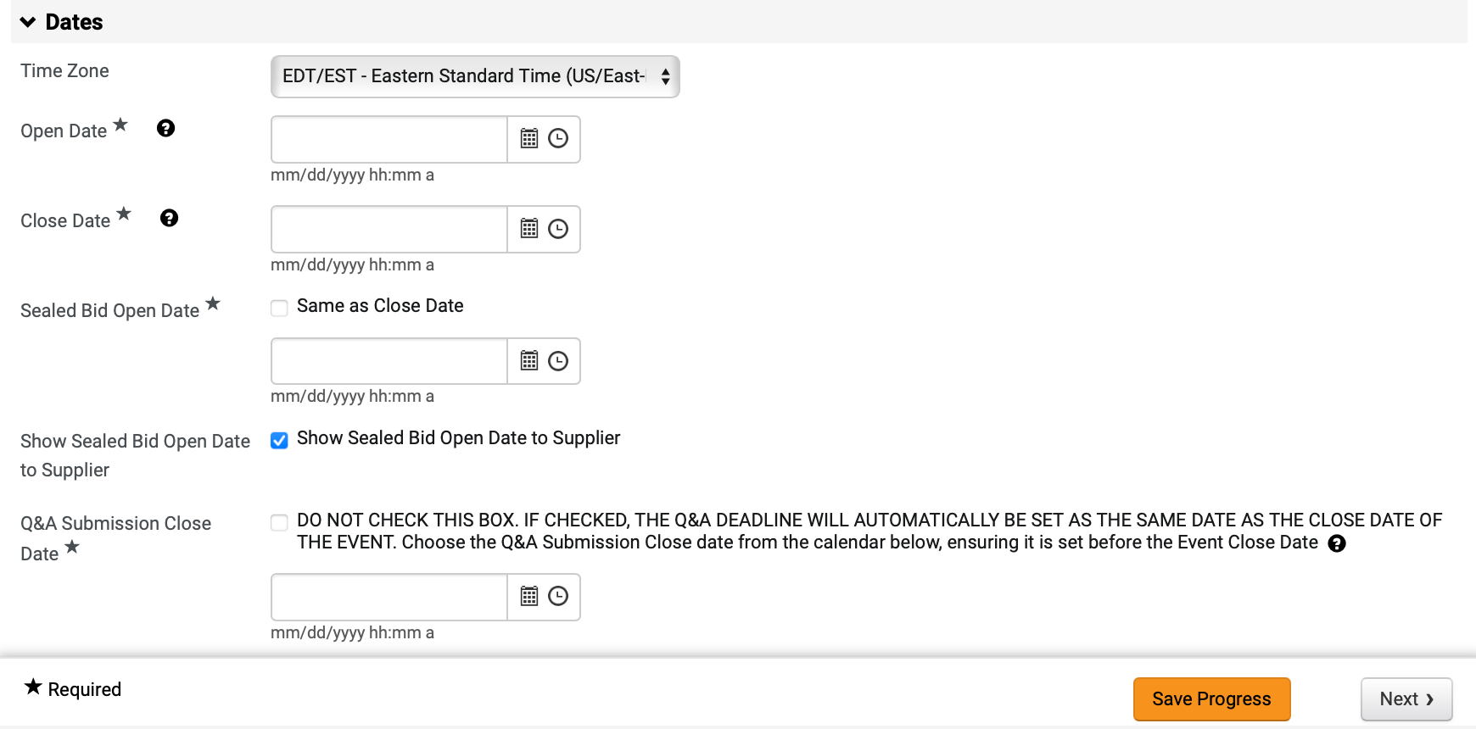
Create a Request for Qualified Contractors (RFQC) (Part 12 of 52)
INSTRUCTIONS
Select Time Zone (Optional).
Note: Verify Time Zone is set to Eastern Standard Time.
Enter Open Date* and Close Date*.
Select Sealed Bid Open Date*.
Note: Same as Close Date is auto-checked. If you uncheck Same as Close Date box, the Sealed Bid Open Date field is visible.
Select Show Sealed Bid Open Date to Supplier.
Note: Show Sealed Bid Open Date to Supplier box is auto-checked.
Enter Q&A Submission Close Date*.
Note: If checked, the date field will automatically be set to reflect the close date of the event.
Click Save Progress and Next.
34
35
36
37
38
39

Slide 14
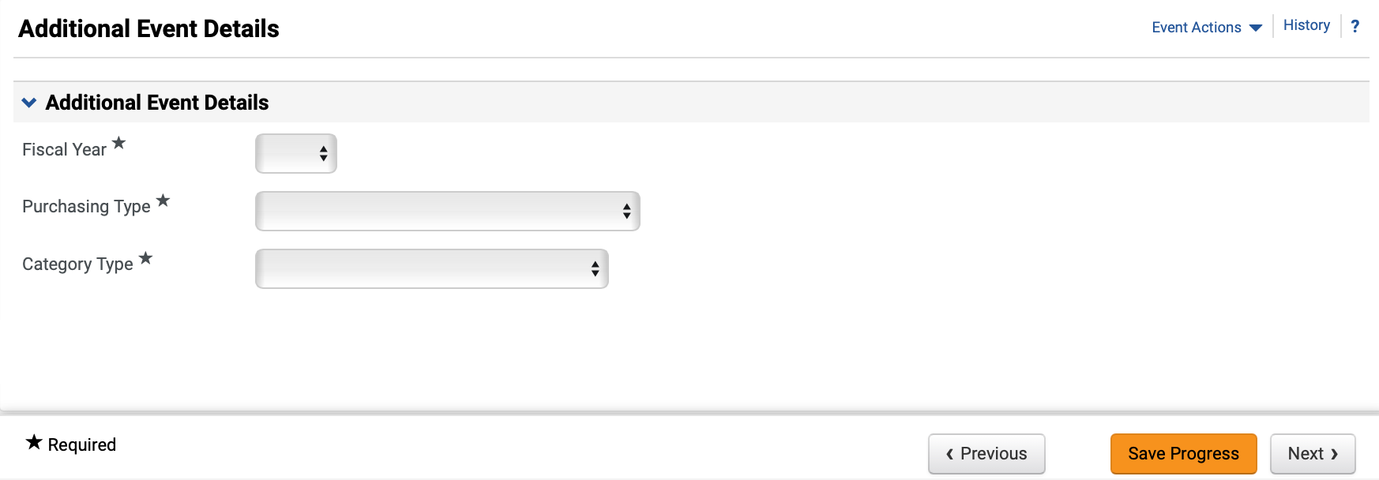
Create a Request for Qualified Contractors (RFQC) (Part 13 of 52)
INSTRUCTIONS
Select the Fiscal Year* the event will be awarded.
Select Purchasing Type* and Category Type*.
Click Next.
40
41
42

Slide 15
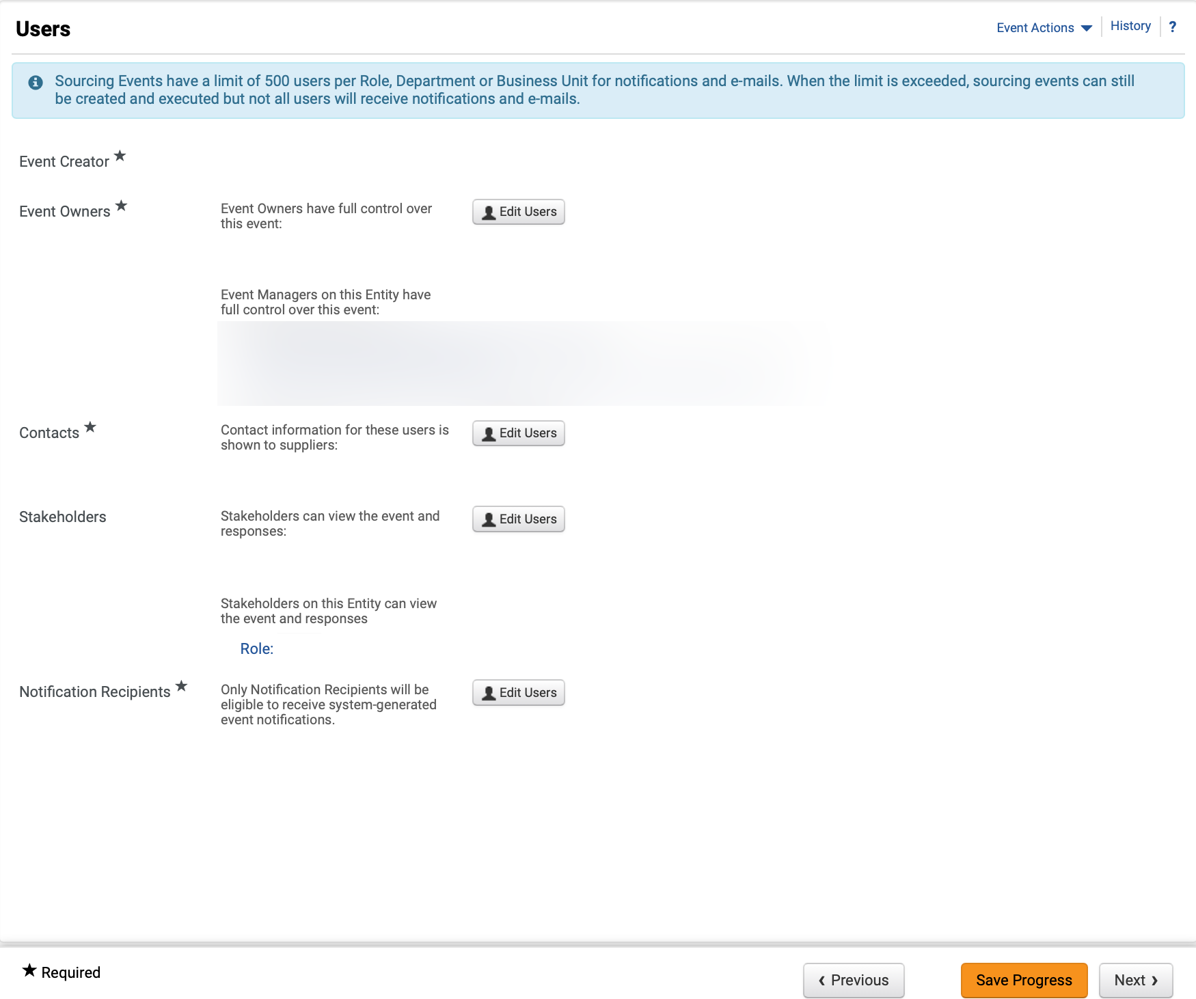
Create a Request for Qualified Contractors (RFQC) (Part 14 of 52)
INSTRUCTIONS
Review Event Owners*, Contacts* and Notification Recipients*.
Note: Click Edit Users to update any of the editable fields. Review Managing Administrators, Stakeholders and Contract Managers Job Aid for further details.
Click Next.
43
44

Slide 16
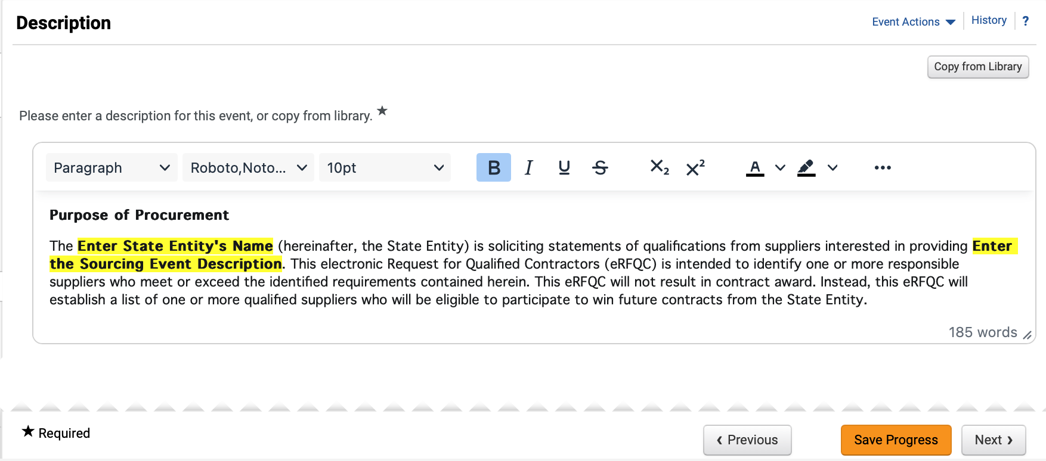
Create a Request for Qualified Contractors (RFQC) (Part 15 of 52)
INSTRUCTIONS
Review and edit Description*.
Note: Remove instructions when editing Description this will show up in the Georgia Procurement Registry (GPR). To remove yellow highlighting, select the text and click the Paint Bucket to change the background color. To Copy from Library, follow Steps 46 – 47, or skip to Step 48 to add Stage Description.
To Copy Description from Library, click Copy from Library.
Note: Click Magnifying Glass to display more options.

Slide 17
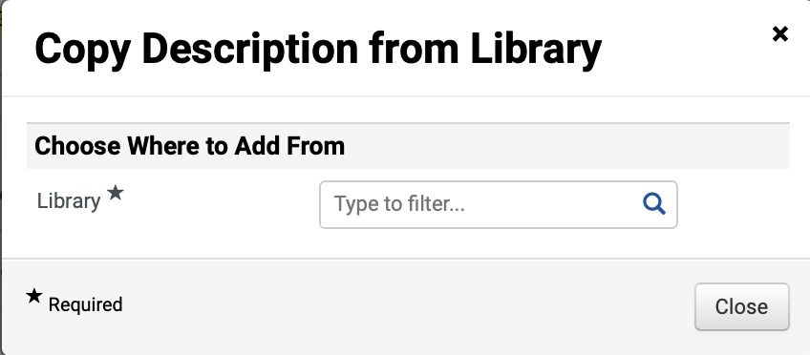
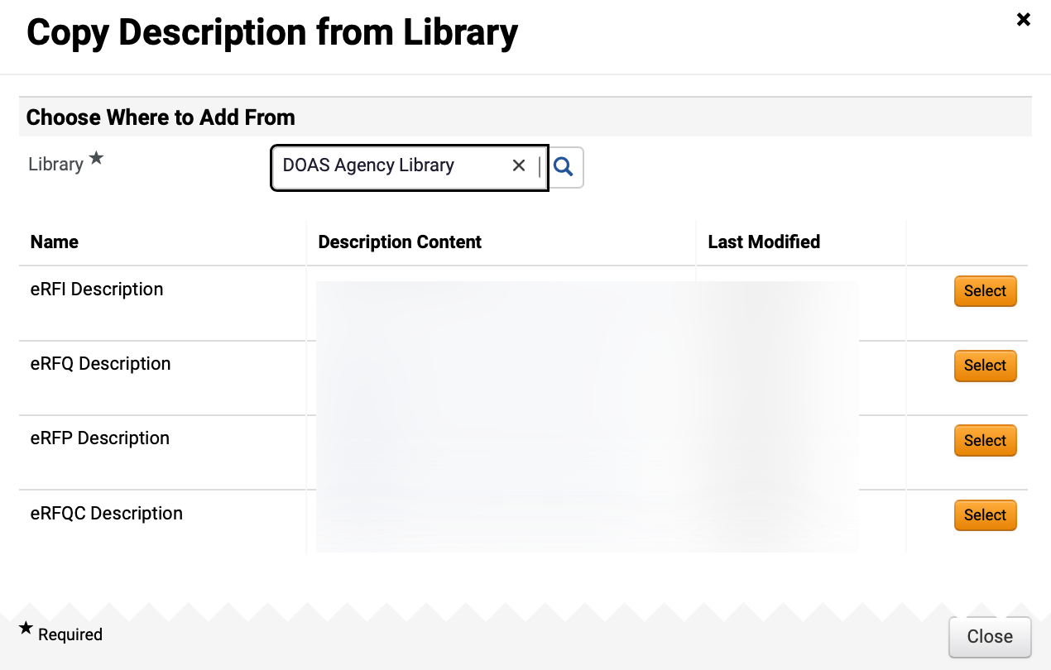
Create a Request for Qualified Contractors (RFQC) (Part 16 of 52)
INSTRUCTIONS
Select Library*.
Note: Click Magnifying Glass to display more options.
Click Select to add Description Content.

Slide 18
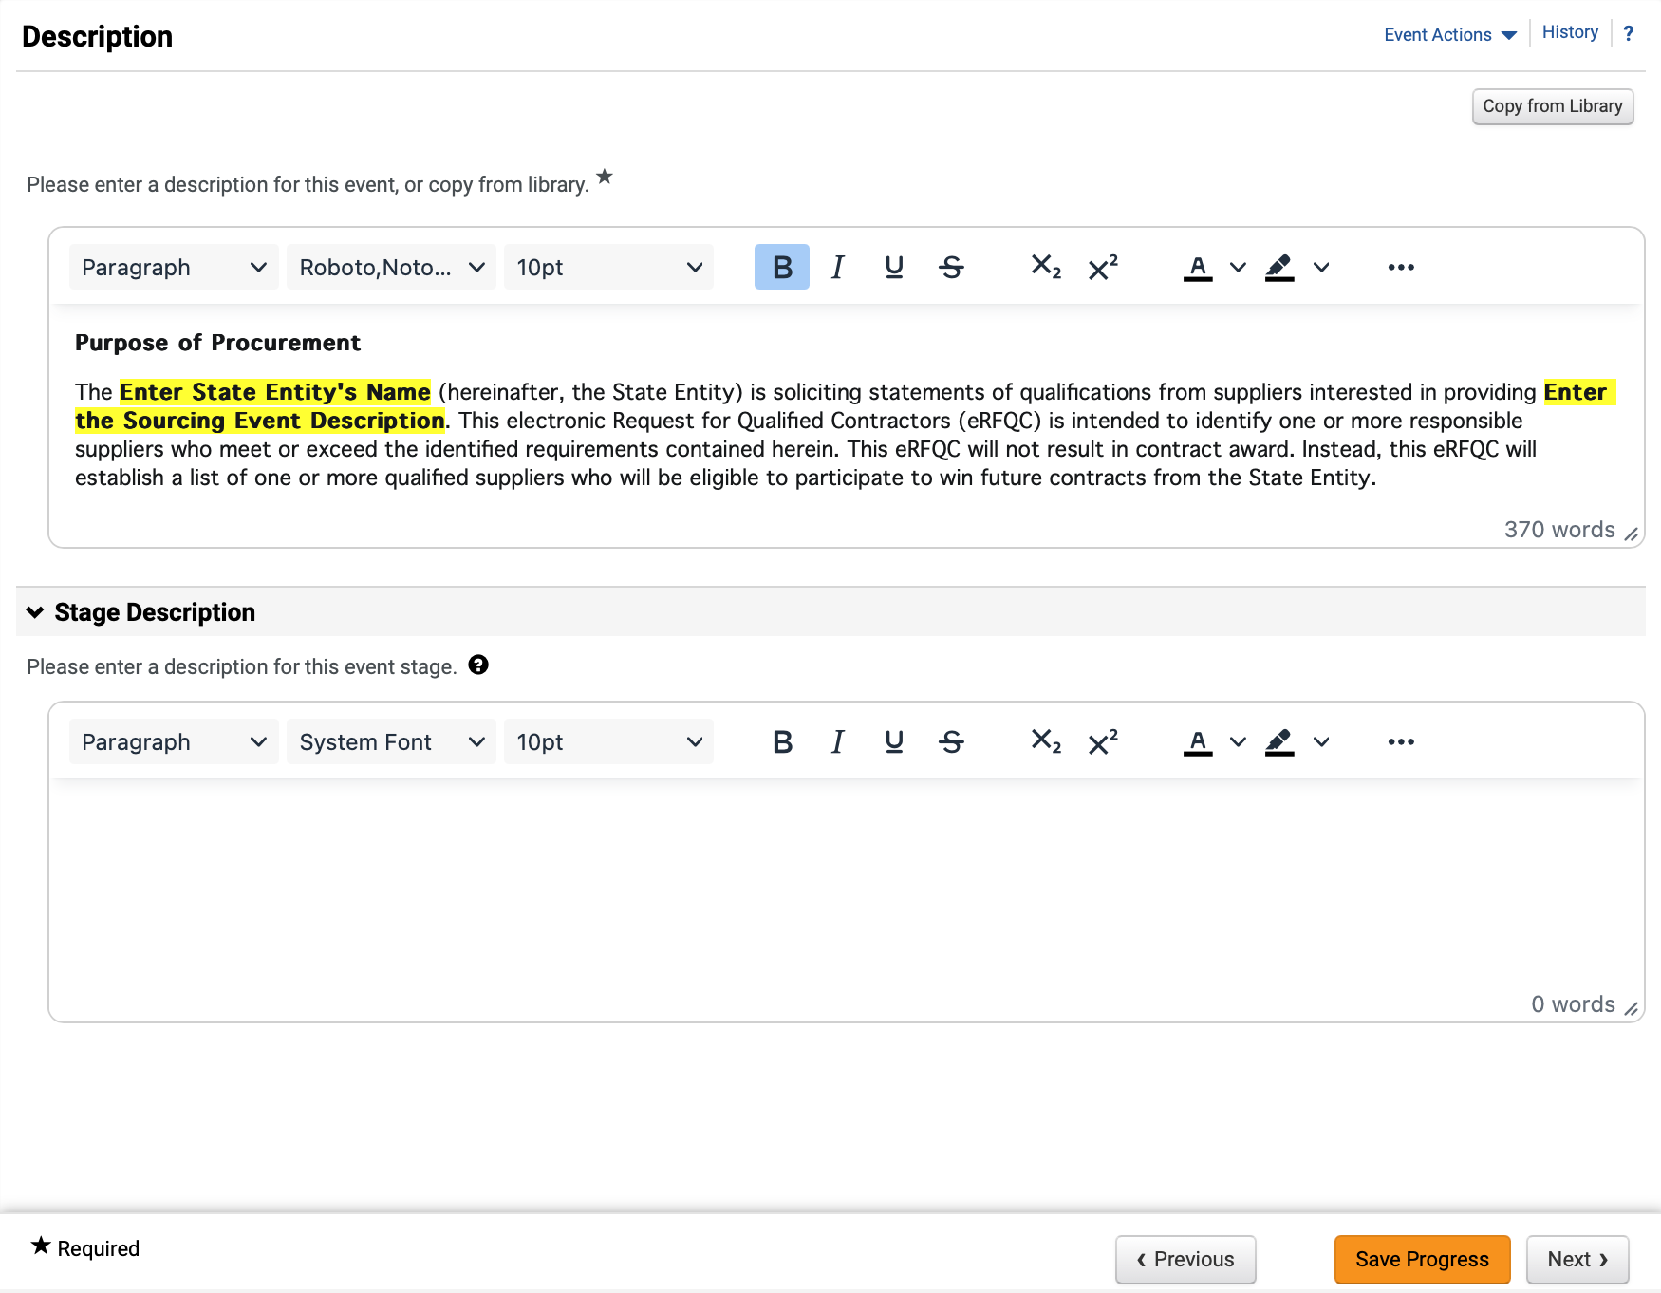
Create a Request for Qualified Contractors (RFQC) (Part 17 of 52)
INSTRUCTIONS
Review added Description.
Enter Stage Description (Optional).
Note: Populate this field only if there is a stage included in the event.
Click Save Progress and Next.
49
50
51

Slide 19
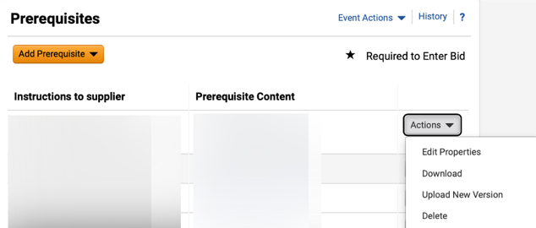
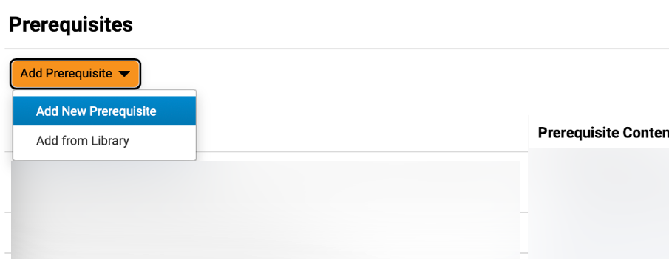
Create a Request for Qualified Contractors (RFQC) (Part 18 of 52)
INSTRUCTIONS
Click Actions and select Edit Properties or Delete, if applicable.
Note: Prerequisites are populated when using the eRFQC Template. Prerequisites should be reviewed by Sourcing Event Buyers to ensure language and attachments are correct.
Click Add Prerequisite (Optional) and select Add New Prerequisite.
Note: If selecting Add New Prerequisite, follow Steps 53 – 58 and then skip to Step 59 to Add Attachment. If selecting Add from Library, follow Steps 67 – 73.

Slide 20
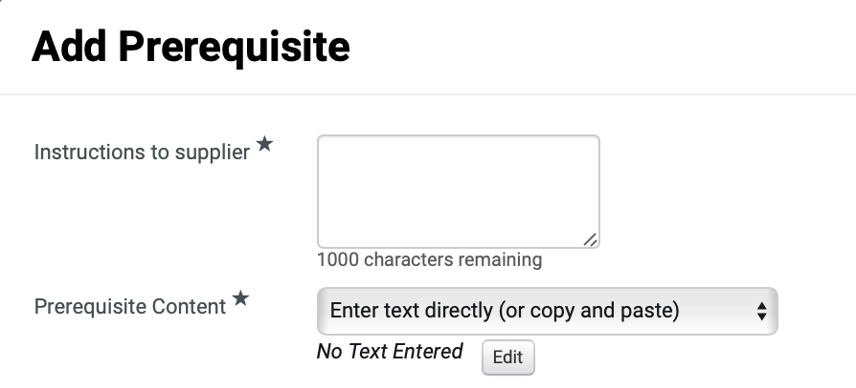
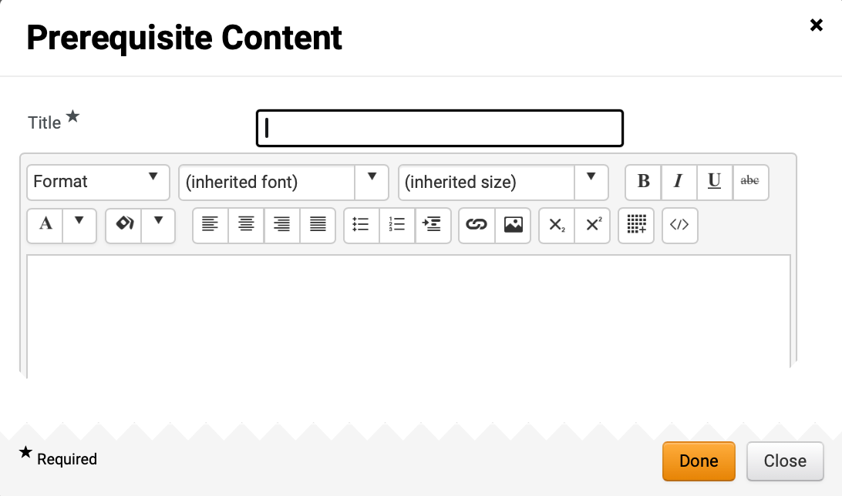
Create a Request for Qualified Contractors (RFQC) (Part 19 of 52)
INSTRUCTIONS
Enter Instructions to supplier* and select Prerequisite Content*.
Note: If selecting Enter text directly, follow Steps 55 – 58, and skip to Step 67. To Attach File, skip to Step 59.
Click Edit.
54
55
Enter Title*.
Enter Prerequisite Content.
Click Done.
56
57
58

Slide 21
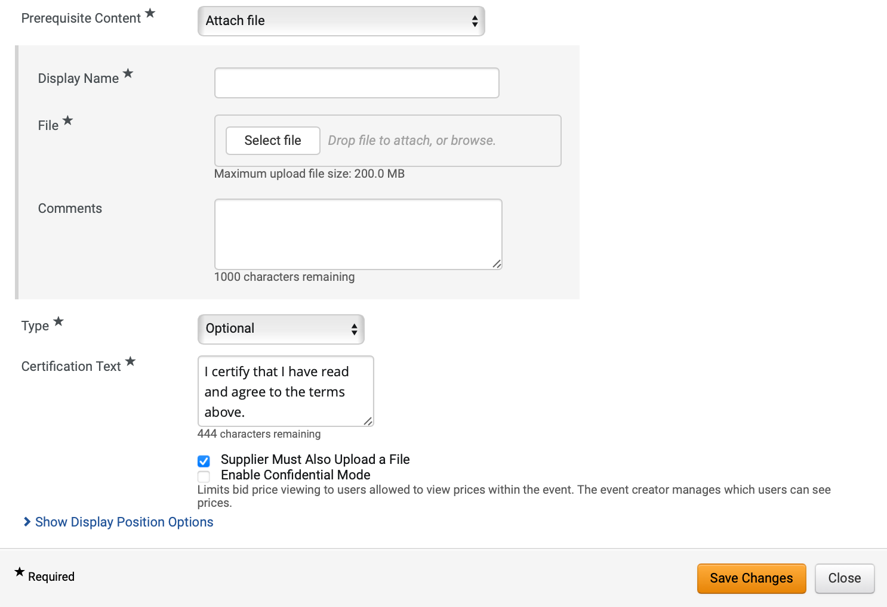
Create a Request for Qualified Contractors (RFQC) (Part 20 of 52)
INSTRUCTIONS
If attaching file, enter Display Name*.
Click Select file to attach File*.
Enter Comments (Optional).
Select Type* and enter Certification Text*.
Note: Certification Text will auto-populate but can be edited.
Check Supplier Must Also Upload a File box (Optional).
Note: If you check this box, Enable Confidential Mode checkbox will display.
Click Show Display Position Options.
59
60
61
62
63
64

Slide 22
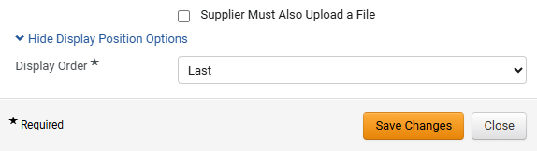
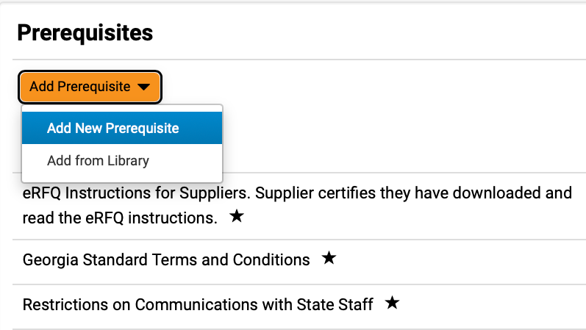
Create a Request for Qualified Contractors (RFQC) (Part 21 of 52)
INSTRUCTIONS
Select Display Order*.
Click Save Changes.
Note: Repeat the steps above to add additional custom prerequisites.
65
66
Click Add Prerequisite.
Select Add from Library.
67
68

Slide 23
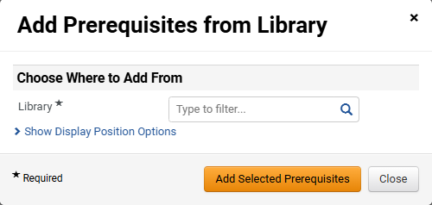
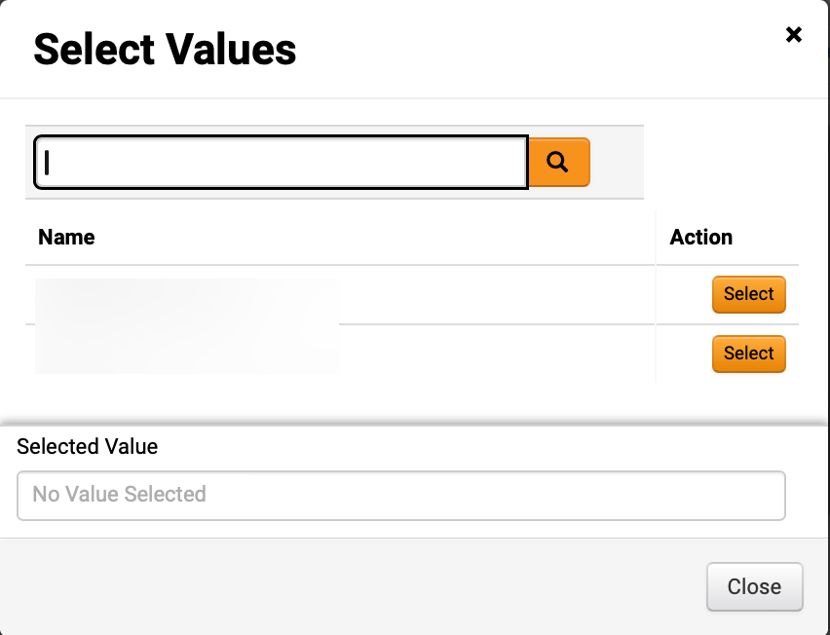
Create a Request for Qualified Contractors (RFQC) (Part 22 of 52)
INSTRUCTIONS
Click Magnifying Glass to select Library*.
Click Select for the desired library.

Slide 24
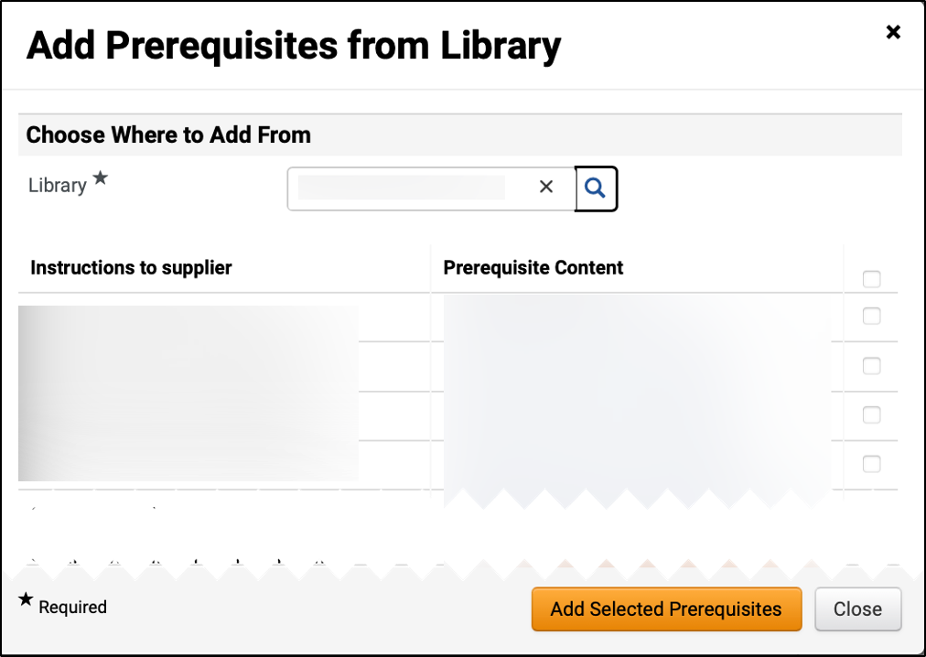
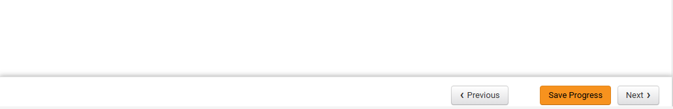
Create a Request for Qualified Contractors (RFQC) (Part 23 of 52)
INSTRUCTIONS
Check the applicable Prerequisite Content box(s).
Click Add Selected Prerequisites.
71
72
Click Save Progress and Next.
73

Slide 25
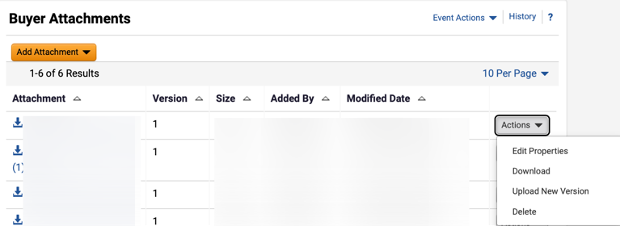
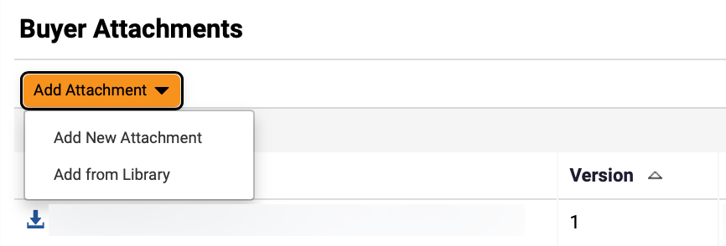
Create a Request for Qualified Contractors (RFQC) (Part 24 of 52)
INSTRUCTIONS
Click Actions and select Edit Properties or Delete an attachment, if applicable.
Click Add Attachment.
Note: Follow Steps 75 – 89 and skip to Step 96 if adding Buyer Attachments or skip to Step 90 to Add from Library. Following your organization's guidance, upload any relevant files to the event. If no files to add, skip to Step 96.
Select Add New Attachment.
75
76

Slide 26
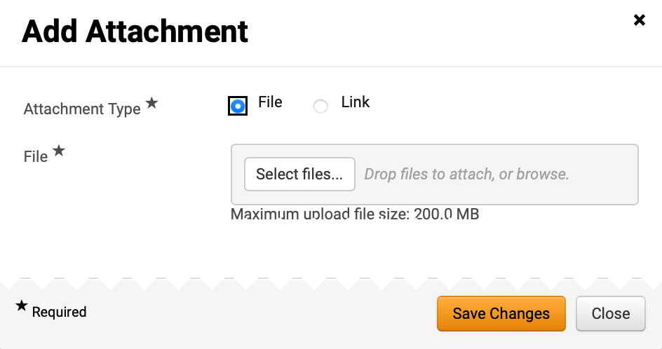
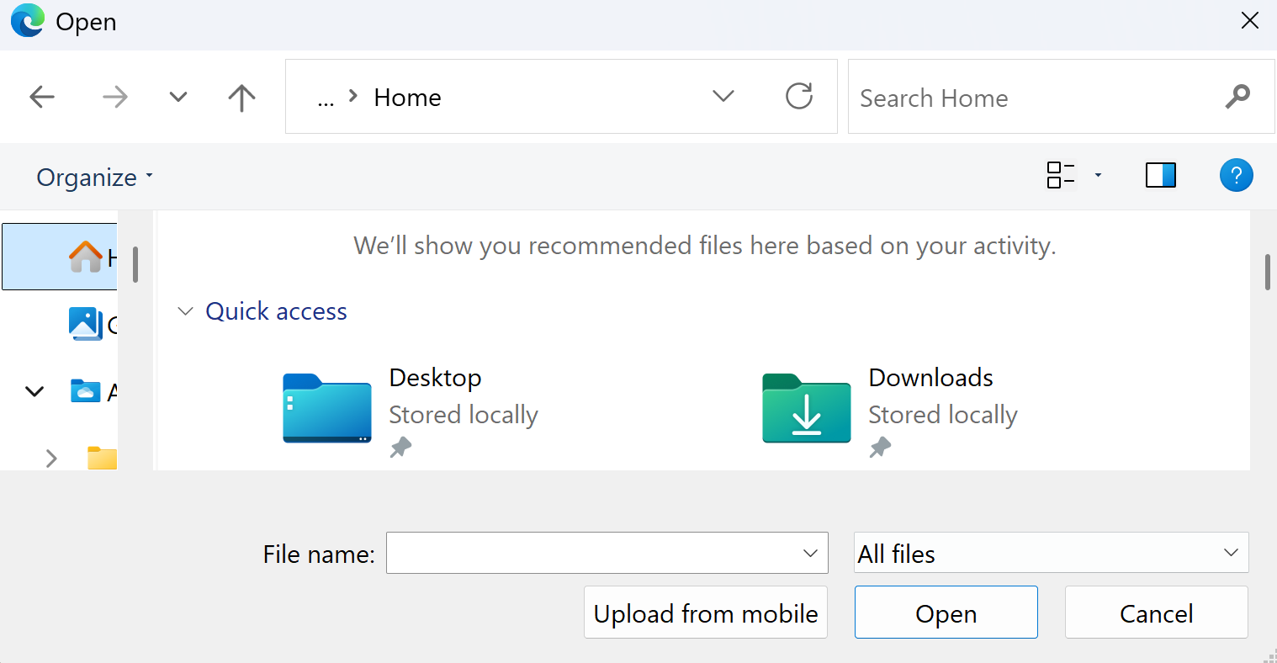
Create a Request for Qualified Contractors (RFQC) (Part 25 of 52)
INSTRUCTIONS
Select Attachment Type*.
Note: If selecting File, follow Steps 78 – 84 then skip to Step 96. If selecting Link, skip to Step 85.
Click Select files… to upload File*.
77
78
Select the applicable File from local computer.
Click Open.
79
80

Slide 27
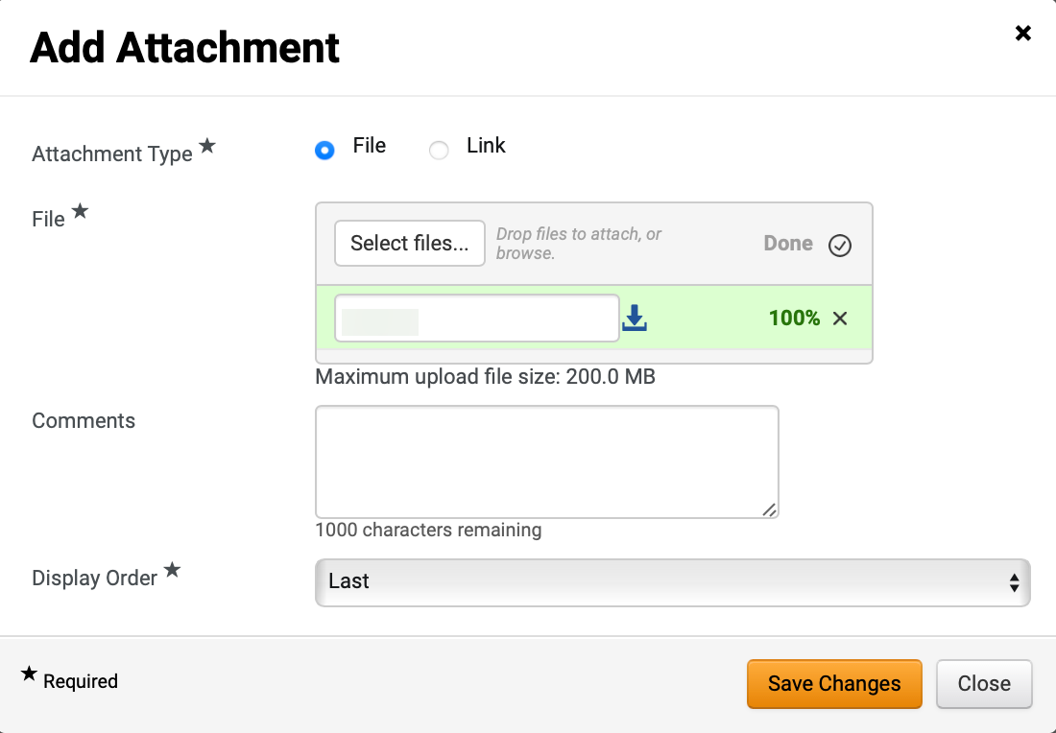
Create a Request for Qualified Contractors (RFQC) (Part 26 of 52)
INSTRUCTIONS
Confirm that the uploaded File* was added.
Enter Comments (Optional).
Select Display Order*.
Click Save Changes.
Note: Skip to Step 99 to Add Question.
81
82
83
84

Slide 28
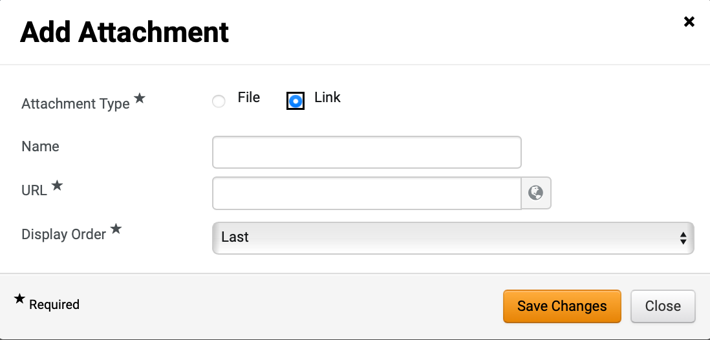
Create a Request for Qualified Contractors (RFQC) (Part 27 of 52)
INSTRUCTIONS
Select Link as Attachment Type*.
Enter Name.
Enter URL*.
Select Display Order*.
Click Save Changes.
85
86
87
88
89
To Add Attachment from Library, select Add from Library.

Slide 29
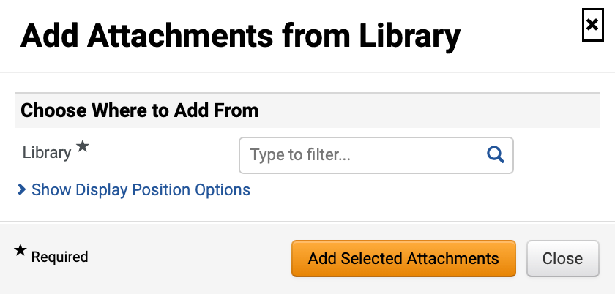
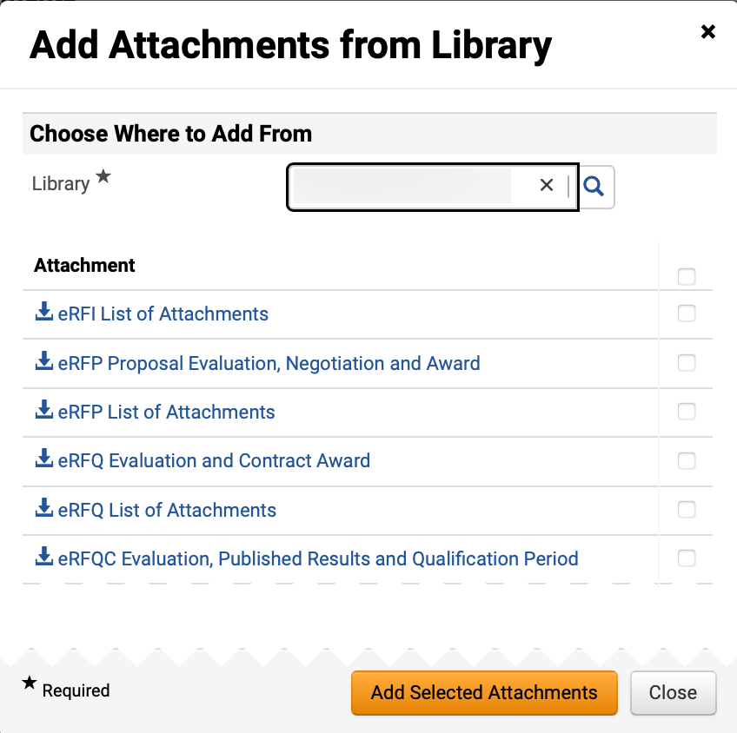
Create a Request for Qualified Contractors (RFQC) (Part 28 of 52)
INSTRUCTIONS
Select Library*.
Note: Use magnifying glass to search for Library.
Click checkbox to Add Attachments.
Note: Multiple Attachments can be selected.
Click Add Selected Attachments.
92
93

Slide 30
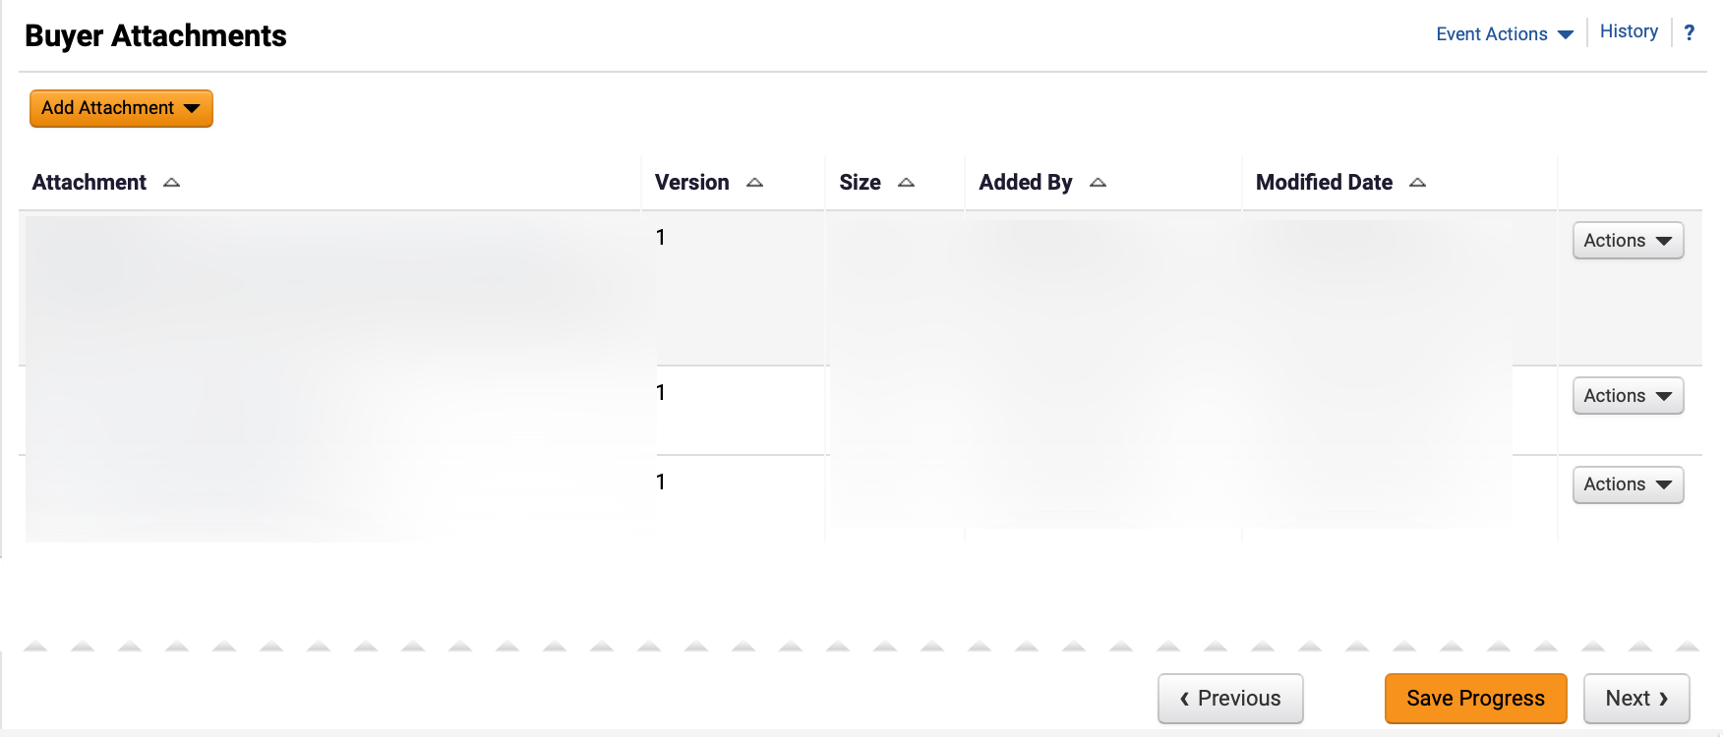
Create a Request for Qualified Contractors (RFQC) (Part 29 of 52)
INSTRUCTIONS
Review Buyer Attachments.
Click Next.
94
95

Slide 31
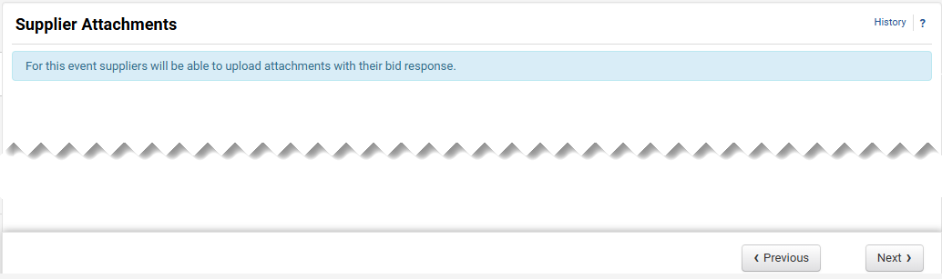
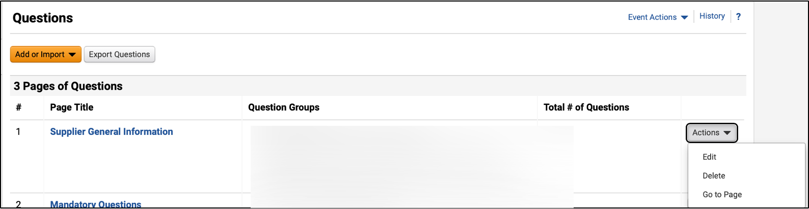
Create a Request for Qualified Contractors (RFQC) (Part 30 of 52)
INSTRUCTIONS
Click Next.
Note: All event types are set up to allow suppliers to upload attachments.
Click Edit to update or delete prepopulated question groups.
Click the Page Title hyperlink to view questions.
Note: Review the chart to learn more about Event Questions.
98
97

Slide 32
Create a Request for Qualified Contractors (RFQC) (Part 31 of 52)
INSTRUCTIONS
Event Questions
Description
Add New Question
Enter a custom question.
Add from Library
Select standard questions.
Import from File
Upload previously prepared questions.
Question Page
Questions can be organized into separate pages. The RFQC Template includes four pre-populated question pages:
Supplier General Information
Mandatory Questions
Mandatory Scored Questions
Additional Scored Questions
Question Group
Within each page, questions can be further grouped into sections with titles based on user-defined criteria. Instructions for each group can also be entered.
Block Questions with Supplier Profile Content
Questions from Supplier Profile Content can be added in groups.
Note: Users can organize their questions and groups freely.
Options:
Group questions in sections under a single page.
Place each group on a separate page.
Have all questions in a single page without groups

Slide 33
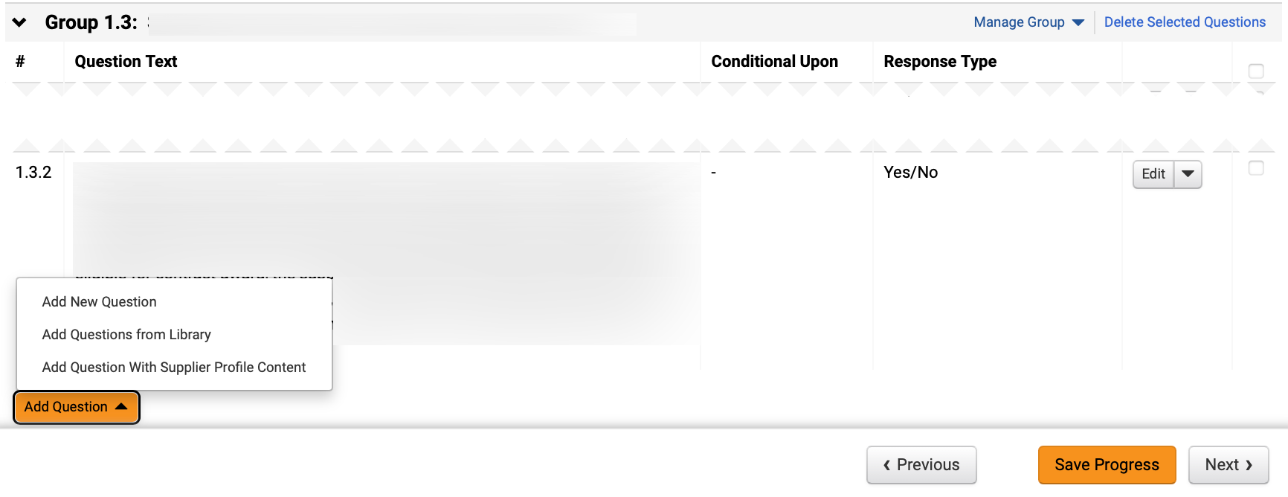
Create a Request for Qualified Contractors (RFQC) (Part 32 of 52)
INSTRUCTIONS
Click Add Question.
To add a custom question, select Add New Question.
Note: To Add New Question, follow Steps 100 – 106 and skip to Step 114. To Add Questions from Library, follow Steps 107 – 113 and skip to Step 114.
99
100

Slide 34
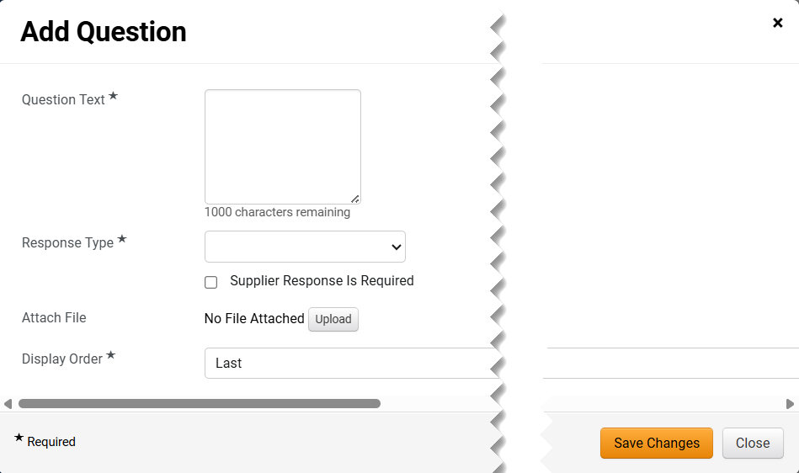
Create a Request for Qualified Contractors (RFQC) (Part 33 of 52)
INSTRUCTIONS
Enter Question Text*.
Select Response Type*.
Note: Additional fields may display depending on Response Type selected.
Check Supplier Response is Required box (Optional).
Click Upload to Attach File (Optional).
Select Display Order*.
Click Save Changes.
101
102
103
104
105
106

Slide 35
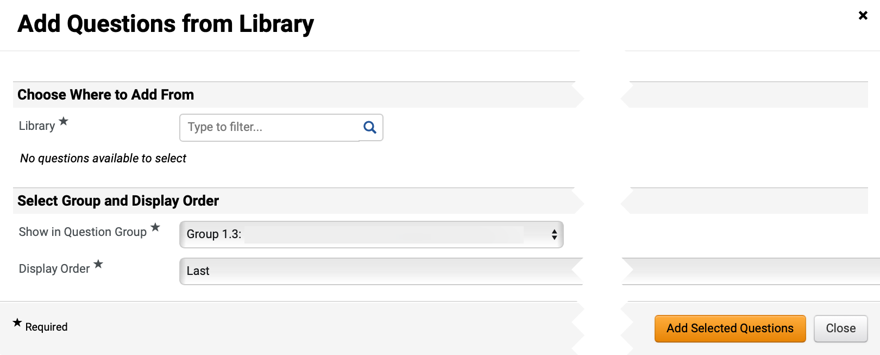
Create a Request for Qualified Contractors (RFQC) (Part 34 of 52)
INSTRUCTIONS
Select Add Question from Library.
Note: To Add Questions from Library, follow Steps 107 – 113 and skip to Step 114.
Select Library*.
Note: Use Magnifying Glass to search.

Slide 36
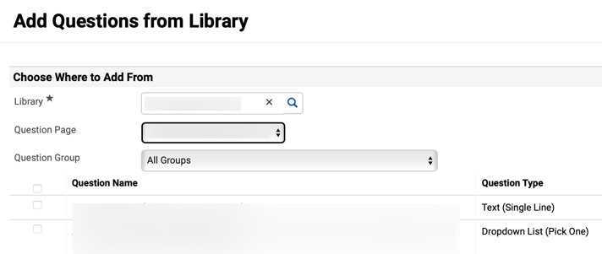
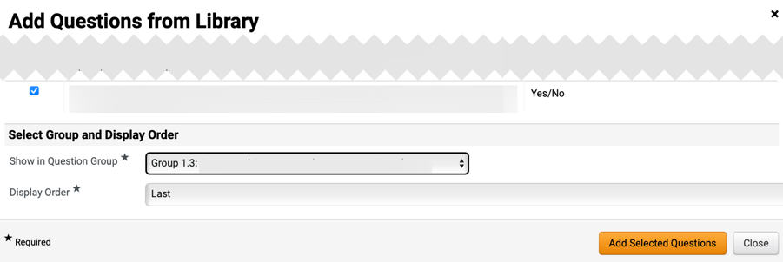
Create a Request for Qualified Contractors (RFQC) (Part 35 of 52)
INSTRUCTIONS
Select Question Page and Question Group.
Note: Question Group can be filtered by All Groups or an individual Question Group.
Check the applicable Question Name box(s).
109
110
Select Show in Question Group* and Display Order*.
Click Add Selected Questions.
111
112

Slide 37
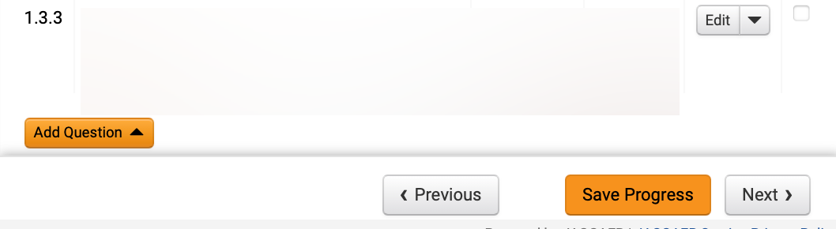
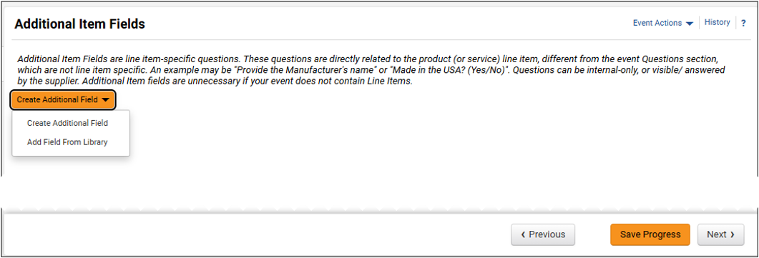
Create a Request for Qualified Contractors (RFQC) (Part 36 of 52)
INSTRUCTIONS
Review added Question and click Next.
Click Create Additional Field and select Create Additional Field to create a custom question.
Note: If selecting Create Additional Field, follow Steps 114 – 120 and skip to Step 127. If selecting Add Field From Library, skip to Step 121.
114

Slide 38
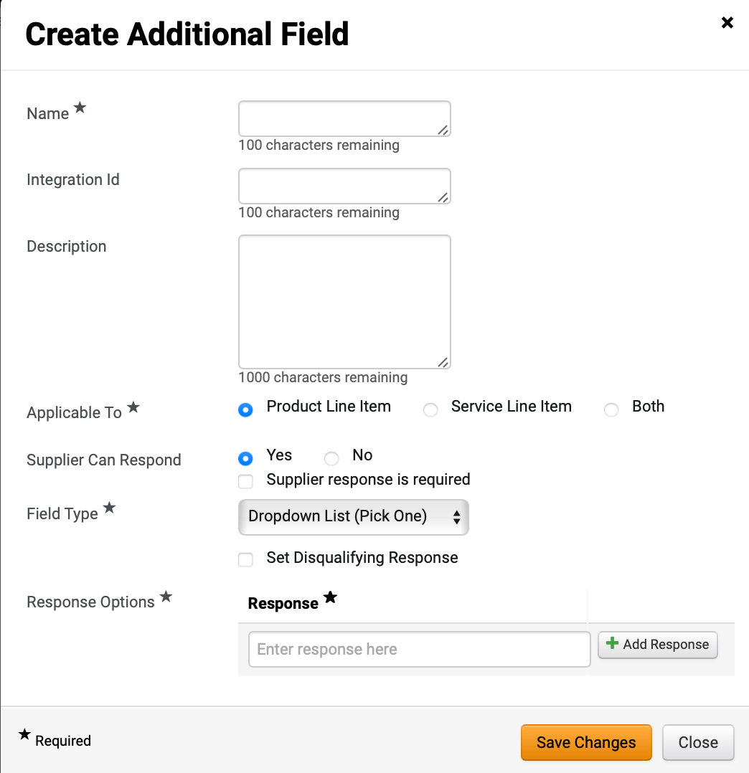
Create a Request for Qualified Contractors (RFQC) (Part 37 of 52)
INSTRUCTIONS
Enter Name* and Description (Optional).
Check Applicable To* box.
Check Supplier Can Respond box.
Note: If selecting Yes, an option to click Supplier response is required checkbox displays.
Select Field Type*.
Note: Response Option displays only based on Field Type selected. An option to Set Disqualifying Response may display.
Enter Response* and click Add Response.
Click Save Changes.
115
116
117
118
119
120

Slide 39
Create a Request for Qualified Contractors (RFQC) (Part 38 of 52)
INSTRUCTIONS
Select Add Field from Library.

Slide 40

Create a Request for Qualified Contractors (RFQC) (Part 39 of 52)
INSTRUCTIONS
Select Library*.
Note: Use magnifying glass to search. Additional Item Fields will populate once Library is selected.
Check applicable Additional Item Fields box(s).
Click Add Selected Item Fields.
122
123
124

Slide 41


Create a Request for Qualified Contractors (RFQC) (Part 40 of 52)
INSTRUCTIONS
Review added Additional Item Fields.
Click Save Progress and Next.
125
126
Click Service Line Items.
Note: Content will be populated based on the template used to create the event but can be edited or deleted.
Click Edit beside eRFQC Estimated Value*.
127
128

Slide 42

Create a Request for Qualified Contractors (RFQC) (Part 41 of 52)
INSTRUCTIONS
Remove populated Description and enter Estimated Value.
Note: The Estimated Value entered in Description should be the same Estimated Value Sourcing Event Buyers will be directing all suppliers to enter when submitting their bids. To ensure the RFQC can be awarded appropriately, the event cannot be awarded without a line item.
Click Save Changes.
129
130

Slide 43
Create a Request for Qualified Contractors (RFQC) (Part 42 of 52)
INSTRUCTIONS
Click Add Service Line Item and select Add New Item.
Note: To Add New Item, follow Steps 131 – 133 and skip to Step 143. If selecting Add Item from Library, skip to Step 134. If the solicitation includes both products and services, add items for both tabs following the same steps.
131

Slide 44

Create a Request for Qualified Contractors (RFQC) (Part 43 of 52)
INSTRUCTIONS
Enter Service Line Item information as applicable.
Note: Check the Unit Price is Required box to ensure suppliers do not leave the price line blank as it will prevent contract award.
Click Save Changes.
132
133

Slide 45

Create a Request for Qualified Contractors (RFQC) (Part 44 of 52)
INSTRUCTIONS
To Add Item from Library, click Add Service Line Item.
Select Add Item from Library.
134
135
Select Library*.
Note: Once Library is selected, additional fields will display.
136

Slide 46

Create a Request for Qualified Contractors (RFQC) (Part 45 of 52)
INSTRUCTIONS
Check applicable Service Line Items box in Service Line Items Group.
Note: Multiple Service Line Items can be selected.
Select Show in Item Group*.
Select Display Order*.
Click Add Selected Items.
137
138
139
140

Slide 47

Create a Request for Qualified Contractors (RFQC) (Part 46 of 52)
INSTRUCTIONS
Review added Items.
Click Next.
141
142

Slide 48

Create a Request for Qualified Contractors (RFQC) (Part 47 of 52)
INSTRUCTIONS
Review added Suppliers.
Note: From the Suppliers Invited by Commodity Code tab view which registered suppliers will receive an email notification based on the NIGP Codes selected in the Setup section. If the tab is blank, return to the Setup section and select the appropriate NIGP codes.
To invite additional suppliers, select the Add Suppliers to Event tab.
143
144

Slide 49

Create a Request for Qualified Contractors (RFQC) (Part 48 of 52)
INSTRUCTIONS
Enter Supplier Name in Quick search to search for Suppliers.
Click Add to Event.
Note: An Added confirmation icon will display.
Click Manually Invite Suppliers (Optional).
Note: To Manually Invite Suppliers, follow Steps 147 – 151 or skip to Step 152.
Select Add Supplier to Event.
Note: If adding several suppliers, select Get Import Template.
147
145
148
146

Slide 50


Create a Request for Qualified Contractors (RFQC) (Part 49 of 52)
INSTRUCTIONS
Enter Supplier Name* and enter Sales or Corporate Contact Name (Optional).
Enter Email*.
Click Save or Save and Add Another.
149
150
151
Review added Supplier.

Slide 51


Create a Request for Qualified Contractors (RFQC) (Part 50 of 52)
INSTRUCTIONS
Click Save Progress and Next.
153
Review Progress for each section.
Note: Click the Section hyperlink to return to a section for editing.
Click Submit.
154
155

Slide 52


Create a Request for Qualified Contractors (RFQC) (Part 51 of 52)
INSTRUCTIONS
Review Event Submitted summary page.
Note: If there is workflow surrounding the event, approval steps can be viewed by clicking View Approval Steps.
Click Return to My Event hyperlink.
Click Tools.
Select Approvals.
158
159

Slide 53


Create a Request for Qualified Contractors (RFQC) (Part 52 of 52)
INSTRUCTIONS
Review Sourcing Event Approval Workflow and make changes as applicable.
You have successfully created a Request for Qualified Contractors.

