Slide 1
Run Sourcing Reports in
GA@WORK Marketplace
DESCRIPTION
This guide will show Buyers and Agency Procurement Officers how to Run Sourcing Reports in GA@WORK Marketplace.
OVERVIEW
The key steps in the process are below:
Navigate to Sourcing, Contracts, & Supplier Management.
Click Sign On.
Open Contracts and select Reports.
Choose parameters and run Reports.
Business Process:
Access Sourcing App
Sign On
Review Available Reports
Run Reports

Slide 2
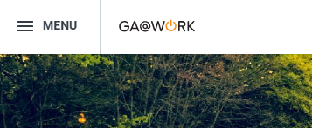
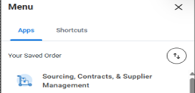
Run Sourcing Reports in GA@WORK Marketplace. (Part 1 of 3)
INSTRUCTIONS
Click the Global Navigation Menu.
Note: University System of Georgia (USG) follow your logon process. Proceed to Step 4.
Click Sourcing, Contracts, & Supplier Management.
Note: Click Add Apps to add the apps if it is not present in your menu.

Slide 3
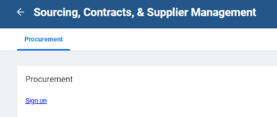
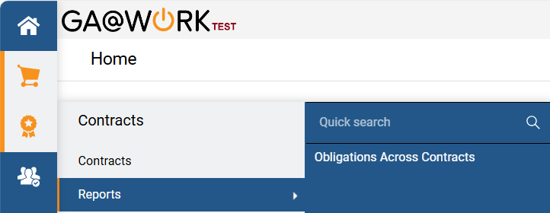
Run Sourcing Reports in GA@WORK Marketplace (Part 2 of 3)
INSTRUCTIONS
Click Sign on.
Click Contracts.
Click Reports.
Select the applicable Report.
4
6
5

Slide 4
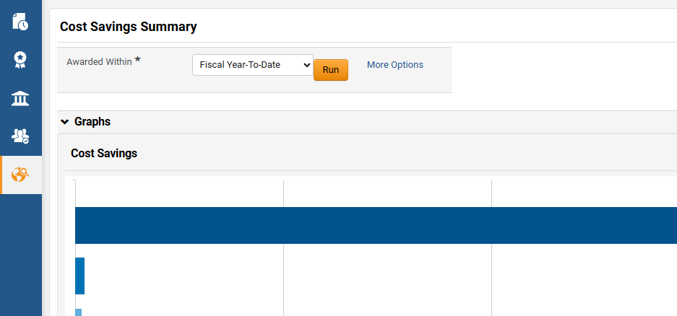
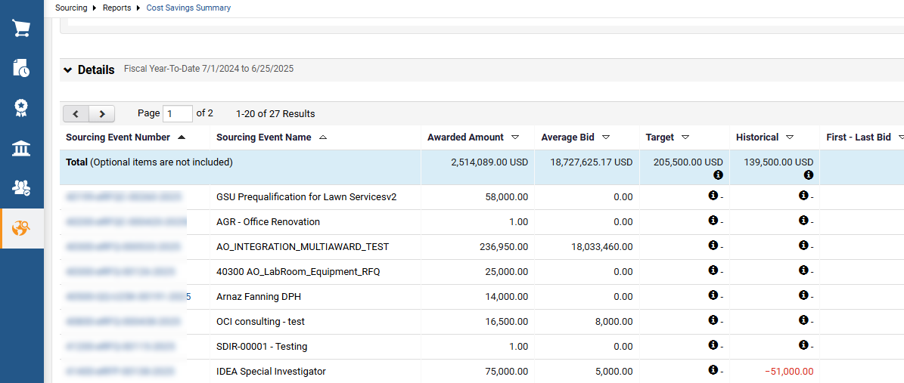

Run Sourcing Reports in GA@WORK Marketplace (Part 3 of 3)
INSTRUCTIONS
Select an option for Awarded Within* and click Run.
View the Report.
Note: Click the Sourcing Event number for details.
You have successfully run a report in JAGGAER Sourcing Director.

