Slide 1
Create Return to Supplier Event
DESCRIPTION
This guide will show Requesters and PO Buyers the steps to create a Return to Supplier Event, an optional business process for recording item returns after full receipt due to defects or other reasons, with an optional credit supplier invoice.
OVERVIEW
The key steps in the process are below:
Enter Create Return in the Search field.
Select Create Return task.
Enter the Return details.
Click OK.
Enter the quantity for each item to be returned.
Click Submit for Accounts Payable Data Entry Specialist approval.
Business Process:
Create Return
Enter Details for Return
Submit
Routed for Approval

Slide 2

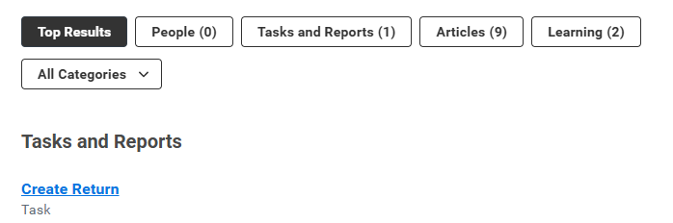
Create Return to Supplier Event (Part 1 of 4)
INSTRUCTIONS
Enter Create Return in the Search field and press Enter.
Click the Create Return task.

Slide 3
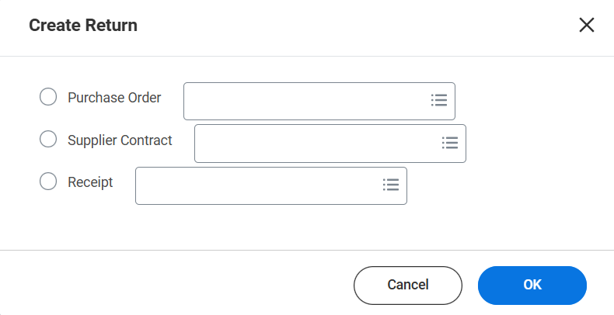
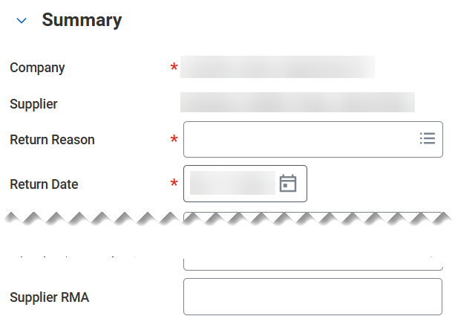
Create Return to Supplier Event (Part 2 of 4)
INSTRUCTIONS
Select the Purchase Order, Supplier Contract or the Receipt, as applicable.
Click OK.
3
4
Select the Return Reason*.
Select the Return Date*.
Note: Enter the Supplier RMA, if applicable.
5
6

Slide 4
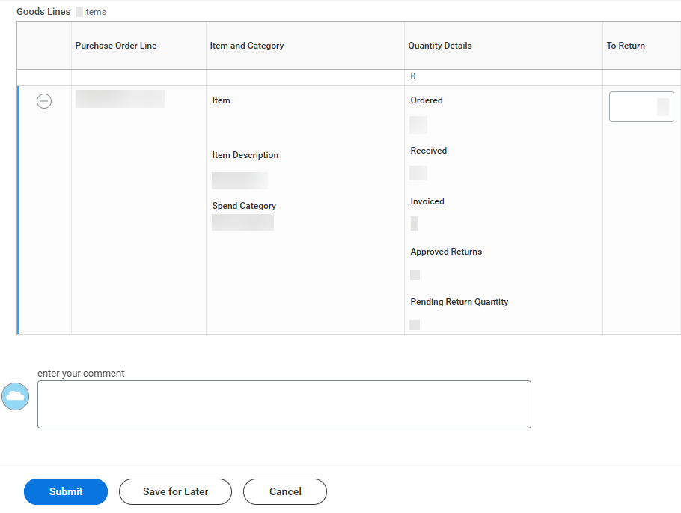
Create Return to Supplier Event (Part 3 of 4)
INSTRUCTIONS
In the Goods Lines section under To Return, enter the quantity of each item to return.
Note: You may enter your comment, if applicable.
Click Submit.
7
8

Slide 5
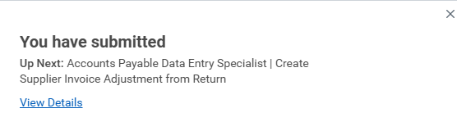

Create Return to Supplier Event (Part 4 of 4)
INSTRUCTIONS
You have successfully submitted the Create Return to Supplier Event.
Note: The Accounts Payable Data Entry Specialist must approve the return. You may select View Details for more information regarding the Create Return to Supplier Event.
You have successfully created a return to supplier event.

