Slide 1
Buyer Hub
DESCRIPTION
This guide will show Buyers and Procurement Operations Lead how to access and navigate the Buyer Hub.
OVERVIEW
The key steps in the process are below:
Click the Global Navigation Menu and click Buyer Hub.
Click the Navigation Pane to access the Requisitions, Purchase Orders, and Supplier Contracts.
Access the Tasks and Reports in the Buyer’s Hub Overview.
Business Process:
Locate the Buyer Hub App
View the Navigation Pane and Overview
Select any Task or Report

Slide 2
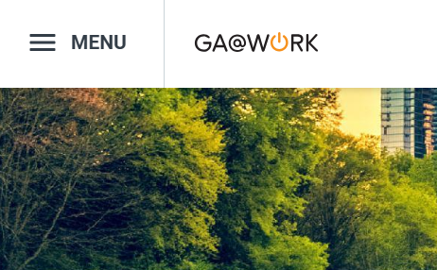
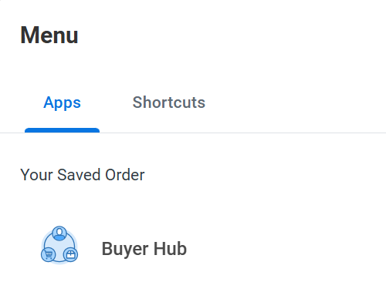
Buyer Hub (Part 1 of 12)
INSTRUCTIONS
Click the Global Navigation Menu.
Click Buyer Hub.

Slide 3
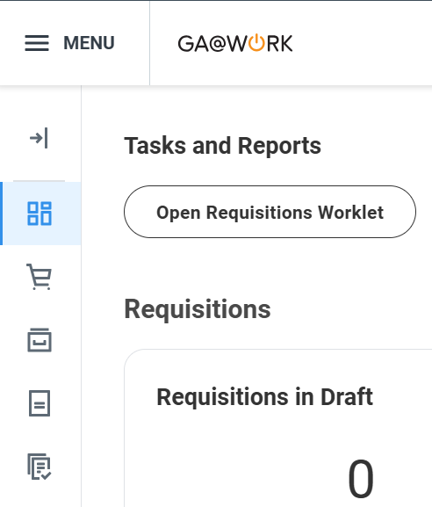
Buyer Hub (Part 2 of 12)
INSTRUCTIONS
Click the Navigation Pane.
Note: The Buyer Hub is a Launch Page (worklet) which aggregates various tasks and reports that can be performed on procurement transactions including requisitions and purchase orders.

Slide 4
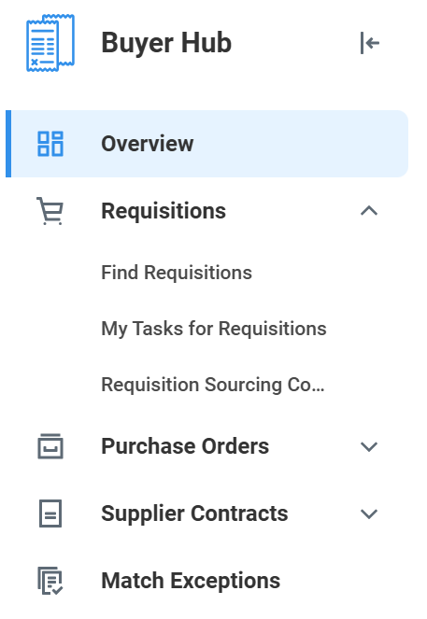
Buyer Hub (Part 3 of 12)
Select Requisitions to expand the menu. Use the table to learn more about each section in the menu.
​ | ​
​ | ​
​ | ​
​ | ​
Buyer Hub Section
Description
Create Requisitions > Find Requisition
Use this to search for all requisitions, based on various statuses and other filters for your company
Requisition > My Tasks for Requisitions
Do not use. Instead use the "Requisition Sourcing Console" to source, or the "Overview > Requisitions to Review" on the main page to take approval action on requisitions.
Requisition > Requisition Sourcing Console
Use this report to search for all requisitions that need sourcing into a PO. This is equivalent to sourcing a requisition using its related action. NOTE: you cannot combine multiple requisitions into a single PO using this method. Instead for more advanced sourcing such as combining requisitions into POs, use the "Source Requisitions" task on the main search box on the top of homepage.

Slide 5
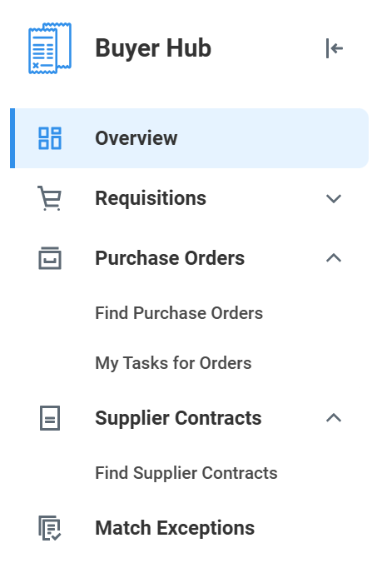
Buyer Hub (Part 4 of 12)
Select Purchase Orders and Supplier Contracts to expand the menus. Use the table to learn more about each section in the menu.
​ | ​
​ | ​
​ | ​
​ | ​
Buyer Hub Section
Description
Purchase Orders > Find Purchase Orders
Use this to search for all POs in your agency and filter on statuses and other fields as needed.
Purchase Orders > My Tasks for Orders
Approval Actions needed by you on the POs and change orders.
Supplier Contracts > Find Supplier Contracts
Use this to search for supplier contracts for your agency, and filter by status and other fields as needed.
Match Exceptions
Use this to search for all supplier invoices in match exceptions for your agency.

Slide 6
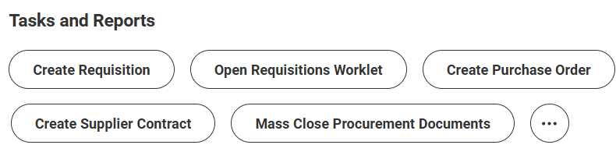
Buyer Hub (Part 5 of 12)
INSTRUCTIONS
In the Buyer Hub’s Overview, view the Tasks and Reports available. Use the table to learn more about each report.
Buyer Hub Section
Description
Create Requisition
Use this to start a new requisition.
Open Requisitions Worklet
This takes you to the requisitions App.
Create Purchase Order
Use this to create a new purchase order.
Create Supplier Contact
Not applicable. Contracts will be created in Jaggaer.
Mass Close Procurement Documents
Use to initiate mass close of requisitions or purchase orders. This usually is a month-end or year-end task.
Create Request for Quote
Not applicable as sourcing events will be fully housed in Jaggaer.

Slide 7
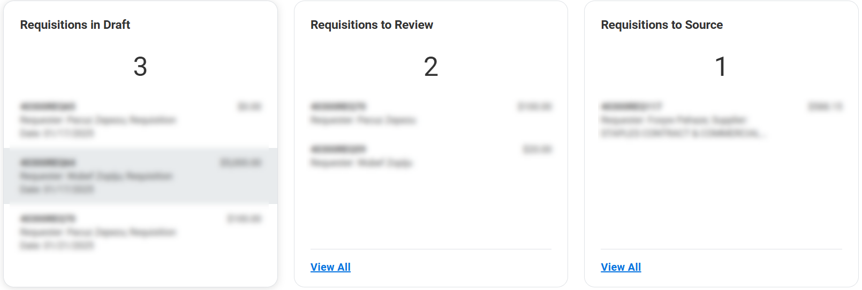
Buyer Hub (Part 6 of 12)
INSTRUCTIONS
In the Buyer Hub’s Overview, click the Requisition. Use the table to learn more about each report.
Note: The numbers indicate available items for each section.
​ | ​
​ | ​
​ | ​
​ | ​
Buyer Hub Section
Description
Requisition in Draft Box
Click to view requisitions in draft status (that you have either created or a requester of). For viewing all requisitions in draft status, use the "Find Requisitions" Report
Requisition to Review
These are requisitions pending your approval.
Requisition to Source
Do not use this. Instead, use the "Find Requisitions" Report to search for "Successfully Completed" requisitions and source them using related actions there.

Slide 8
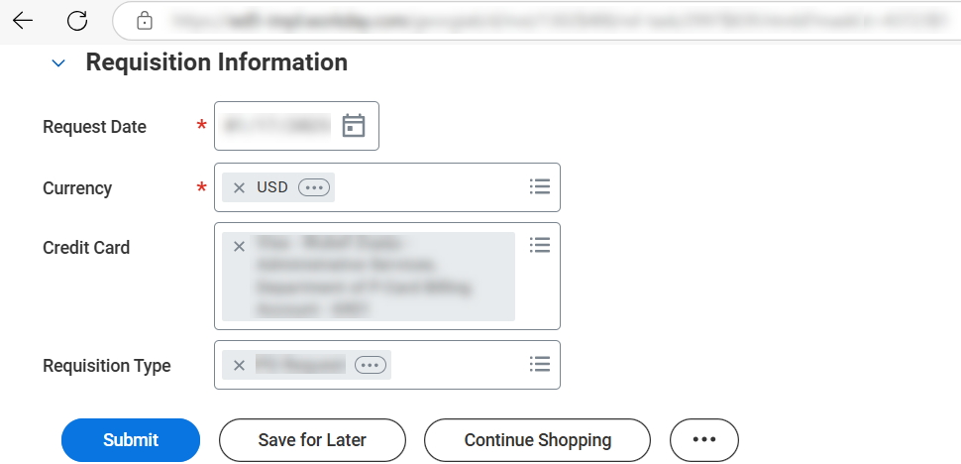
Buyer Hub (Part 7 of 12)
INSTRUCTIONS
Review a selected Requisition and complete the task(s), if desired. Click Back in the Browser to return to the Buyer Hub.

Slide 9
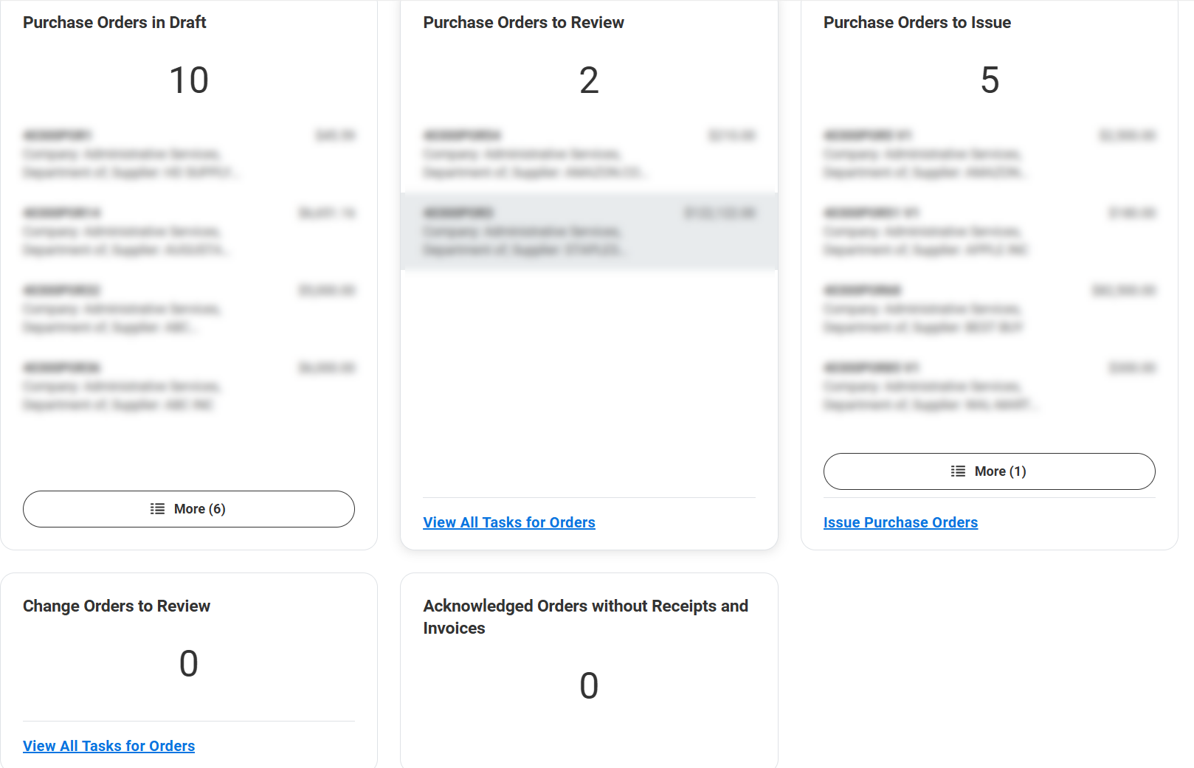
Buyer Hub (Part 8 of 12)
INSTRUCTIONS
In the Buyer Hub’s Overview, click the Purchase Order. Use the table on the next page to learn more about each report.
Note: Click More, View All Tasks for Orders, or Issue
Purchase Orders, if necessary.

Slide 10
Buyer Hub (Part 9 of 12)
INSTRUCTIONS
​ | ​
​ | ​
​ | ​
​ ​ | ​
​ ​ ​ | ​
Buyer Hub Section
Description
Purchase Order in Draft
Click to open and edit purchase orders. Note: there could be other purchase orders where you are not the buyer and to review those, use the "find purchase orders" task
Purchase Orders to Review (and Change Orders to
Review)
These are purchase orders pending your approval
Purchase Orders to Issue
These are approved purchase orders where you are the buyer. To view other POs where you may not be the buyer, use the "Find Purchase Orders" task and filter as needed.
Acknowledged Order Without Receipts/Invoices
Not applicable as we won't be using acknowledgements

Slide 11
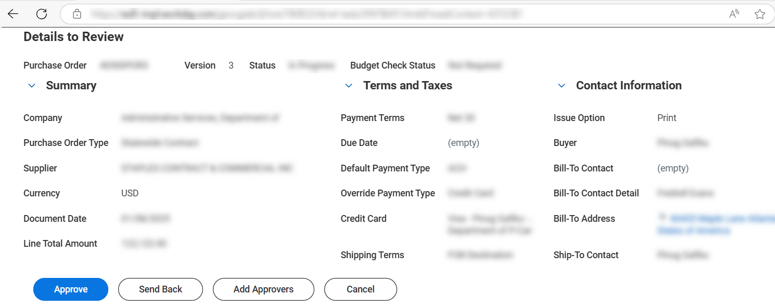
Buyer Hub (Part 10 of 12)
INSTRUCTIONS
Review a selected Purchase Order and complete the task(s), if desired. Click Back in the Browser to return to the Buyer Hub.

Slide 12
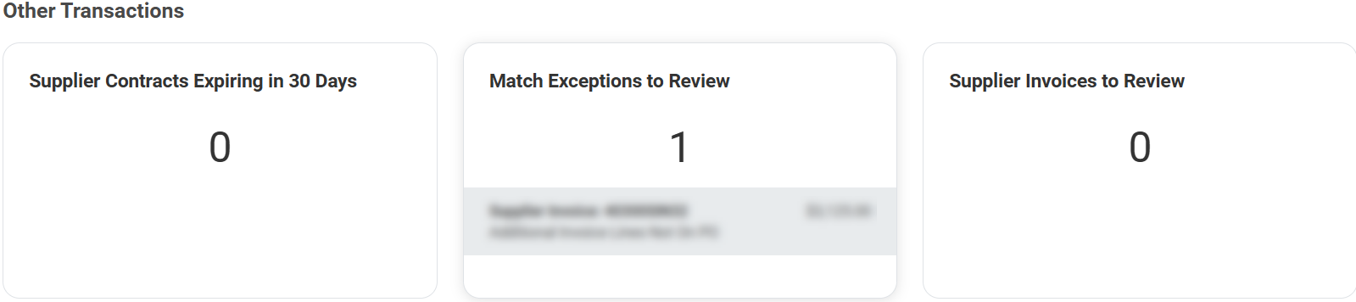
Buyer Hub (Part 11 of 12)
INSTRUCTIONS
In the Buyer Hub’s Overview, click the Match Exceptions to Review. Use the table to learn more about other transactions.
​ | ​
​ | ​
Buyer Hub Section
Description
Other Transactions
Transactions where you are the buyer. To view other transactions, you may use the "Find Supplier Contracts" or "Find Supplier Invoices" tasks and filter as needed

Slide 13
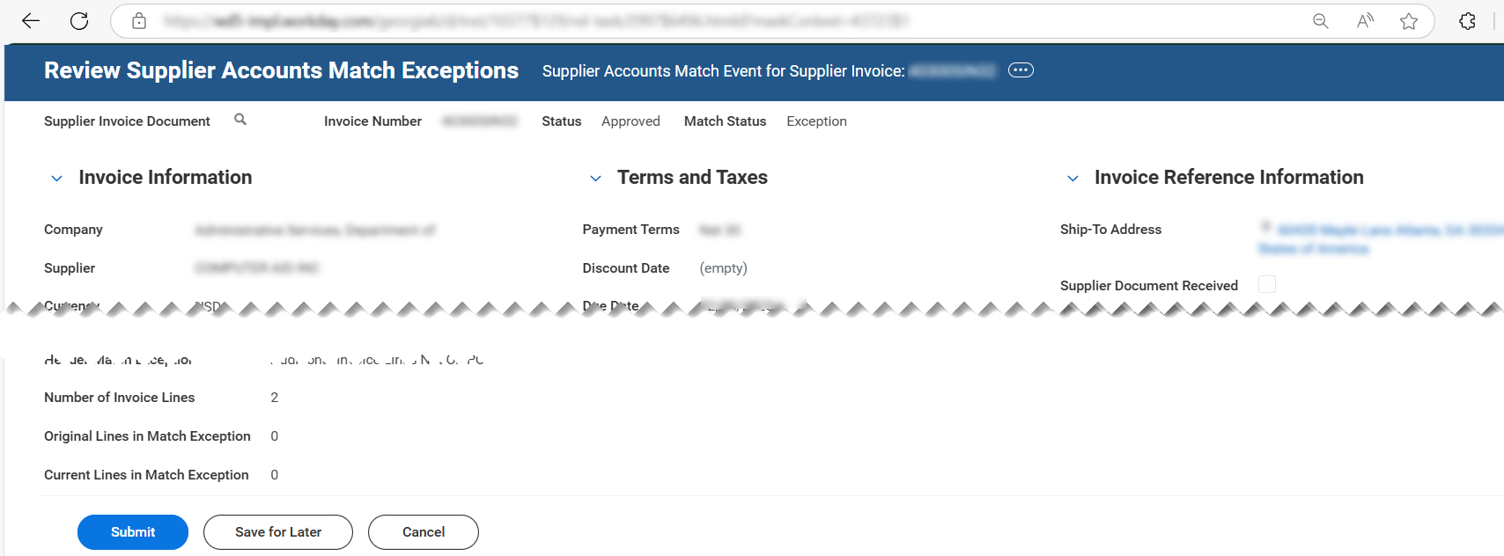

Buyer Hub (Part 12 of 12)
INSTRUCTIONS
Review a selected Supplier Invoice and complete the task(s), if desired. Click Back in the Browser to return to the Buyer Hub.
You have successfully accessed and navigated the buyer hub.

