Slide 1
Navigate the
Strategic Sourcing Module
DESCRIPTION
This guide will help Sourcing Event Buyers navigate to the GA@WORK Strategic Sourcing Module, search events, view notifications, and manage sourcing events.
OVERVIEW
The key steps in the process are below:
Navigate to the Sourcing Contracts & Supplier Management page.
View Notifications and Action Items.
Search for Sourcing Events, as applicable.
View Sourcing Event details.
Navigate to Sourcing Director
View Notifications and Action Items
Search Sourcing Events
View Sourcing Event

Slide 2

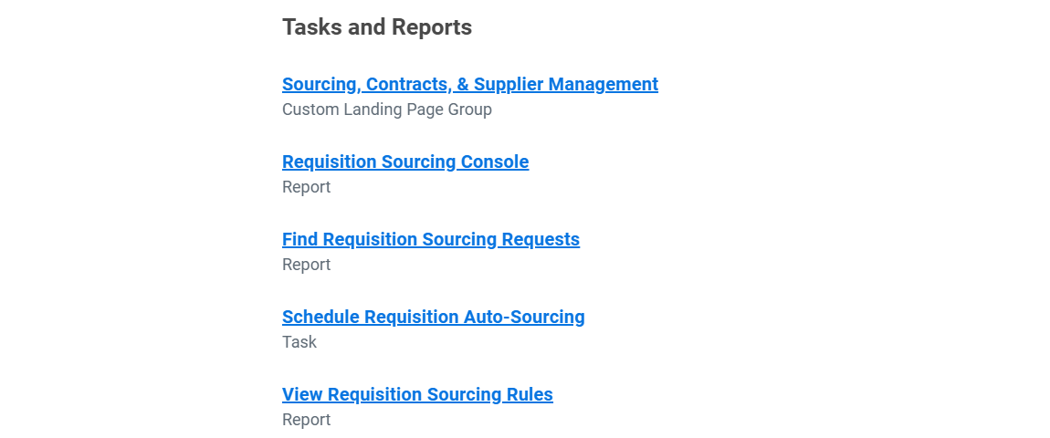
Navigate the Strategic Sourcing Module (Part 1 of 8)
INSTRUCTIONS
Enter Sourcing in the Search field and press Enter.
Note: University System of Georgia (USG) users complete local logon and then proceed to Step 4.
Click Sourcing, Contracts, & Supplier Management.
Note: You may need to scroll down to see the Tasks and Reports. Add this to your Apps for easier access.

Slide 3
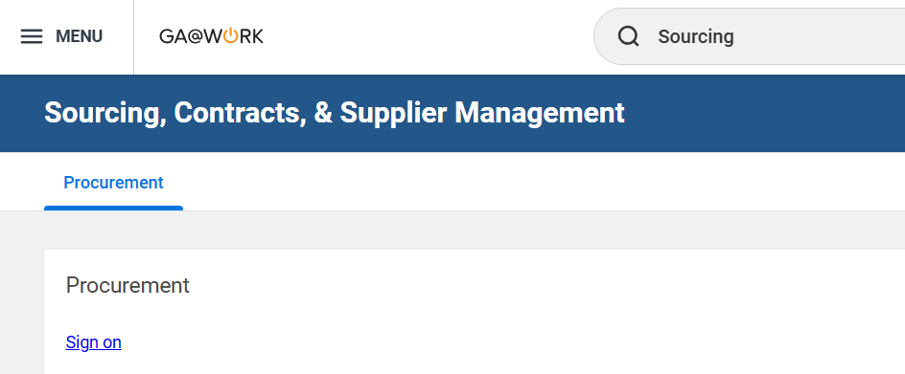
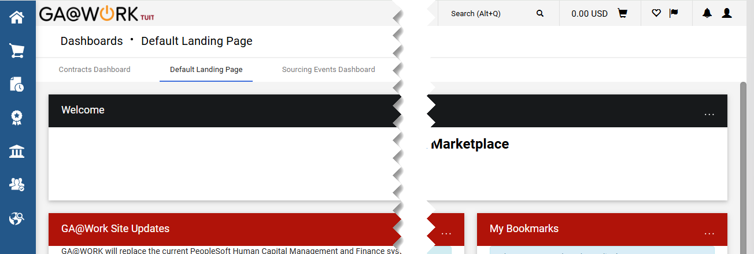
Navigate the Strategic Sourcing Module
(Part 2 of 8)
INSTRUCTIONS
Click Sign On.
Click Action Items to view your actions items.
Click Notifications to view your notifications.
Select Sourcing Events Dashboard
Note: Follow steps 7 - 9 to view the Sourcing Events Dashboard.
4
6
5

Slide 4
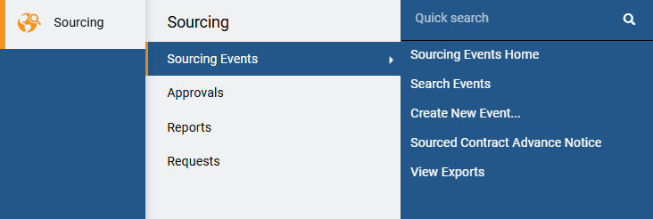
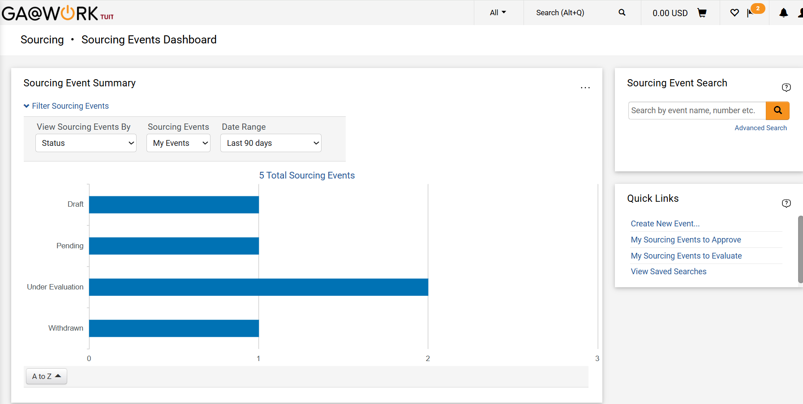
Navigate the Strategic Sourcing Module
(Part 3 of 8)
INSTRUCTIONS
Click Sourcing.
Select Sourcing Events.
Select Sourcing Events Home.
7
8
9
Select View Sourcing Events By, Sourcing Events or Date Range to customize your view of the Sourcing Event Summary.

Slide 5
Navigate the Strategic Sourcing Module
(Part 4 of 8)
INSTRUCTIONS
Enter Search Terms to perform a quick search. To search for a specific Sourcing Event, proceed to Step 13.
Note: Use the table to learn more about other sections of the Sourcing Events Dashboard.
Sourcing Events Home
Description
Sourcing Event Summary
Displays a summary of the organization's sourcing events. The summary is a bar graph and can be sorted by event type, event owner, status or supplier.
Sourcing Event Search
Allows you to perform a Sourcing Event search from the dashboard.
Quick Links
Allows you to easily access commonly used task.
Key Event Dates
Use this to view events with key event dates occurring in the previous or next seven days.

Slide 6
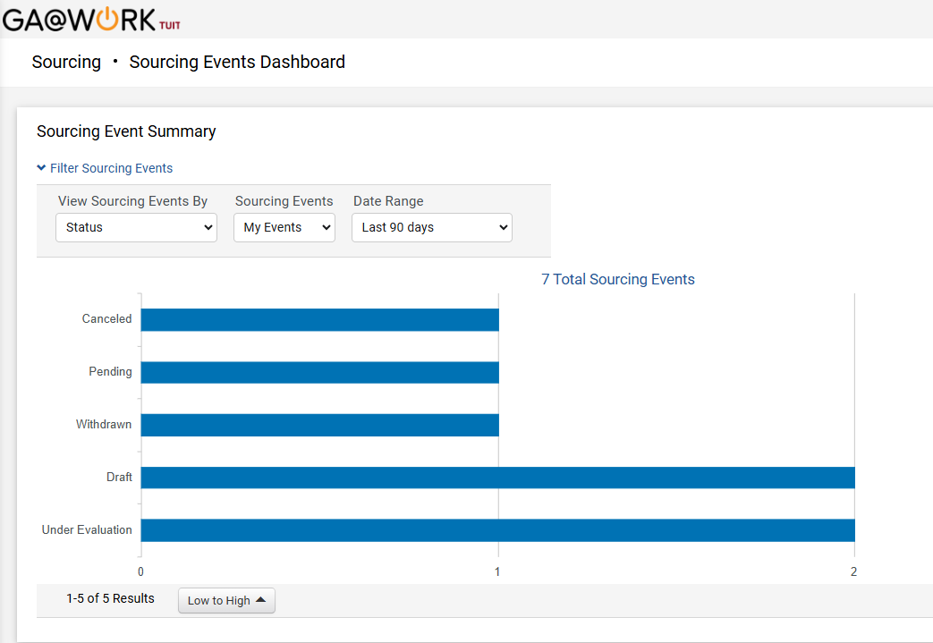
Navigate the Strategic Sourcing Module
(Part 5 of 8)
INSTRUCTIONS
Click any bar on the Sourcing Events Summary to search for the events in that category.
Note: The bar graph is categorized by the value selected in the View Sourcing Events By field. To change the categories, select a different option in that field.

Slide 7
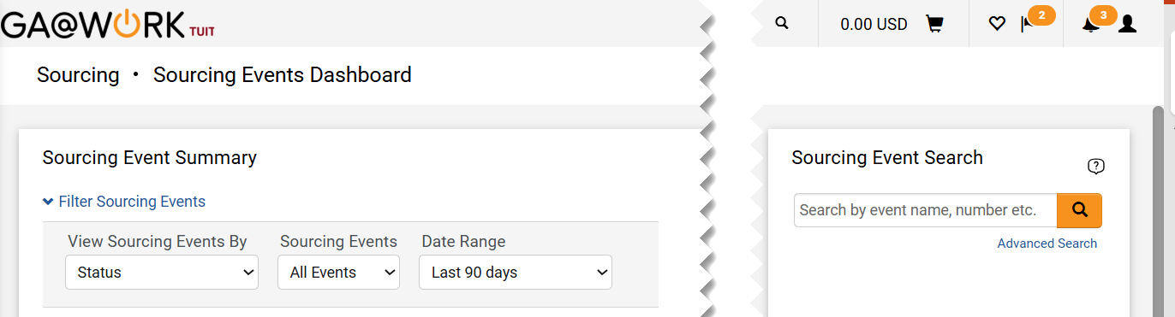
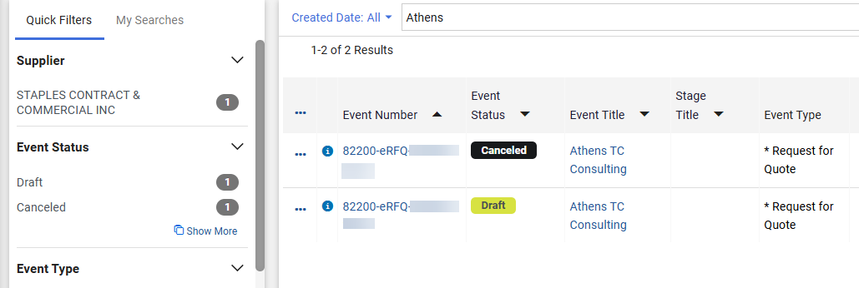
Navigate the Strategic Sourcing Module
(Part 6 of 8)
INSTRUCTIONS
Enter the Sourcing Events Search criteria.
Click Search.
Or, select Advanced Search and proceed to step 17.
13
14
15
Click the Event Number of the desired Event to view details. Skip to Step 20.

Slide 8
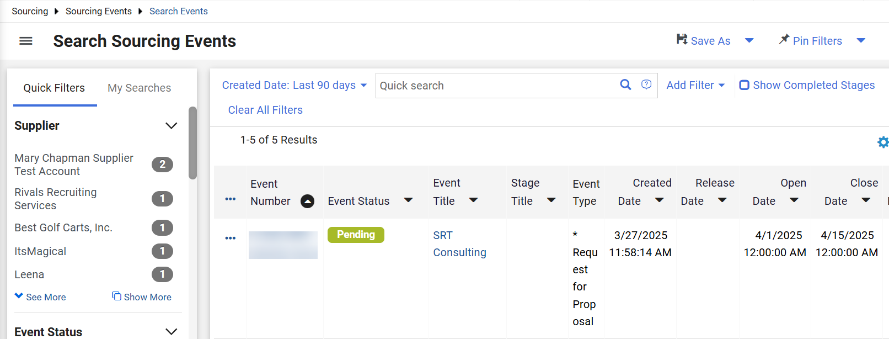
Navigate the Strategic Sourcing Module
(Part 7 of 8)
INSTRUCTIONS
For Advanced Search, filter by Created Date, Add Filter or Show Completed Stages, as applicable
Note: If you do not need to complete an Advanced Search, proceed to Step 20.
Use Quick Filters as needed to locate a Sourcing Event.
Note: Select Clear All Filters to start a new search and remove any filters.
Select the Event Number to view the Sourcing Event details.
18
17
19

Slide 9
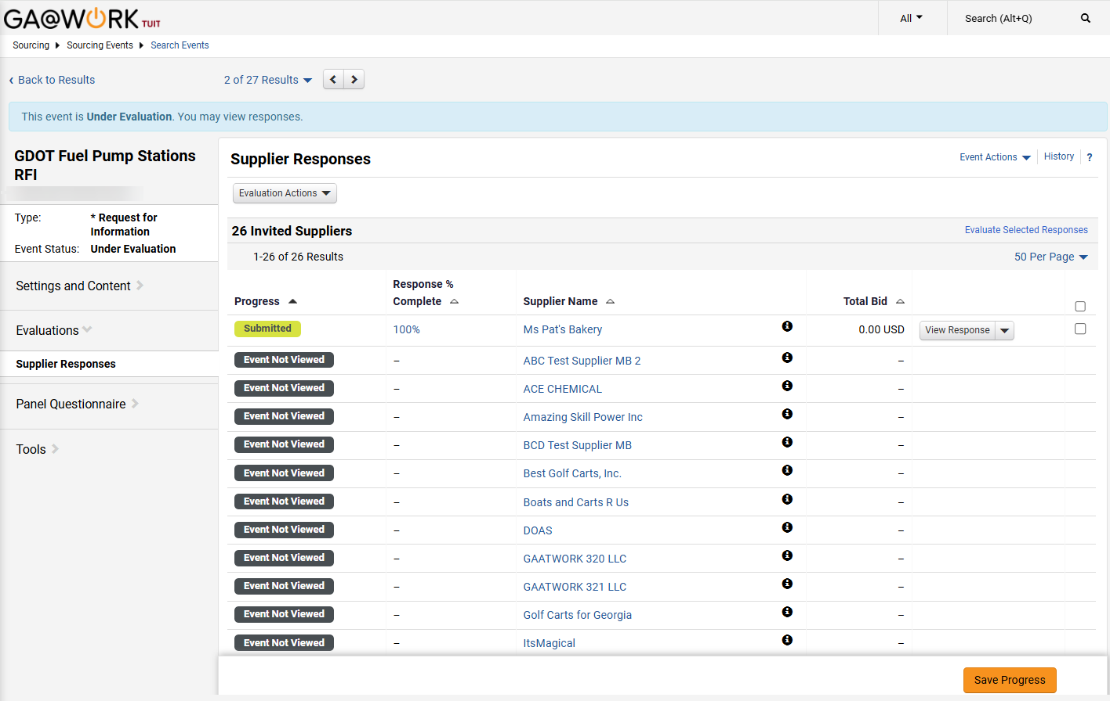

Navigate the Strategic Sourcing Module
(Part 8 of 8)
INSTRUCTIONS
Use the tabs on the left side of the screen to review/edit the event.
Note: Editing and viewing options will vary depending upon the event status and the event you are viewing.
20
You have successfully navigated the Strategic Sourcing Module and searched and viewed a Sourcing Event.

