Slide 1
Cancel a Sourcing Event and Post a Cancellation Notice
DESCRIPTION
This guide will show Sourcing Event Buyers how to Cancel a Sourcing Event at any stage and how to Post a Cancellation Notice.
OVERVIEW
The key steps in the process are below:
Locate the Sourcing Event.
Select the appropriate cancellation option from the Workflow Actions menu.
Upload and Publish the Cancellation Notice.
Business Process:
Locate the Open Event
Cancel the Event
Upload and Publish the Notice

Slide 2
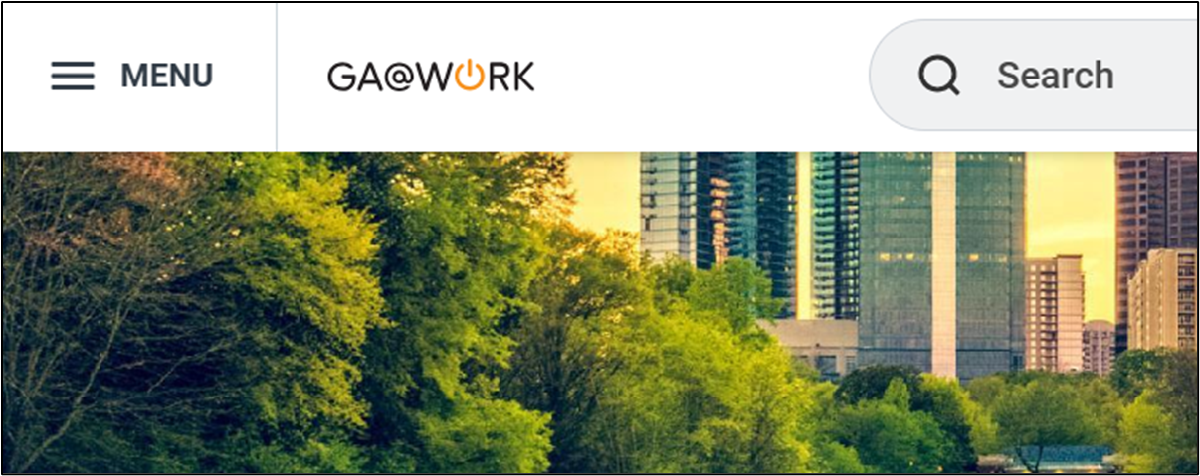
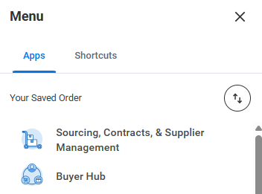
Cancel a Sourcing Event & Post a Cancellation Notice (Part 1 of 8)
INSTRUCTIONS
Click the Global Navigation Menu.
Note: University System of Georgia (USG) users complete local logon and then proceed to Step 4.
Click Sourcing, Contracts, & Supplier Management.
Note: Click Add Apps to add additional apps.

Slide 3
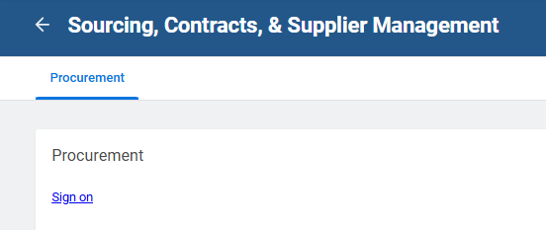
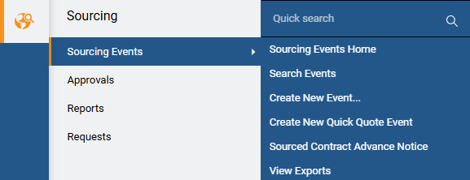
Cancel a Sourcing Event & Post a Cancellation Notice (Part 2 of 8)
INSTRUCTIONS
Click Sign On.
Click Sourcing.
Click Sourcing Events.
Click Search Events.
4
5
6

Slide 4
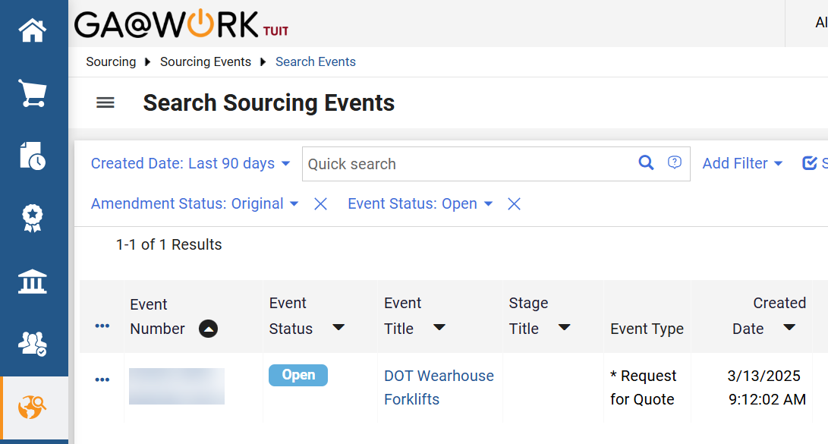
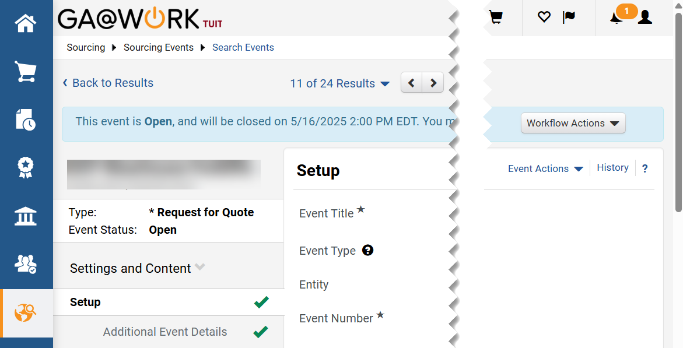
Cancel a Sourcing Event & Post a Cancellation Notice (Part 3 of 8)
INSTRUCTIONS
Locate the Sourcing Event. Select the Event Number for the event you are cancelling.
Click Workflow Actions.

Slide 5
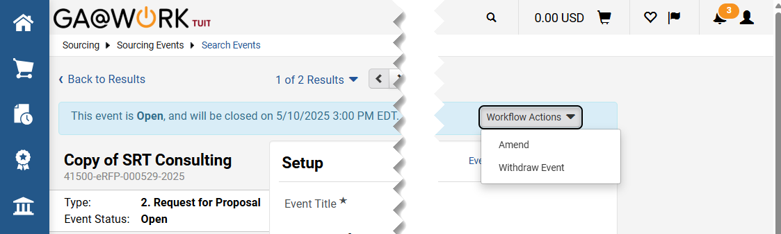
Cancel a Sourcing Event & Post a Cancellation Notice (Part 4 of 8)
INSTRUCTIONS
Click Withdraw Event.
Note: The Workflow Actions will be different based upon the status of the Sourcing Event. Use the chart below when to identify the appropriate option for cancelling an event.
Event Status
Cancellation in GA@WORK Marketplace
Draft
Delete the Event
Pending
Reject
Open
Withdraw Event
Under Evaluation
Close without Awarding
Awarded
Archive
Note: Although the buyer cannot change the status of an awarded event, the buyer can still access the Tools menu and post the Cancellation notice to the Award Notifications section.

Slide 6
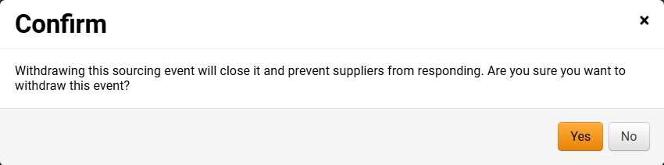
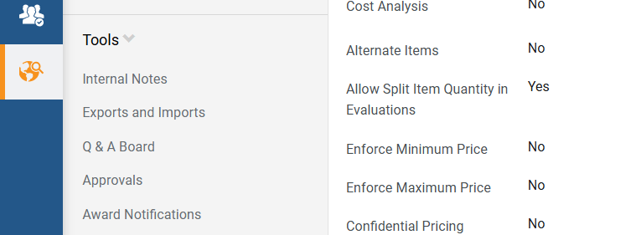
Cancel a Sourcing Event & Post a Cancellation Notice (Part 5 of 8)
INSTRUCTIONS
Click Yes.
From the Tools menu select Award Notifications.

Slide 7
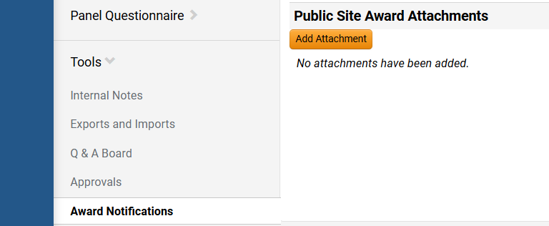
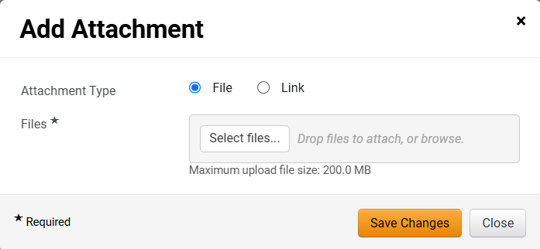
Cancel a Sourcing Event & Post a Cancellation Notice (Part 6 of 8)
INSTRUCTIONS
Click Add Attachment.
Select File or Link. Then upload the notice or enter the URL, name and description for a link.
Click Save Changes.
13
14

Slide 8
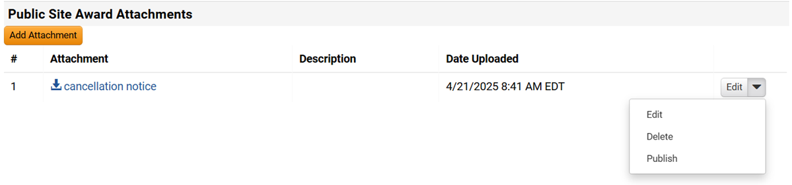
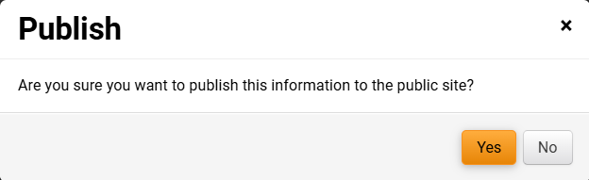
Cancel a Sourcing Event & Post a Cancellation Notice (Part 7 of 8)
INSTRUCTIONS
Click Edit.
Select Publish.
15
16
Click Yes.

Slide 9
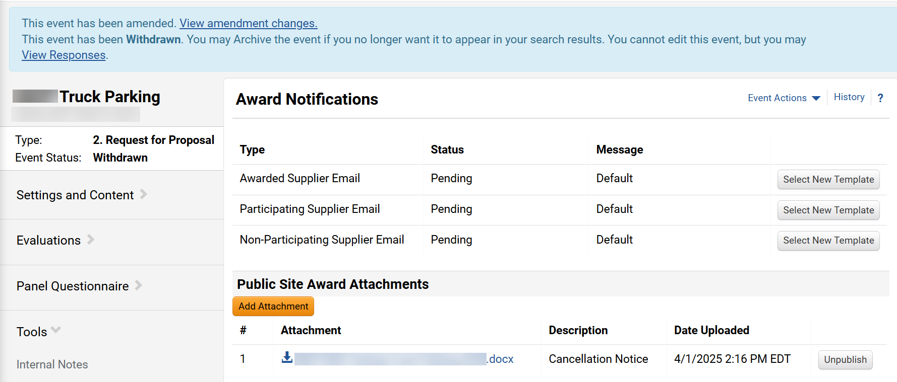

Cancel a Sourcing Event & Post a Cancellation Notice (Part 8 of 8)
INSTRUCTIONS
Verify the event has been withdrawn and the notice has been published. Note that your task has changed from Edit to Unpublish.
Note: Withdrawing an Event here will trigger an Event Status update to the Georgia Procurement Registry (GPR). Verify the event status shows in the GPR after publishing the cancellation notice.
You have successfully canceled the event and posted a cancellation notice.

