Slide 1
Amend a Sourcing Event
DESCRIPTION
This guide will show Sourcing Event Buyers how to Amend a Sourcing Event.
OVERVIEW
The key steps in the process are below:
Navigate to Sourcing.
Select Sourcing Event.
Confirm Amendment and complete the necessary fields.
Submit the Sourcing Event amendment.
Business Process:
Navigate to Sourcing Module
Select Sourcing Event
Confirm Amendment information
Submit the Sourcing Event amendment

Slide 2

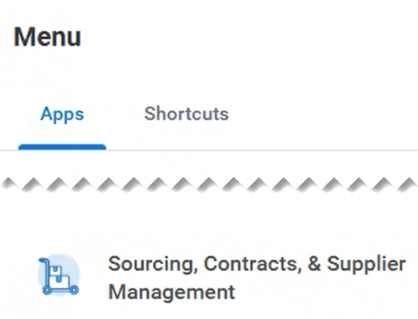
Amend a Sourcing Event (Part 1 of 10)
INSTRUCTIONS
Click the Global Navigation Menu.
Note: University System of Georgia (USG) and GDOT users complete local logon and then proceed to Step 4.
Click Sourcing, Contracts & Supplier Management.

Slide 3
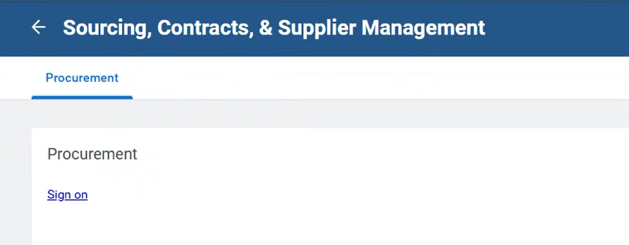
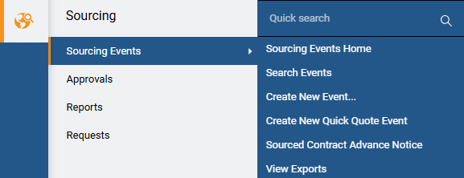
Amend a Sourcing Event (Part 2 of 10)
INSTRUCTIONS
Click Sign On.
Note: The system utilizes Single Sign-On (SSO) capabilities and no log in information is required.
Select Sourcing.
Select Sourcing Events.
Select Search Events.
4
5
6

Slide 4
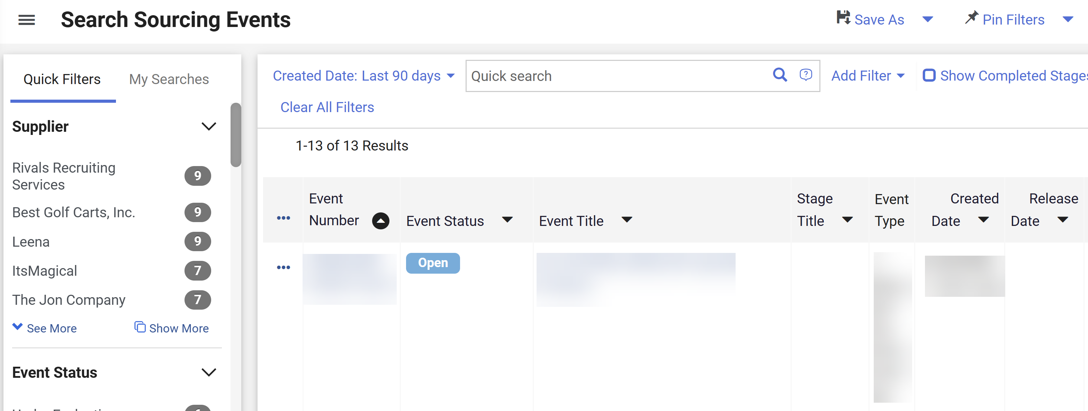
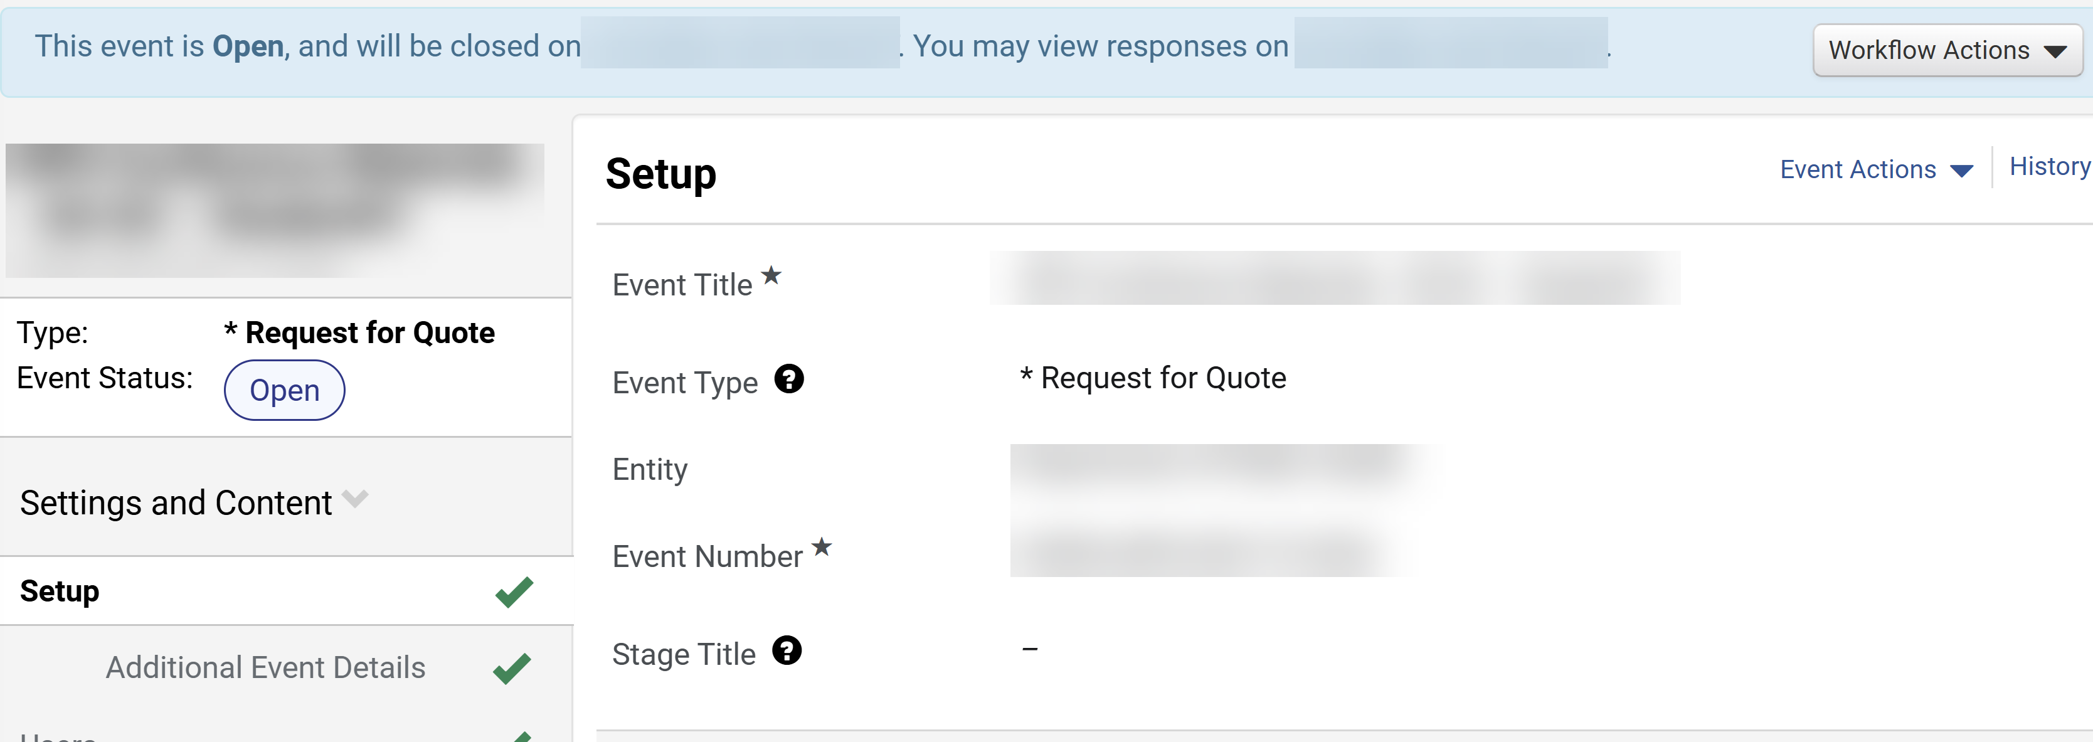
Amend a Sourcing Event (Part 3 of 10)
INSTRUCTIONS
Click the Event Number hyperlink.
Note: Use Filters to find the Sourcing Event. The Event Status must be Open.
Review Event homepage.

Slide 5
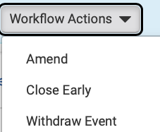
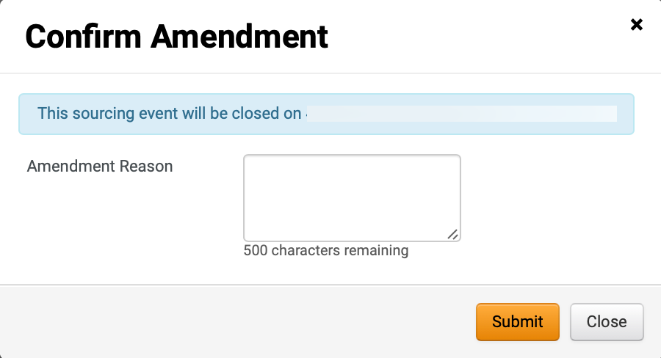
Amend a Sourcing Event (Part 4 of 10)
INSTRUCTIONS
Click Workflow Actions.
Select Amend.
Note: When an event is amended, suppliers who have already submitted bids will be required to resubmit their responses.
9
10
Enter Amendment Reason (Optional).
Note: Amendment Reason entered by the Sourcing Event Buyer will be included in email notification to invited suppliers.
Click Submit.
11
12

Slide 6
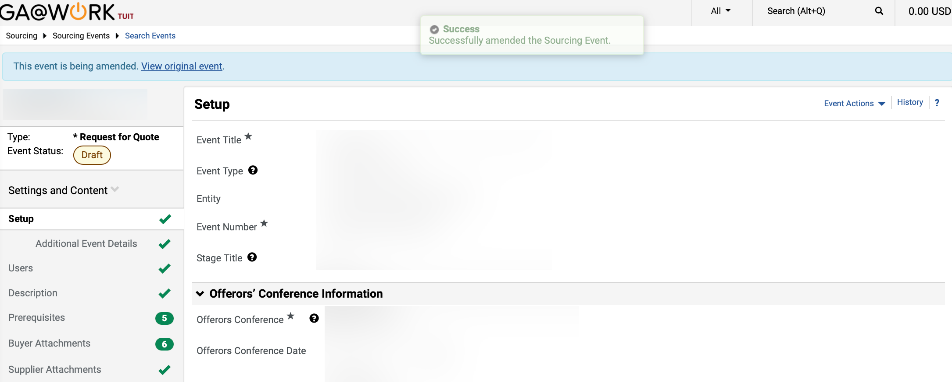
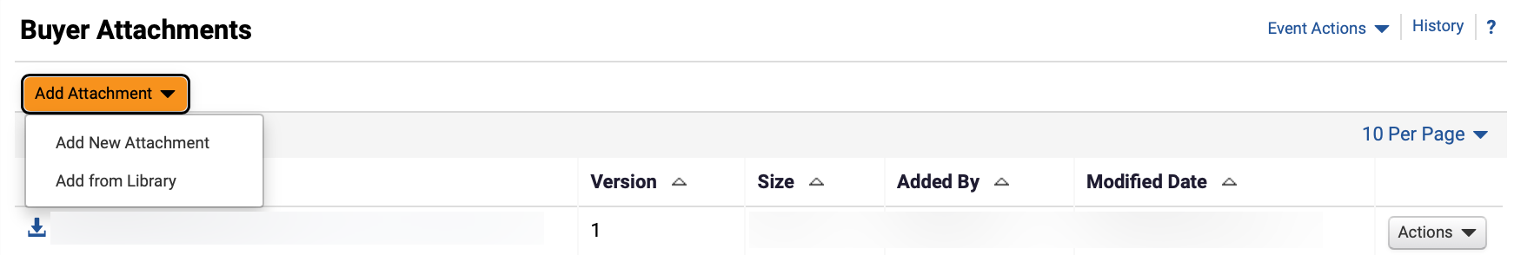
Amend a Sourcing Event (Part 5 of 10)
INSTRUCTIONS
Review Draft Event Status.
Note: Update the Sourcing Event as necessary and follow Steps 14 – 28 to add Addendum Form in Buyer Attachments.
Click Buyer Attachments.
13
14
To add SPD-SPR013 Addendum Form, click Add Attachment.
Select Add New Attachment.
15
16

Slide 7
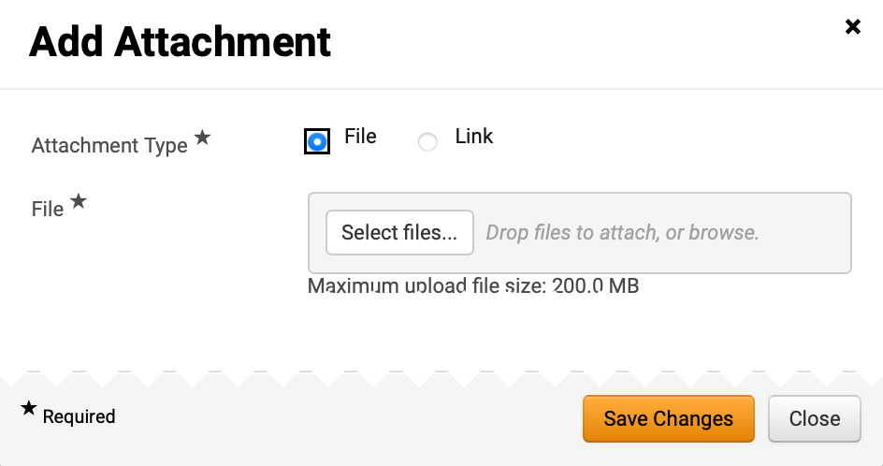
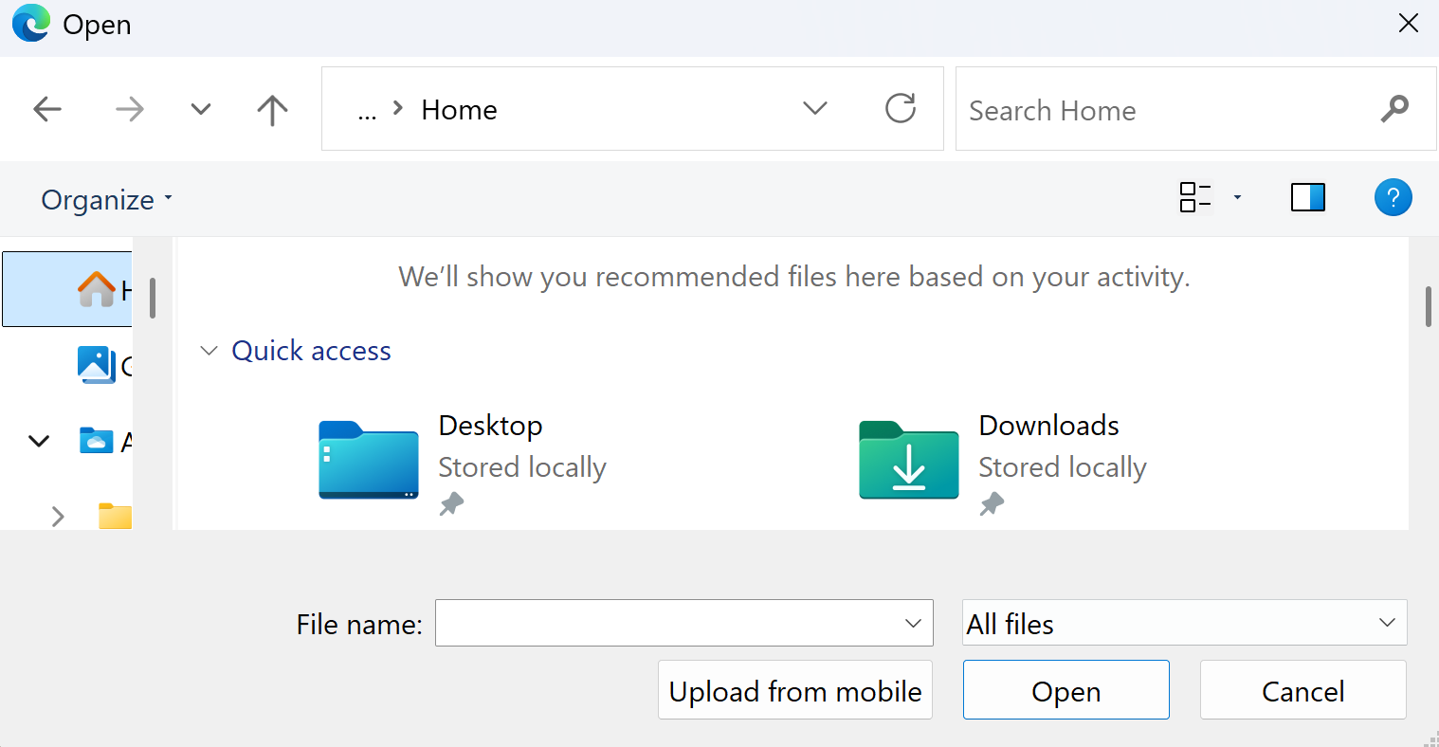
Amend a Sourcing Event (Part 6 of 10)
INSTRUCTIONS
Select Attachment Type*.
Note: If selecting File, follow Steps 18 – 24 then skip to Step 29. If selecting Link, skip to Step 25.
Click Select files… to upload File*.
17
18
Select the applicable File from local computer.
Click Open.
19
20

Slide 8
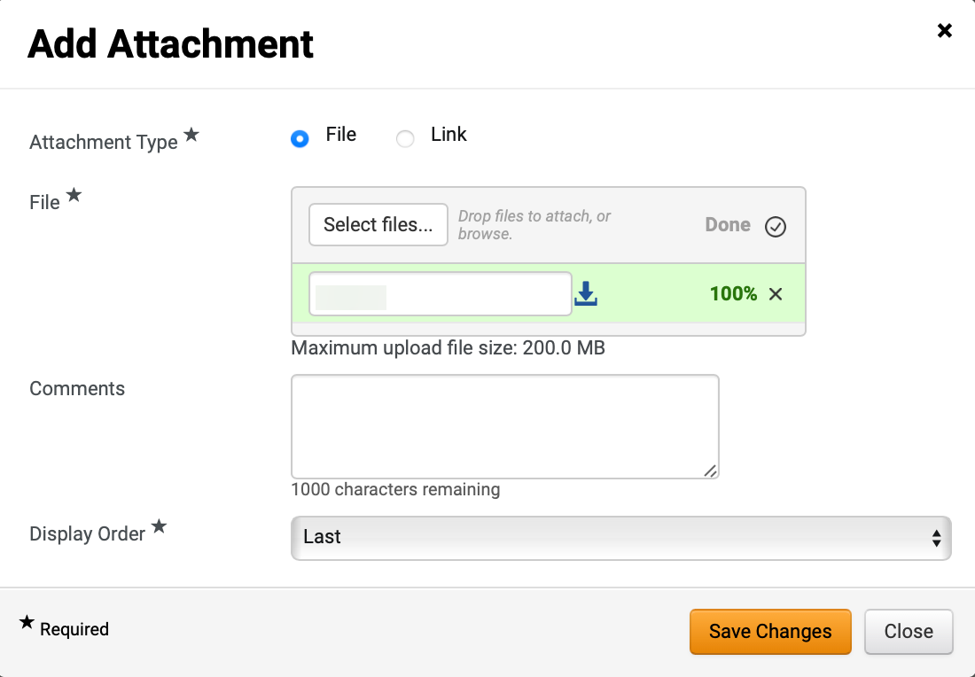
Amend a Sourcing Event (Part 7 of 10)
INSTRUCTIONS
Confirm that the uploaded File* was added.
Enter Comments (Optional).
Select Display Order*.
Click Save Changes.
21
22
23
24

Slide 9
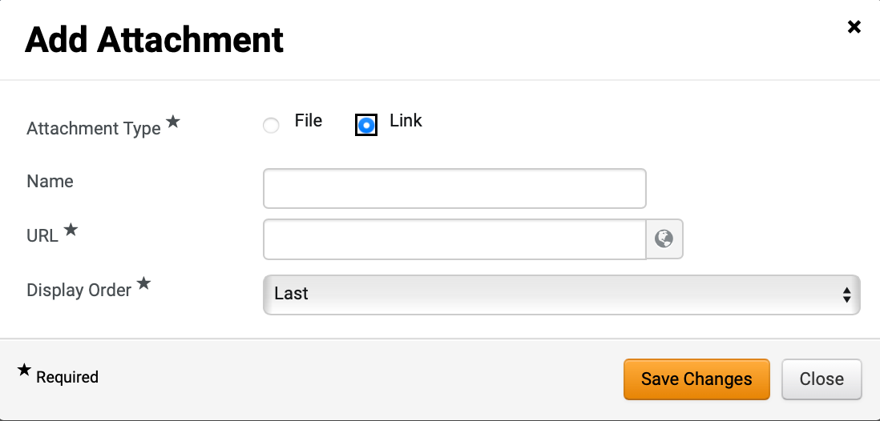
Amend a Sourcing Event (Part 8 of 10)
INSTRUCTIONS
Select Link as Attachment Type*.
Enter Name and enter URL*.
Select Display Order*.
Click Save Changes.
25
26
27
28

Slide 10
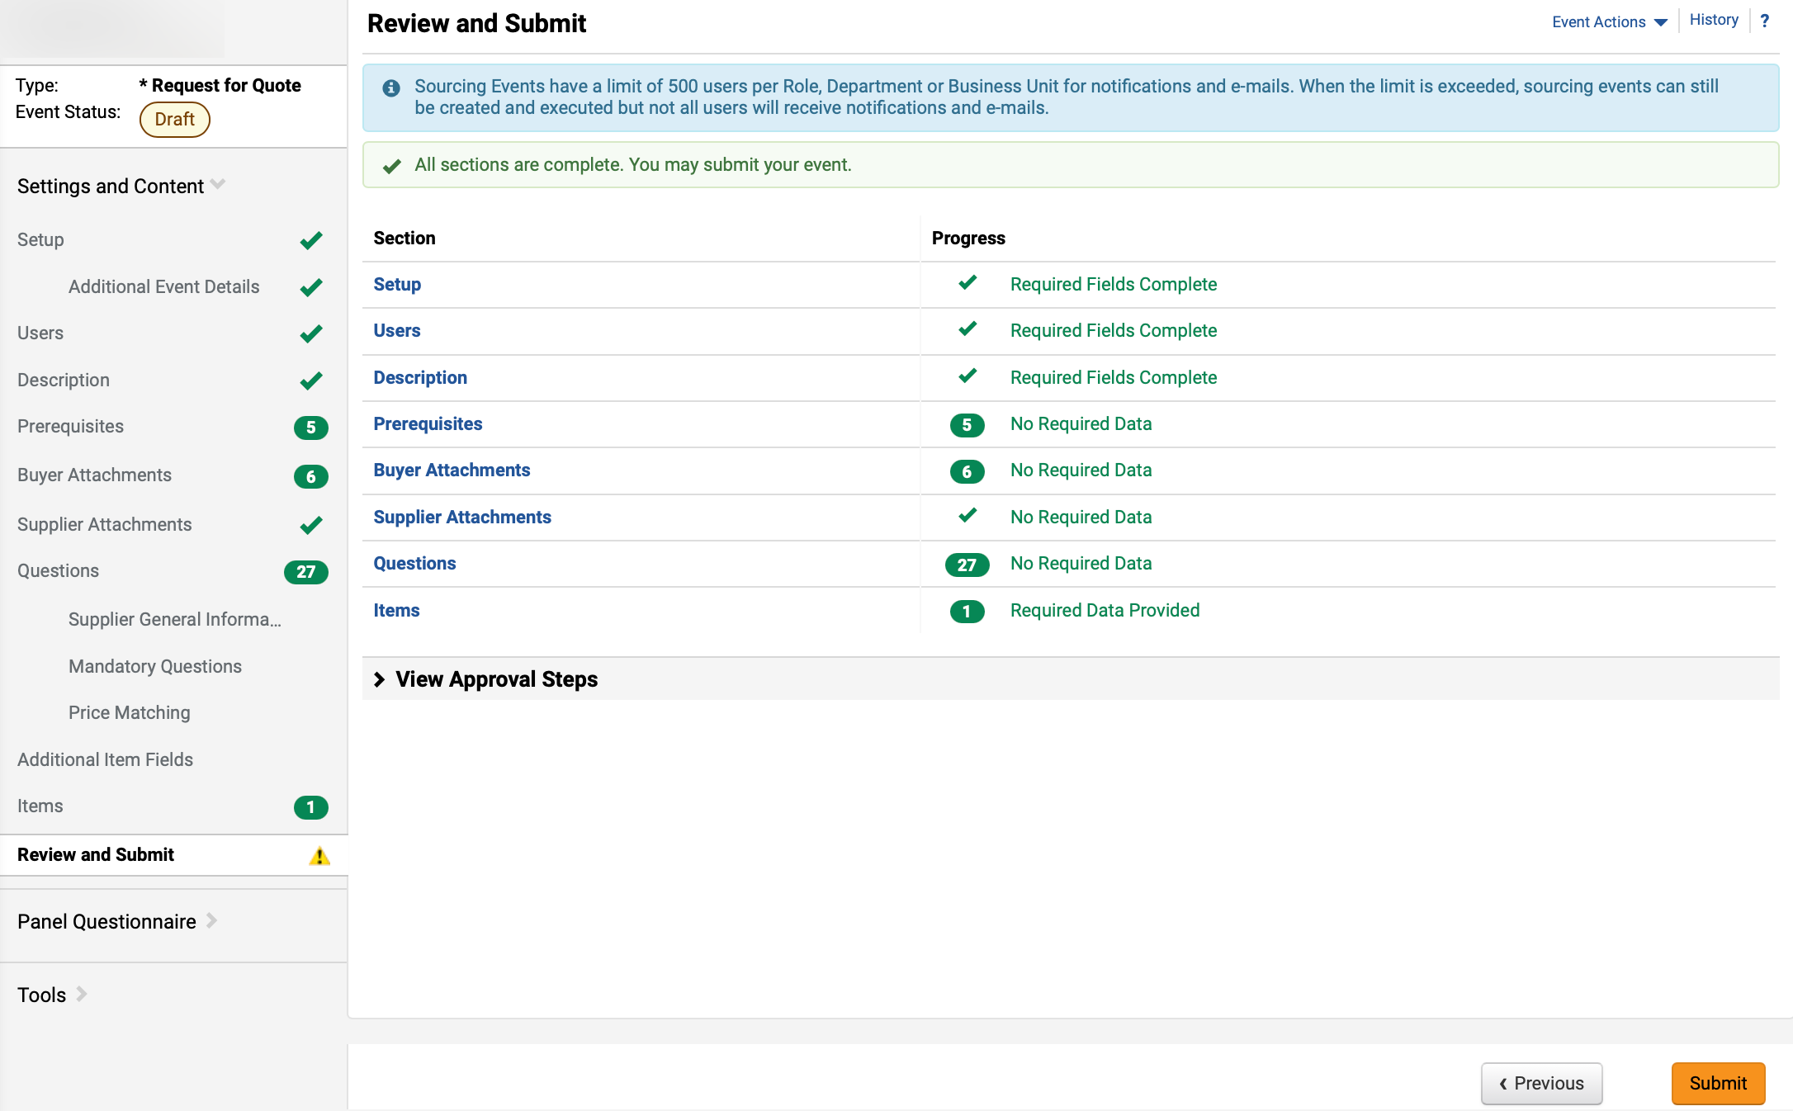
Amend a Sourcing Event (Part 9 of 10)
INSTRUCTIONS
Click Review and Submit.
Review Section and Progress.
Click Submit.
Note: An email notification will be sent to all invited suppliers that the Sourcing Event has been amended, including the Amendment Reason entered by the Sourcing Event Buyer.
30
29
31

Slide 11
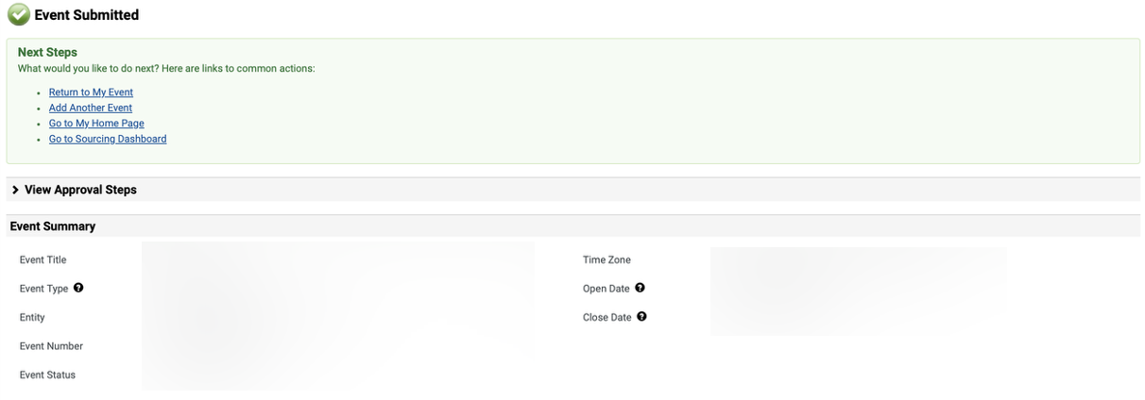
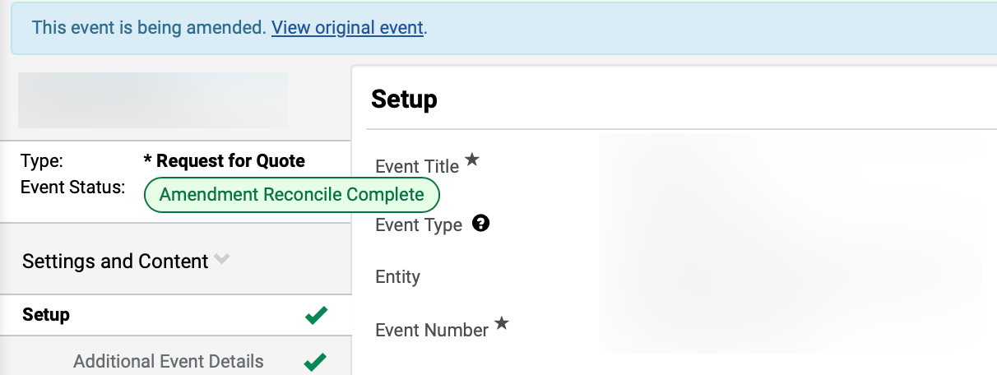
Amend a Sourcing Event (Part 10 of 10)
INSTRUCTIONS
Review Event Summary.
Click Return to My Event.
33
32
Review Amendment Event Status.
Note: In certain cases, once an Amendment is submitted, it may enter a Pending Approval status, triggering Group or SPD pre-approval workflows.
You have successfully amended a sourcing event.

