Slide 1
Create P-Card Purchase Order
(Manually, not from a Requisition)
DESCRIPTION
This guide will show Buyers how to manually Create a P-Card Purchase Order.
Note: You have the option to use the copy function to create a P-Card Purchase Order manually. The Create from Supplier Contract option should not be selected and used in GA@WORK.
OVERVIEW
The key steps in the process are below:
Select the Create Purchase Order task.
Select the Supplier*, Purchase Order Type, and update the Document Date*, if necessary.
Verify Create Blank Purchase Order is selected and click OK.
Review all Pre-Populated Fields and update, if needed.
Select the Goods Lines and Service Lines tabs and click the Plus Sign (+) to add a row.
Enter the Required Information, add Comments, if desired, and click Submit.
View the confirmation of Submission.
Business Process:
Select Create Purchase Order task
Create P-Card Purchase Order (Manually)
View Confirmation of Submission

Slide 2
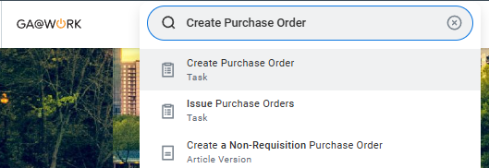
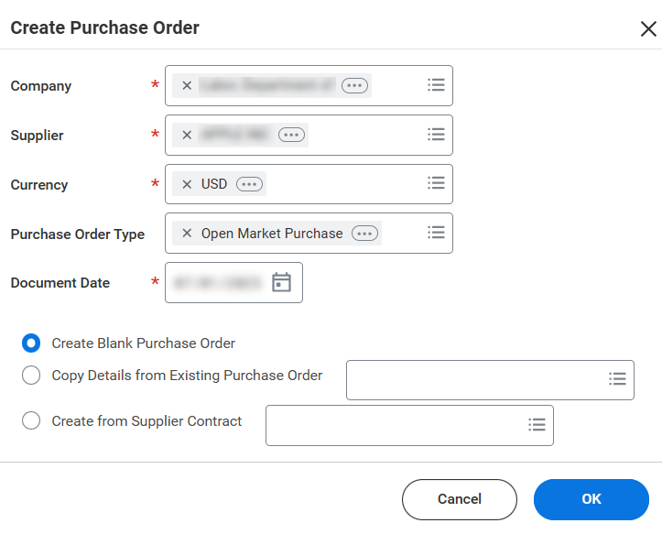
Create P-Card Purchase Order - Manually, not from a Requisition (Part 1 of 12)
INSTRUCTIONS
Enter Create Purchase Order in the Search field then press Enter.
Select Create Purchase Order task.
1
2
Select a Supplier*.
Note: Currency* defaults to USD and Company* defaults to your agency unless assigned to multiple.

Slide 3
Create P-Card Purchase Order - Manually, not from a Requisition (Part 2 of 12)
INSTRUCTIONS
Select a Purchase Order Type (e.g., Open Market Purchase).
Update the Document Date*, if necessary.
Note: Document Date* defaults to the current date.
4
5
Verify Create Blank Purchase Order is selected.
Click OK.
Note: Create from Supplier Contract is not a valid option
since Supplier Contracts will not appear as available
regardless of the type of Purchase Order selected.
6
7

Slide 4
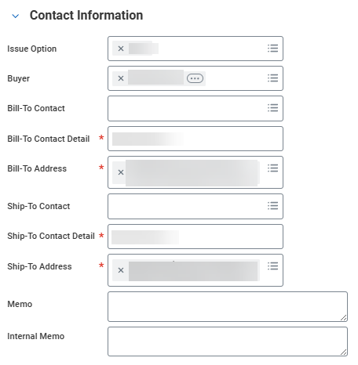
Create P-Card Purchase Order - Manually, not from a Requisition (Part 3 of 12)
In the Contact Information section, confirm the Issue Option and Buyer.
Note: The Buyer must be the cardholder to select their credit card for payment. Update any incorrect information, if necessary.
Confirm the Bill-To Contact, the Bill-To Contact Detail* and Bill-To Address*.
Confirm the Ship-To Contact Detail* and Ship-To Address*.
Note: Update any incorrect information and include additional information, if desired. Populating PO Header Memo (optional). The Memo field is visible to the Supplier on the Purchase Order but not the Internal Memo field.
8
9
10

Slide 5
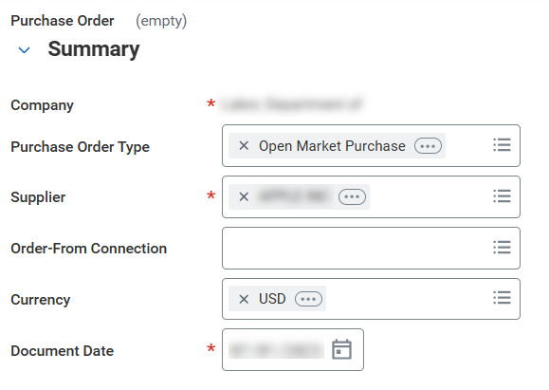
Create P-Card Purchase Order - Manually, not from Requisition (Part 4 of 12)
INSTRUCTIONS
In the Summary section, confirm the Company*.
Confirm the Purchase Order Type.
Confirm the Supplier*
Confirm the Document Date*.
Note: Update any incorrect information and include any additional information, if desired. For Order-From Connection always select a NON-EDX value to ensure the Issue Option does not default to XML.
11
12
13
14

Slide 6
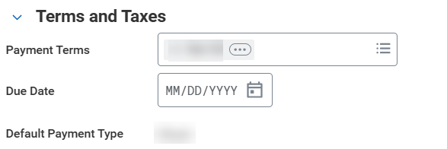
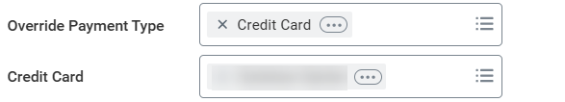
Create P-Card Purchase Order - Manually, not from Requisition (Part 5 of 12)
INSTRUCTIONS
In the Terms and Taxes section, confirm the Payment Terms.
Confirm the Default Payment Type.
Note: Update any incorrect information, if necessary.
15
16
Select Credit Card for Override Payment Type.
Select the desired Credit Card.
17
18

Slide 7
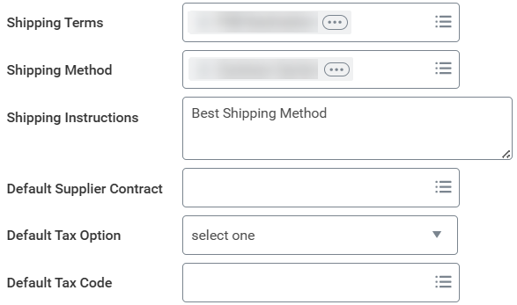
Create P-Card Purchase Order - Manually, not from Requisition (Part 6 of 12)
INSTRUCTIONS
Confirm the Shipping Terms and Shipping Method.
Confirm the Shipping Instructions.
Note: Update any incorrect information and include any
additional information, if desired.
19
20

Slide 8
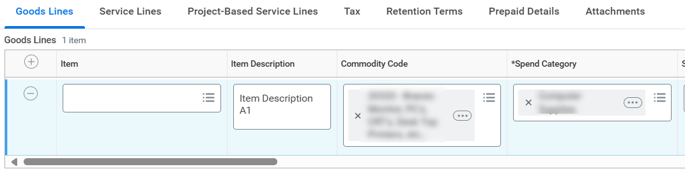
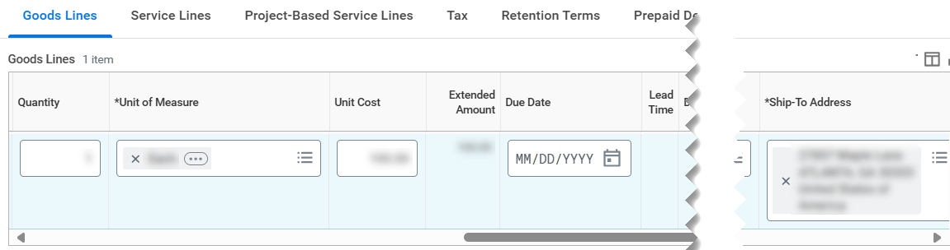
Create P-Card Purchase Order - Manually, not from Requisition (Part 7 of 12)
INSTRUCTIONS
Click Add (+)
Enter the Item Description and Commodity Code.
Select the *Spend Category, if necessary.
Note: *Spend Category may auto-populate after selecting
the Commodity Code.
21
23
22
Select a Quantity.
Select a *Unit of Measure.
Enter a Unit Cost.
Note: Verify the *Ship-To Address accurately reflects where the line items should be delivered. Link a Supplier Contract to the PO, if appropriate.
24
25
26

Slide 9
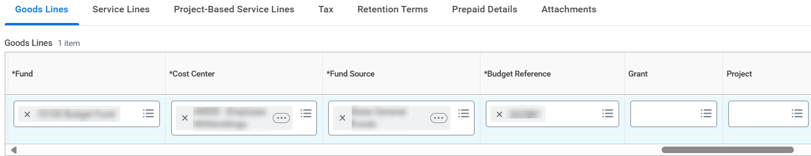
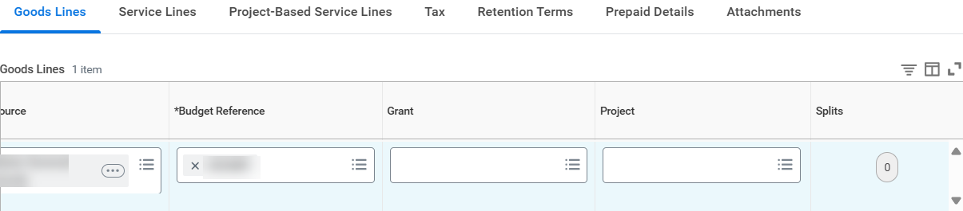
Create P-Card Purchase Order - Manually, not from Requisition (Part 8 of 12)
INSTRUCTIONS
Select a *Fund.
Select a *Cost Center.
Select a *Fund Source.
Select a *Budget Reference.
Note: Specify Grant, Project, Program and/or Additional Worktags, as appropriate.
27
28
29
30
Select Splits to divide across multiple budgets, if applicable.
Note: This is necessary for accurate accounting purposes.

Slide 10
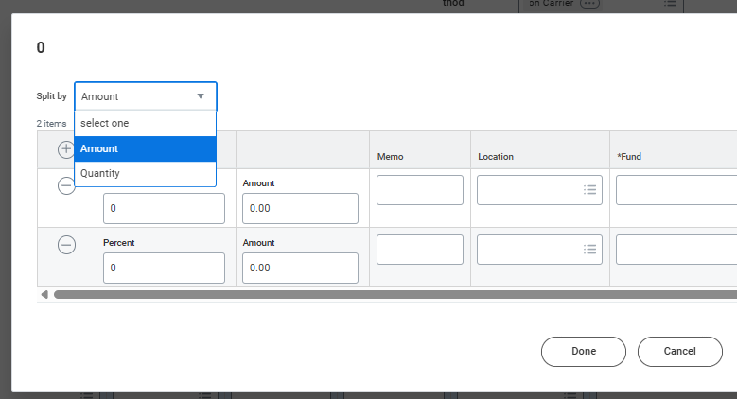
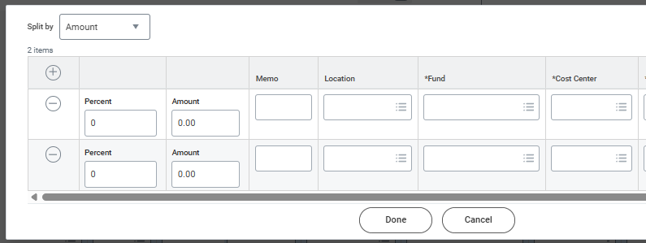
Create P-Card Purchase Order - Manually, not from Requisition (Part 9 of 12)
INSTRUCTIONS
Select the desired Split by, either Amount or Quantity.
Click Add (+) for the number of lines needed.
Enter the Amount (% or amount) or Quantity.
Note: this will vary depending on the Split by selection made in the previous step.
Select a *Fund and a *Cost Center.
34
33
35

Slide 11
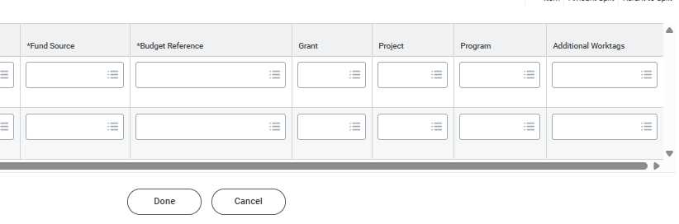
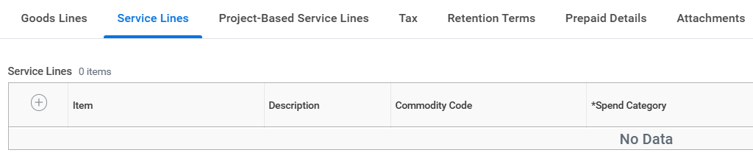
Create P-Card Purchase Order - Manually, not from Requisition (Part 10 of 12)
INSTRUCTIONS
Select a *Fund Source and *Budget Reference.
Click Done.
Note: Include additional information, if desired.
36
37
Select the Service Lines tab.
Note: The Service Line Obligation Amounts are liquidated by Amount vs Quantity. Click Add (+) to include another Service line, and repeat Steps 22-37, if needed.

Slide 12
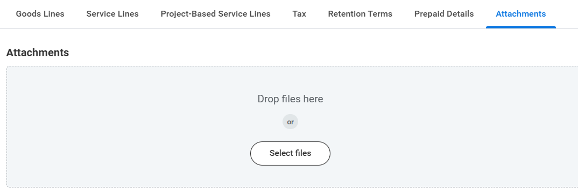
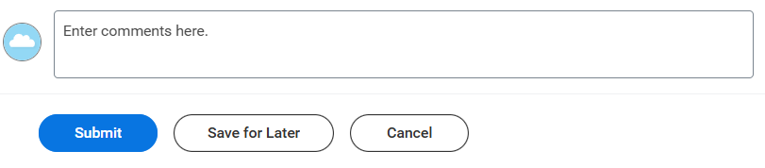
Create P-Card Purchase Order - Manually, not from Requisition (Part 11 of 12)
INSTRUCTIONS
Select the Attachments tab and include an attachment, if desired.
Enter Comments, if desired.
Click Submit.
Note: You may Save for Later if the Purchase Order is not
ready for approval and processing.
40
41

Slide 13
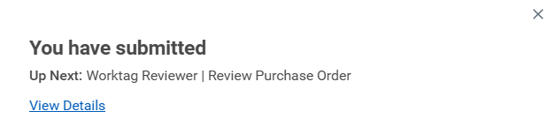

Create P-Card Purchase Order - Manually, not from Requisition (Part 12 of 12)
INSTRUCTIONS
View the confirmation of Submission, if desired.
Note: Click View Details for more information regarding the
Submission, if desired.
You have successfully created a P-Card purchase order manually, not from an existing requisition.

