Slide 1
Guest Search of Statewide Contracts in GA@WORK Marketplace
DESCRIPTION
This guide will show Guests, such as local government representatives, how to search for Statewide Contracts in GA@WORK Marketplace.
OVERVIEW
The key steps in the process are below:
Access the Contracts module.
Click Contracts.
Search Contracts.
Review Search Contracts.
Business Process:
Access Contracts Module
Click Contracts
Search Contracts
Review Search Contracts
Disclaimer: Due to regular system updates, the screens and features in GA@WORK may differ slightly from those shown in this job aid. For questions or assistance, please contact the Help Desk.

Slide 2
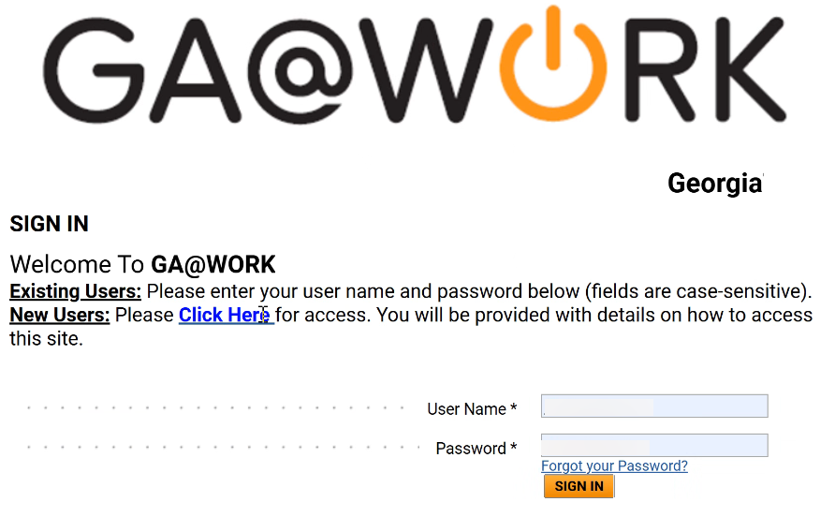
Guest Search of Statewide Contracts in GA@WORK Marketplace (Part 1 of 3)
INSTRUCTIONS
Enter User Name*.
Note: Complete all required fields marked with a black star *.​
Enter Password*.
Click Sign In.
1
2
3

Slide 3
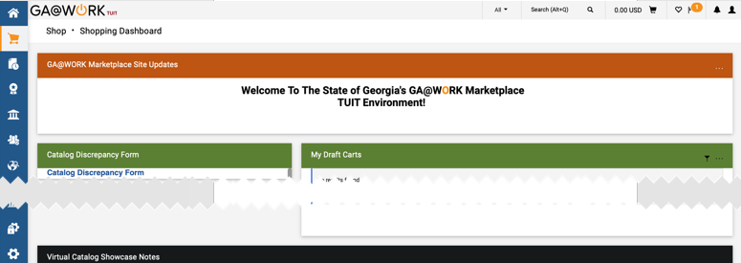
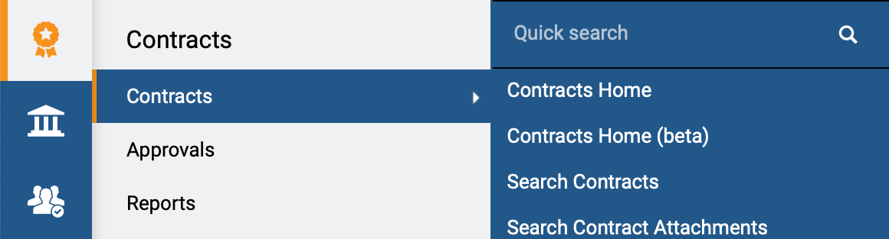
Guest Search of Statewide Contracts in GA@WORK Marketplace (Part 2 of 3)
INSTRUCTIONS
Review GA@WORK Marketplace homepage.
Access the Contracts module.
Click Contracts.
Click Search Contracts.
5
6
7

Slide 4
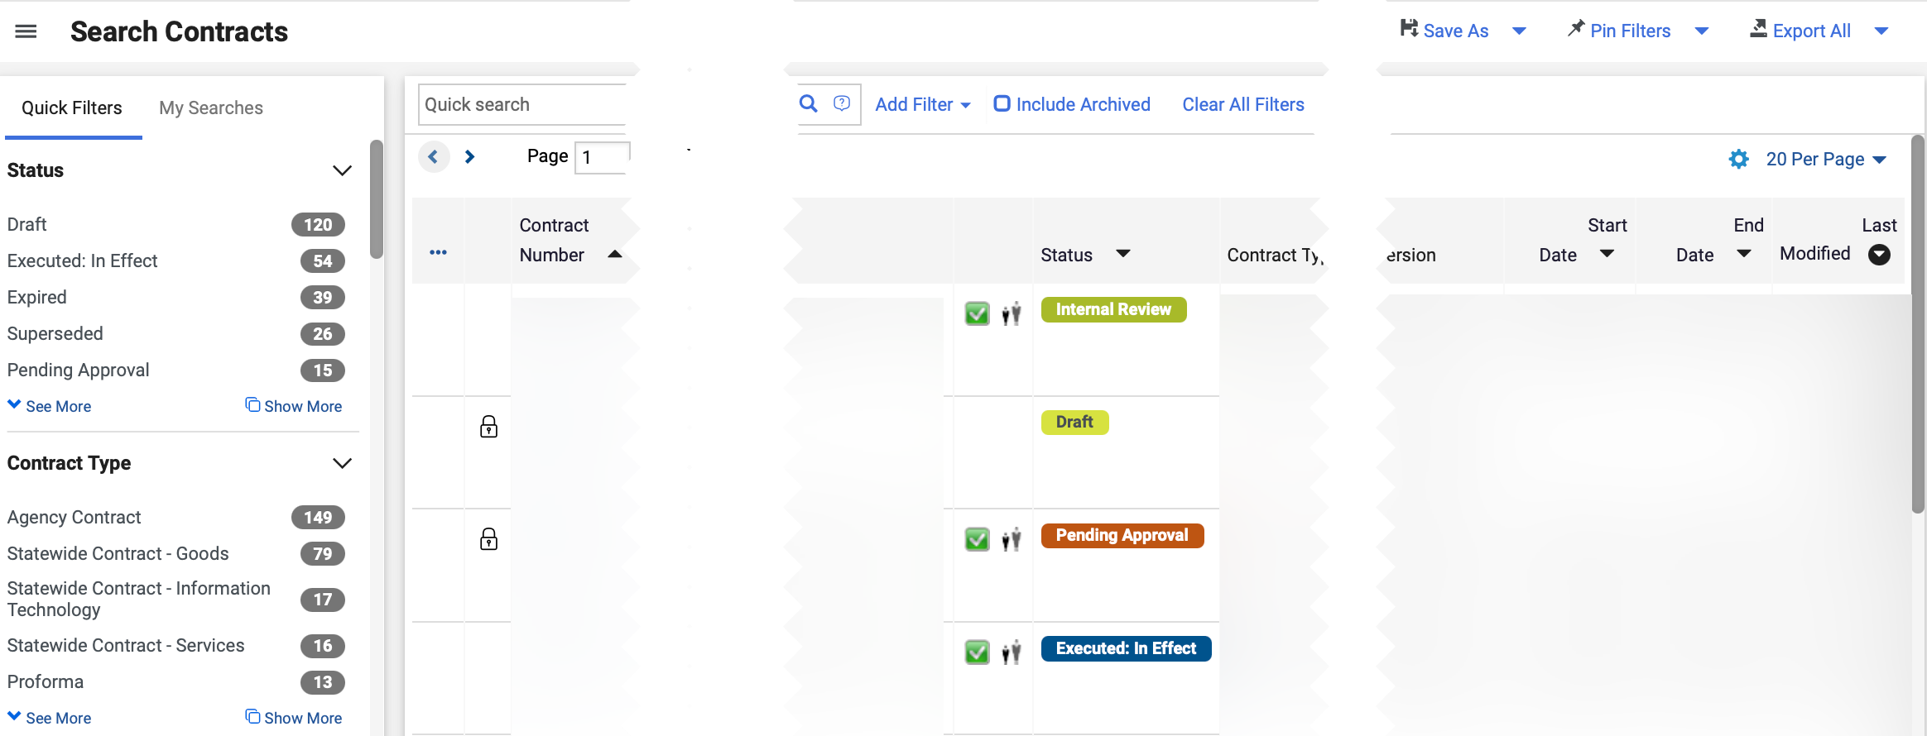

Guest Search of Statewide Contracts in GA@WORK Marketplace (Part 3 of 3)
INSTRUCTIONS
Review Search Contracts.
Note: No filters are required to display the complete list of documents; however, they can be used to reduce the number of contracts displayed. Clicking the Contract Number hyperlink will open the contract page for review.
You have successfully made a Guest Search of Statewide Contracts in GA@WORK Marketplace.

