Slide 1
Register as a Prospective Supplier in GA@WORK Marketplace for Suppliers
DESCRIPTION
This guide will show a Supplier how to Register as a Prospective Supplier in GA@WORK Marketplace for Suppliers.
OVERVIEW
The key Steps in the process are below:
Access the GA@WORK Marketplace for Suppliers.
Click Create Account.
Add Supplier Registration Information.
Supplier is registered in the GA@WORK Marketplace for Suppliers.
Business Process:
Access Supplier Portal
Create Account
Add Supplier Registration Information
Supplier is Registered

Slide 2
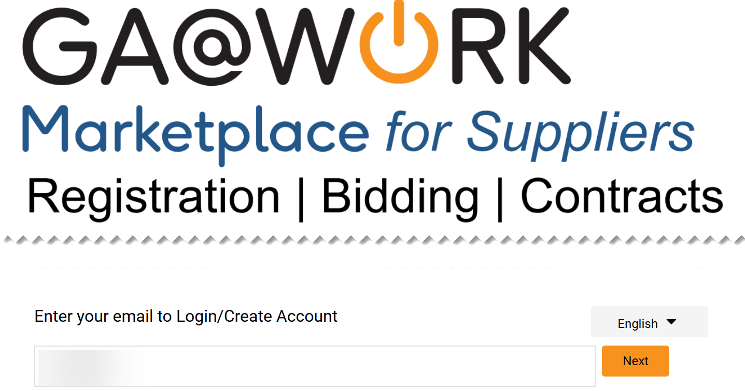
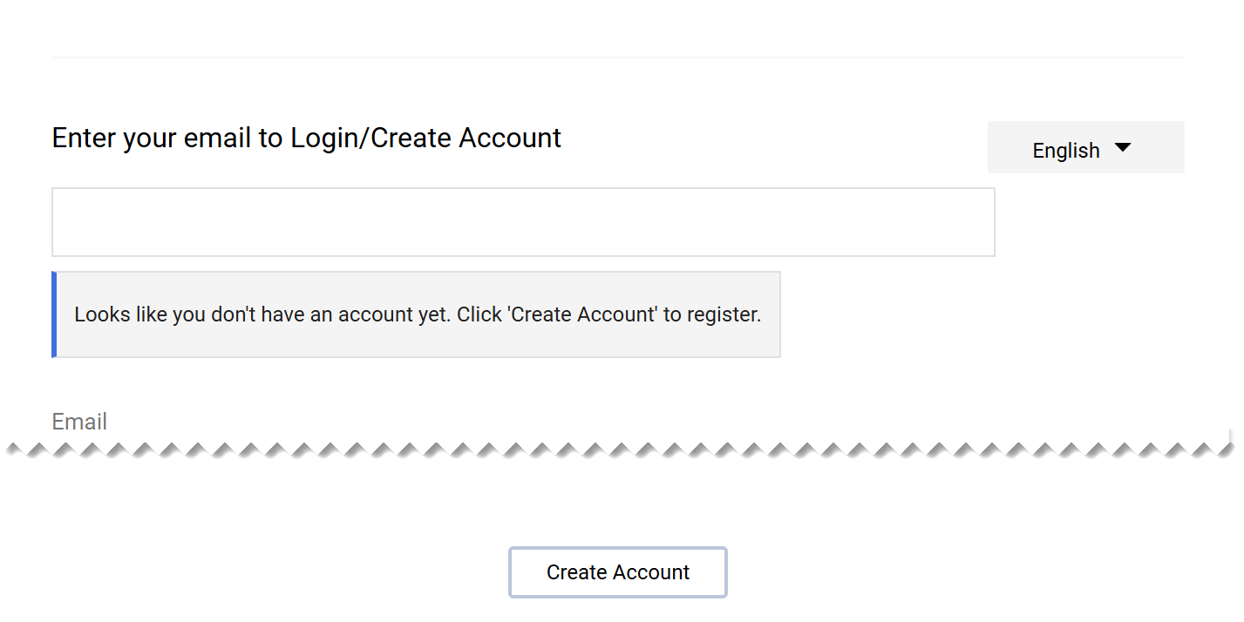
Register as a Prospective Supplier
(Part 1 of 49)
INSTRUCTIONS
Enter your Email.
Click Next.
1
2
Click Create Account.

Slide 3
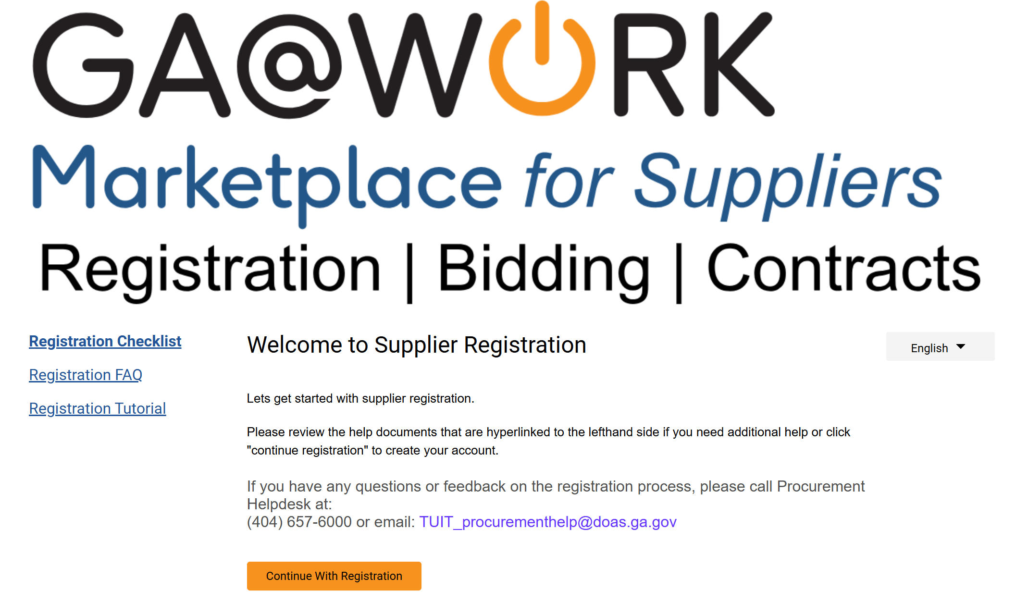
Register as a Prospective Supplier
(Part 2 of 49)
INSTRUCTIONS
Click Continue with Registration.
Note: Supplier Registration support documents are hyperlinked to the left side.

Slide 4
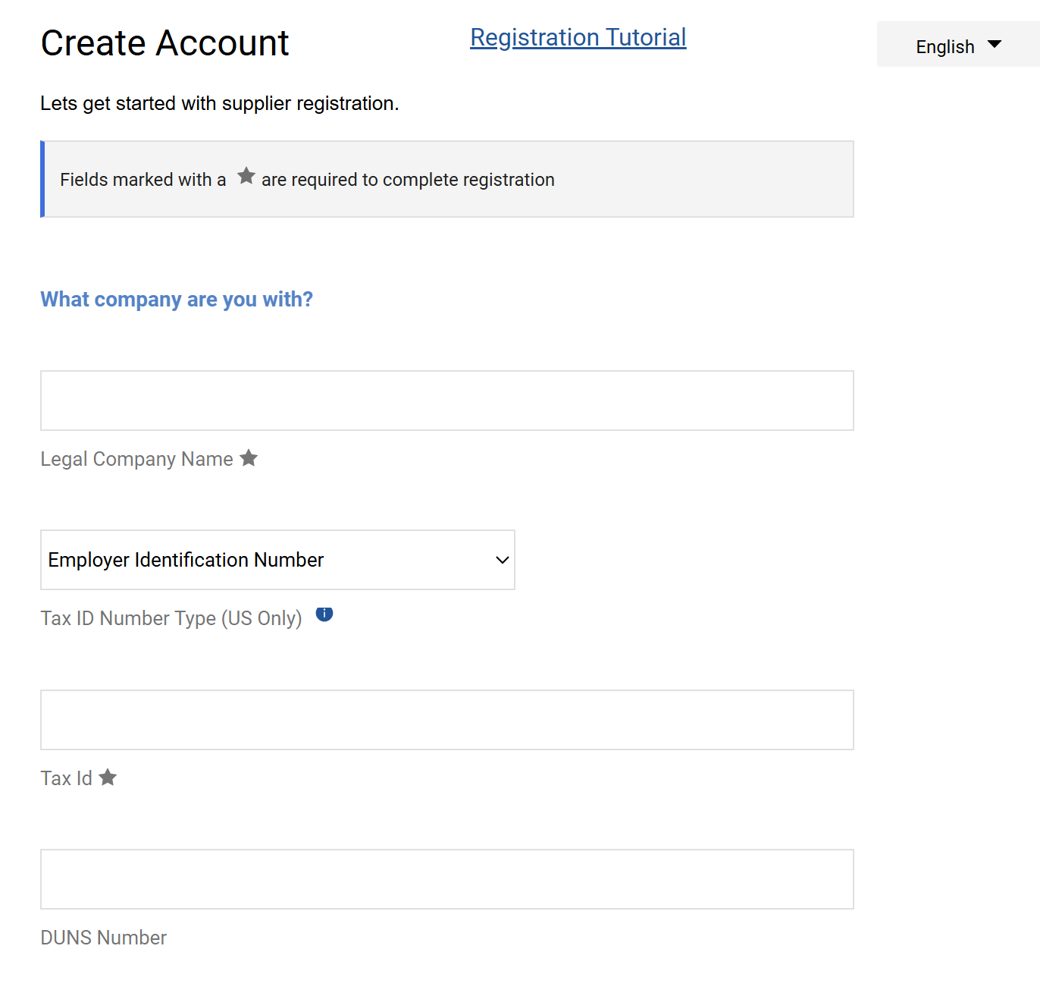
Register as a Prospective Supplier
(Part 3 of 49)
INSTRUCTIONS
Enter the Legal Company Name*.
Note: Complete all Required* fields.
Select Employer Identification Number as Tax ID Number Type (US Only).
Enter a Tax Id*.
Enter a DUNS Number (optional).
5
6
7
8

Slide 5
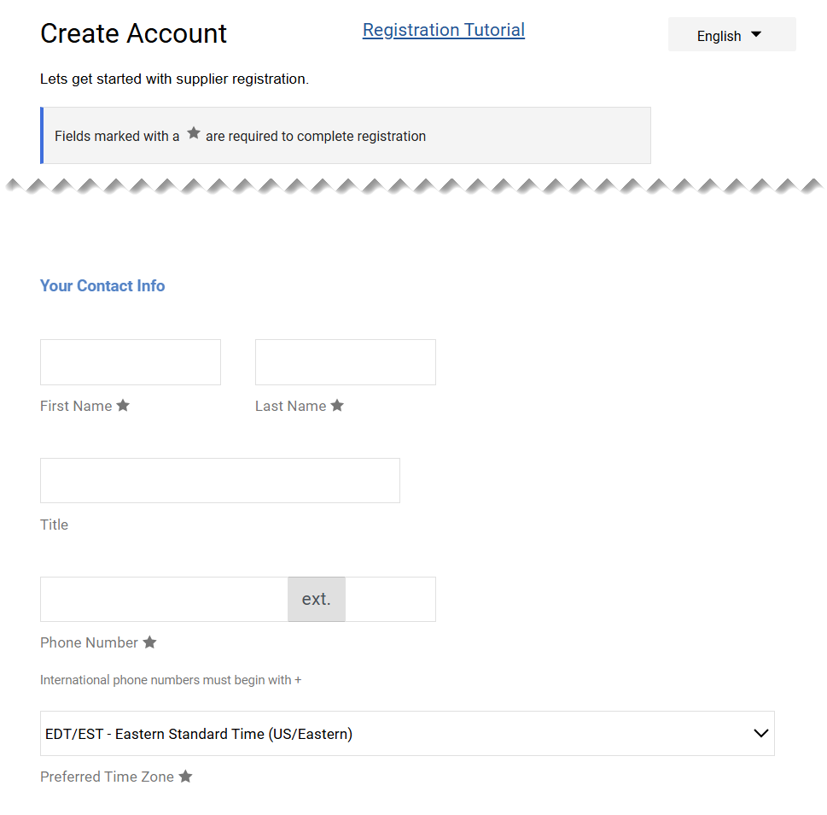
Register as a Prospective Supplier
(Part 4 of 49)
INSTRUCTIONS
Enter a First Name*.
Enter a Last Name*.
Enter a Title (optional).
Enter a Phone Number*.
Select the Preferred Time Zone*.
Note: The Preferred Time Zone will default to EDT/EST if not selected.
10
9
11
12
13

Slide 6
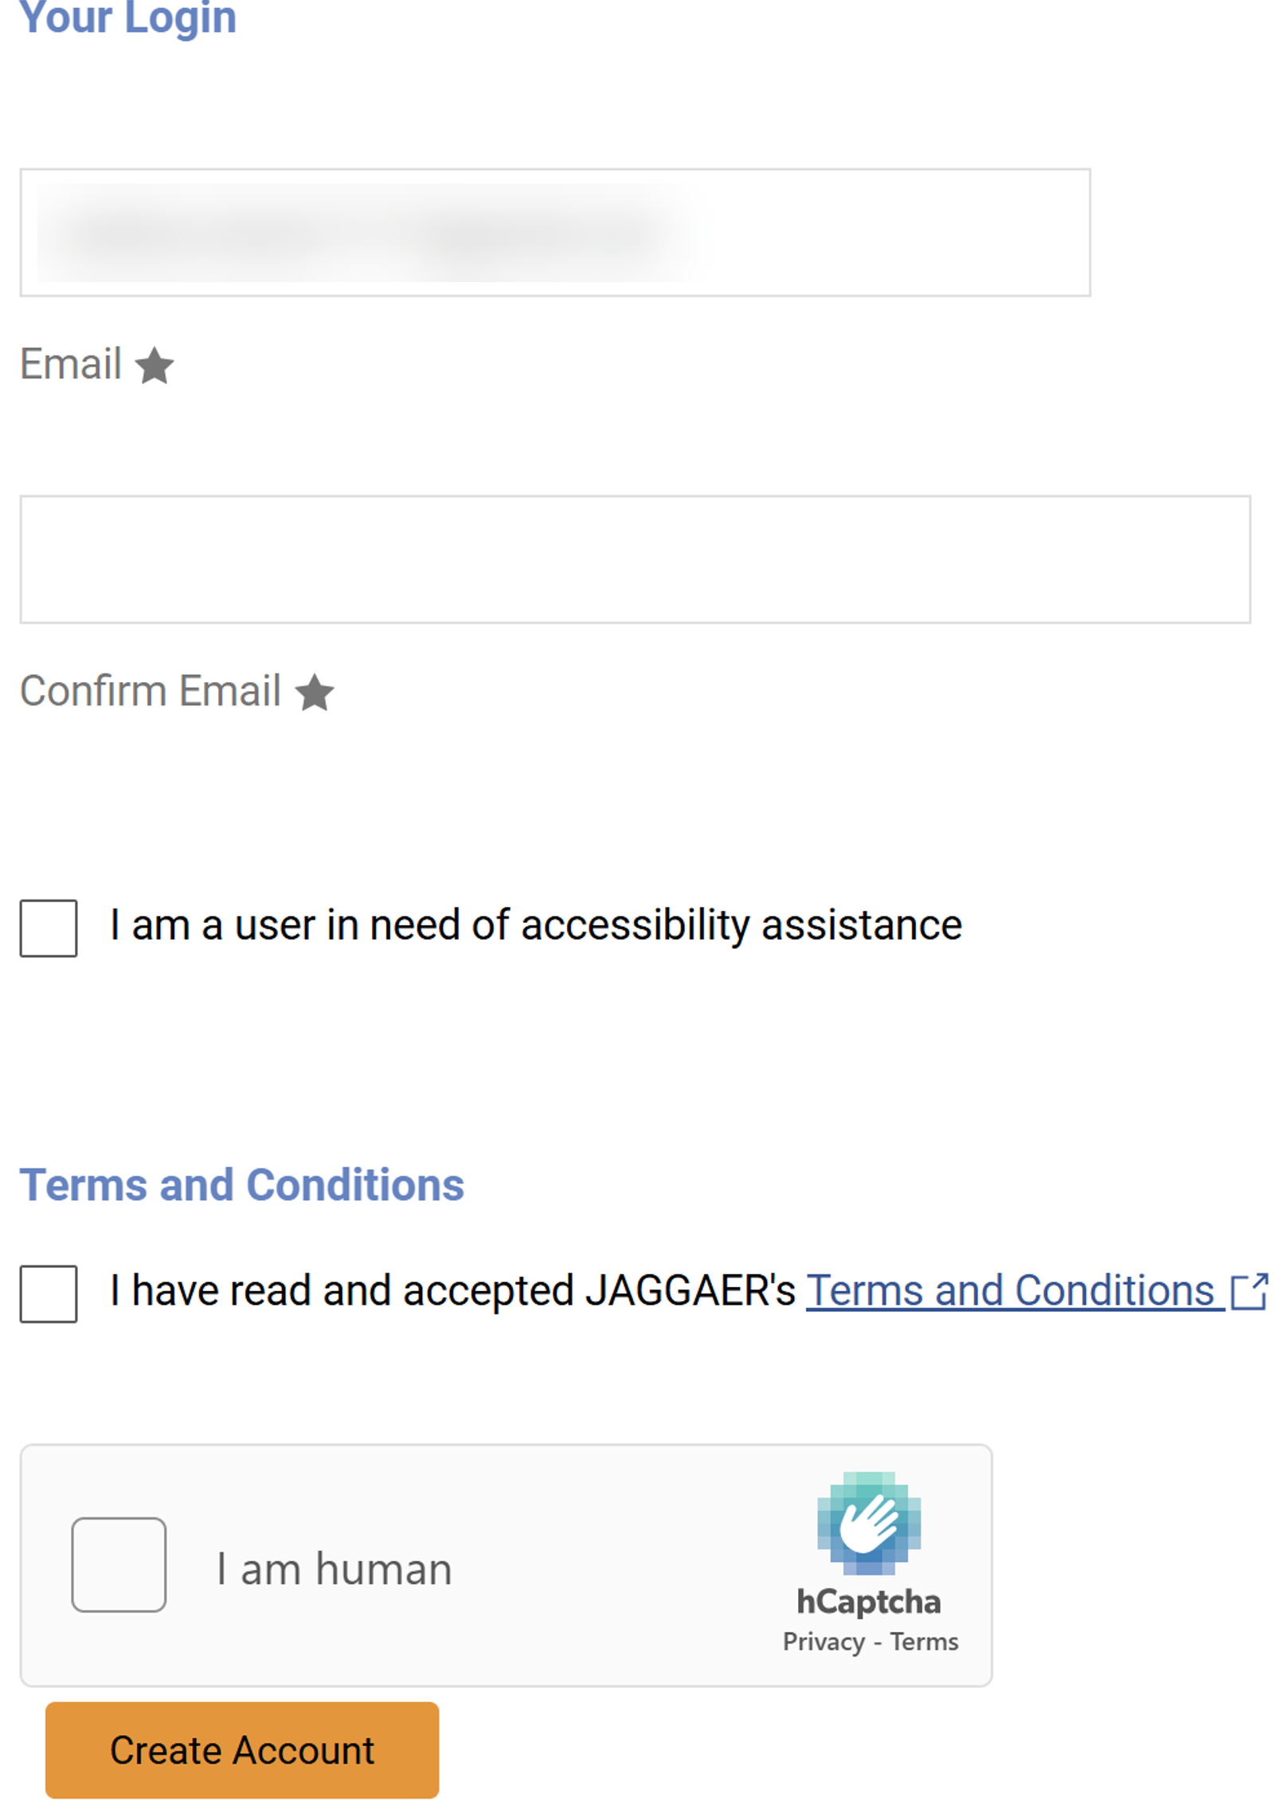
Register as a Prospective Supplier
(Part 5 of 49)
INSTRUCTIONS
Enter Confirm Email*.
Note: Email* will auto-populate with data from Step 3.
If applicable, check I am a user in need of accessibility assistance.
Check the Terms and Conditions.
Check the I am human box.
Click Create Account.
Note: Terms and Conditions and the Captcha checkbox are required to be checked before creating an account.
14
14
15
16
17
18

Slide 7
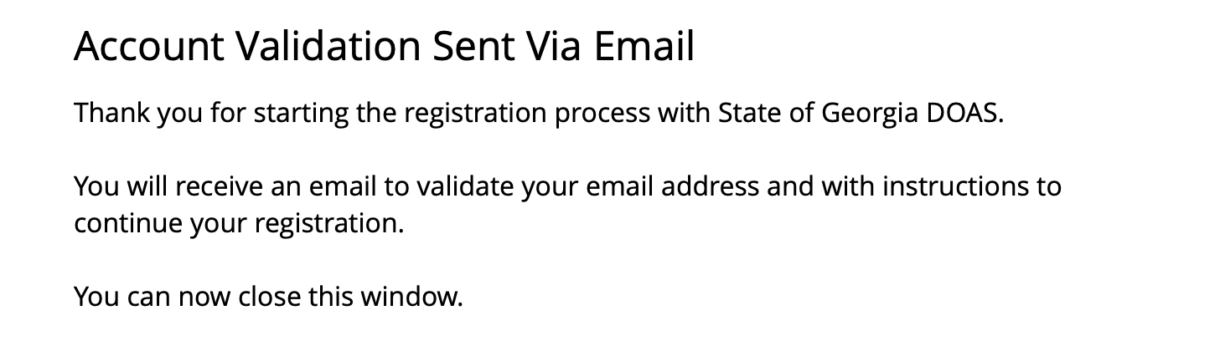
Register as a Prospective Supplier
(Part 6 of 49)
INSTRUCTIONS
Review the Account Validation Sent Via Email notification.
Note: Account Validation Email will be sent to the Email address provided during Supplier Registration (Step 14).

Slide 8
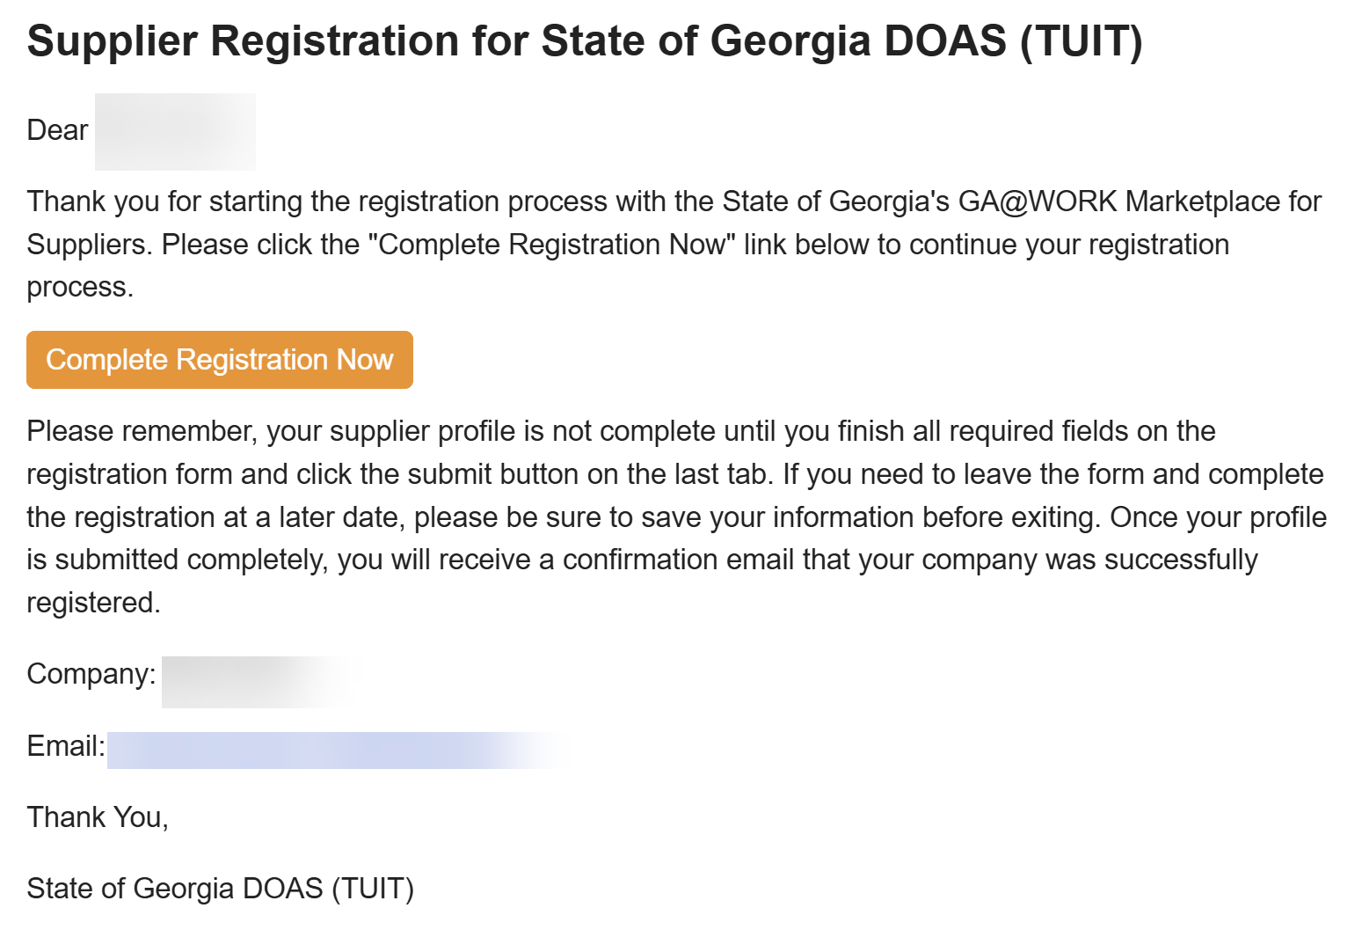
Register as a Prospective Supplier – Registration (Part 7 of 49)
INSTRUCTIONS
Review registration email and click Complete Registration Now.

Slide 9
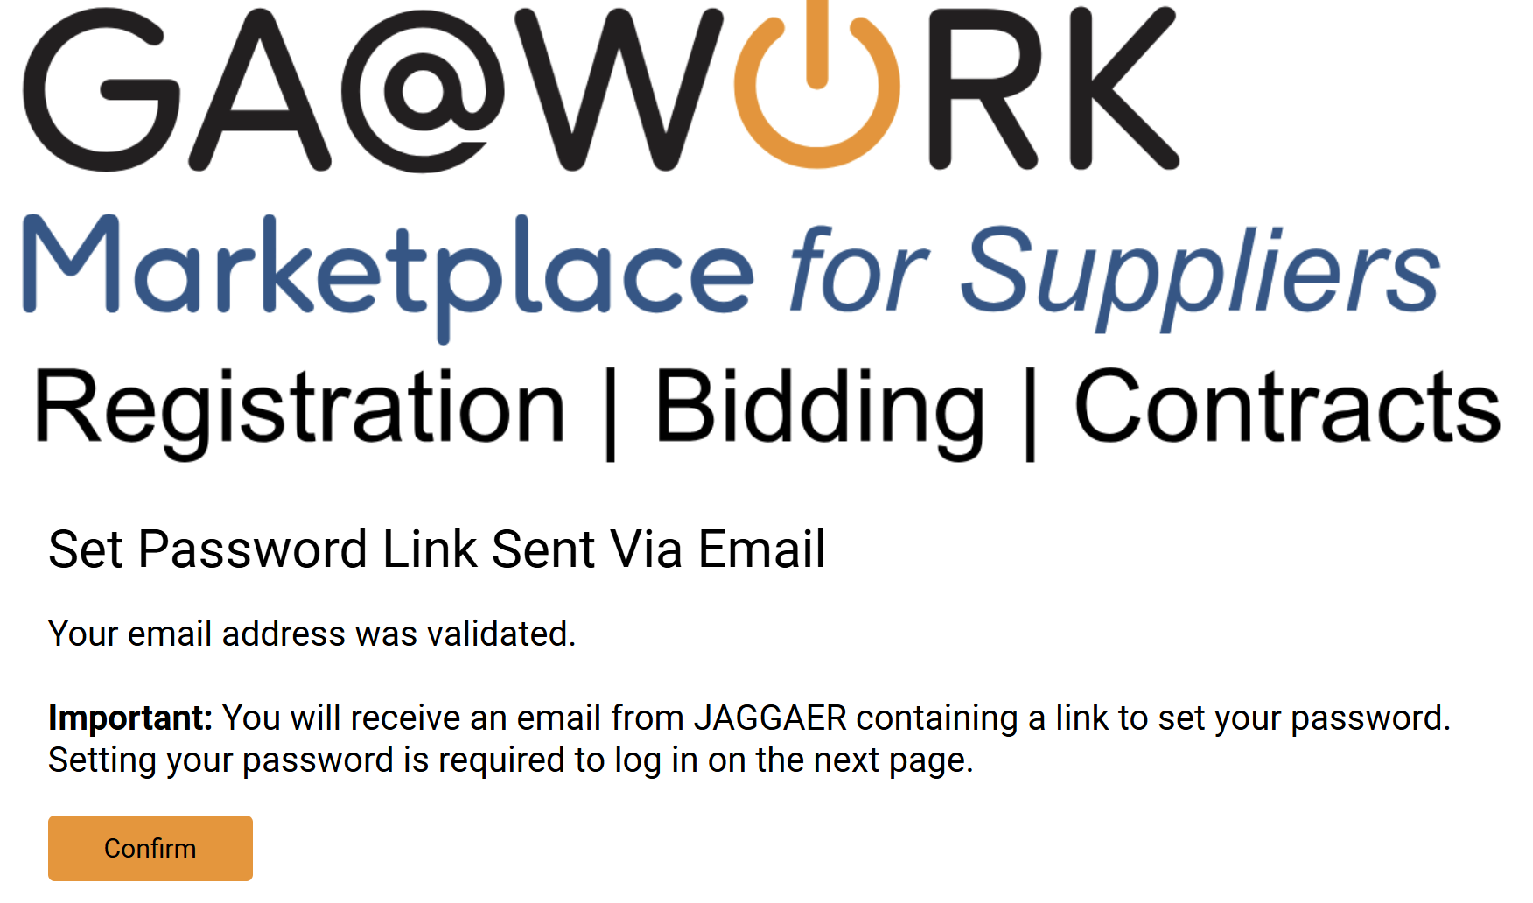
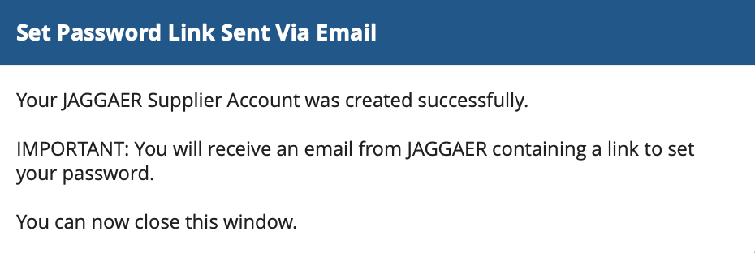
Register as a Prospective Supplier
(Part 8 of 49)
INSTRUCTIONS
Click Confirm.
Review confirmation notification and Open Email.

Slide 10
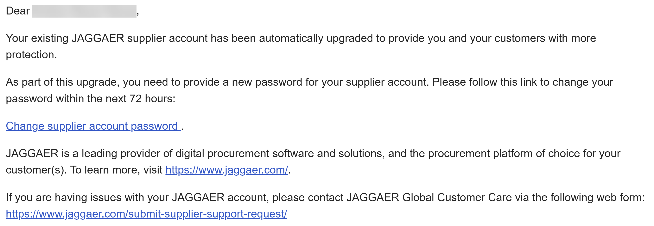
Register as a Prospective Supplier
(Part 9 of 49)
INSTRUCTIONS
Open email and click Change supplier account password hyperlink and set a password.

Slide 11
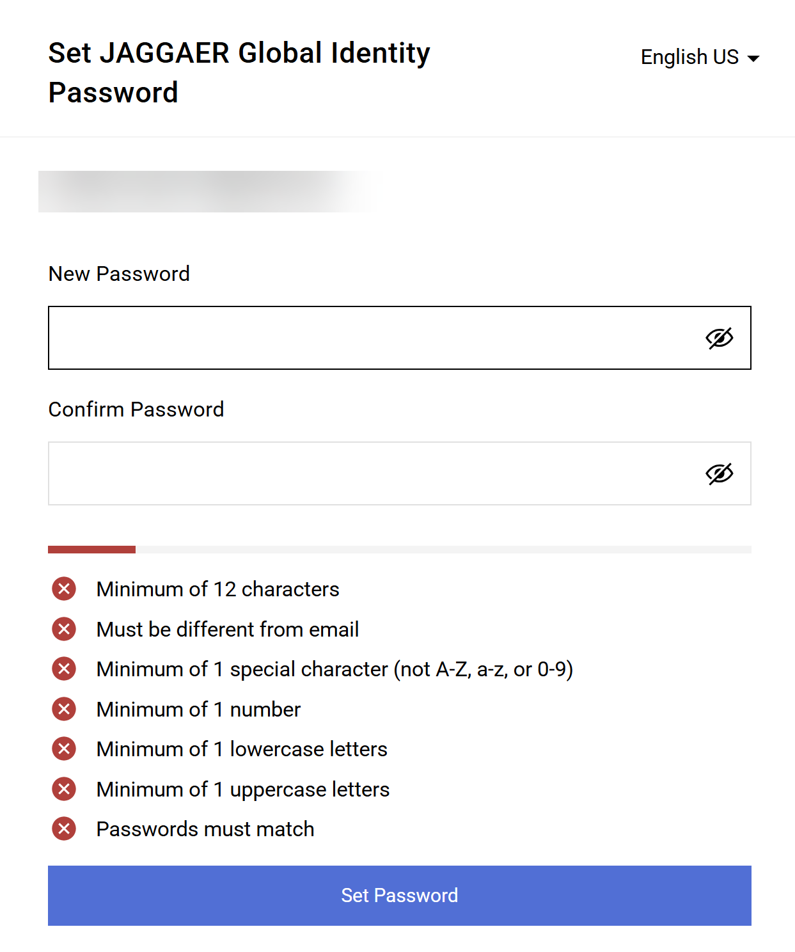
Register as a Prospective Supplier
(Part 10 of 49)
INSTRUCTIONS
Enter a New Password.
Re-enter the password to Confirm Password.
Click Set Password.
24
25
26

Slide 12
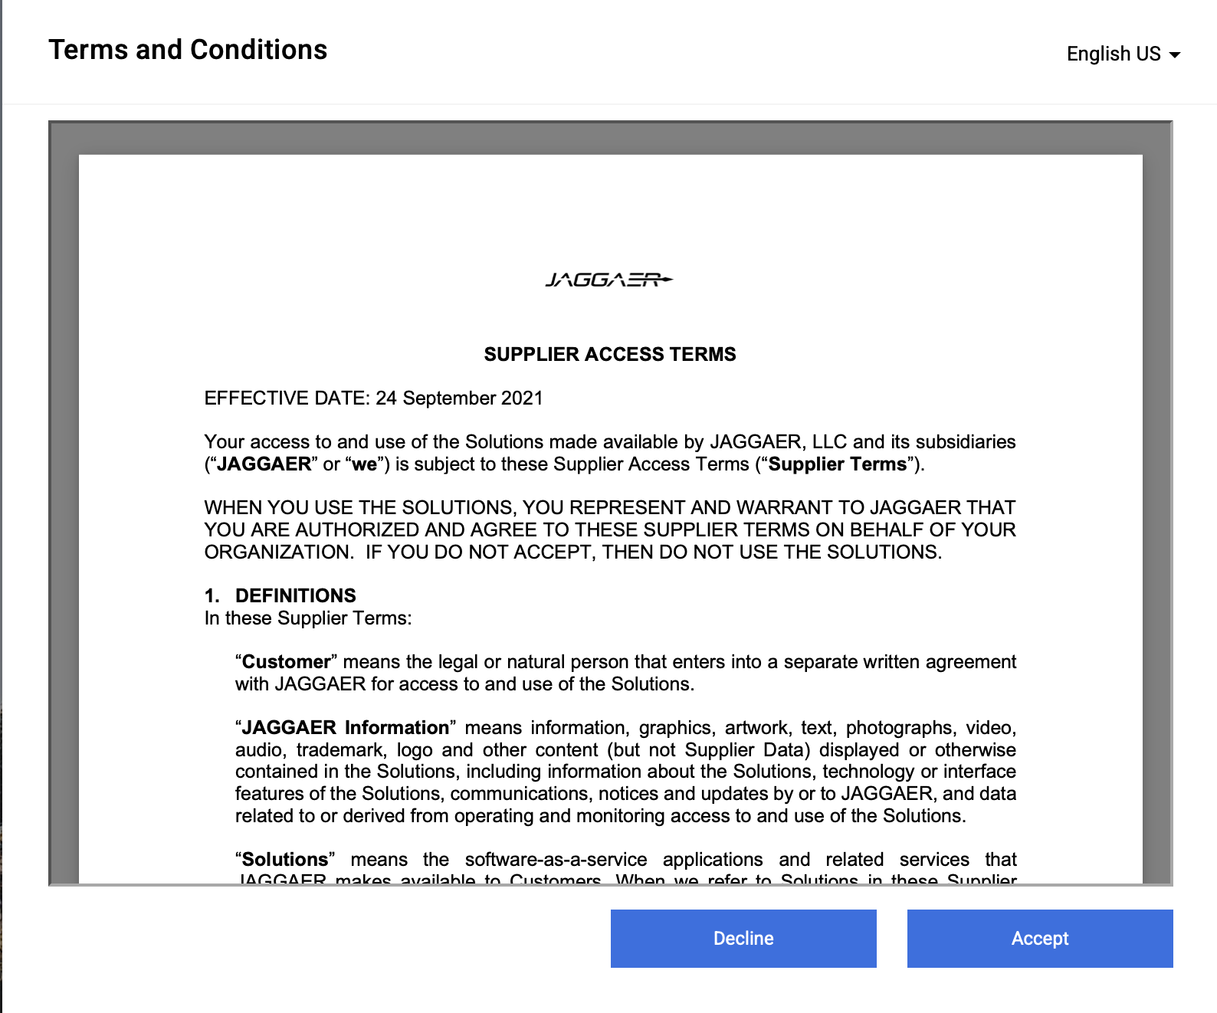
Register as a Prospective Supplier
(Part 11 of 49)
INSTRUCTIONS
Review Terms and Conditions
Click Accept.
27
28

Slide 13
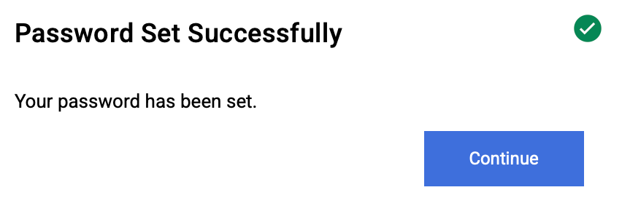
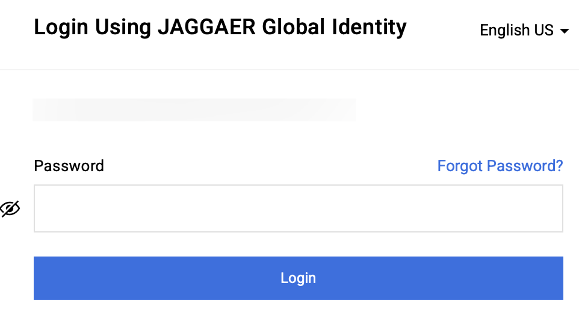
Register as a Prospective Supplier
(Part 12 of 49)
INSTRUCTIONS
Click Continue.
Enter your Password.
Click Login.
30
31

Slide 14
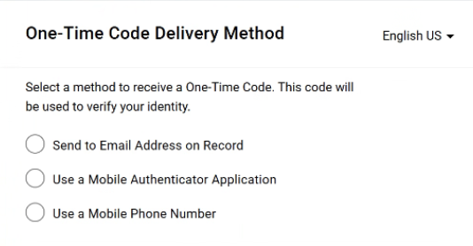
Register as a Prospective Supplier
(Part 13 of 49)
INSTRUCTIONS
Select a method to receive a One-Time Code.
Note: Only one method can be selected to receive the code. Follow Steps 33 – 37 if selecting Send to Email Address on Record. Skip to Steps 38 - 42 if selecting Use a Mobile Authenticator Application or skip to Steps 43 - 50 if selecting Use a Mobile Phone Number. Once completed, skip to Step 51.

Slide 15
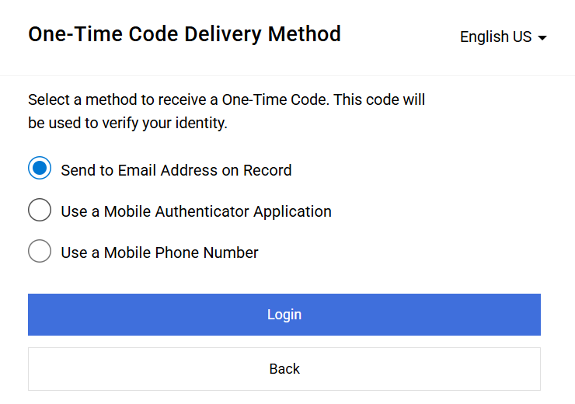
Register as a Prospective Supplier
(Part 14 of 49)
INSTRUCTIONS
Select Send to Email Address on Record.
Click Login.
33
34

Slide 16
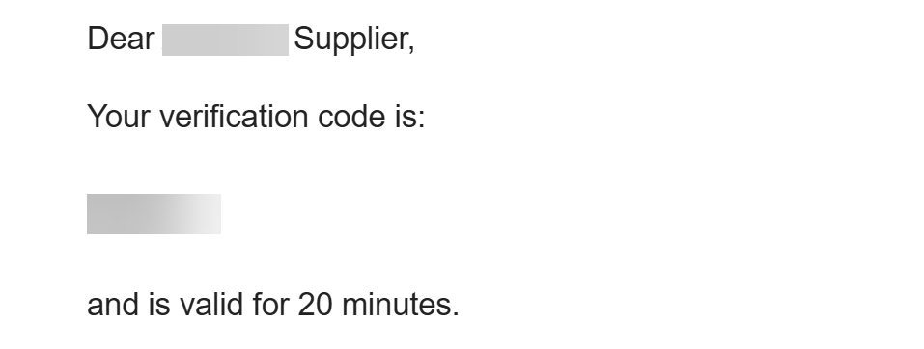
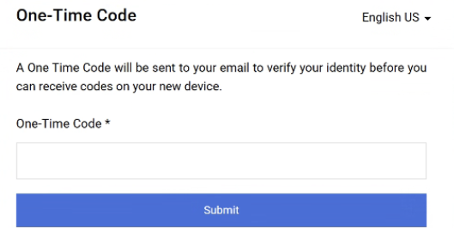
Register as a Prospective Supplier
(Part 15 of 49)
INSTRUCTIONS
Receive and make note of the One-Time Code.
Note: The Verification Code is only valid for 20 minutes.
In GA@WORK Marketplace, enter your One-Time Code*.
Click Submit.
Note: Skip to Step 51 to continue.
36
37

Slide 17
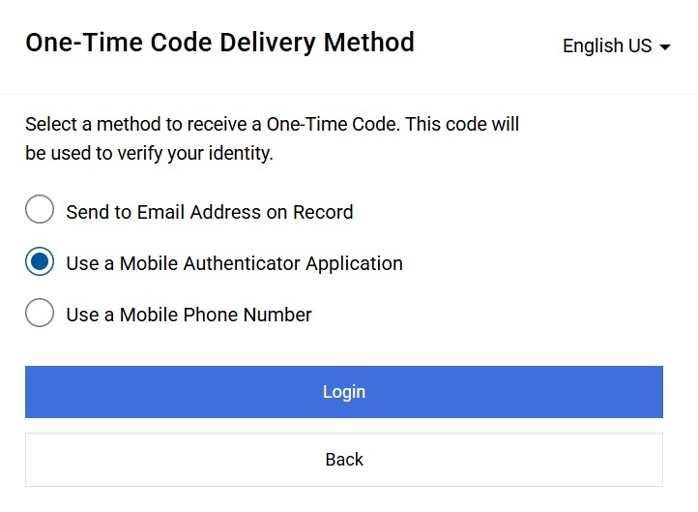
Register as a Prospective Supplier
(Part 16 of 49)
INSTRUCTIONS
Select Use a Mobile Authenticator Application.
Click Login.
38
39

Slide 18
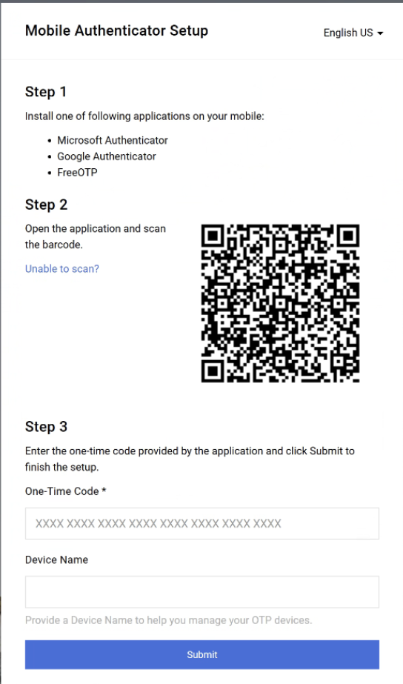
Register as a Prospective Supplier
(Part 17 of 49)
INSTRUCTIONS
Enter One-Time Code*.
Enter Device Name (optional).
Click Submit.
Note: Skip to Step 51 to continue.
40
41
42

Slide 19
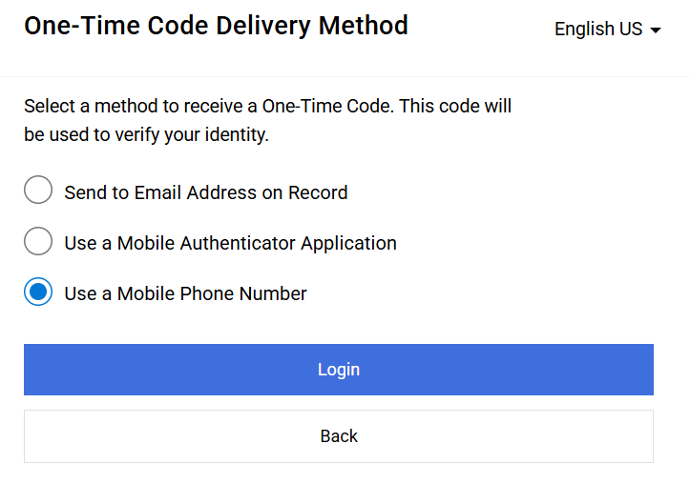
Register as a Prospective Supplier
(Part 18 of 49)
INSTRUCTIONS
Select Use a Mobile Phone Number.
Click Login.
43
44

Slide 20
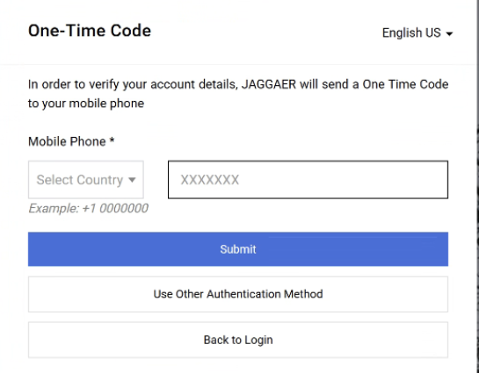
Register as a Prospective Supplier
(Part 19 of 49)
INSTRUCTIONS
Select Country*.
Enter Mobile Phone*.
Click Submit.
45
46
47

Slide 21
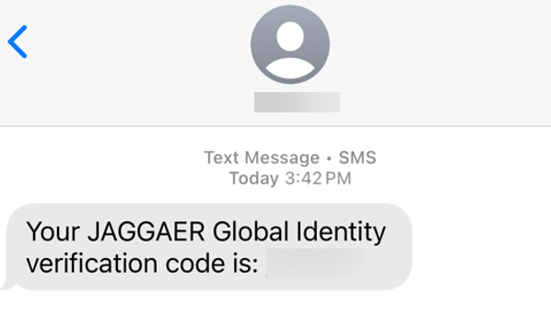
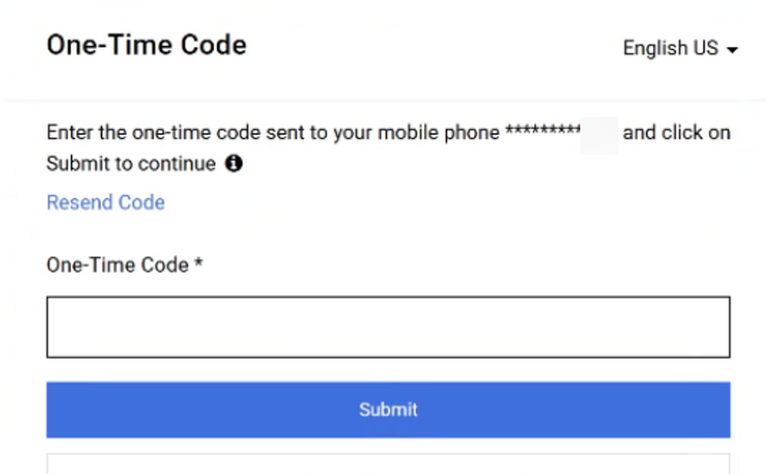
Register as a Prospective Supplier
(Part 20 of 49)
INSTRUCTIONS
Review Verification Code sent to Mobile Phone.
Note: Message will be received from JAGGAER Global Identity.
Enter One-Time Code*.
Click Submit.
Note: Skip to Step 51 to continue.
49
50

Slide 22
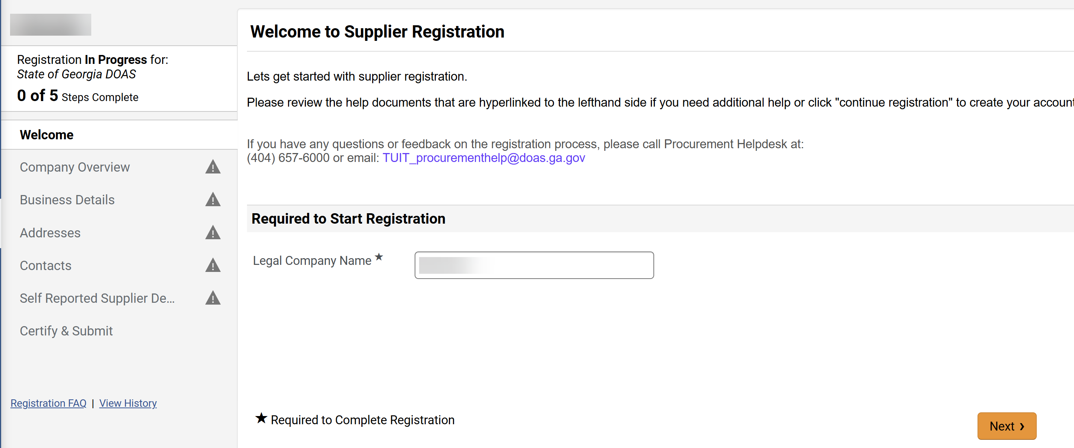
Register as a Prospective Supplier
(Part 21 of 49)
INSTRUCTIONS
Review the Legal Company Name*.
Note: Ensure your Legal Company Name matches Line 1 of Form W-9.
Click Next.
Note: Click Save Changes if you need to complete the registration later.
51
52

Slide 23
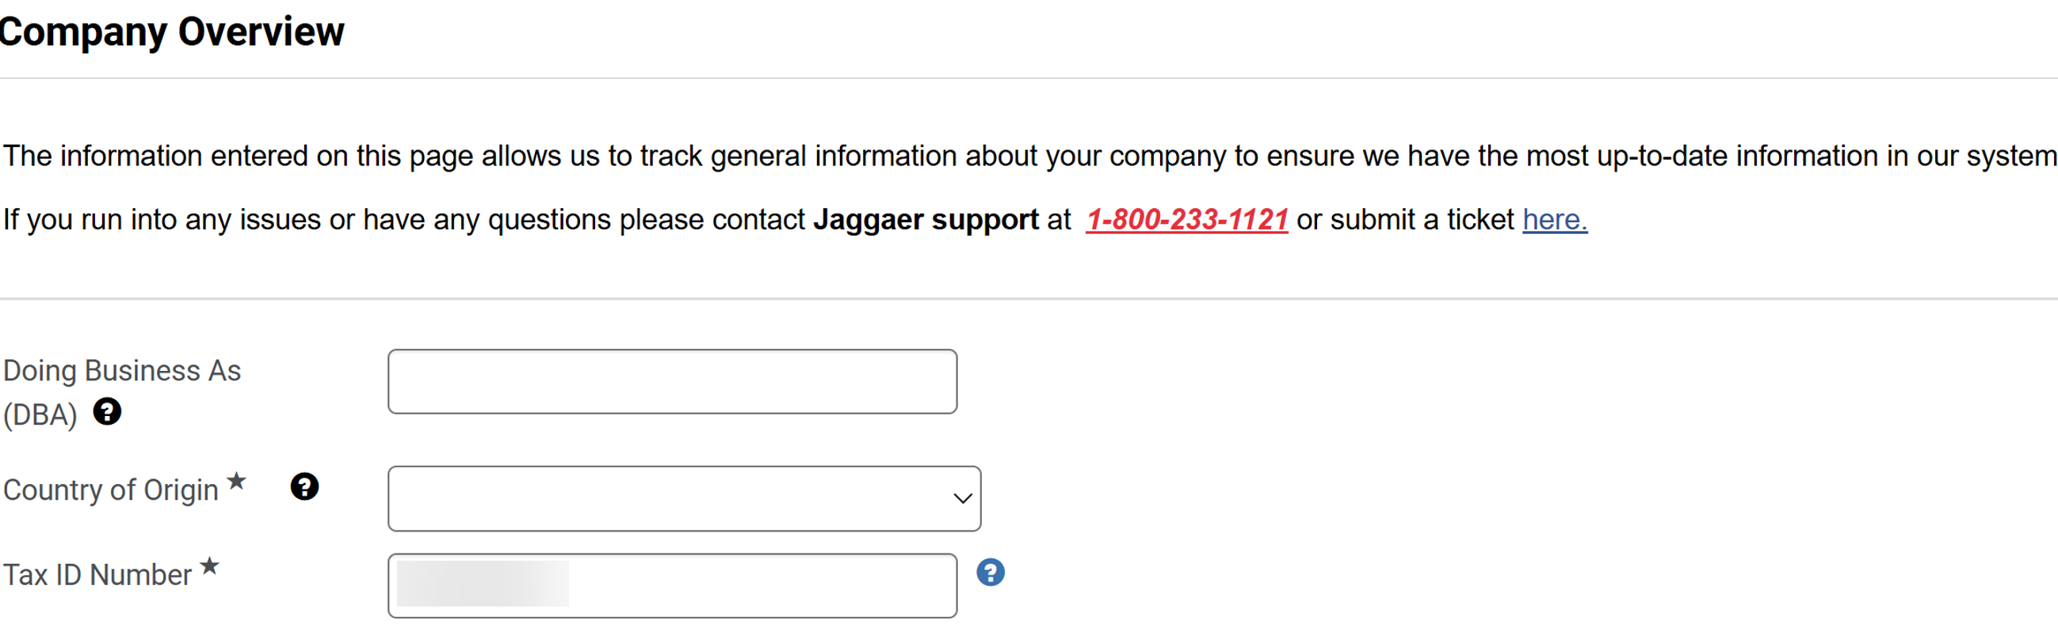
Register as a Prospective Supplier
(Part 22 of 49)
INSTRUCTIONS
Enter Doing Business As (DBA).
Select Country of Origin*.
Review auto-populated Tax ID Number*.
53
54
55
Notes:
=

Slide 24
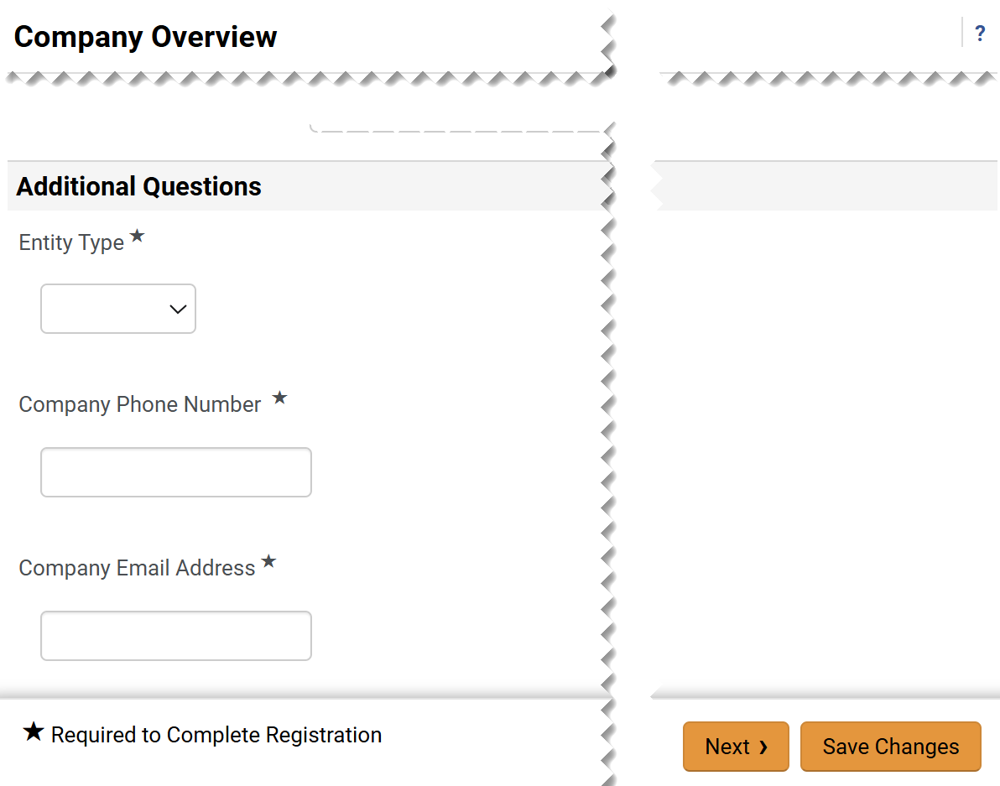
Register as a Prospective Supplier
(Part 23 of 49)
INSTRUCTIONS
Select Entity Type*.
Enter Company Phone Number*.
Enter Company Email Address*.
Click Next.
56
57
58
59

Slide 25
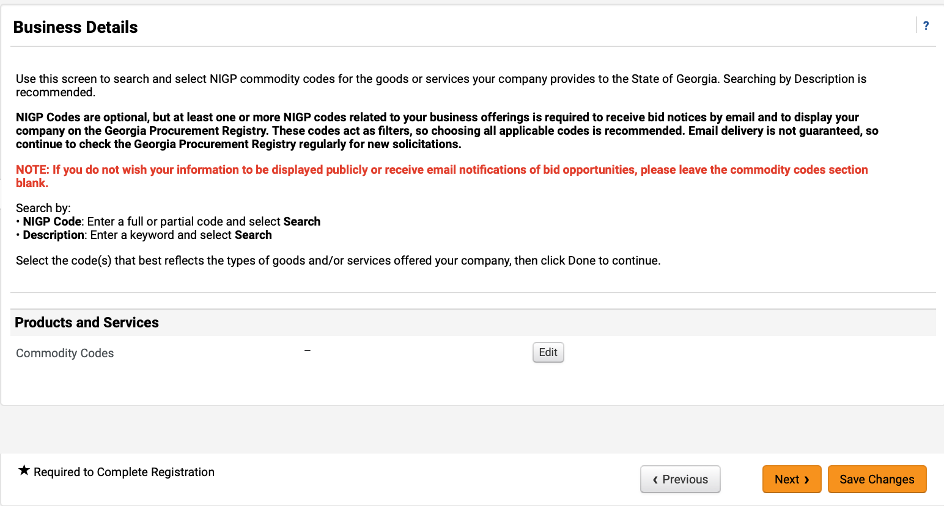
Register as a Prospective Supplier
(Part 24 of 49)
INSTRUCTIONS
Click Edit to add Commodity Codes.
Note: Commodity Codes (NIGP Codes) are optional, but at least one or more Commodity Codes related to your business offerings is required to receive bid notices by email and to display your company on the Georgia Procurement Registry. If you do not wish your information to be displayed publicly or receive email notifications of bid opportunities, please leave the commodity codes section blank and skip to Step 65. To Remove Commodity Code, click Remove
next to it.

Slide 26
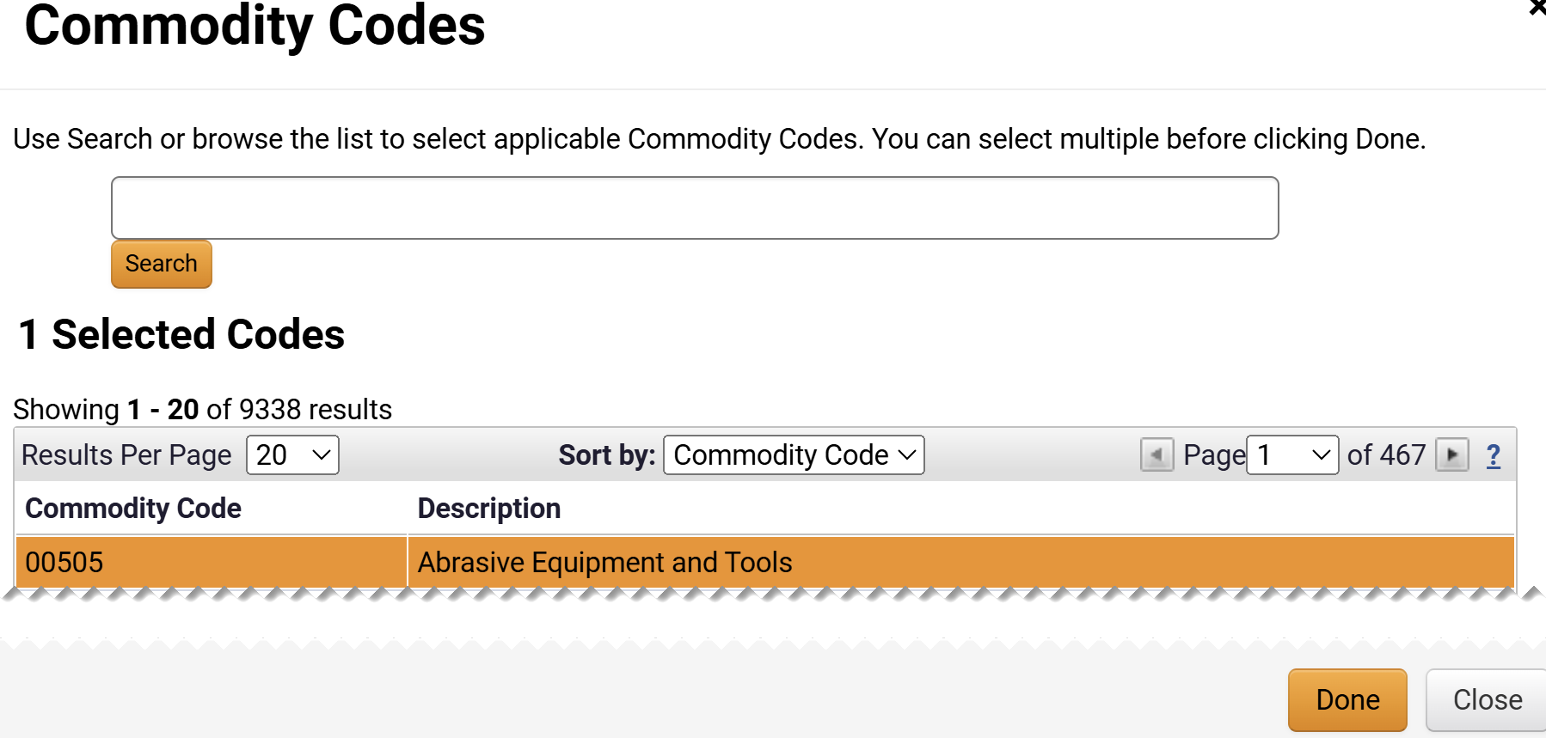
Register as a Prospective Supplier
(Part 25 of 49)
INSTRUCTIONS
Select the Commodity Code.
Note: Use the search field or browse list to select a Commodity Code. Multiple Commodity Codes can be selected by clicking on each Commodity Code. Click twice to unselect and remove Commodity Code.
Click Done.
61
62

Slide 27
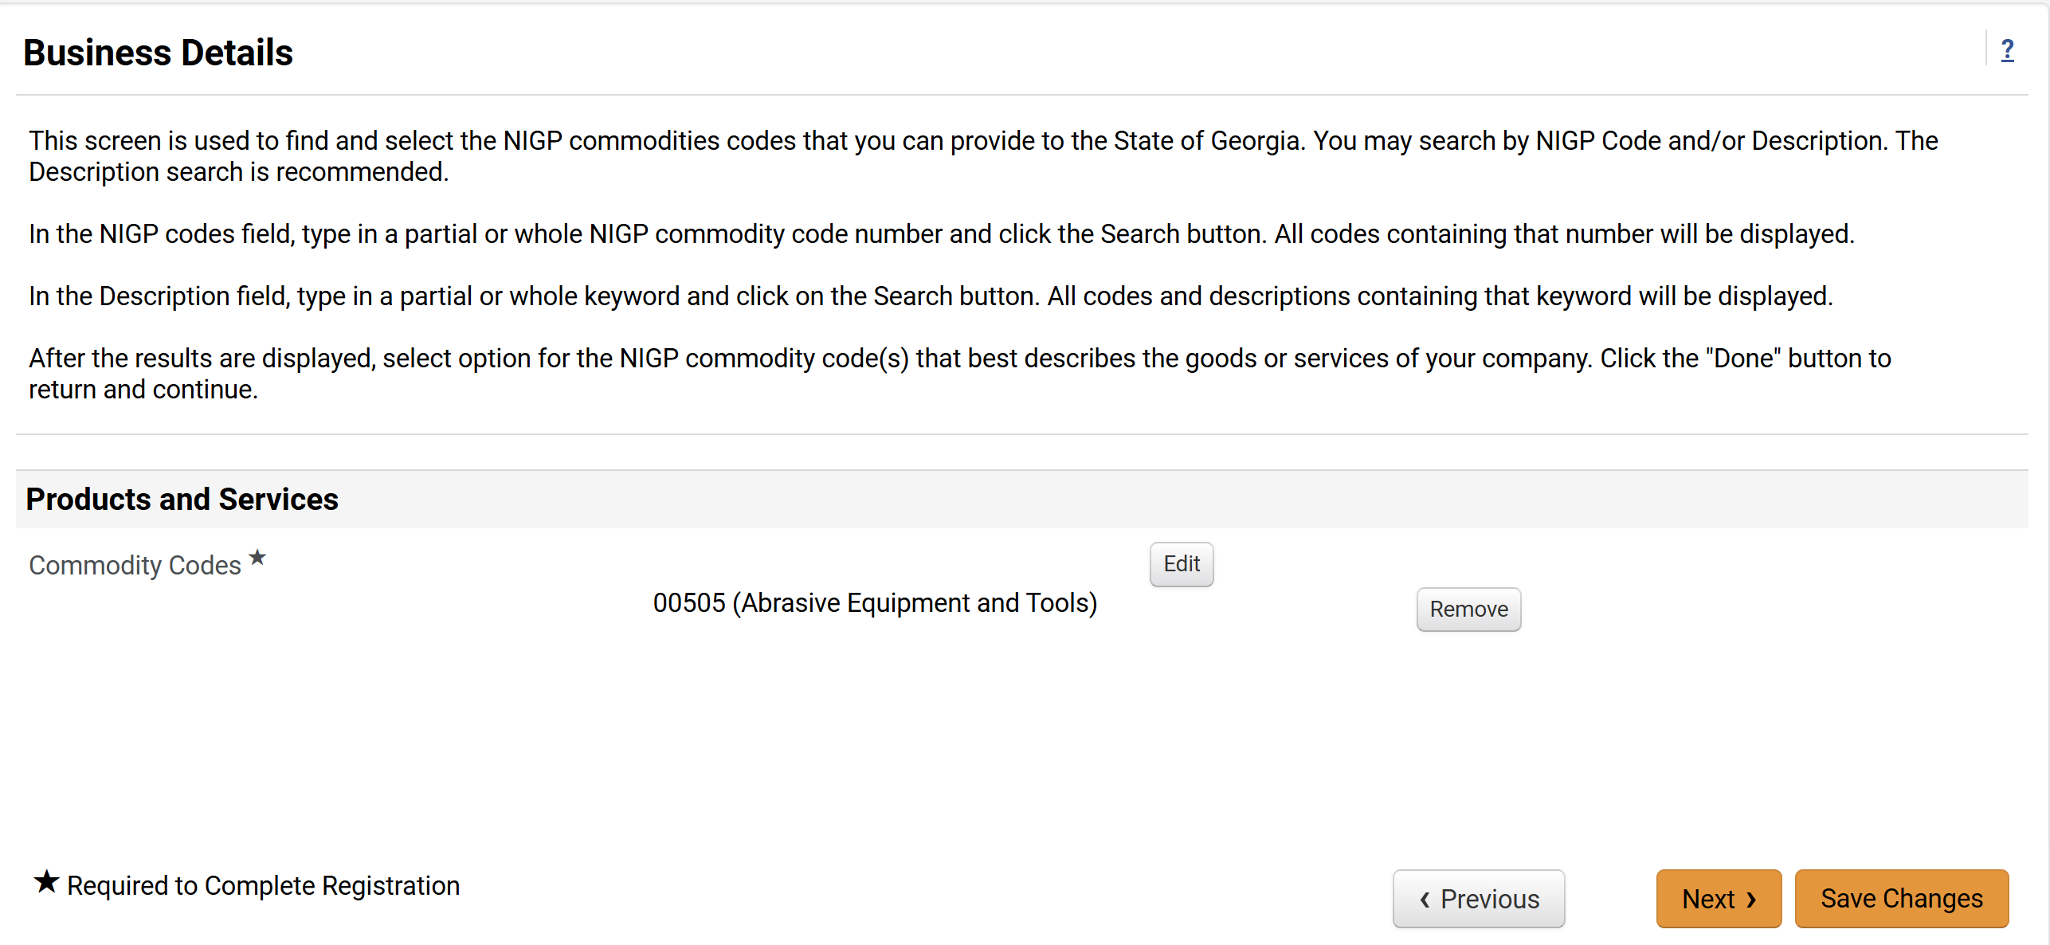
Register as a Prospective Supplier
(Part 26 of 49)
INSTRUCTIONS
Review added Commodity Codes.
Note: A Commodity Code can be removed by clicking on Remove next to it.
Click Next.
63
64

Slide 28
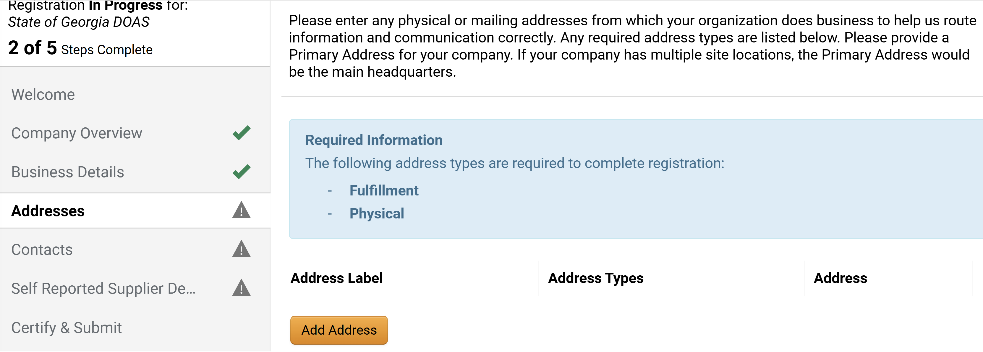
Register as a Prospective Supplier
(Part 27 of 49)
INSTRUCTIONS
Click Add Address.
Note: The Step Incomplete icon will be visible next to the Addresses tab until the Fulfillment and Physical addresses are added. Fulfillment and Physical address types are required. If Other (physical) is selected, follow Steps 66 – 89 or skip to Step 92 if Takes Orders (fulfillment) is selected.

Slide 29
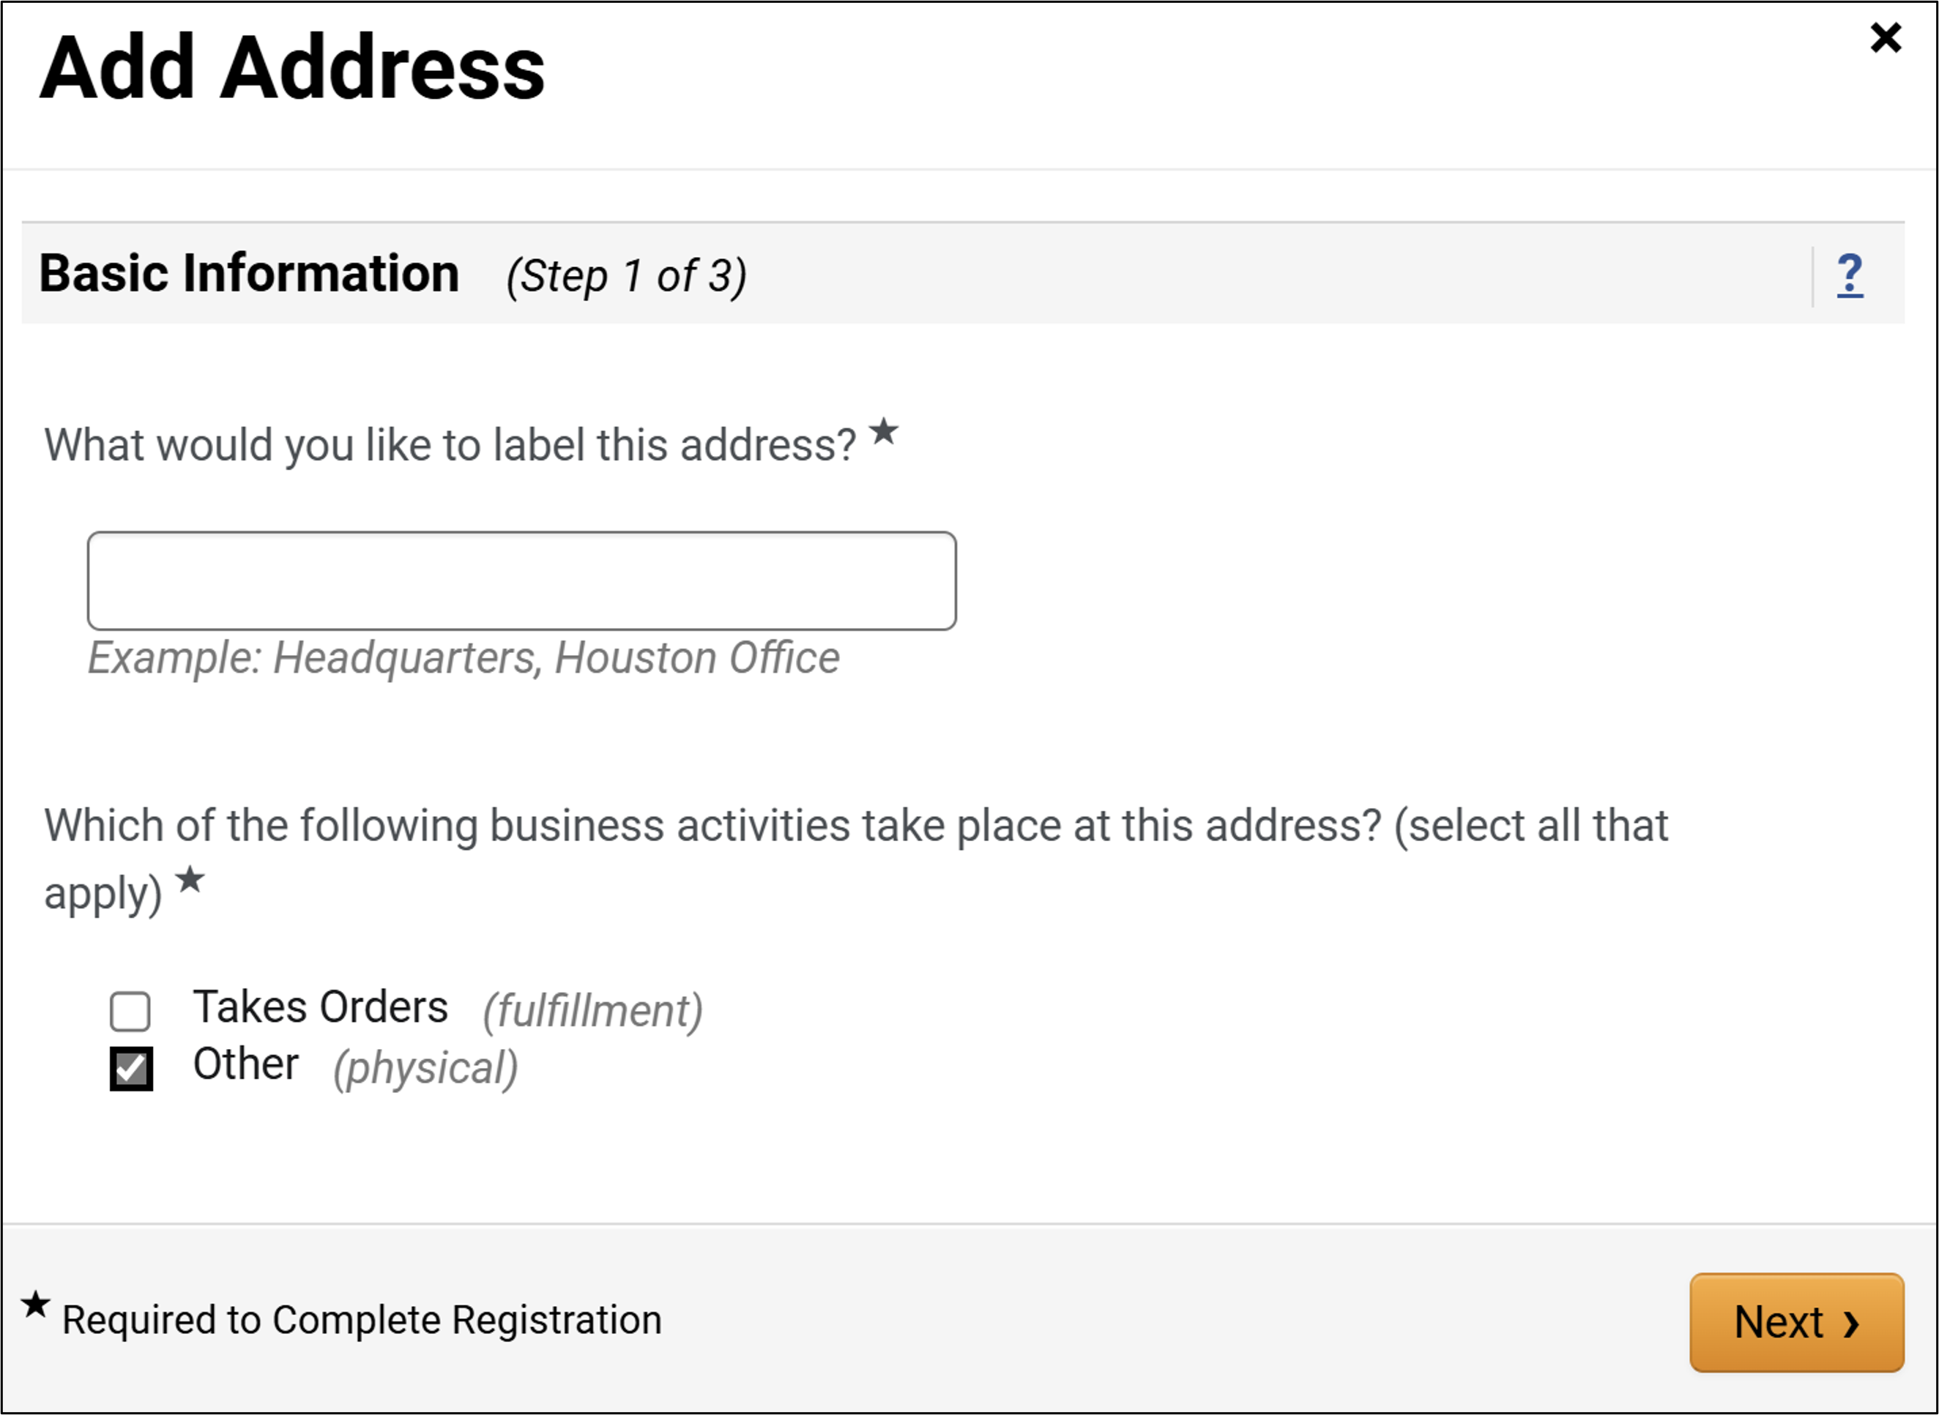
Register as a Prospective Supplier
(Part 28 of 49)
INSTRUCTIONS
For Other (Physical), enter What would you like to label this address?*.
Select Other (physical).
Click Next.
66
67
68

Slide 30
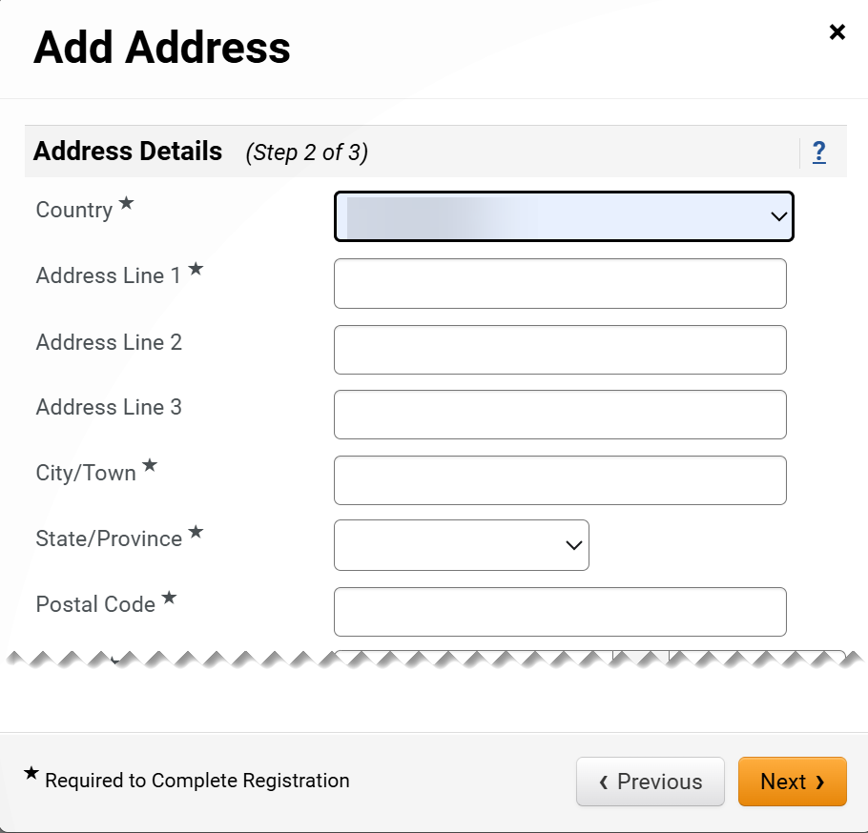
Register as a Prospective Supplier
(Part 29 of 49)
INSTRUCTIONS
Select Country*.
Enter Address Line 1*.
Enter Address Line 2 or Line 3 (Only if applicable).
Enter City/Town*.
Enter State/Province*.
Enter Postal Code*.
69
70
71
71
72
73
74

Slide 31
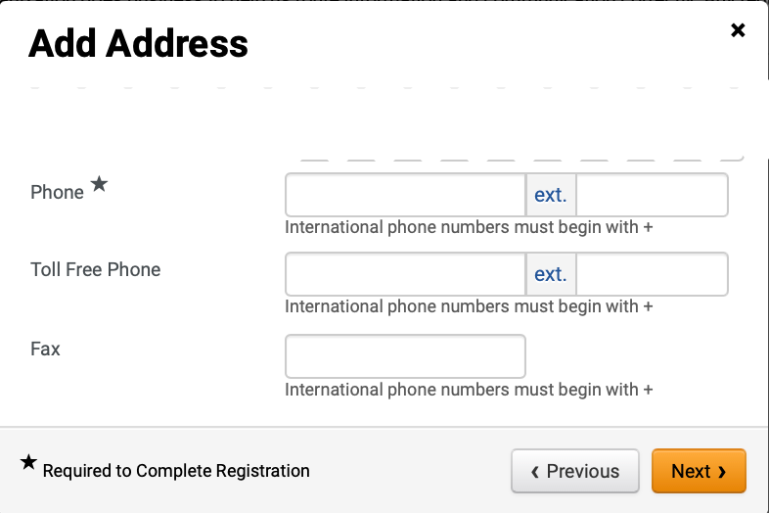
Register as a Prospective Supplier
(Part 30 of 49)
INSTRUCTIONS
Enter Phone*.
Enter Toll Free Phone (optional).
Enter Fax (optional).
Click Next.
75
76
77
78

Slide 32
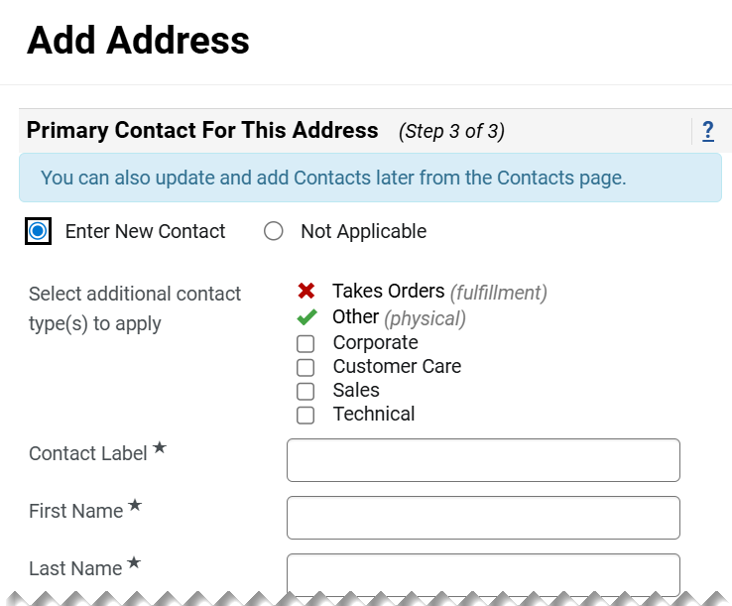
Register as a Prospective Supplier
(Part 31 of 49)
INSTRUCTIONS
Check Enter New Contact box.
Select additional contact type(s) to apply (Optional).
Enter a Contact Label*.
Enter a First Name*.
Enter a Last Name*.
79
80
81
82
83

Slide 33
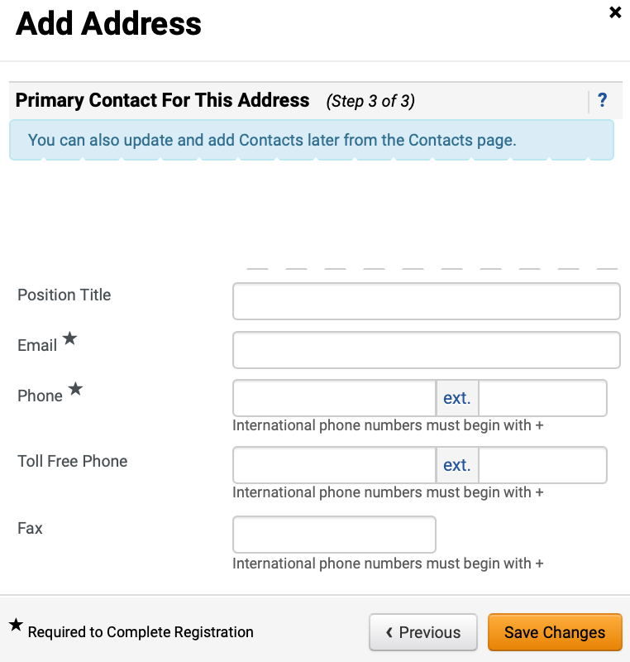
Register as a Prospective Supplier
(Part 32 of 49)
INSTRUCTIONS
Enter a Position Title (optional).
Enter an Email*.
Enter a Phone*.
Enter a Toll Free Phone (optional).
Enter a Fax (optional).
Click Save Changes.
84
85
86
87
88
89

Slide 34
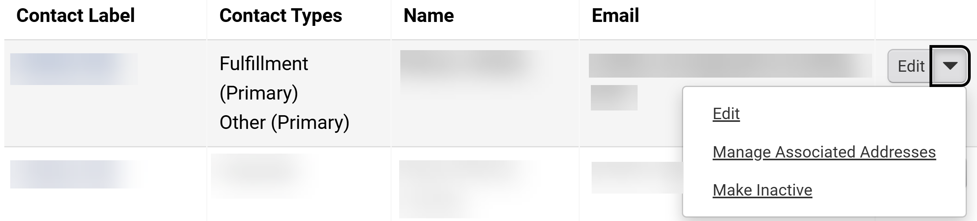
Register as a Prospective Supplier
(Part 33 of 49)
INSTRUCTIONS
Review added Contact.
Click Edit.
Note: To remove Contact, click the dropdown arrow then select Make Inactive next to it. To Add Corporate Contact, skip to Step 124.
91
90

Slide 35
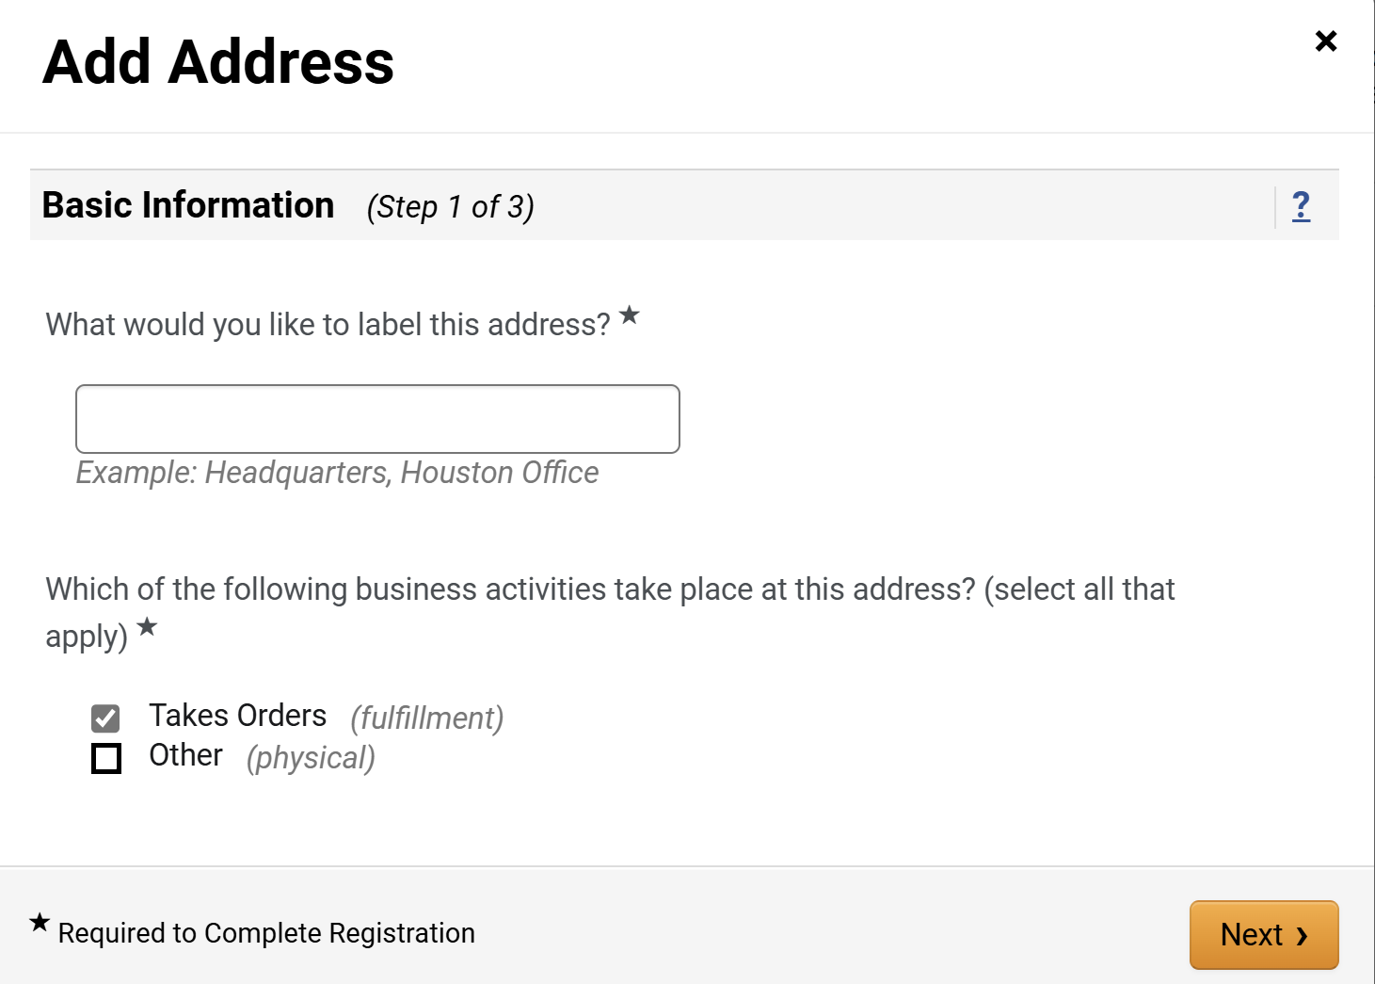
Register as a Prospective Supplier
(Part 34 of 49)
INSTRUCTIONS
For Take Orders (fulfillment), enter What would you like to label this address?*.
Select Takes Orders (fulfillment) for Which of the following business activities take place at this address?*.
Click Next.
92
93
94

Slide 36
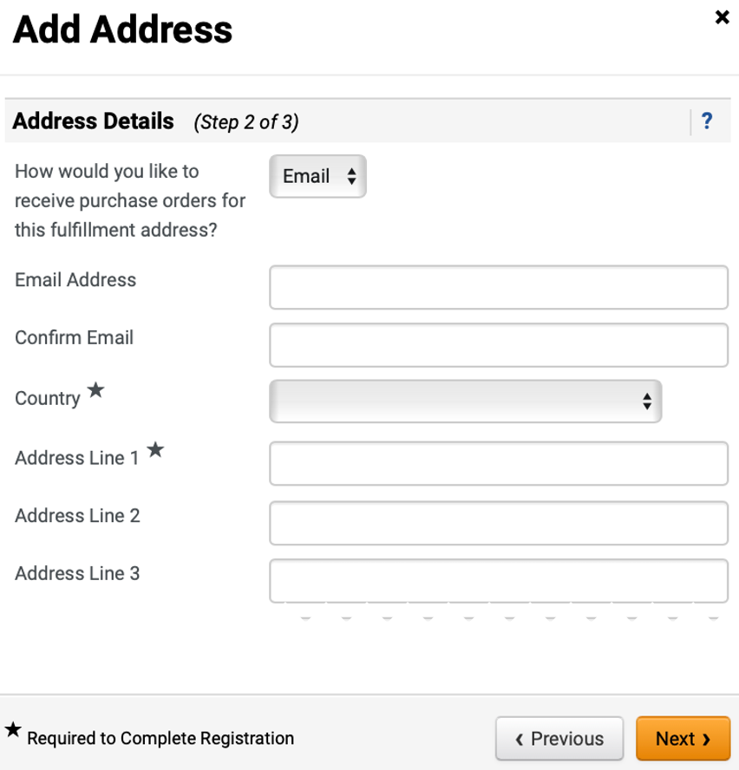
Register as a Prospective Supplier
(Part 35 of 49)
INSTRUCTIONS
Select Email for How would you like to receive purchase orders for this fulfillment address?.
Note: If Email is selected, follow Steps 95 - 97. If Fax is selected, follow Steps 98 – 99. If Mail is selected follow Step 100. Upon completion, skip to Step 101 to complete Address Details.
Enter an Email Address.
Enter a Confirm Email.
95
96
97

Slide 37
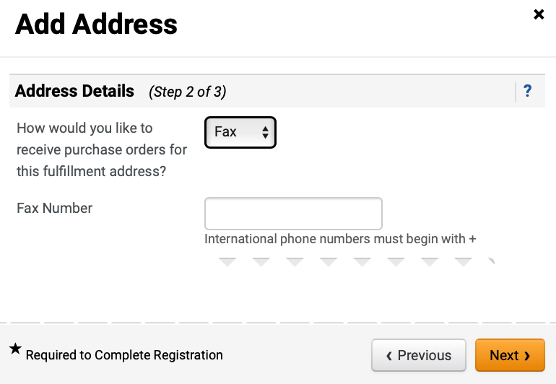
Register as a Prospective Supplier
(Part 36 of 49)
INSTRUCTIONS
Select Fax for How would you like to receive purchase orders for this fulfillment address?.
Note: User can select Email, Fax, or Mail.
Enter Fax Number.
98
99

Slide 38
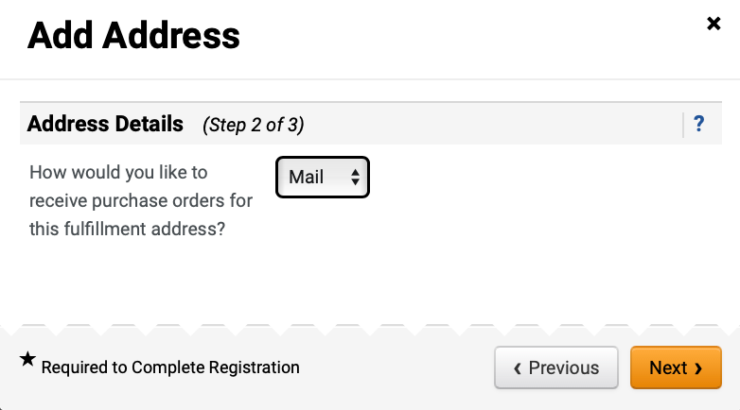
Register as a Prospective Supplier
(Part 37 of 49)
INSTRUCTIONS
Select Mail for How would you like to receive purchase orders for this fulfillment address?.
Note: User can select Email, Fax, or Mail.

Slide 39
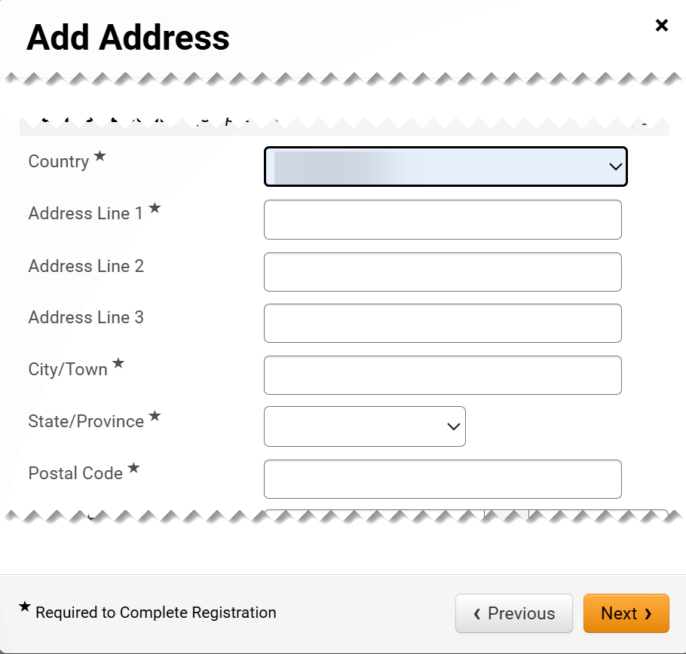
Register as a Prospective Supplier
(Part 38 of 49)
INSTRUCTIONS
Select Country*.
Enter Address Line 1*.
If applicable, enter Address Line 2 or Line 3.
Enter City/Town*.
Enter State/Province*.
Enter Postal Code*.
101
102
103
103
104
105
106

Slide 40
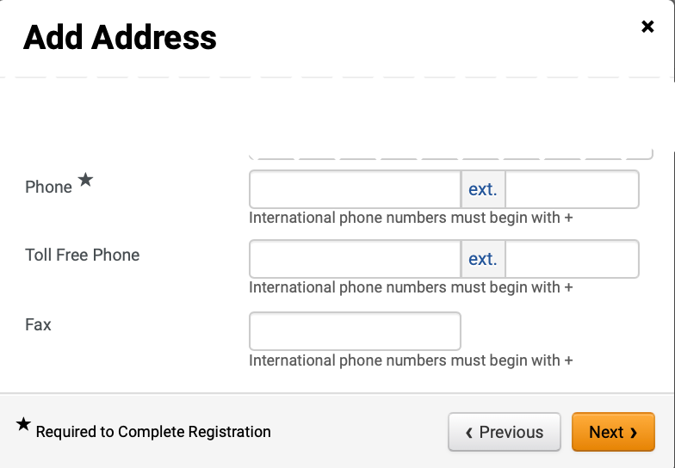
Register as a Prospective Supplier
(Part 39 of 49)
INSTRUCTIONS
Enter Phone*.
Enter Toll Free Phone (optional).
Enter Fax (optional).
Click Next.
107
108
109
110

Slide 41
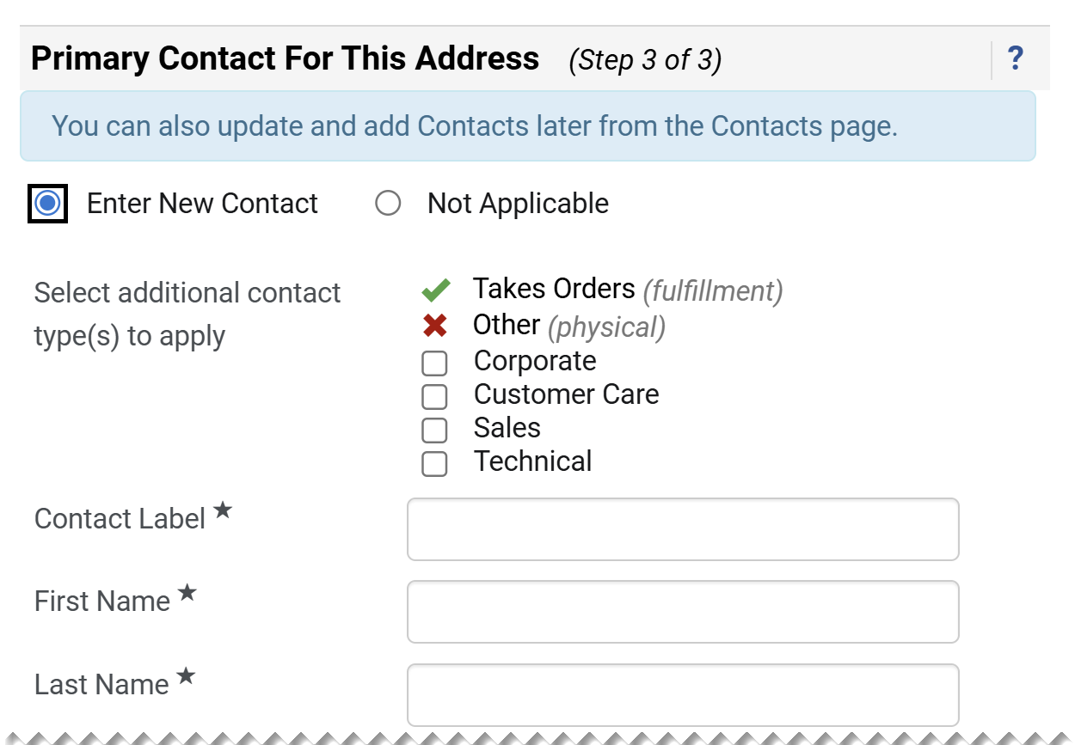
Register as a Prospective Supplier
(Part 40 of 49)
INSTRUCTIONS
Check Enter New Contact box.
Select additional contact type(s) to apply (Optional).
Enter a Contact Label*.
Enter a First Name*.
Enter a Last Name*.
111
112
113
114
115

Slide 42
Register as a Prospective Supplier
(Part 41 of 49)
INSTRUCTIONS
Enter a Position Title (optional).
Enter an Email*.
Enter a Phone*.
Enter a Toll Free Phone (optional).
Enter a Fax (optional).
Click Save Changes.
116
117
118
119
120
121

Slide 43
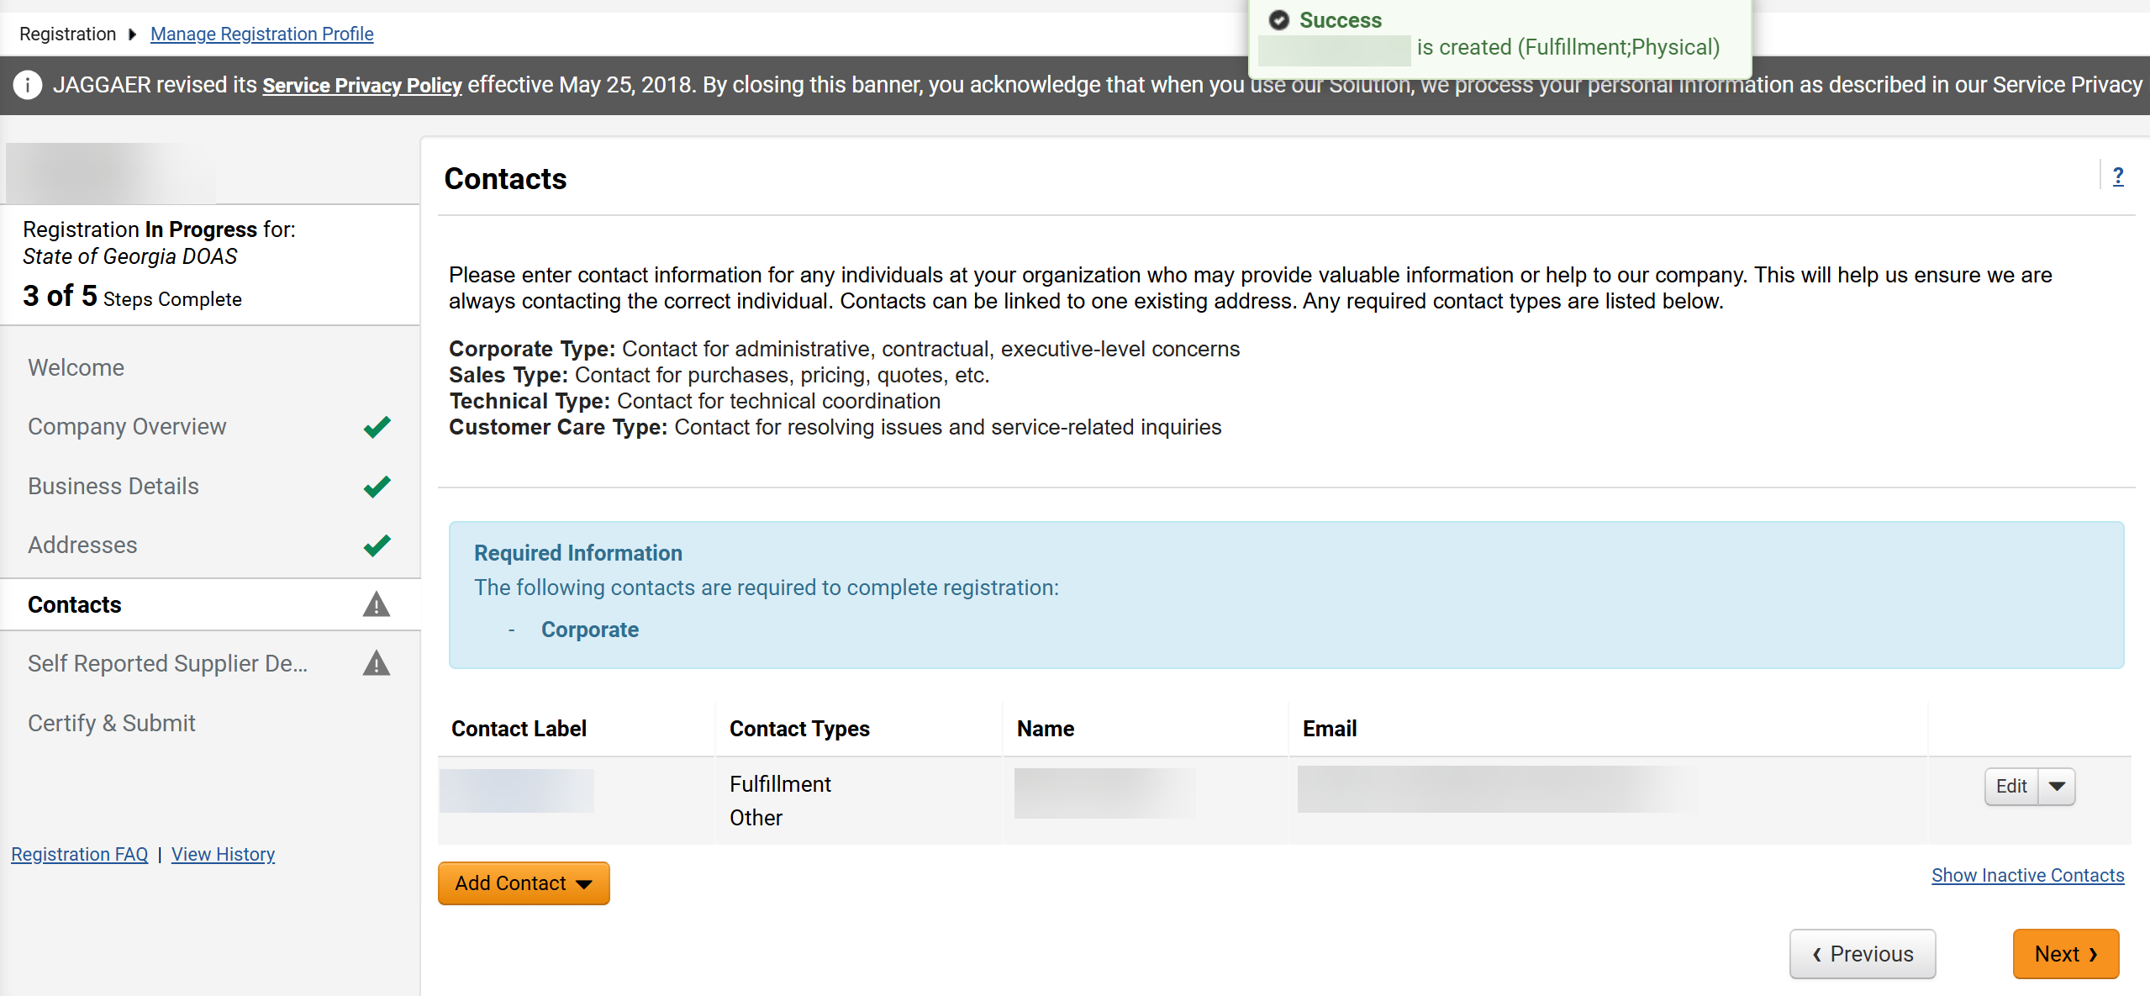
Register as a Prospective Supplier
(Part 42 of 49)
INSTRUCTIONS
Review success notification.
Review added Contact.
Note: The Step Incomplete icon will be visible next to the Contacts tab until the Corporate Contact is added.
122
123

Slide 44
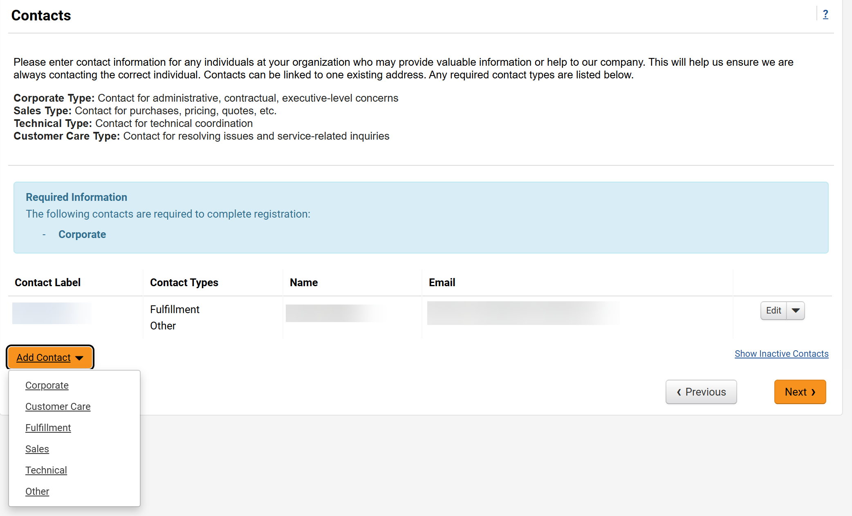
Register as a Prospective Supplier
(Part 43 of 49)
INSTRUCTIONS
Click Add Contact.
Note: The Corporate Contact is a required contact that should be authorized to represent the organization concerning financial matters.
Select Corporate.
124
125

Slide 45
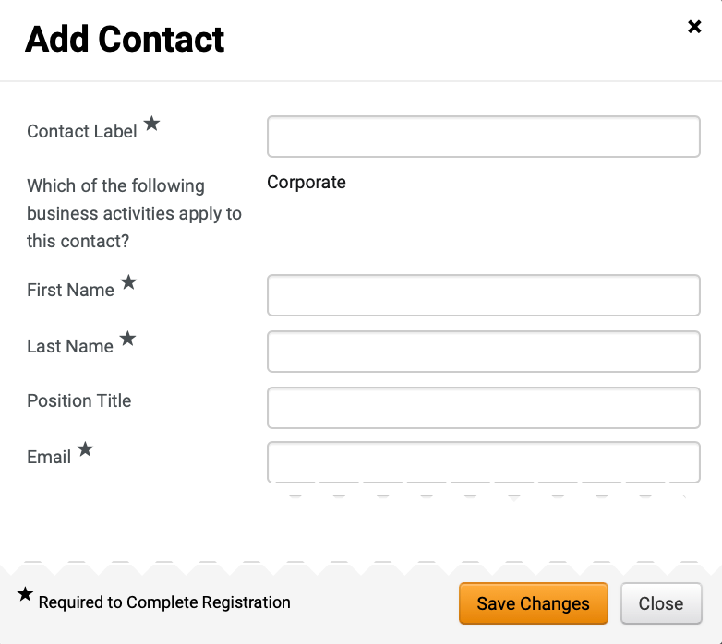
Register as a Prospective Supplier
(Part 44 of 49)
INSTRUCTIONS
Enter Contact Label*.
Corporate will auto-populate as Which of the following business activities apply to this contact?
Enter First Name*.
Enter Last Name*.
Enter Position Title (optional).
Enter Email*.
126
127
128
129
130
131

Slide 46
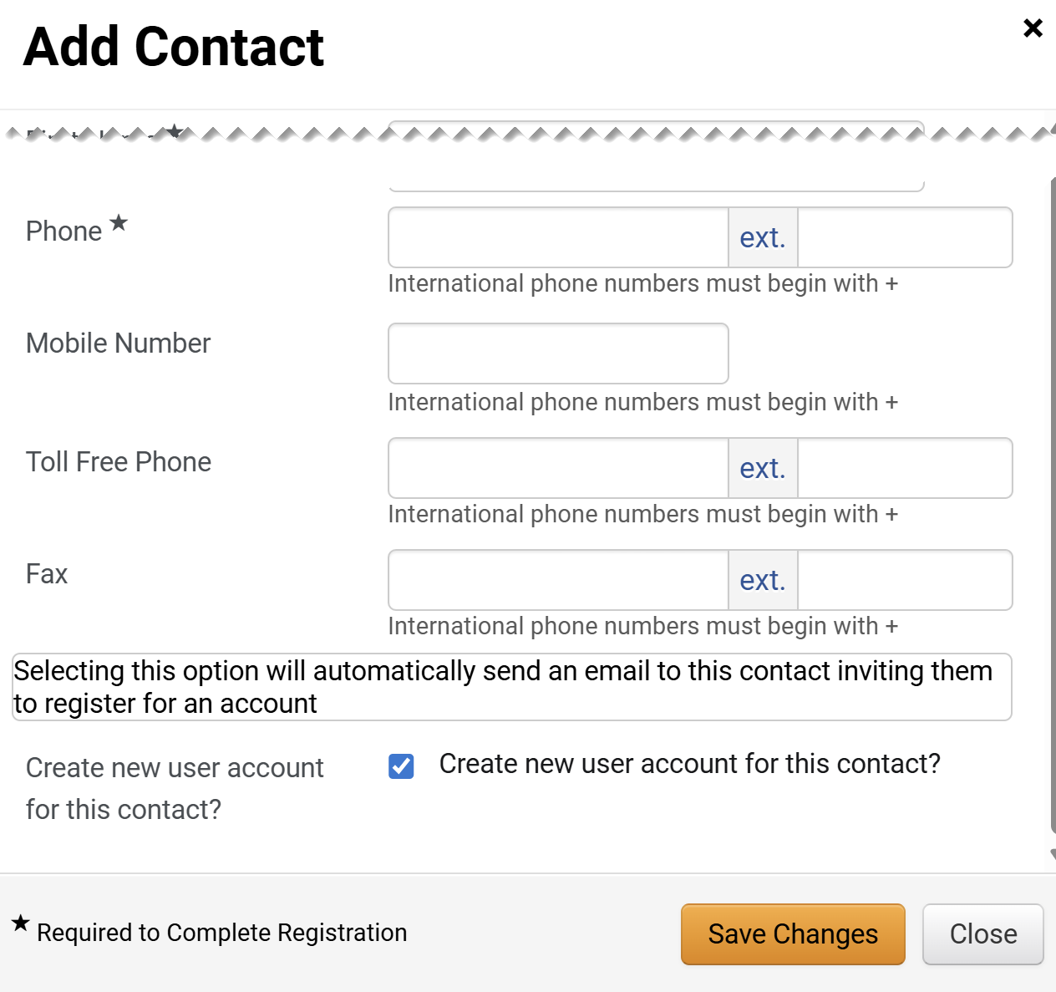
Register as a Prospective Supplier
(Part 45 of 49)
INSTRUCTIONS
Enter Phone*.
Enter Mobile Number (optional).
Enter Toll Free Phone (optional).
Enter Fax (optional).
Check the Create new user account for this contact? box.
Note: This is only applicable if Corporate is selected as the Contact Type. If selected, an email inviting the contact to register for an account will be automatically sent to set up login credentials for the contact.
Click Save Changes.
132
133
134
135
136
137

Slide 47
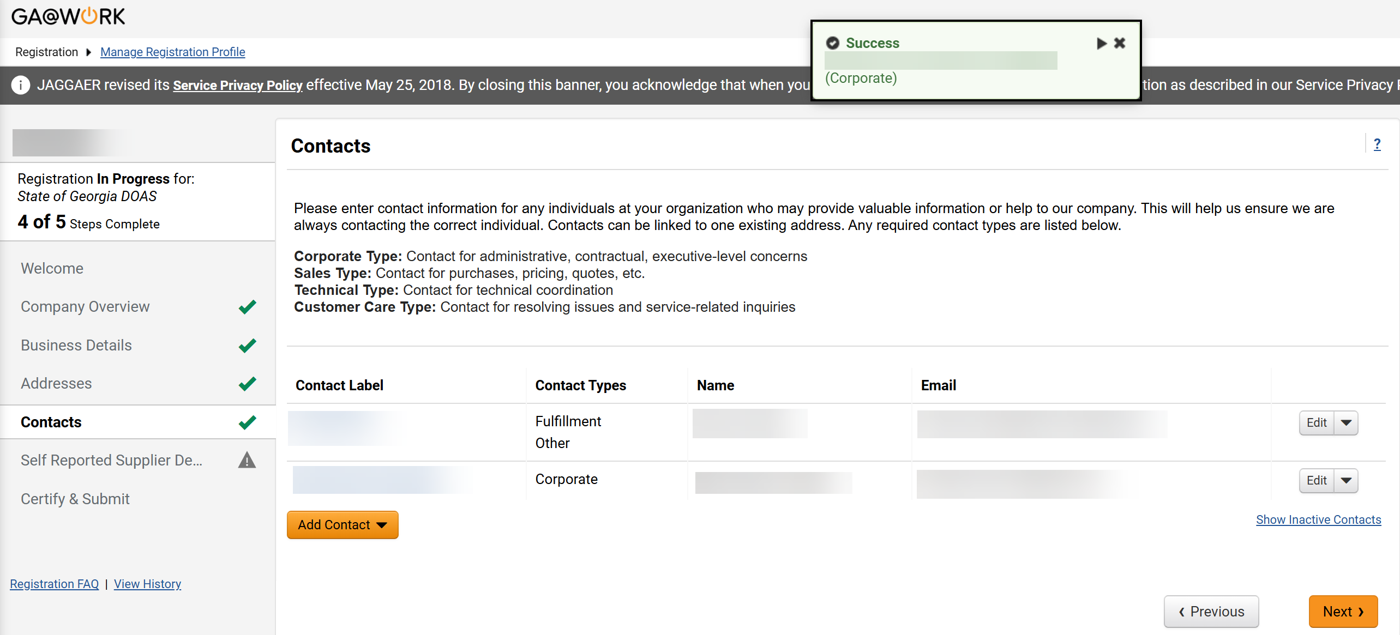
Register as a Prospective Supplier
(Part 46 of 49)
INSTRUCTIONS
Review success notification.
Review added Contact.
Note: The Step Complete icon will be visible next to the Contacts tab.
Click Next.
138
139
140

Slide 48

Register as a Prospective Supplier
(Part 47 of 49)
INSTRUCTIONS
Select Are you a Georgia Resident?*.
Select Gross Annual Receipts*.
Select Number of Employees*.
Select Are you a small business?*.
141
142
143
144

Slide 49

Register as a Prospective Supplier
(Part 48 of 49)
INSTRUCTIONS
Select Are you a Minority Owned Business?*.
Select Are you a Woman Owned Business?*.
Select Are you a Veteran Owned Business?*.
Select Are you a Small Disadvantaged Business?*.
Click Next.
145
146
147
148
149

Slide 50


Register as a Prospective Supplier
(Part 49 of 49)
INSTRUCTIONS
Review Preparer Details and Today’s Date.
Note: Preparer’s Initials, Preparer’s Name and Preparer’s Email Address fields will auto-populate but can be edited.
Check the Certification* box.
Click Submit.
150
151
152
Review Registration Complete notification.
Note: It is also possible to access the registration via the Homepage then click Manage Registration Profile.
You have successfully Registered as a Prospective Supplier.

