Slide 1
Update Supplier Profile Information (GA@WORK Marketplace for Suppliers)
DESCRIPTION
This guide will show a Supplier how to Update Supplier Profile Information in GA@WORK Marketplace for Suppliers.
Note: Suppliers Approved for Payment may update only Self Reported Demographic Information and NIGP Codes.
OVERVIEW
The key steps in the process are below:
Access the GA@WORK Marketplace for Suppliers.
Access Registration module.
Update Supplier Profile Information.
Supplier Profile Information is Updated in GA@WORK Marketplace for Suppliers.
Business Process:
Access Supplier Marketplace
Access Registration
Update Supplier Profile Information
Supplier Profile Information is Updated

Slide 2
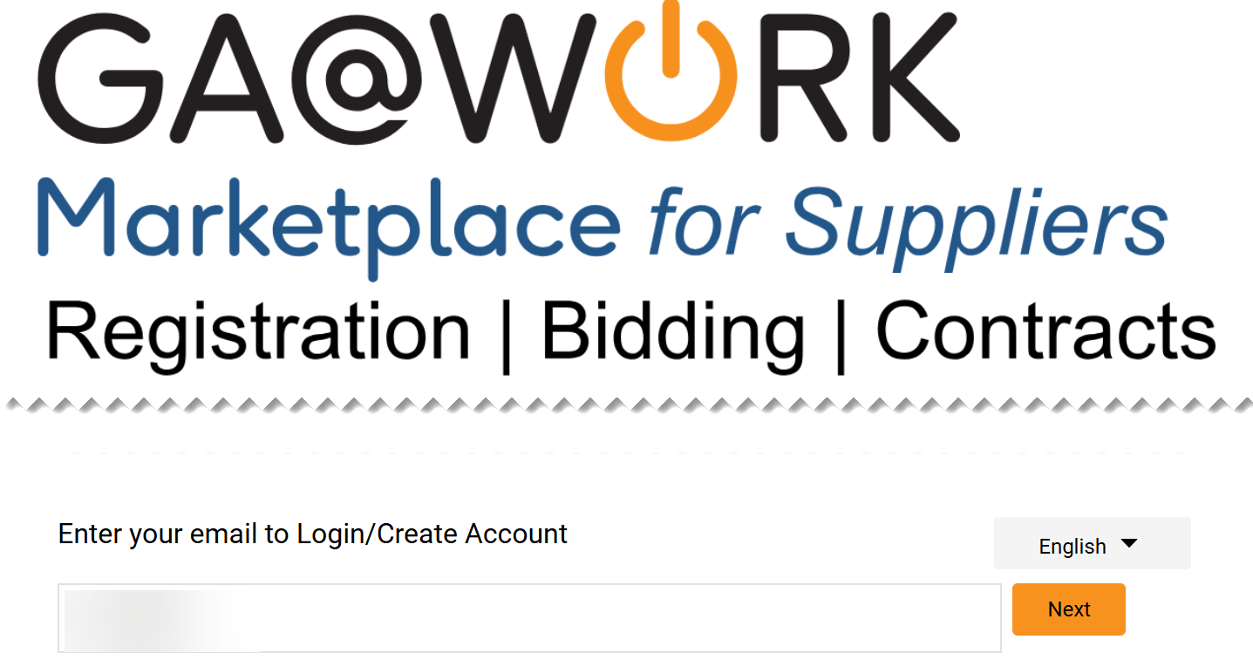
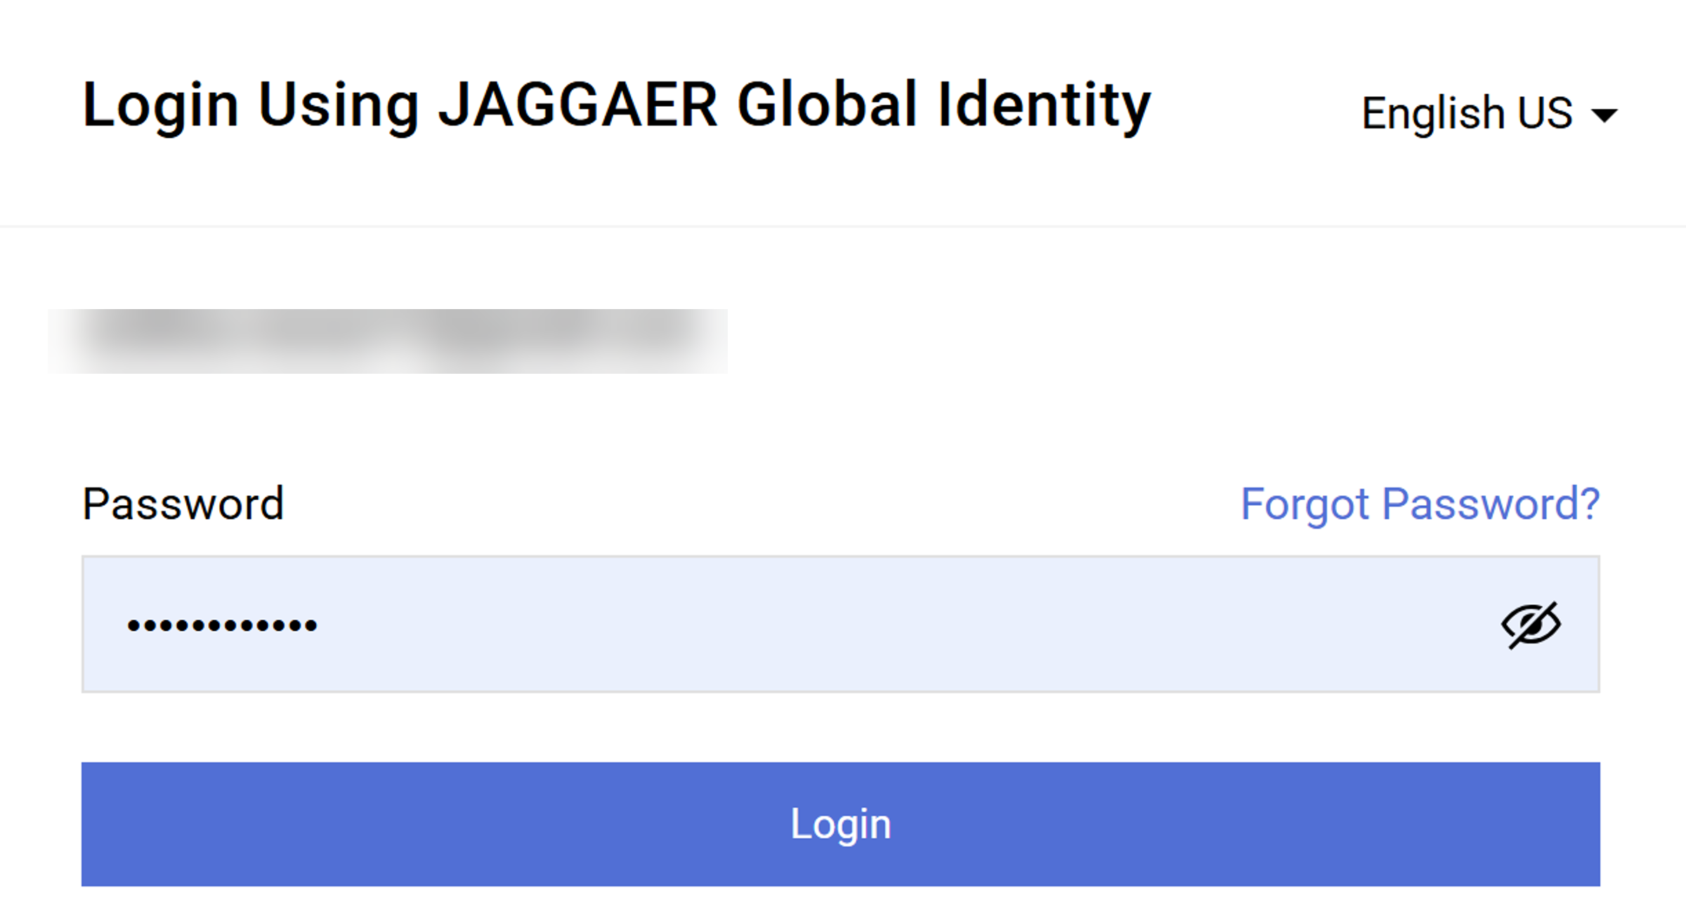
Update Supplier Profile Information
(Part 1 of 42)
INSTRUCTIONS
Open GA@WORK Marketplace and enter your email to Login.
Note: To log in a supplier must have started the registration process in GA@WORK Marketplace for Suppliers.
Click Next.
1
2
Enter your Password.
Click Login.
3
4

Slide 3
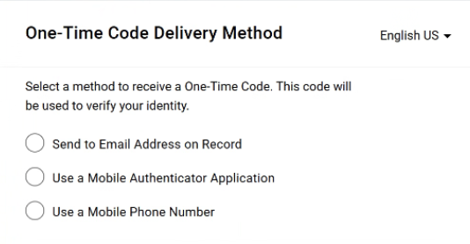
Update Supplier Profile Information
(Part 2 of 42)
INSTRUCTIONS
Select a method to receive a One-Time Code.
Note: Only one method can be selected to receive the code. Follow Steps 6 – 10 if selecting Send to Email Address on Record. Skip to Steps 11 – 15 if selecting Use a Mobile Authenticator Application or skip to Step 16 - 22 if selecting Use a Mobile Phone Number.
Once completed, skip to Step 23.

Slide 4
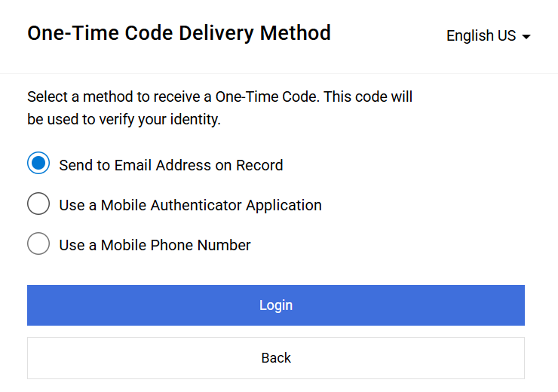
Update Supplier Profile Information
(Part 3 of 42)
INSTRUCTIONS
Select Send to Email Address on Record.
Click Login.
6
7

Slide 5
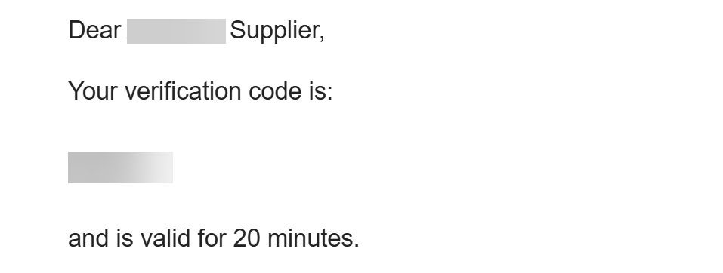
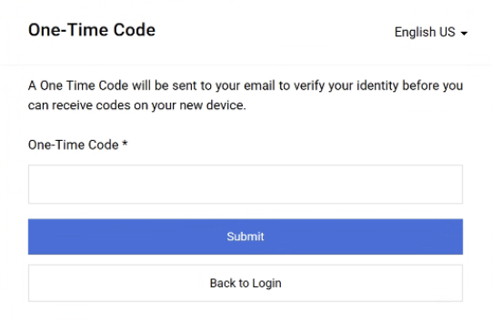
Update Supplier Profile Information
(Part 4 of 42)
INSTRUCTIONS
Receive and make note of the One-Time Code.
Note: The Verification Code is only valid for 20 minutes.
In GA@WORK Marketplace, enter your One-Time Code*.
Note: Complete all Required* fields.
Click Submit.
Note: Skip to Step 24 to continue.
9
10

Slide 6
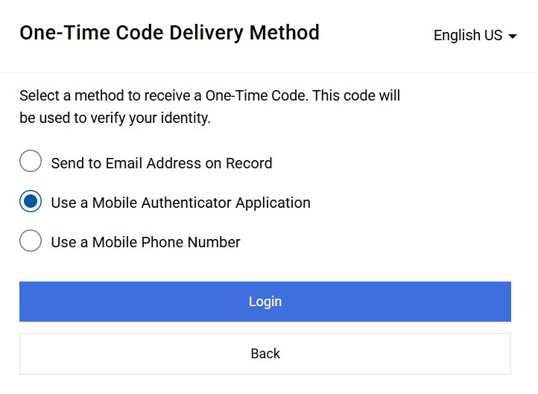
Update Supplier Profile Information
(Part 5 of 42)
INSTRUCTIONS
Select Use a Mobile Authenticator Application.
Click Login.
11
12

Slide 7
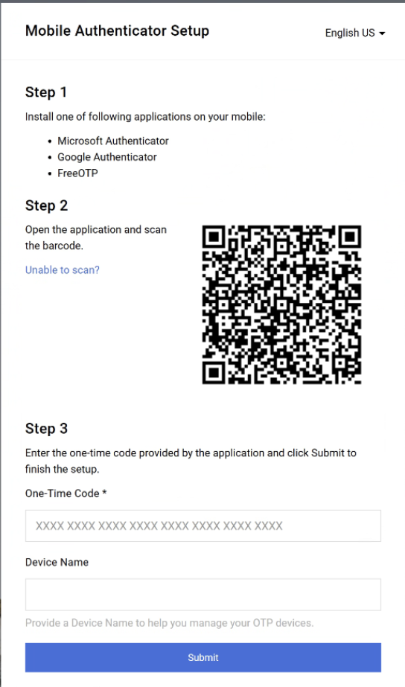
Update Supplier Profile Information
(Part 6 of 42)
INSTRUCTIONS
Enter One-Time Code*.
Enter Device Name (optional).
Click Submit.
Note: Skip to Step 23.
13
14
15

Slide 8
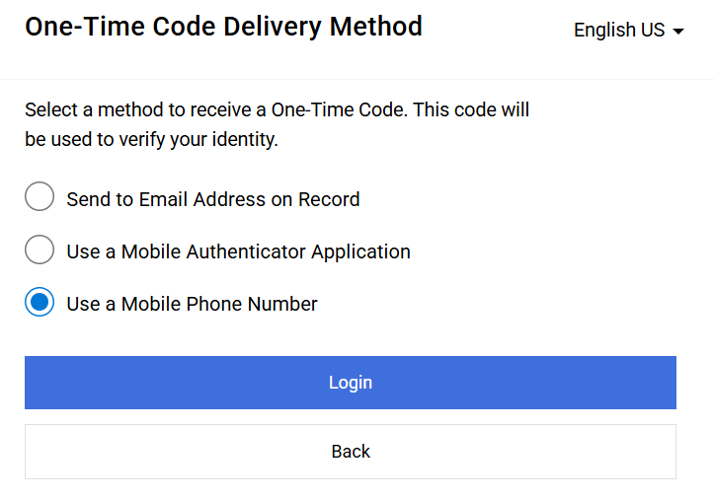
Update Supplier Profile Information
(Part 7 of 42)
INSTRUCTIONS
Select Use a Mobile Phone Number.
Click Login.
16
17

Slide 9
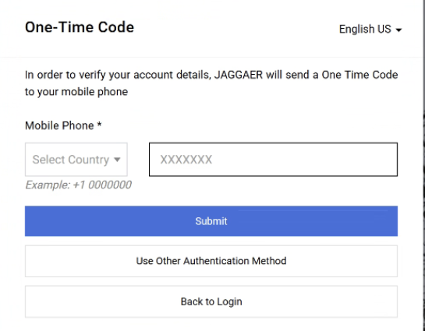
Update Supplier Profile Information
(Part 8 of 42)
INSTRUCTIONS
Enter Mobile Phone*.
Click Submit.
18
19

Slide 10
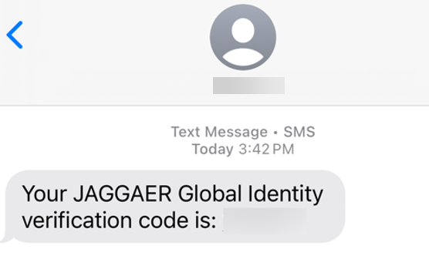
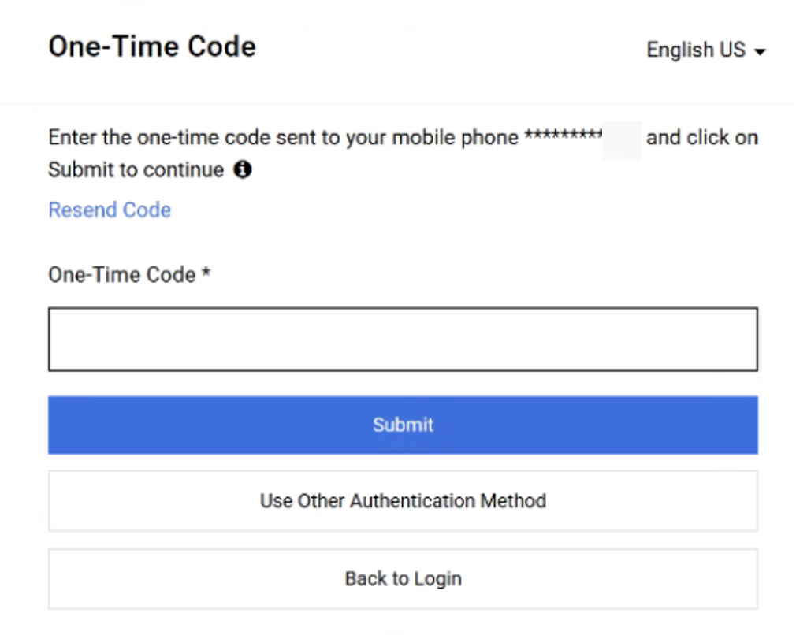
Update Supplier Profile Information
(Part 9 of 42)
INSTRUCTIONS
Review Verification Code sent to Mobile Phone.
Note: Message will be received from JAGGAER
Global Identity.
In GA@WORK Marketplace, enter your One-Time Code*.
Click Submit.
Note: Skip to Step 23.
21
22

Slide 11
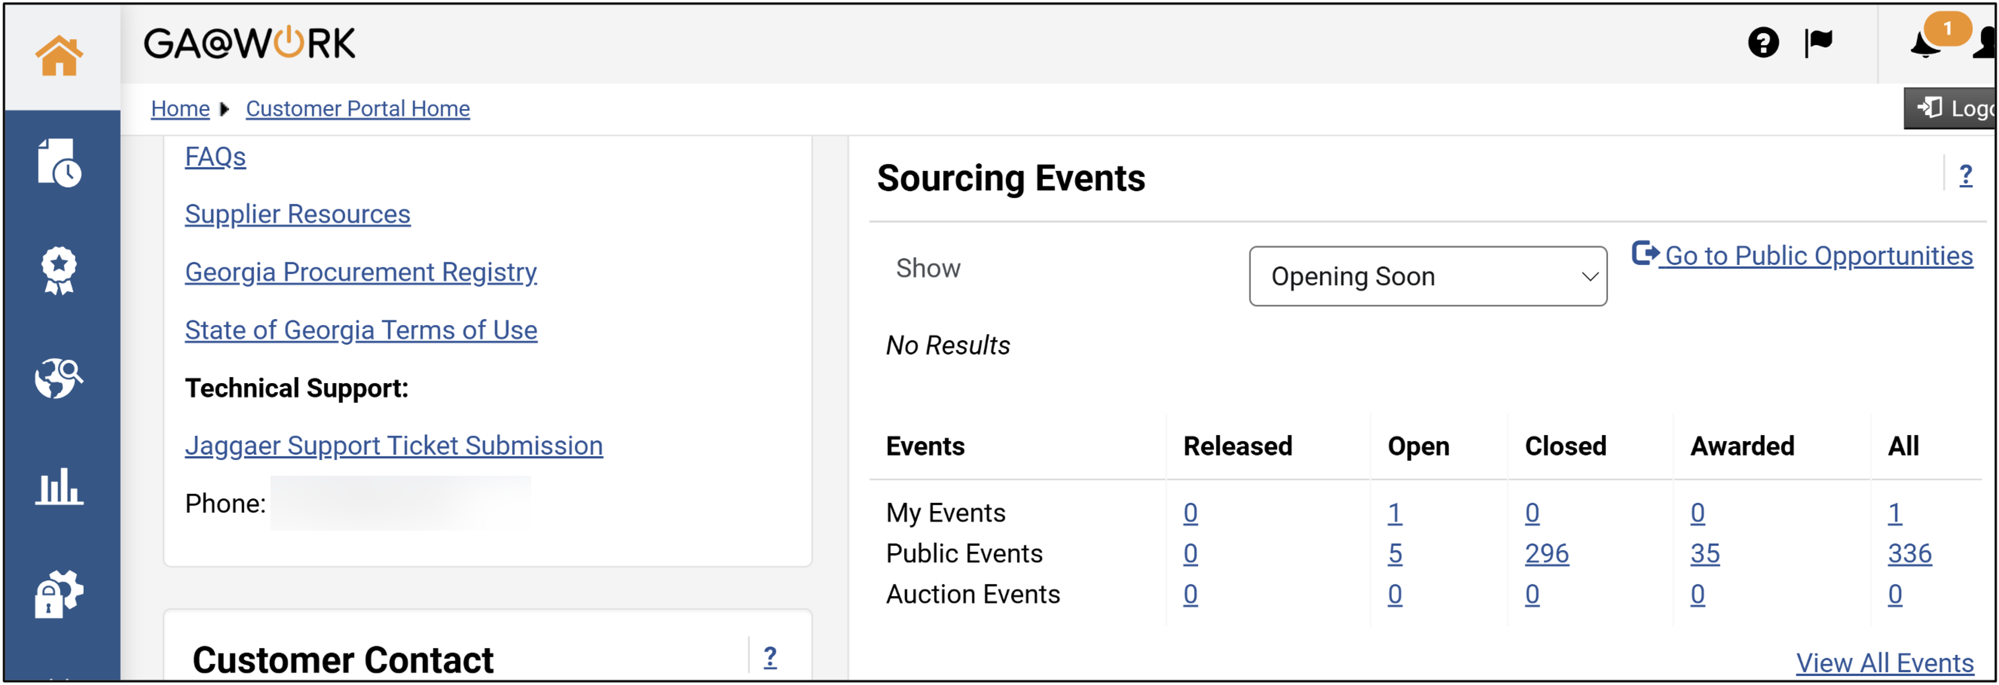
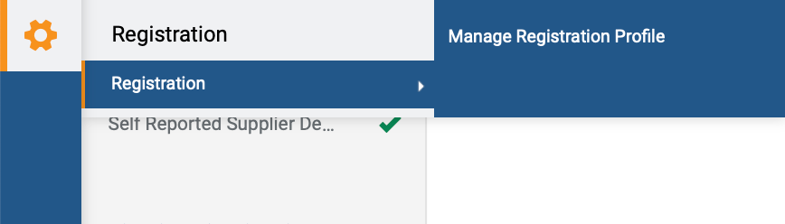
Update Supplier Profile Information
(Part 10 of 42)
INSTRUCTIONS
The Homepage is displayed.
Access the Registration module.
Click Registration.
Click Manage Registration Profile.
Note: It is also possible to access the registration via the Homepage then click Manage Registration Profile.
24
26
25

Slide 12
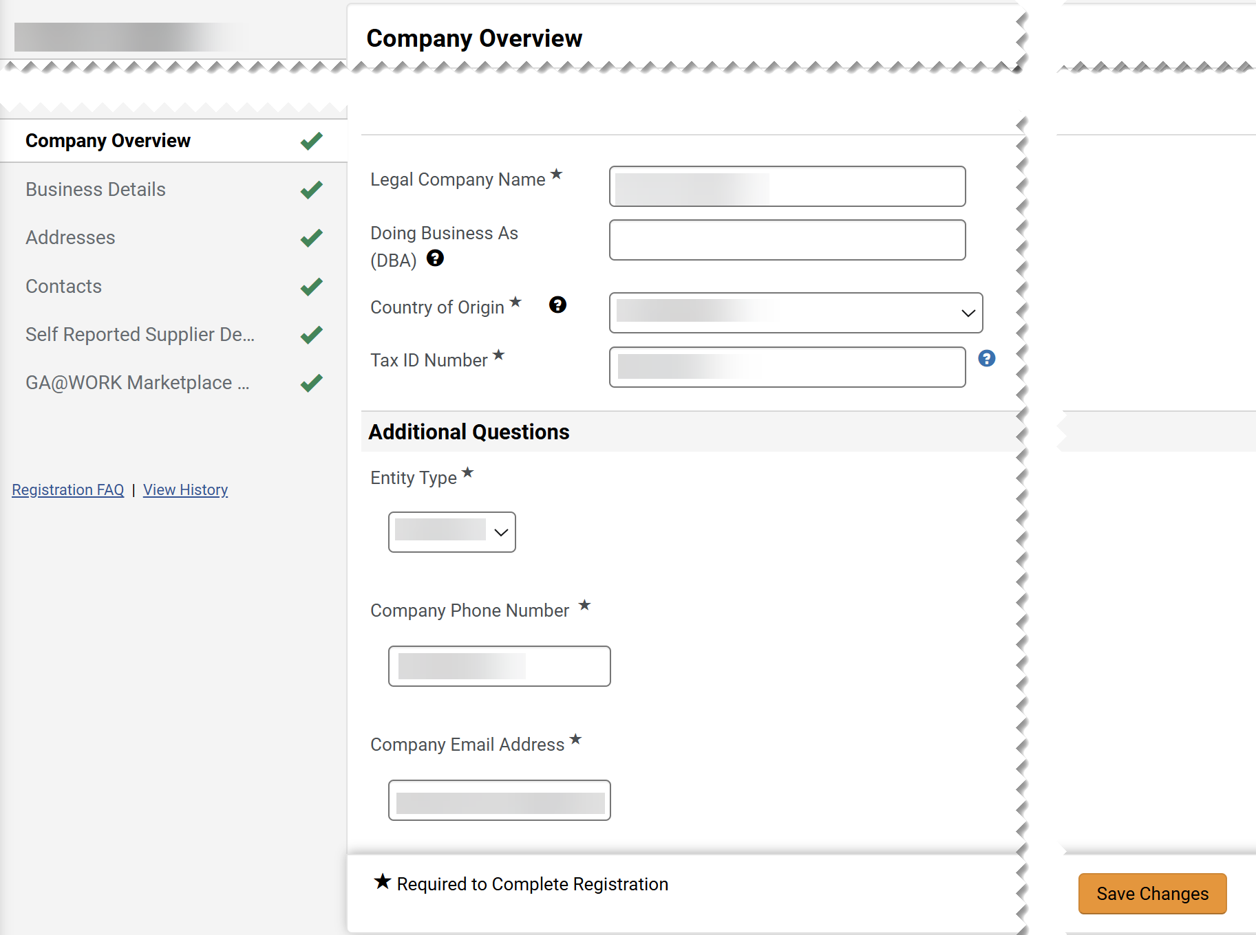
Update Supplier Profile Information
(Part 11 of 42)
INSTRUCTIONS
Edit Company Overview fields.
Note: Company Overview fields will auto-populate but can be edited.
Click Save Changes.
27
28

Slide 13
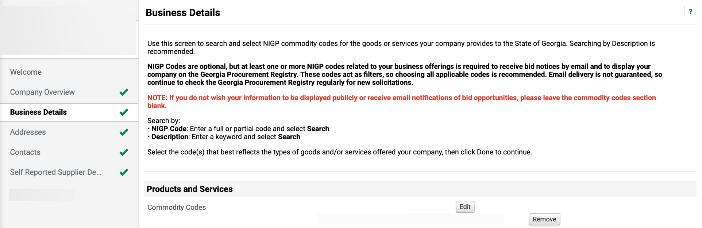
Update Supplier Profile Information
(Part 12 of 42)
INSTRUCTIONS
Click Business Details.
Click Edit to select Commodity Codes.
Note: Commodity Codes (NIGP Codes) are optional, but at least one or more Commodity Codes related to your business offerings is required to receive bid notices by email and to display your company on the Georgia Procurement Registry. If you do not wish for your information to be displayed publicly or receive email notifications of bid opportunities, please leave the Commodity Codes section blank and skip to Step 35. Click Remove next to applicable Commodity Code(s).
29
30

Slide 14
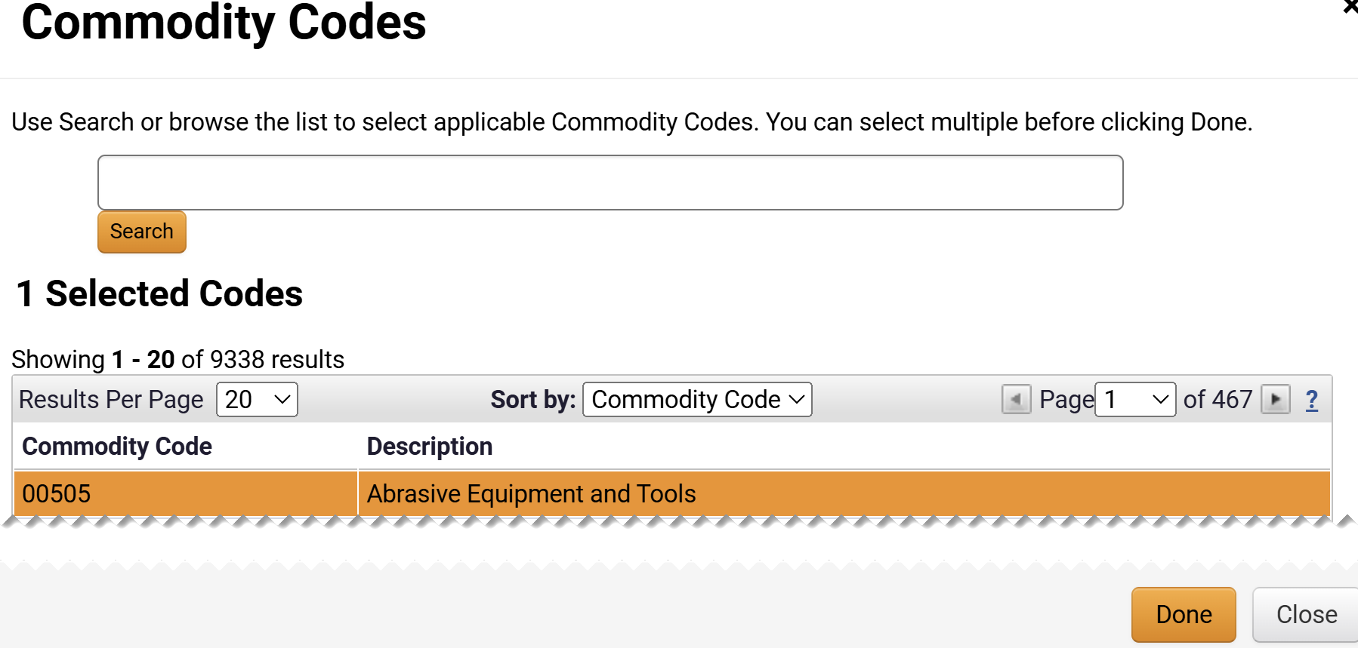
Update Supplier Profile Information
(Part 13 of 42)
INSTRUCTIONS
Select the Commodity Code.
Note: Use Search or browse list to select a Commodity Code. Multiple Commodity Codes can be selected. Click twice to remove Commodity Code(s).
Click Done.
31
32

Slide 15
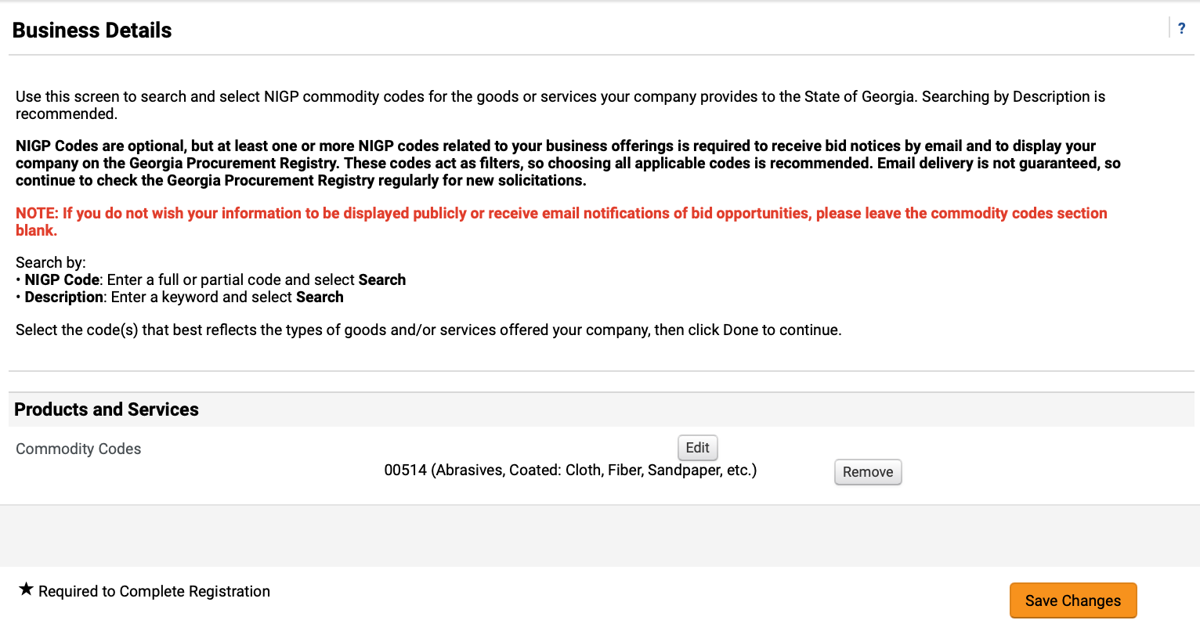
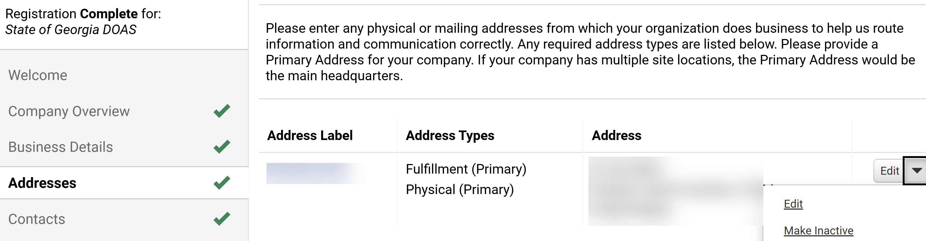
Update Supplier Profile Information
(Part 14 of 42)
INSTRUCTIONS
Click Remove to delete the selected Commodity Code (Optional).
Click Save Changes.
33
34
Click Addresses.
Click Address Label hyperlink.
Note: To remove Address, click the dropdown arrow then select Make Inactive next to it. To Add Address, skip to Step 39.
35
36

Slide 16
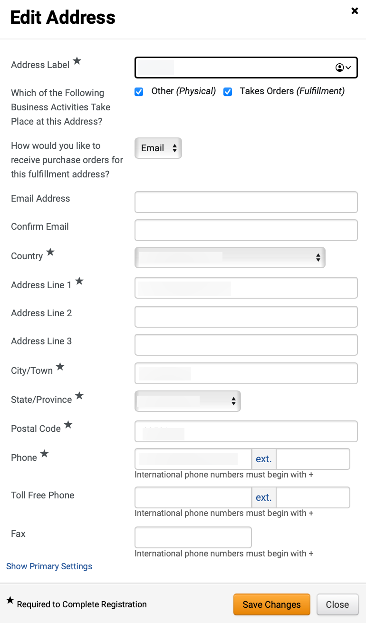
Update Supplier Profile Information
(Part 15 of 42)
INSTRUCTIONS
Edit Address fields.
Click Save Changes.
37
38

Slide 17
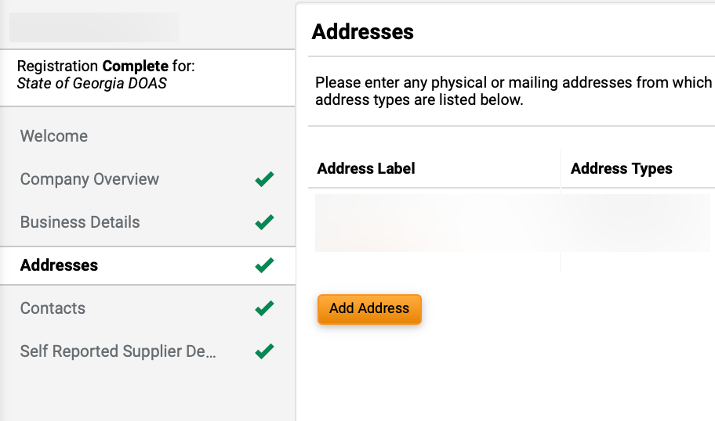
Update Supplier Profile Information
(Part 16 of 42)
INSTRUCTIONS
Click Add Address.
Note: If Other (physical) is selected, follow Steps 40-65 or skip to Step 66 if Takes Orders (fulfillment) is selected.

Slide 18
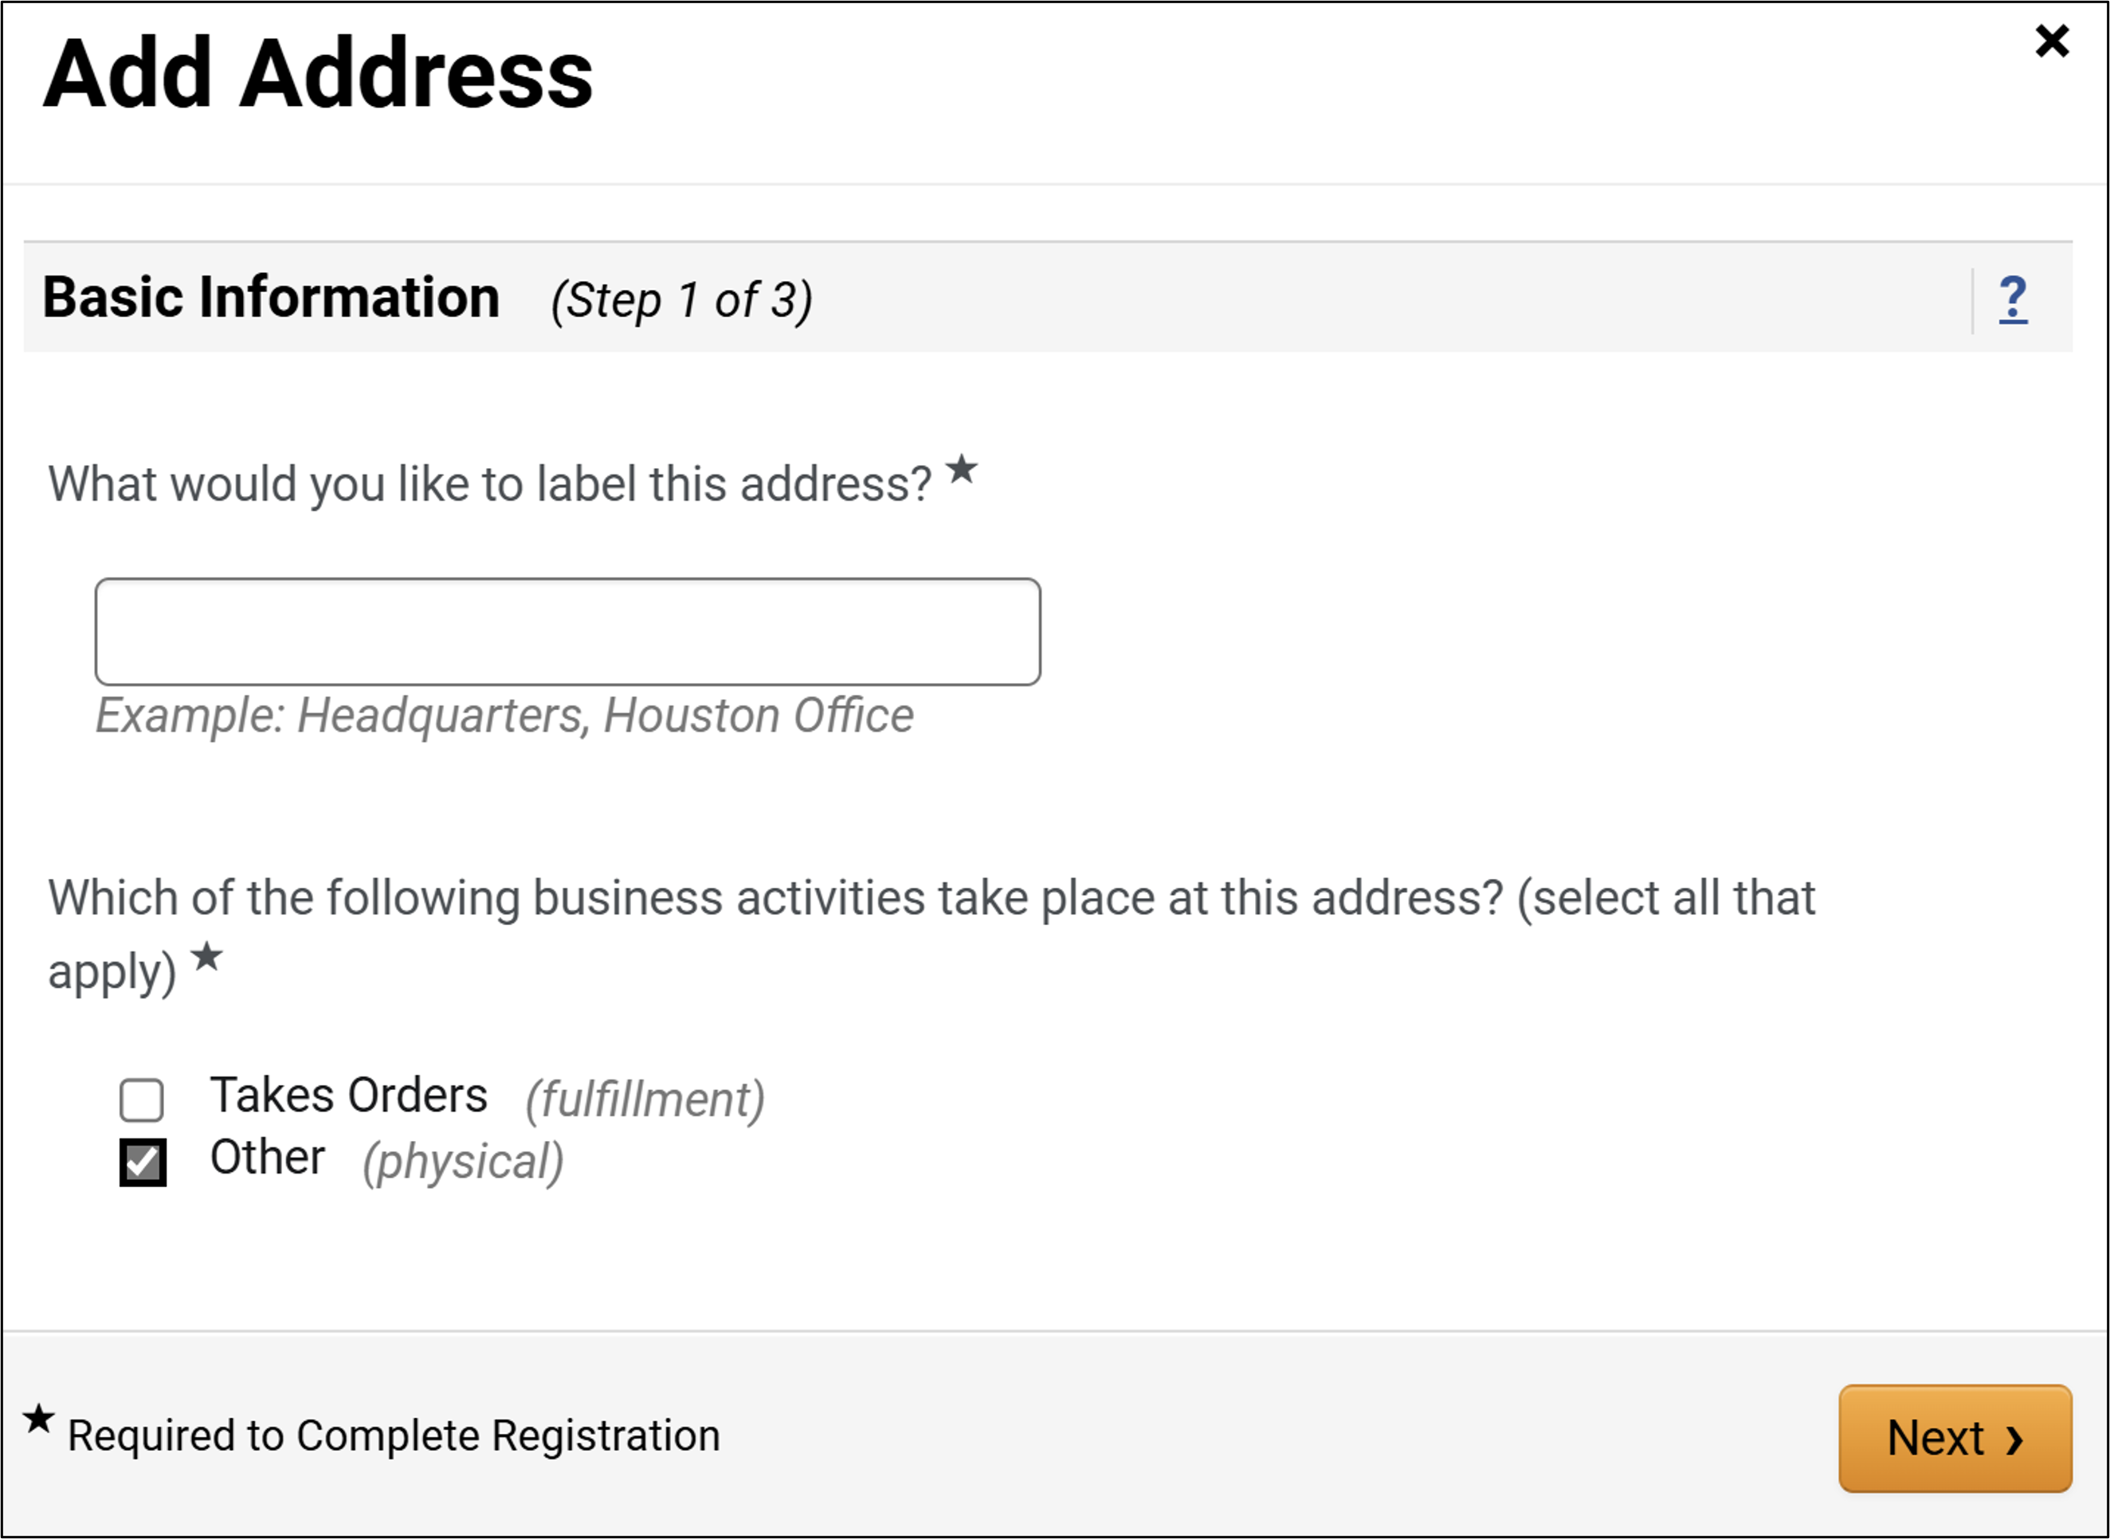
Update Supplier Profile Information
(Part 17 of 42)
INSTRUCTIONS
For Other (Physical) enter What would you like to label this address?*.
Select Other (physical).
Click Next.
40
41
42

Slide 19
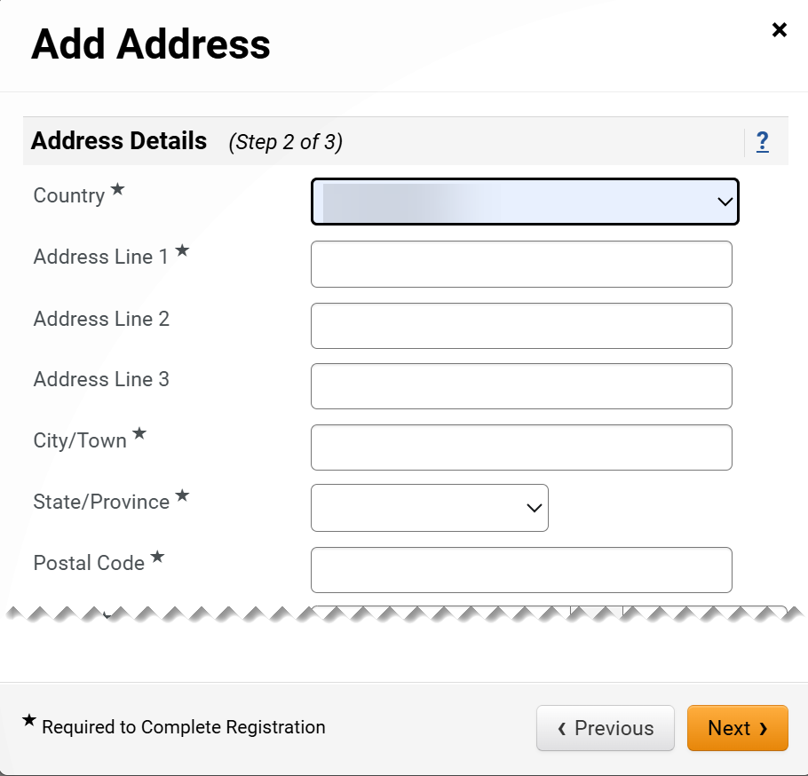
Update Supplier Profile Information
(Part 18 of 42)
INSTRUCTIONS
Select Country*.
Enter Address Line 1*.
If applicable, enter Address Line 2 or Line 3.
Enter City/Town*.
Enter State/Province*.
Enter Postal Code*.
43
44
45
46
47
48

Slide 20
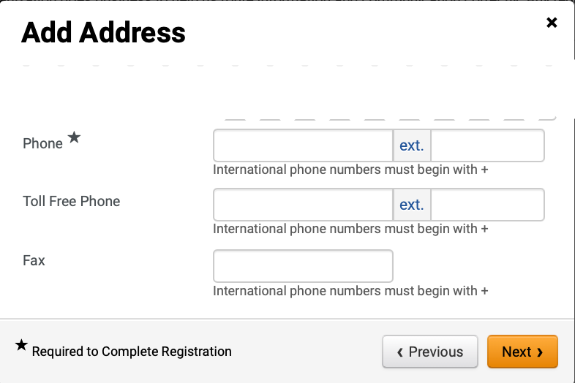
Update Supplier Profile Information
(Part 19 of 42)
INSTRUCTIONS
Enter Phone*.
Enter Toll Free Phone (optional).
Enter Fax (optional).
Click Next.
49
50
51
52

Slide 21
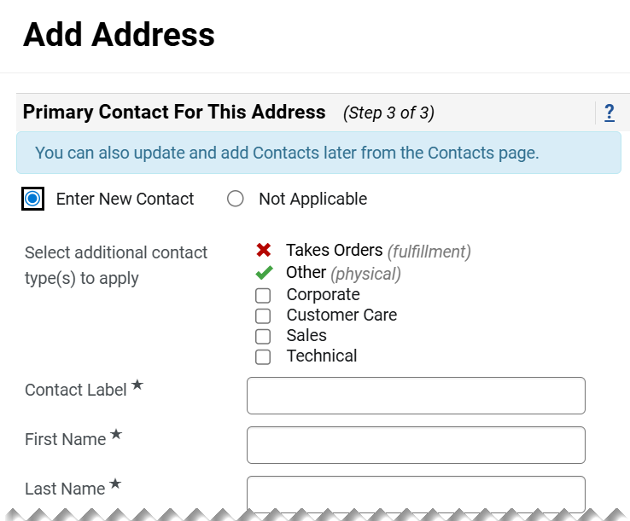
Update Supplier Profile Information
(Part 20 of 42)
INSTRUCTIONS
Check Enter New Contact box.
Select additional contact type(s) to apply (Optional).
Enter a Contact Label*.
Enter a First Name*.
Enter a Last Name*.
53
54
55
56
57

Slide 22
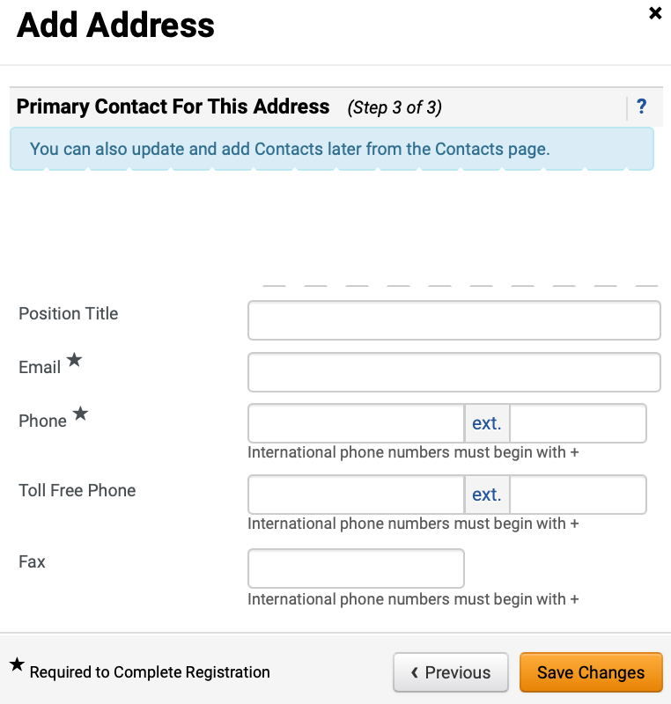
Update Supplier Profile Information
(Part 21 of 42)
INSTRUCTIONS
Enter a Position Title (optional).
Enter an Email*.
Enter a Phone*.
If applicable, enter a Toll Free Phone (optional).
Enter a Fax (optional).
Click Save Changes.
58
59
60
61
62
63

Slide 23
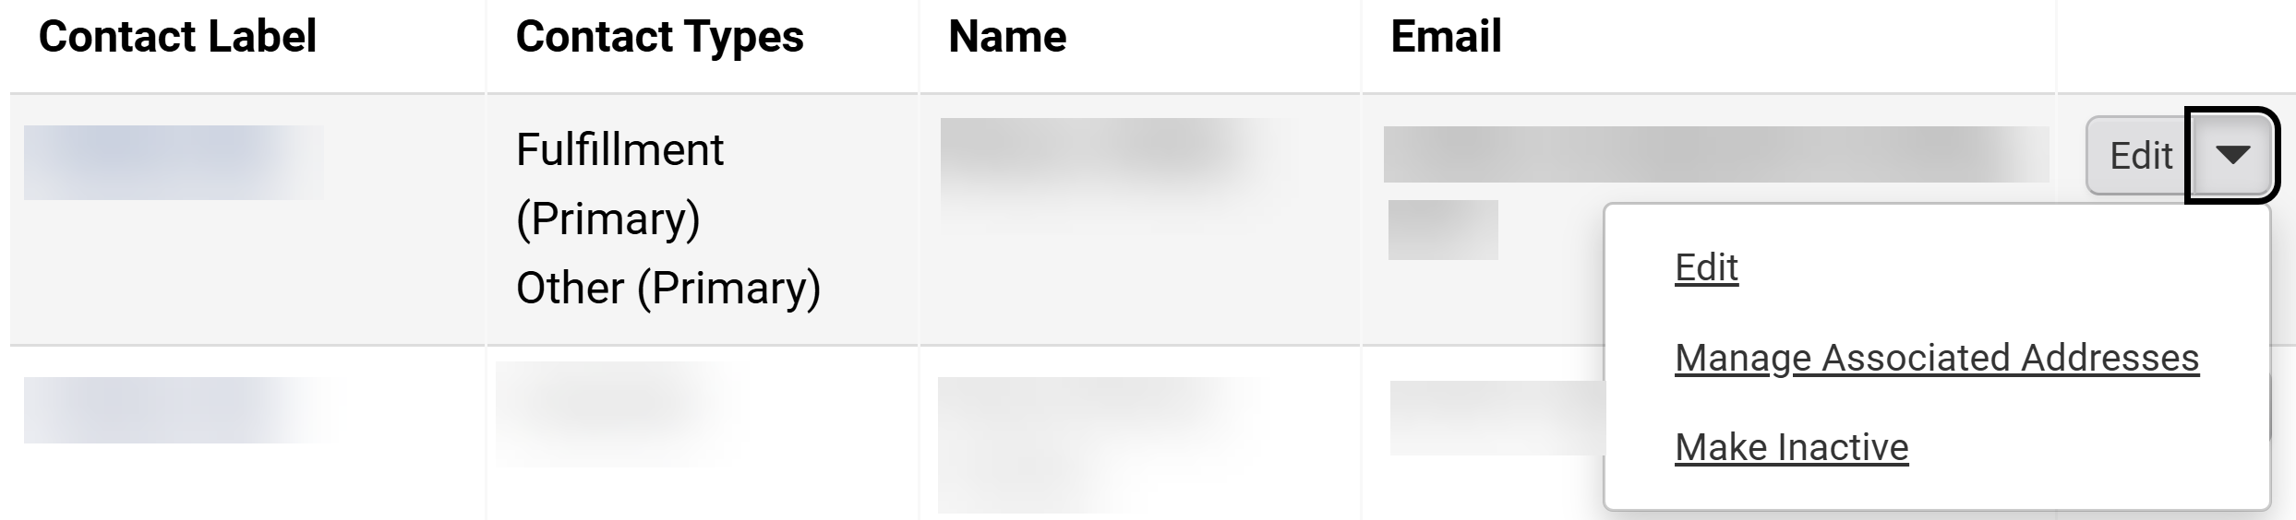
Update Supplier Profile Information
(Part 22 of 42)
INSTRUCTIONS
Review added Contact.
Click Edit.
Note: To remove Contact, click the dropdown arrow then select Make Inactive next to it. To Manage Associated Addresses, skip to Step 40. To Add Corporate Contact, skip to Step 66.
65
64

Slide 24
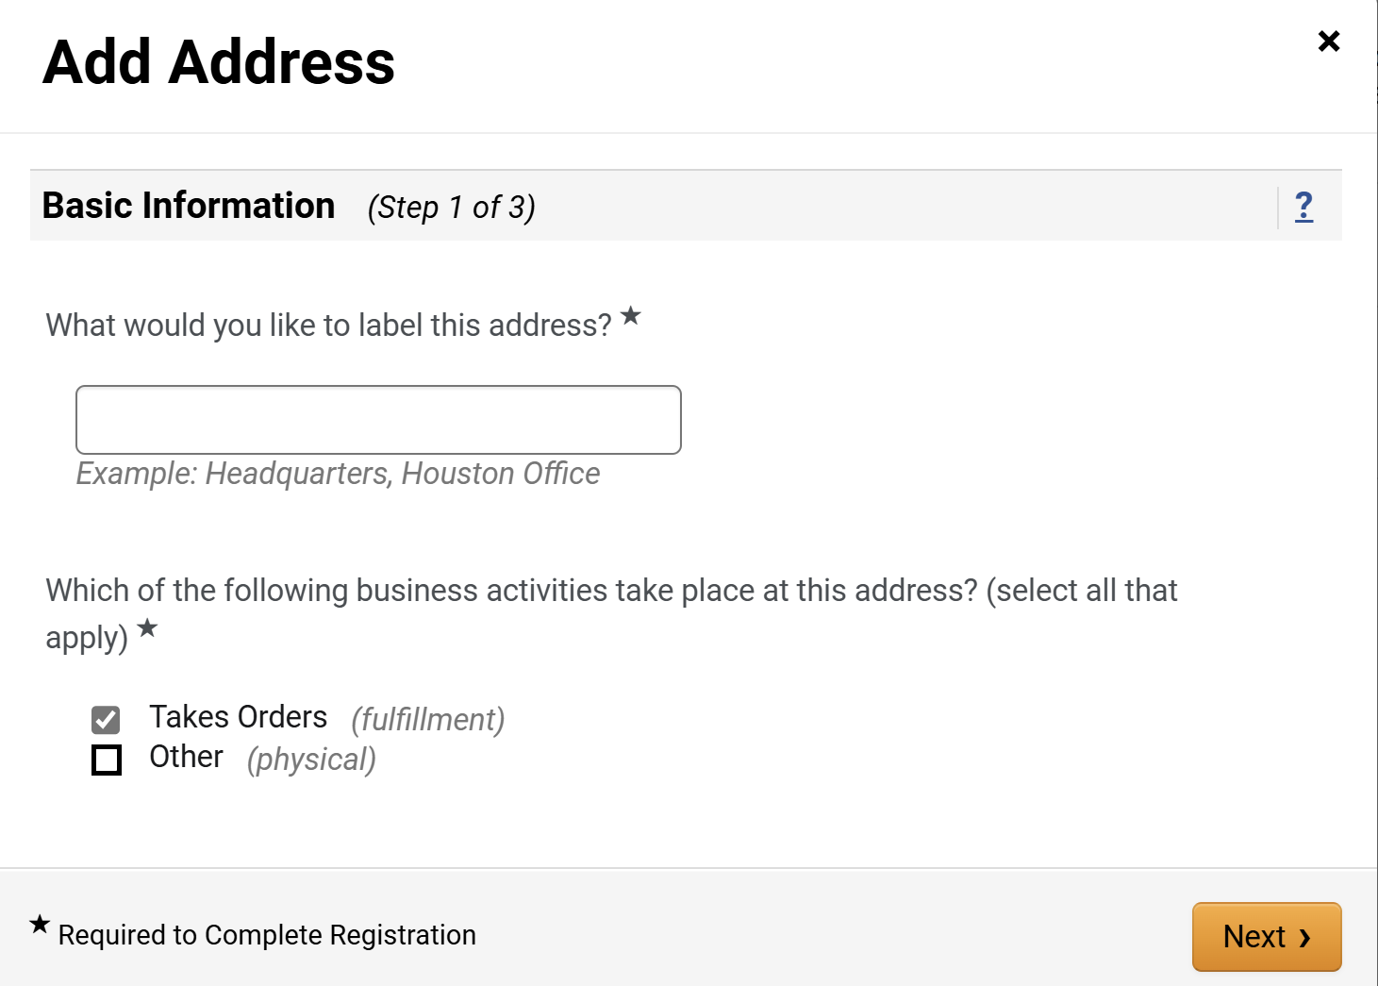
Update Supplier Profile Information
(Part 23 of 42)
INSTRUCTIONS
For Take Orders (fulfillment), enter What would you like to label this address?*.
Select Takes Orders (fulfillment) for Which of the following business activities take place at this address?*.
Click Next.
66
67
68

Slide 25
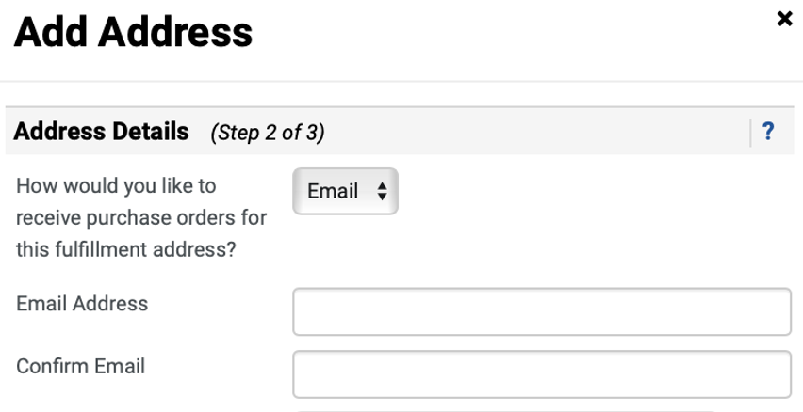
Update Supplier Profile Information
(Part 24 of 42)
INSTRUCTIONS
Select Email for How would you like to receive purchase orders for this fulfillment address?.
Note: If Email is selected, follow Steps 69-71. If Fax is selected, follow Steps 72-73. If Mail is selected follow Step 74. Once How would you like to receive purchase orders for this fulfillment address is complete, skip to Step 75.
Enter an Email Address.
Enter a Confirm Email.
69
70
71

Slide 26
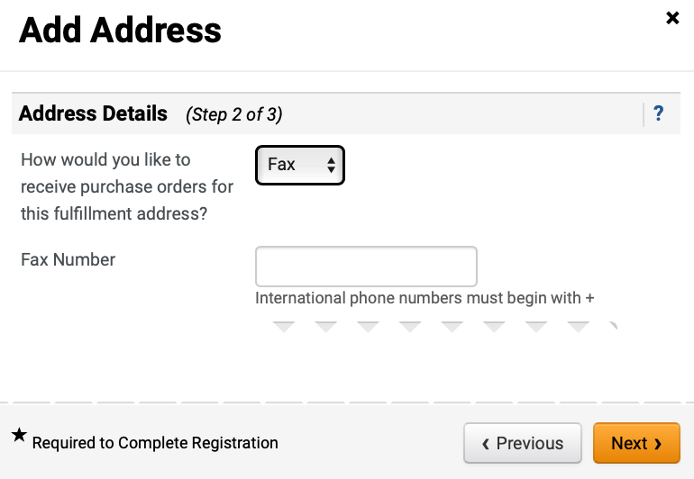
Update Supplier Profile Information
(Part 25 of 42)
INSTRUCTIONS
Select Fax for How would you like to receive purchase orders for this fulfillment address?.
Note: User can select Email, Fax, or Mail.
Enter Fax Number.
72
73

Slide 27
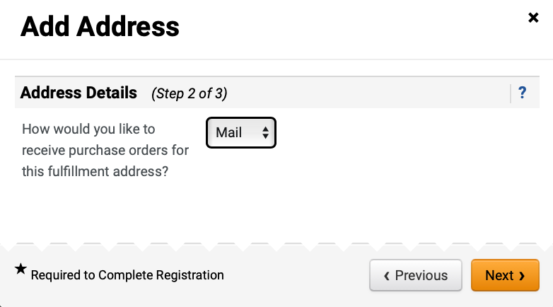
Update Supplier Profile Information
(Part 26 of 42)
INSTRUCTIONS
Select Mail for How would you like to receive purchase orders for this fulfillment address?.
Note: User can select Email, Fax, or Mail.

Slide 28
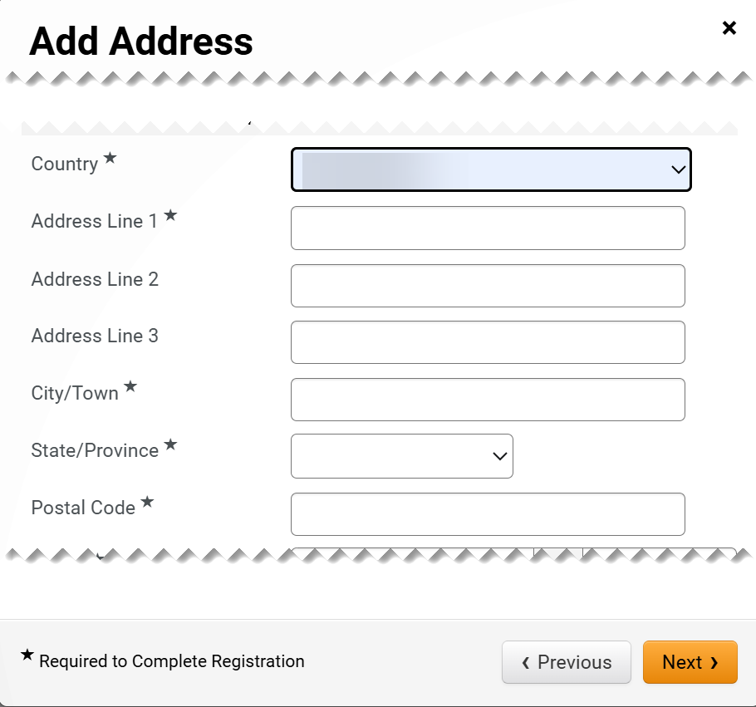
Update Supplier Profile Information
(Part 27 of 42)
INSTRUCTIONS
Select Country*.
Enter Address Line 1*.
If applicable, enter Address Line 2 or Line 3.
Enter City/Town*.
Enter State/Province*.
Enter Postal Code*.
75
76
77
78
79
80

Slide 29
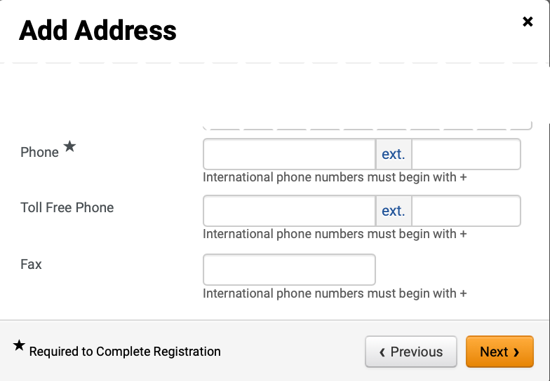
Update Supplier Profile Information
(Part 28 of 42)
INSTRUCTIONS
Enter Phone*.
Enter Toll Free Phone (optional).
Enter Fax (optional).
Click Next.
81
82
83
84

Slide 30
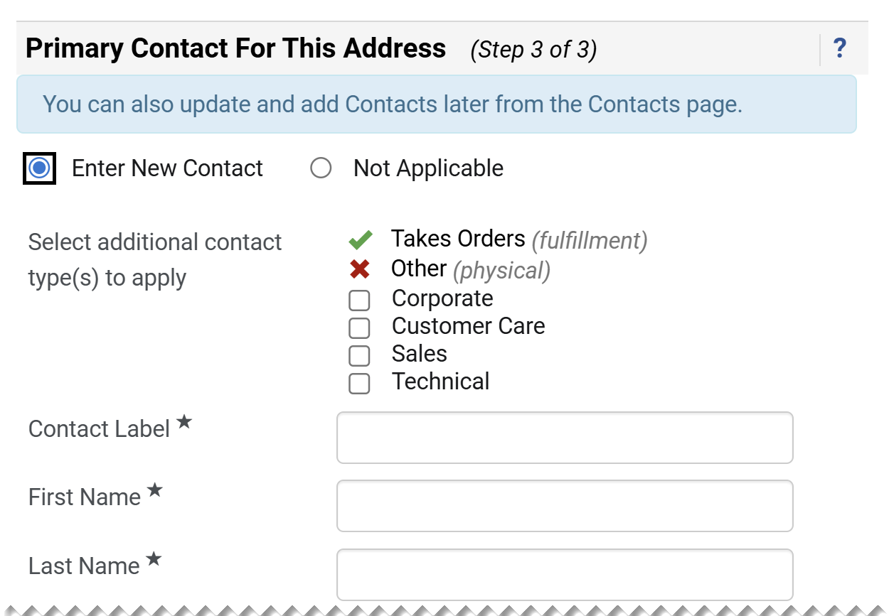
Update Supplier Profile Information
(Part 29 of 42)
INSTRUCTIONS
Check Enter New Contact box.
Select additional contact type(s) to apply (Optional).
Enter a Contact Label*.
Enter a First Name*.
Enter a Last Name*.
85
86
87
88
89

Slide 31
Update Supplier Profile Information
(Part 30 of 42)
INSTRUCTIONS
Enter a Position Title (optional).
Enter an Email*.
Enter a Phone*.
Enter a Toll Free Phone (optional).
Enter a Fax (optional).
Click Save Changes.
90
91
92
93
94
95

Slide 32
Update Supplier Profile Information
(Part 31 of 42)
INSTRUCTIONS
Review added Contact.
Click Edit.
Note: To remove Contact, click the dropdown arrow then select Make Inactive next to it. To Manage Associated Addresses, skip to Step 100. To Add Corporate Contact, skip to Step 111.
97
96

Slide 33
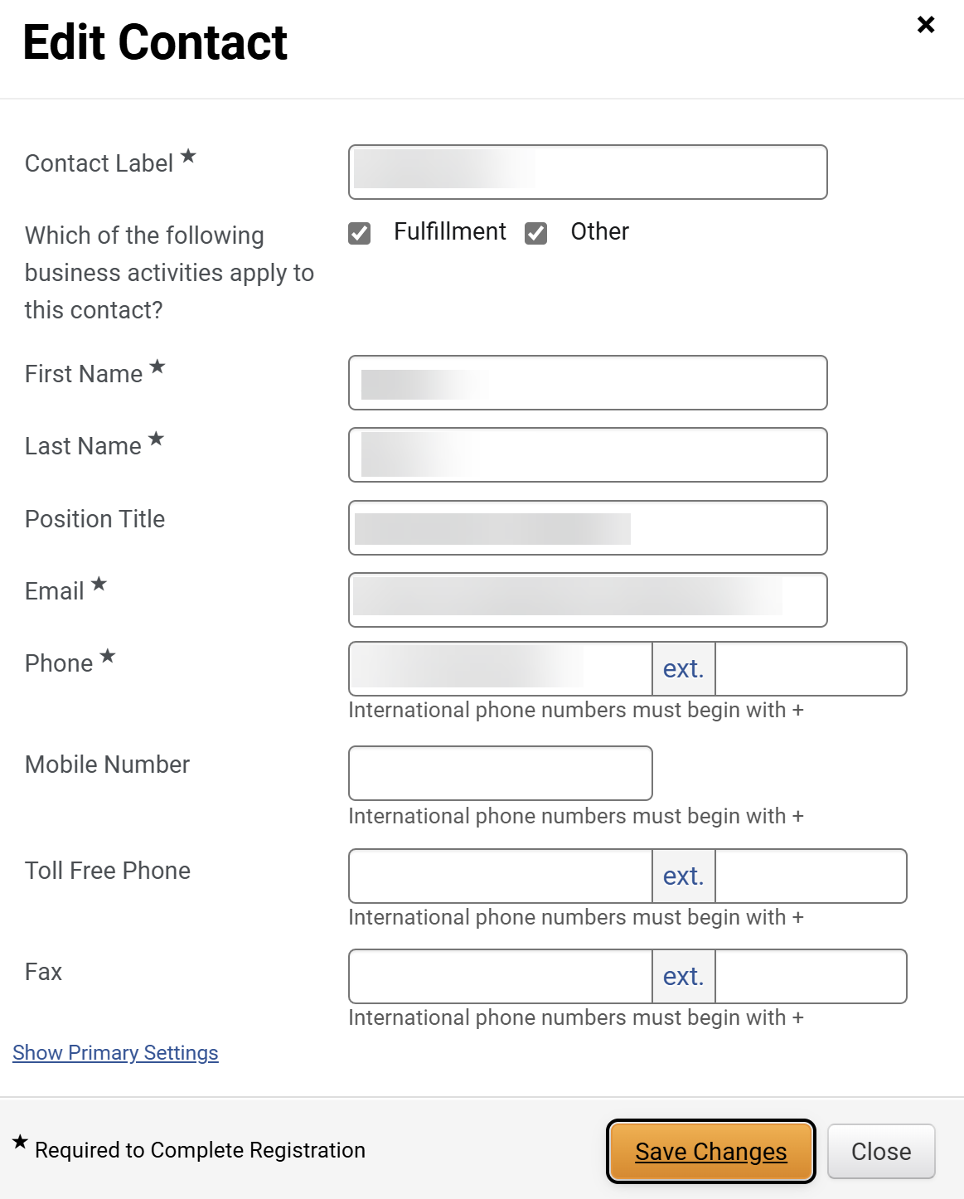
Update Supplier Profile Information
(Part 32 of 42)
INSTRUCTIONS
Edit Contact fields.
Click Save Changes.
98
99

Slide 34
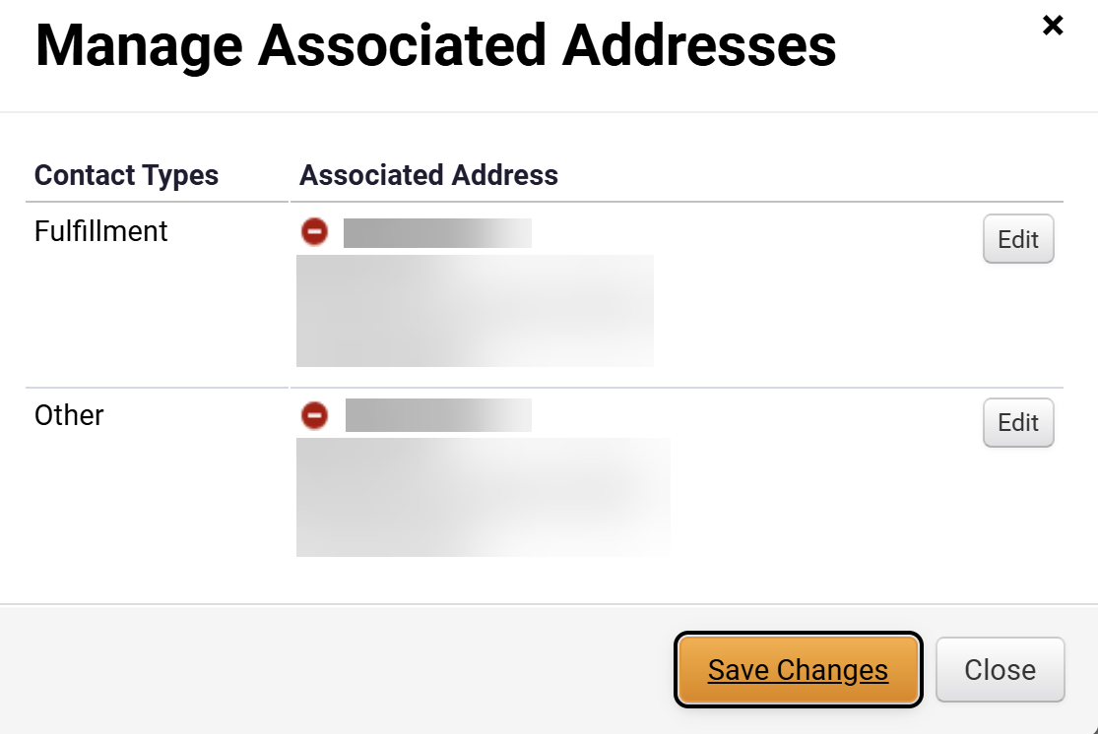
Update Supplier Profile Information
(Part 33 of 42)
INSTRUCTIONS
Review edited Contact.
Click the dropdown.
Click Manage Associated Addresses.
101
100
102
Click Edit.
Note: To remove Address, click the red icon next to it.
103

Slide 35
Update Supplier Profile Information
(Part 34 of 42)
INSTRUCTIONS
Review edited Contact.
Click the dropdown.
Click Manage Associated Addresses.
105
104
106
Click Edit.
Note: To remove Address, click the red icon next to it.
107

Slide 36
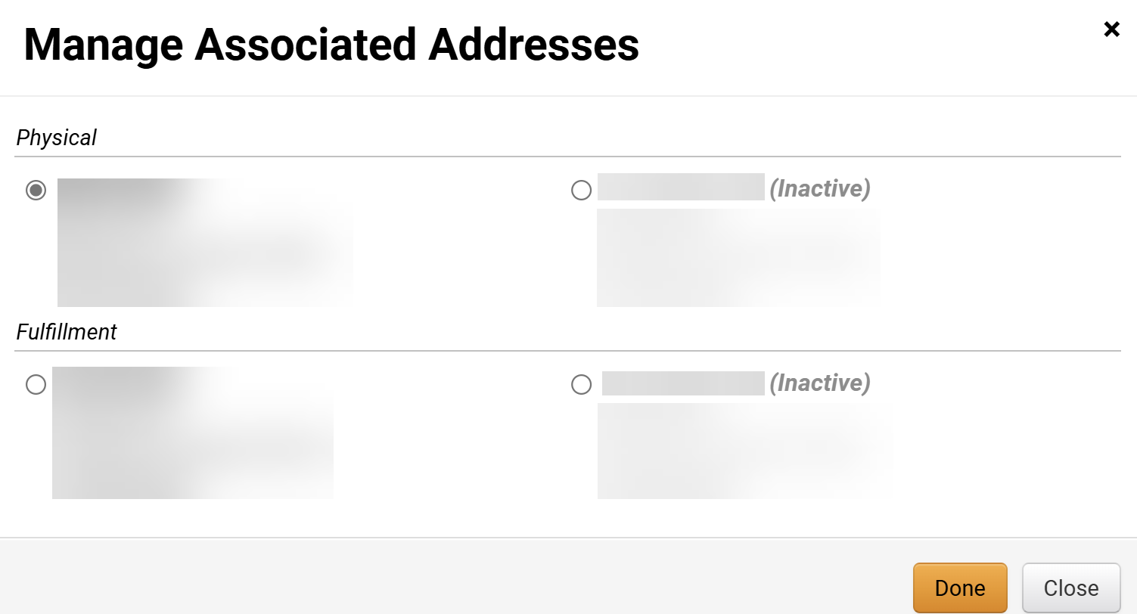
Update Supplier Profile Information
(Part 35 of 42)
INSTRUCTIONS
Select Address.
Note: Inactive Address are also listed with “Inactive”
next to it.
Click Done.
108
109
Click Save Changes.
Note: To remove Address, click the red icon next to it.
110

Slide 37
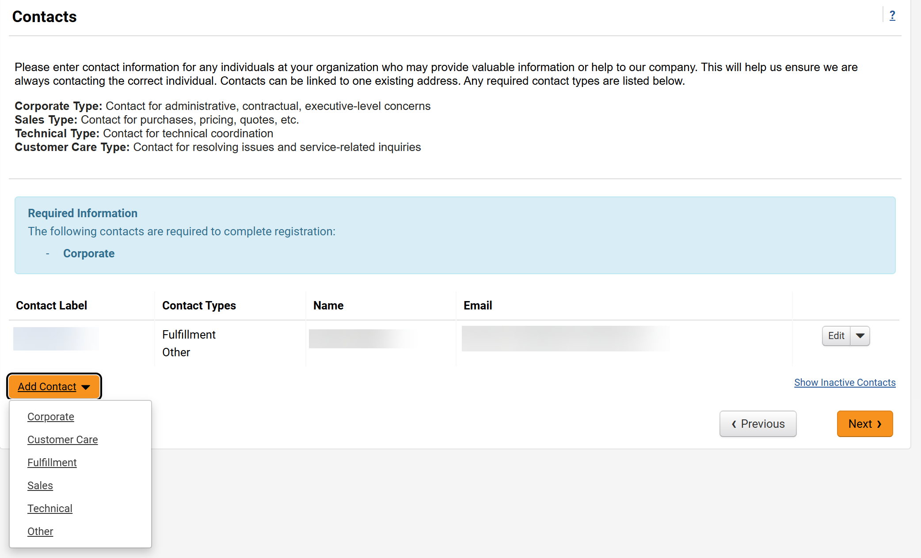
Update Supplier Profile Information
(Part 36 of 42)
INSTRUCTIONS
Click Add Contact.
Note: The Corporate Contact is a required contact that should be authorized to represent the organization concerning financial matters.
Select Corporate.
111
112

Slide 38
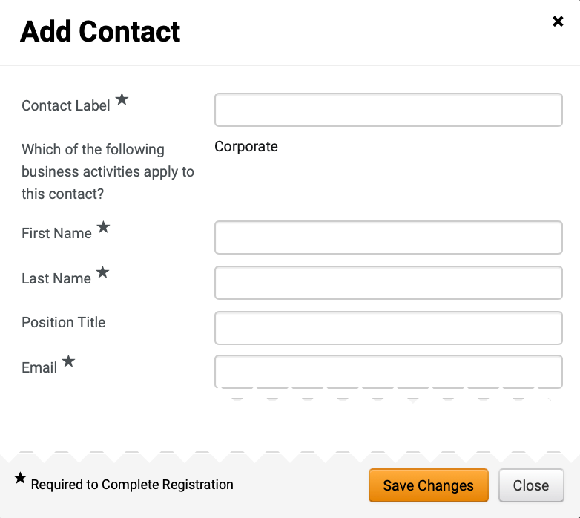
Update Supplier Profile Information
(Part 37 of 42)
INSTRUCTIONS
Enter Contact Label*.
Review Corporate auto-populates Which of the following business activities apply to this contact?
Enter First Name*.
Enter Last Name*.
Enter Position Title (optional).
Enter Email*.
113
114
115
116
117
118

Slide 39
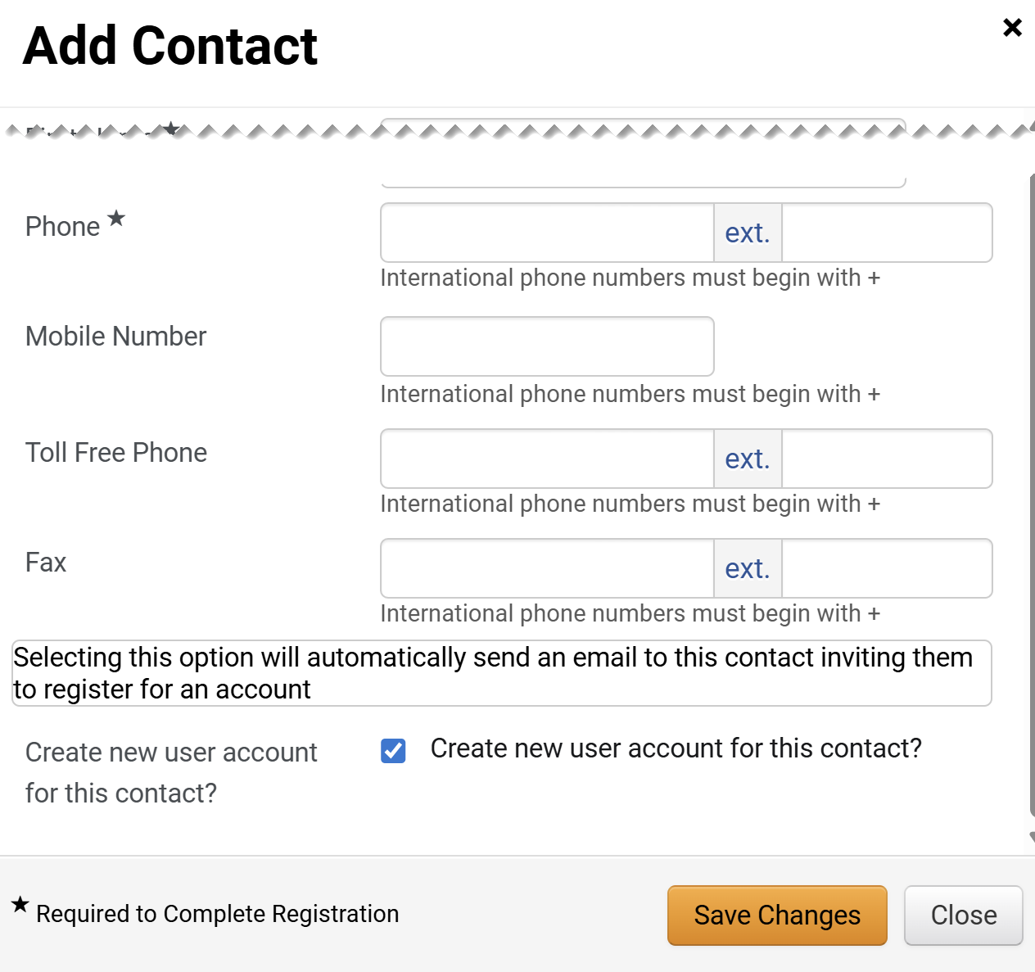
Update Supplier Profile Information
(Part 38 of 42)
INSTRUCTIONS
Enter Phone*.
Enter Mobile Number (optional).
Enter Toll Free Phone (optional).
Enter Fax (optional).
Check the Create new user account for this contact? box.
Note: This is only applicable if Corporate is selected as the Contact Type. If selected, an email inviting the contact to register for an account will be automatically sent to set up login credentials for the contact.
Click Save Changes.
119
120
121
122
123
124

Slide 40
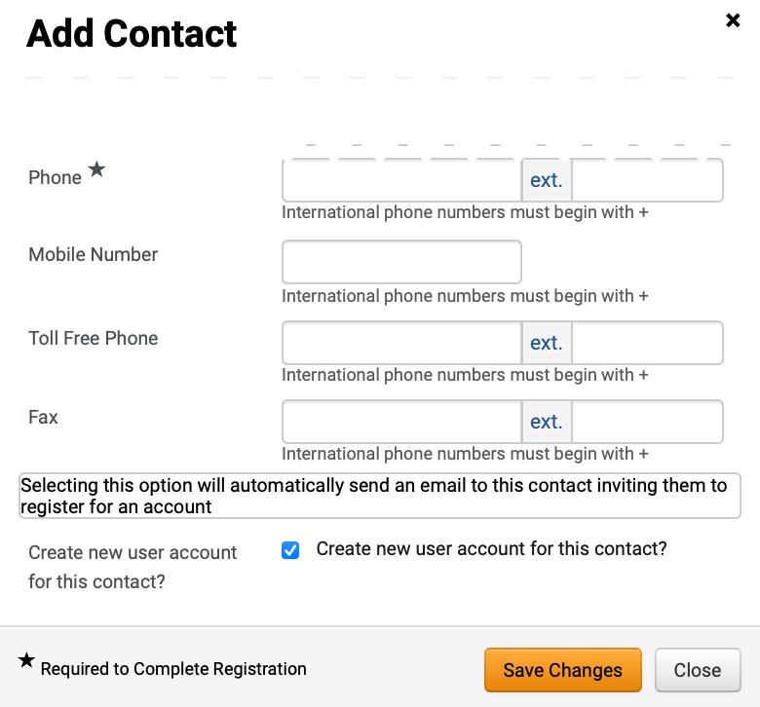
Update Supplier Profile Information
(Part 39 of 42)
INSTRUCTIONS
Enter Phone*.
Enter Mobile Number (optional).
Enter Toll Free Phone (optional).
Enter Fax (optional).
Select Create new user account for this contact? (optional).
Click Save Changes.
125
126
127
128
129
130

Slide 41
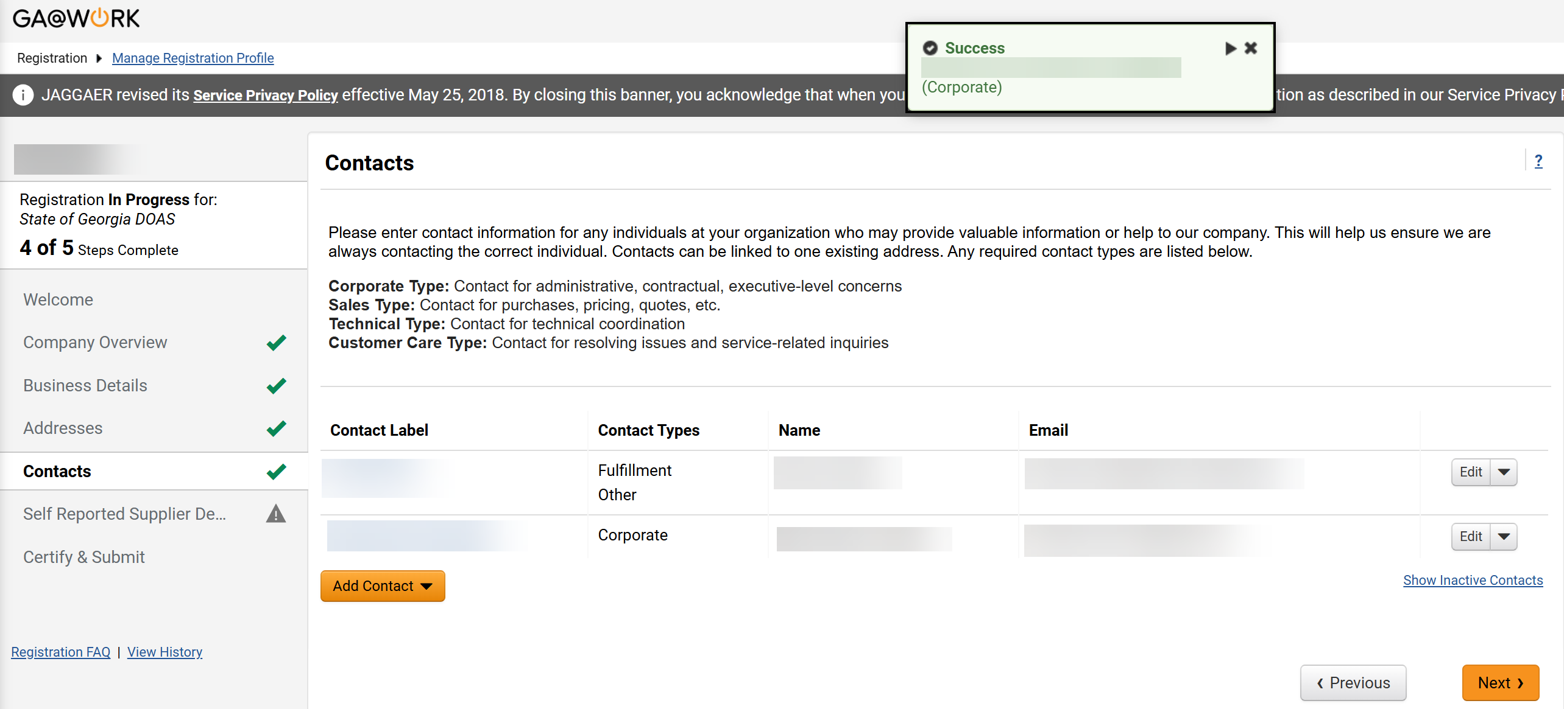
Update Supplier Profile Information
(Part 40 of 42)
INSTRUCTIONS
Review success notification.
Review added Contact.
Note: The Step Complete icon will be visible next to the Contacts tab.
Click Next.
131
132
133

Slide 42
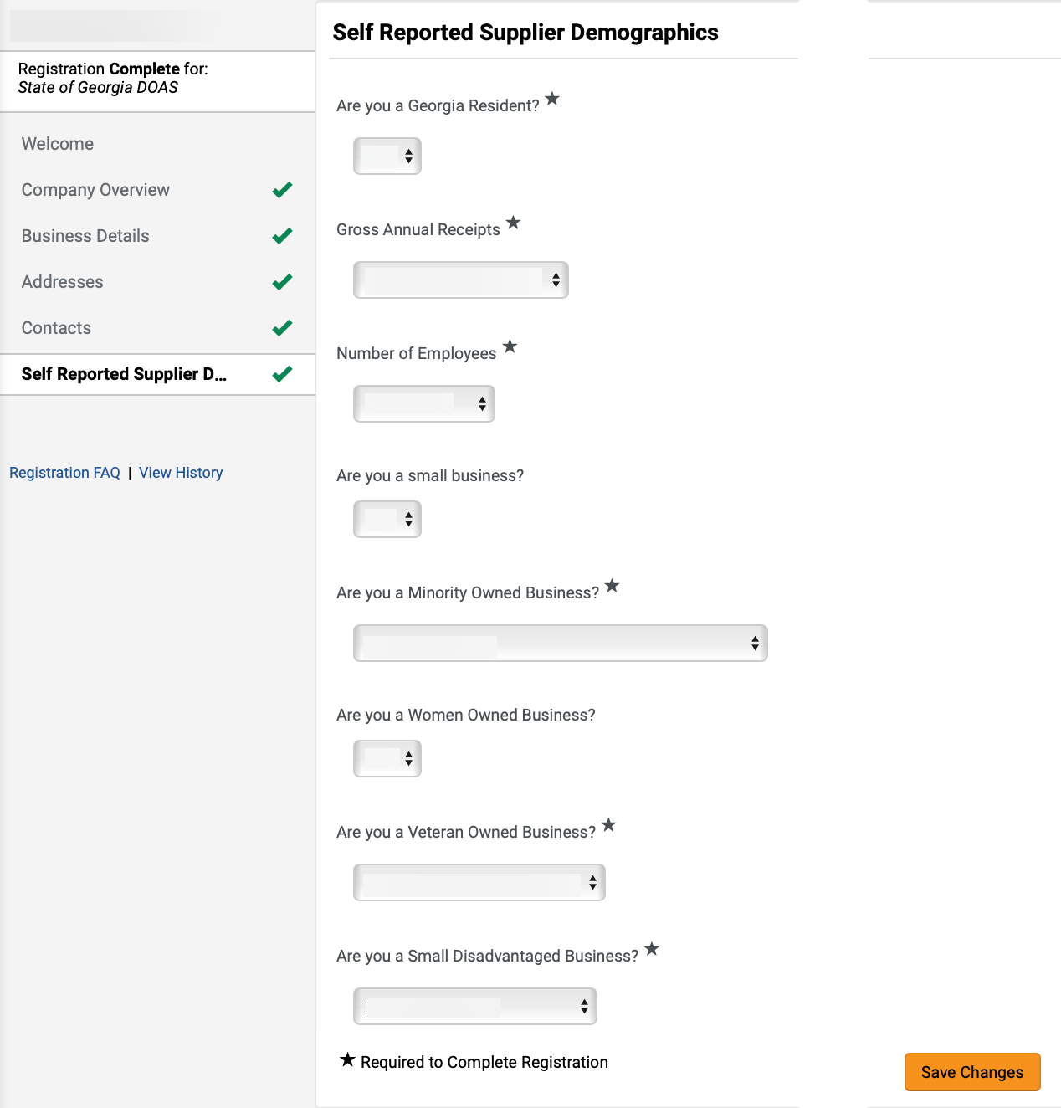
Update Supplier Profile Information
(Part 41 of 42)
INSTRUCTIONS
Click Self Reported Supplier Demographics.
Edit Self Reported Supplier Demographics fields.
Note: Self Reported Supplier Demographics fields will auto-populate but can be edited.
Click Save Changes.
134
135
136

Slide 43


Update Supplier Profile Information
(Part 42 of 42)
INSTRUCTIONS
Review Success notification.
You have successfully Updated Supplier Profile Information.

