Slide 1
Log in to the
GA@WORK Marketplace for Suppliers
DESCRIPTION
This guide will show Suppliers how to Log in to the GA@WORK Marketplace for Suppliers.
Note: Prior registration as a supplier is required to complete the steps in this guide.
OVERVIEW
The key steps in the process are below:
Access the Supplier Portal.
Access the Public Opportunities.
Search Business Opportunities.
Select Event.
Business Process:
Access Supplier Portal
Access Public Opportunities
Search Opportunities
Select Event

Slide 2
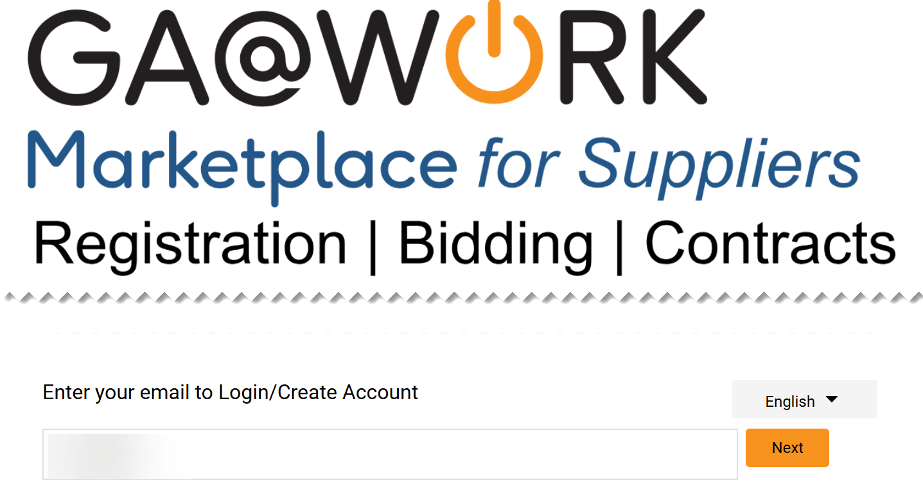
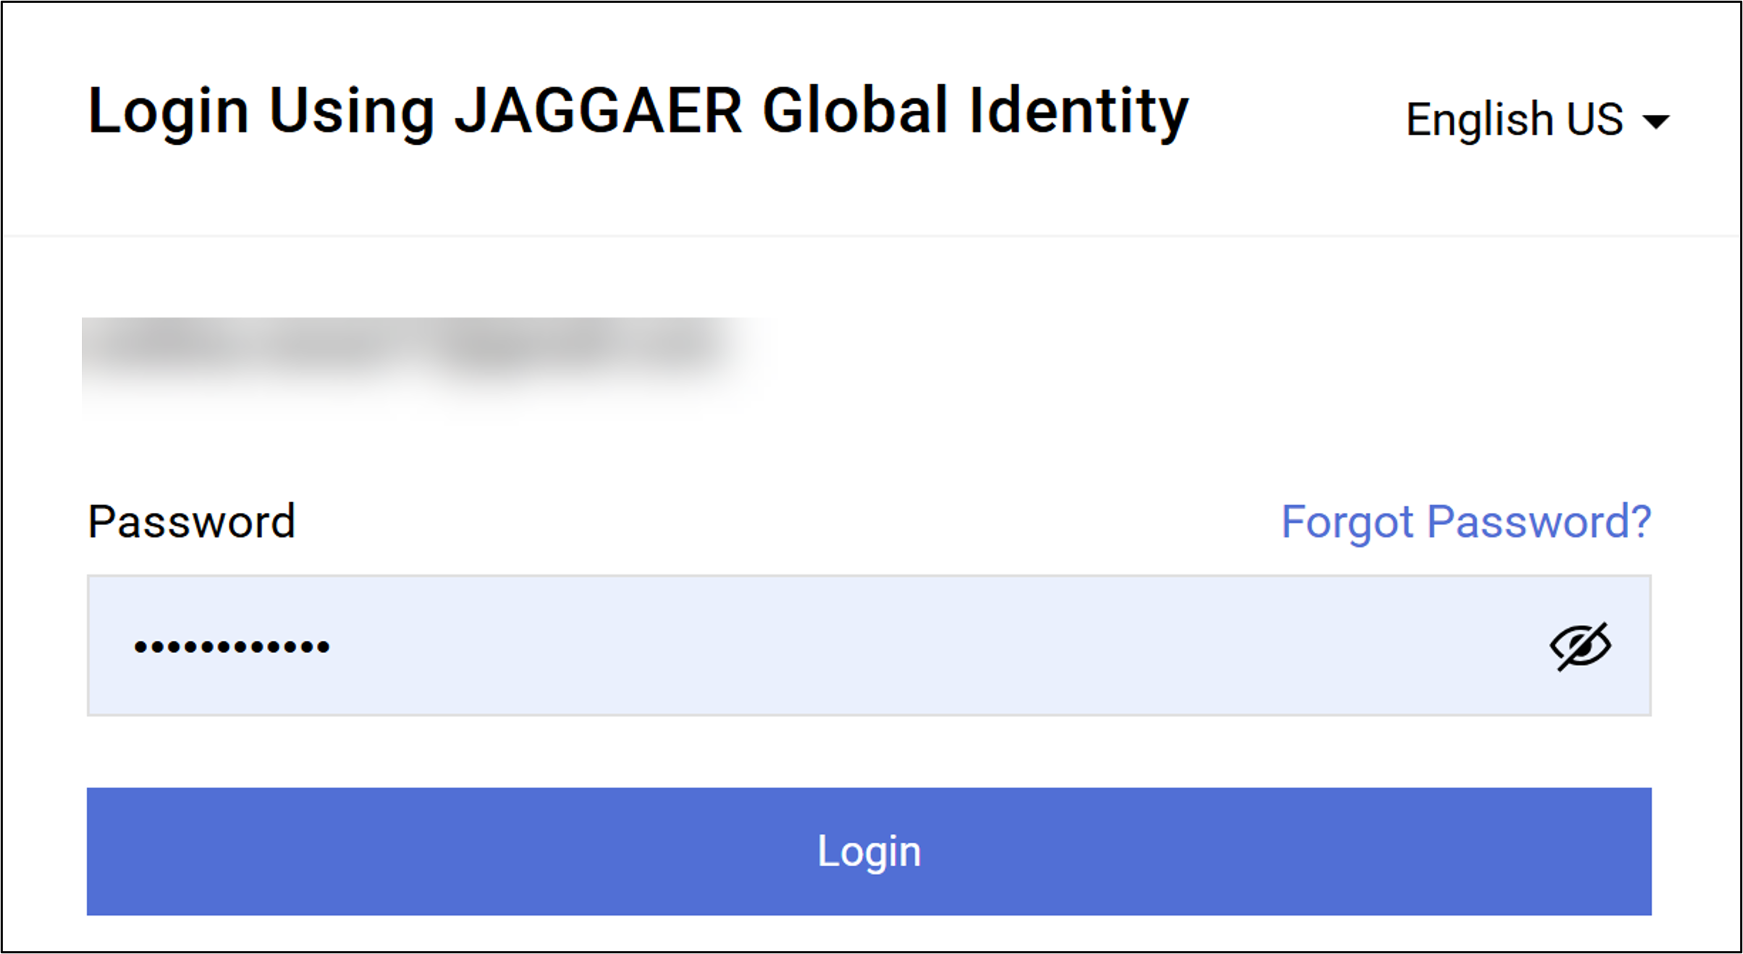
Log in to the GA@WORK Marketplace for Suppliers (Part 1 of 10)
INSTRUCTIONS
Enter your email to Log in.
Click Next.
1
2
Enter your Password.
Click Login.
3
4

Slide 3
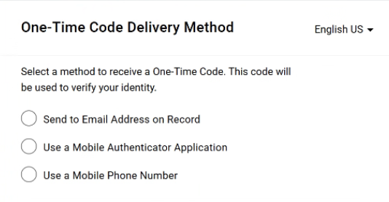
Log in to the GA@WORK Marketplace for Suppliers (Part 2 of 10)
INSTRUCTIONS
Select a method to receive a One-Time Code.
Note: Only one method can be selected to receive the code. Follow steps 6 – 10 if selecting Send to Email Address on Record. Skip to 11 – 15 if selecting Use a Mobile Authenticator Application or skip to step 16 - 22 if selecting Use a Mobile Phone Number. Once completed, skip to step 23.

Slide 4
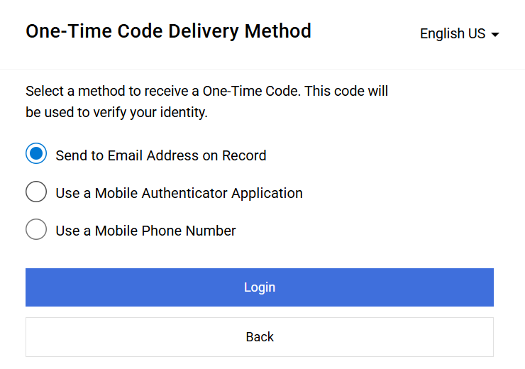
Log in to the GA@WORK Marketplace for Suppliers (Part 3 of 10)
INSTRUCTIONS
Select Send to Email Address on Record.
Click Login
6
7

Slide 5
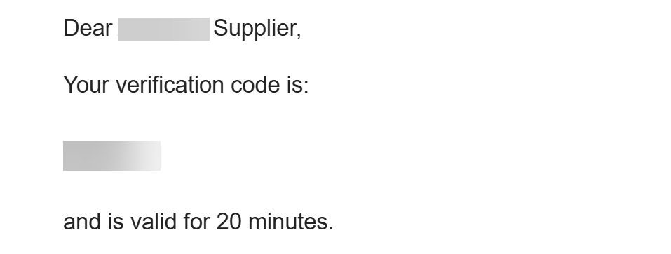
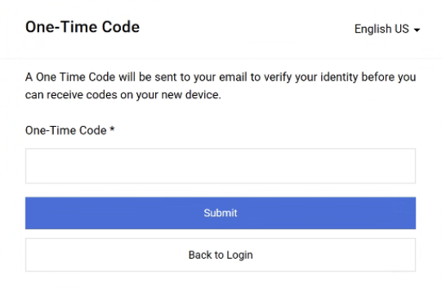
Log in to the GA@WORK Marketplace for Suppliers (Part 4 of 10)
INSTRUCTIONS
Receive and make note of the One-Time Code.
Note: The verification code is only valid for 20 minutes.
In GA@WORK Marketplace, enter your One-Time Code*.
Note: Complete all required fields marked with a black star*.
Click Submit.
Note: Skip to Step 24 to continue.
9
10

Slide 6
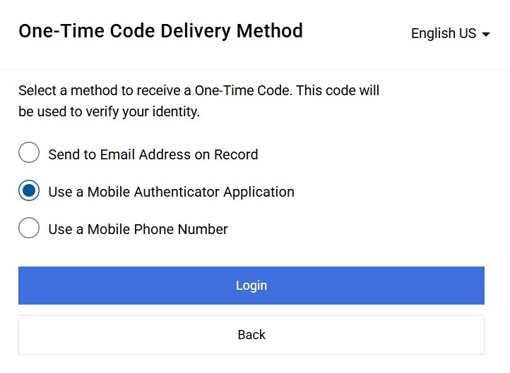
Log in to the GA@WORK Marketplace for Suppliers (Part 5 of 10)
INSTRUCTIONS
Select Use a Mobile Authenticator Application.
Click Login.
11
12

Slide 7
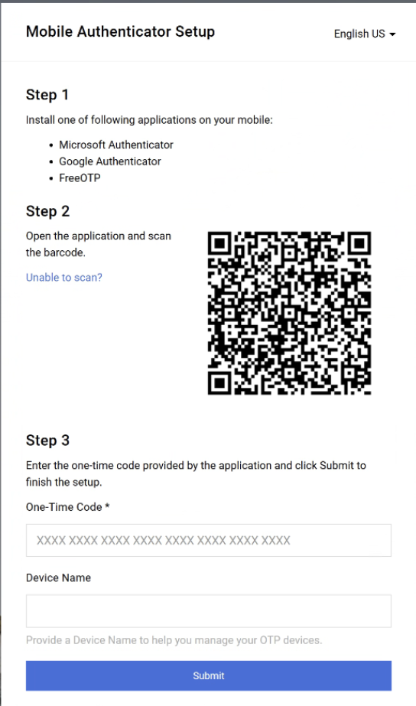
Log in to the GA@WORK Marketplace for Suppliers (Part 6 of 10)
INSTRUCTIONS
Enter One-Time Code*.
Enter Device Name (optional).
Click Submit.
Note: Skip to step 23.
13
14
15

Slide 8
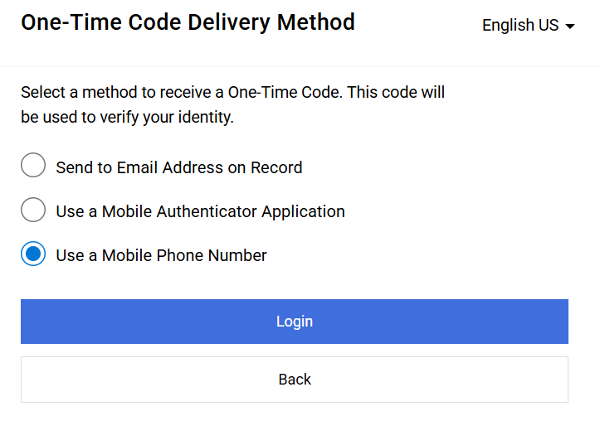
Log in to the GA@WORK Marketplace for Suppliers (Part 7 of 10)
INSTRUCTIONS
Select Use a Mobile Phone Number.
Click Login.
16
17

Slide 9
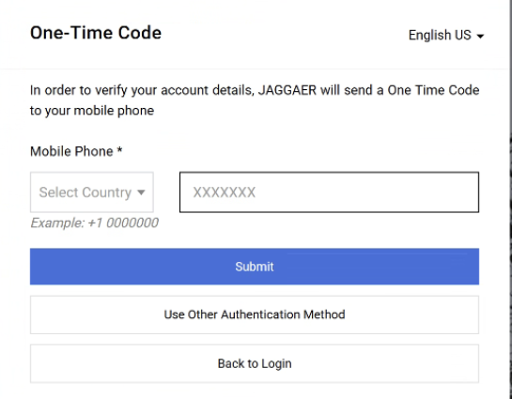
Log in to the GA@WORK Marketplace for Suppliers (Part 8 of 10)
INSTRUCTIONS
Enter Mobile Phone*.
Click Submit.
18
19

Slide 10
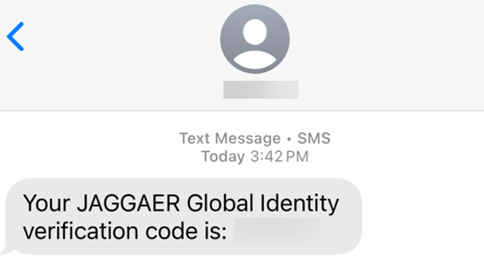
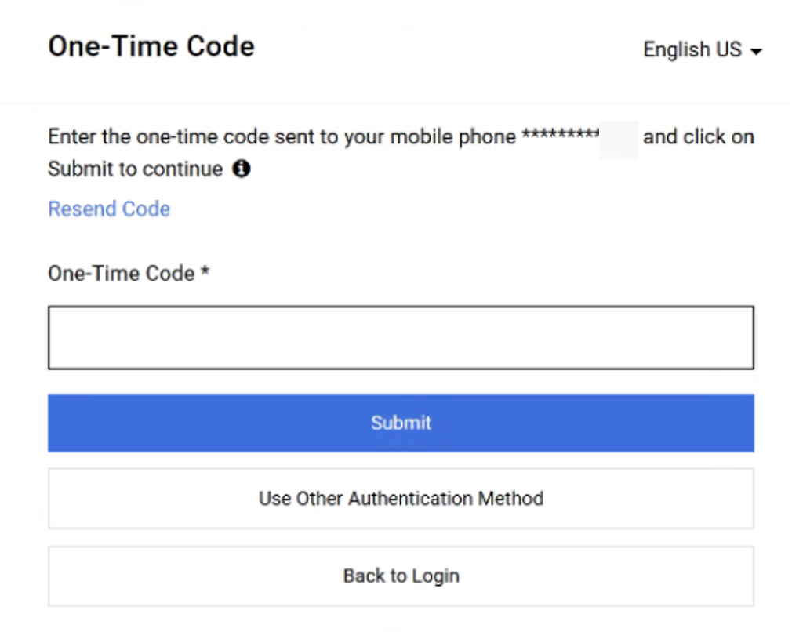
Log in to the GA@WORK Marketplace for Suppliers (Part 9 of 10)
INSTRUCTIONS
Review Verification Code sent to Mobile Phone.
Note: Message will be received from JAGGAER Global Identity.
In GA@WORK Marketplace, enter your One-Time Code*.
Click Submit.
Note: Skip to step 23.
21
22

Slide 11
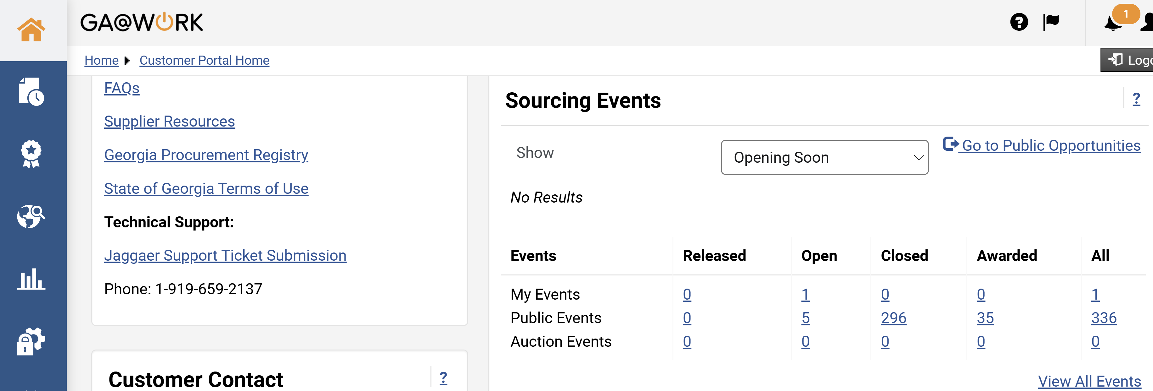
Log in to the GA@WORK Marketplace for Suppliers (Part 10 of 10)
INSTRUCTIONS
Your Homepage is displayed.
You have successfully reviewed How to Log in to the GA@WORK Marketplace for Suppliers.

