Slide 1
Managing Sourcing Event
Question and Answer (Q&A) Board
DESCRIPTION
This guide will show Buyers how to Manage Sourcing Event Question and Answer (Q&A) Board.
OVERVIEW
The key steps in the process are below:
Access the Sourcing module.
Select Search Events.
Access Q&A Board.
Manage Sourcing Event Q&A Board.
Business Process:
Access Sourcing Module
Select Search Events
Access Q&A Board
Manage Sourcing Event Q&A Board

Slide 2

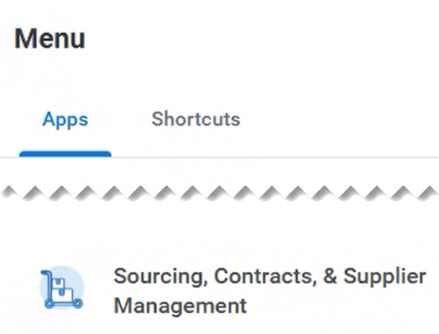
Managing Sourcing Event Question and Answer (Q&A) Board (Part 1 of 11)
INSTRUCTIONS
Click the Global Navigation Menu.
Note: University System of Georgia (USG) users compete local logon and then proceed to Step 4.
Click Sourcing, Contracts & Supplier Management.

Slide 3
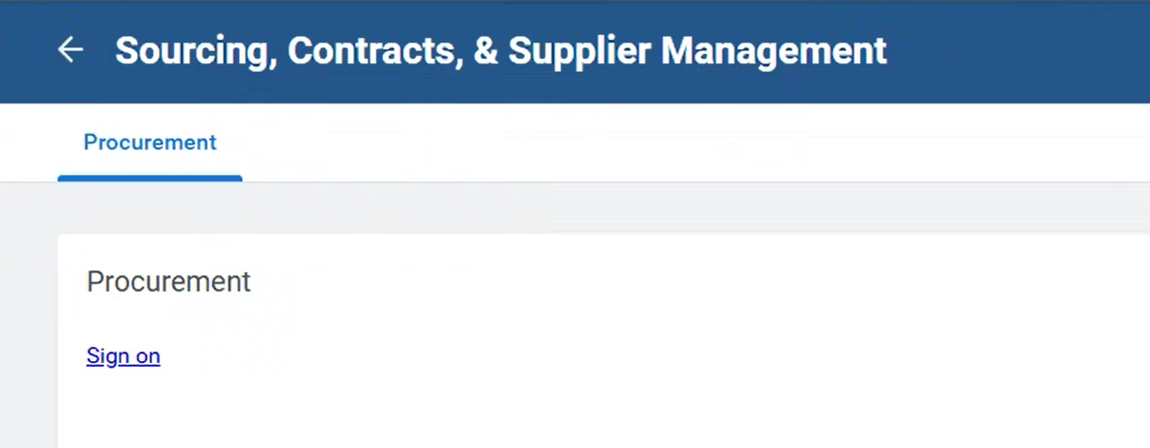
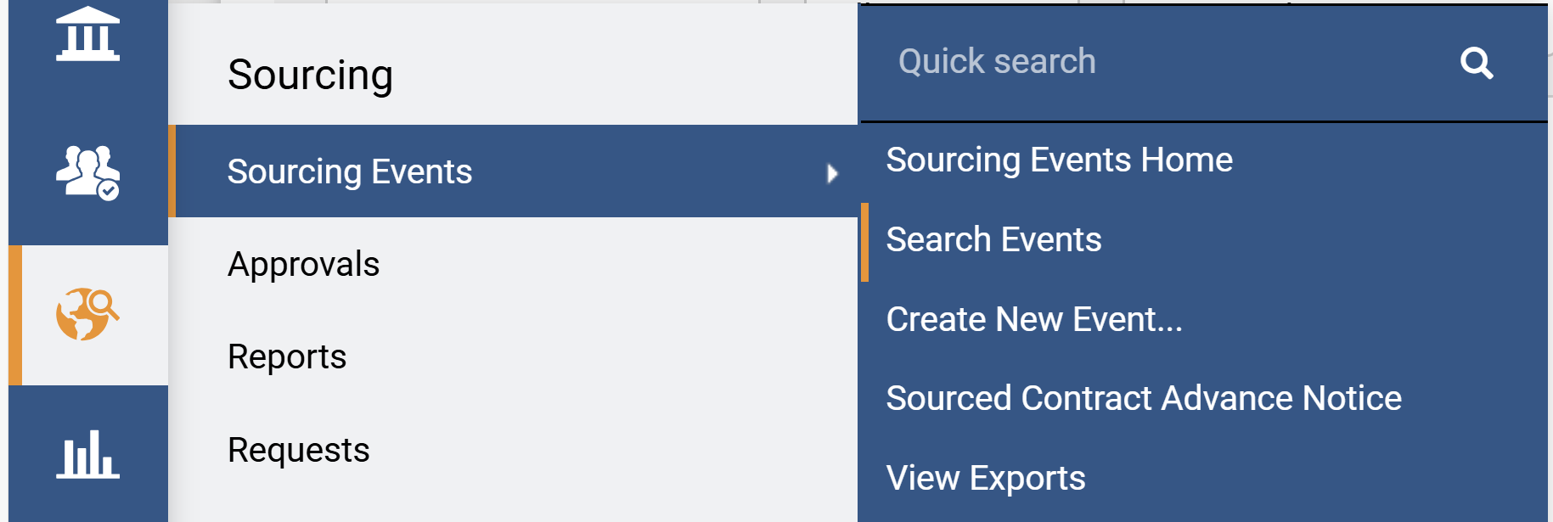
Managing Sourcing Event Question and Answer (Q&A) Board (Part 2 of 11)
INSTRUCTIONS
Click Sign On.
Note: The system utilizes Single Sign-On (SSO) capabilities
and no log in information is required.
Access the Sourcing module.
Click Sourcing Events.
Click Search Events.
5
6
4

Slide 4
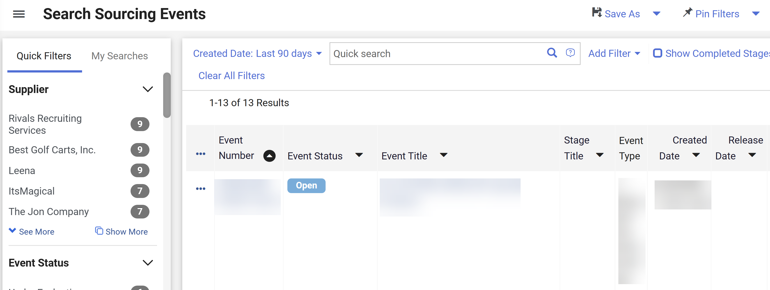
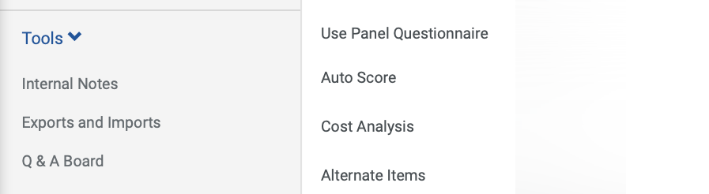
Managing Sourcing Event Question and Answer (Q&A) Board (Part 3 of 11)
INSTRUCTIONS
Click the Event Number hyperlink.
Note: Use Filters to find the Sourcing Event. Ensure the Event Status is Open.
Click Tools.
Click Q&A Board.
Note: To Post a Question, follow steps 10 – 16, to Ask a Question, follow steps 17 – 28, and to Answer a Question follow steps 27 – 34.
8
9

Slide 5
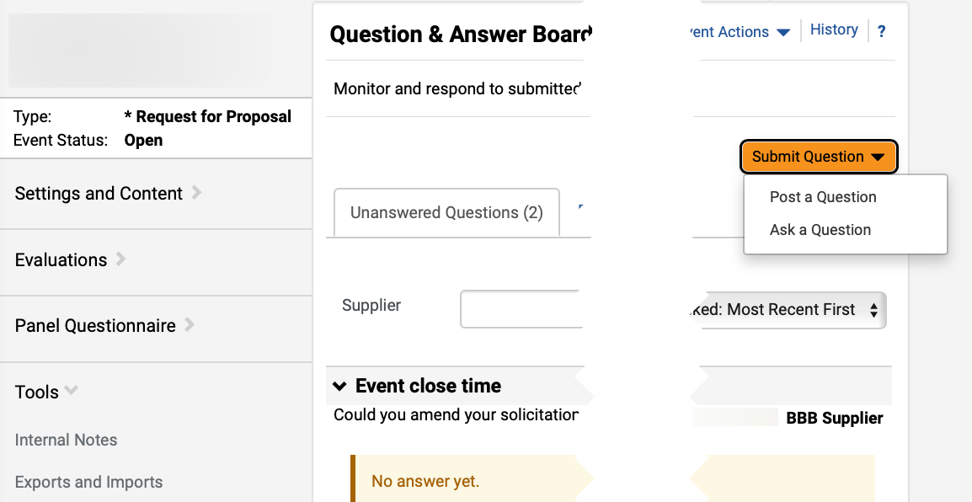
Managing Sourcing Event Question and Answer (Q&A) Board (Part 4 of 11)
INSTRUCTIONS
Click Submit Question.
Click Post a Question.
Note: Post a Question will be visible to all supplier and the internal team.
10
11

Slide 6
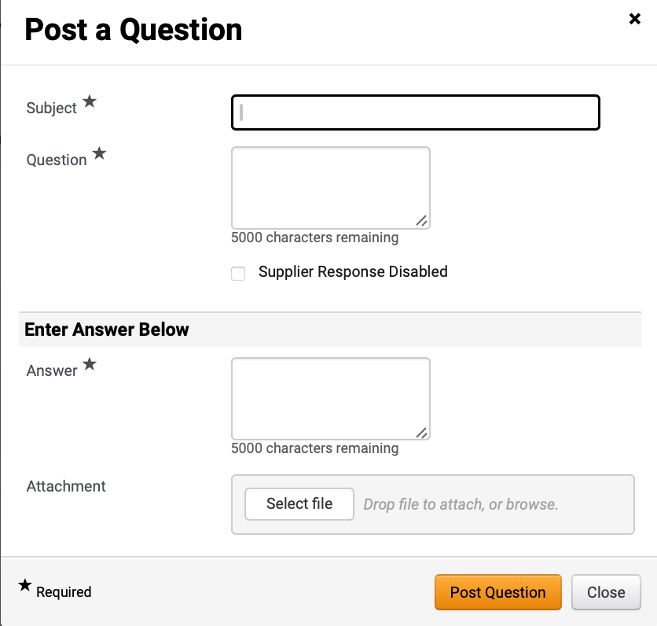
Managing Sourcing Event Question and Answer (Q&A) Board (Part 5 of 11)
INSTRUCTIONS
Enter Subject*.
Note: Complete all required fields marked with a black star *.
Enter Question*.
Enter Answer*.
Click Select file to add Attachment, if applicable.
Click Post Question.
12
13
14
15
16

Slide 7
Managing Sourcing Event Question and Answer (Q&A) Board (Part 6 of 11)
INSTRUCTIONS
Click Submit Question.
Click Ask a Question.
Note: Use Ask a Question to send question to specific supplier(s).
17
18

Slide 8
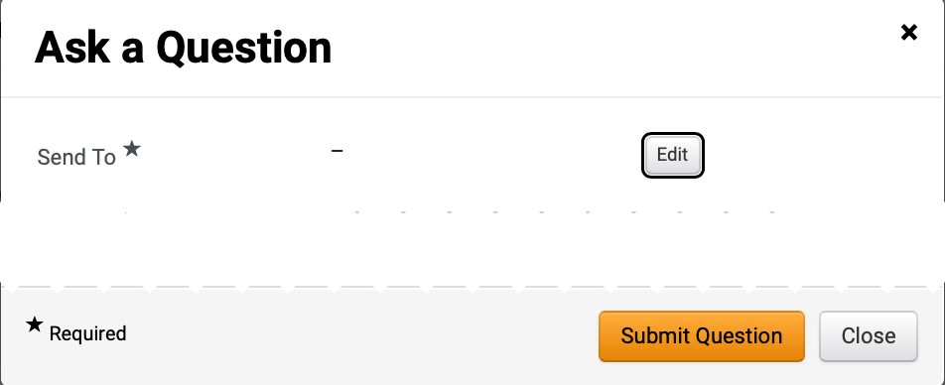
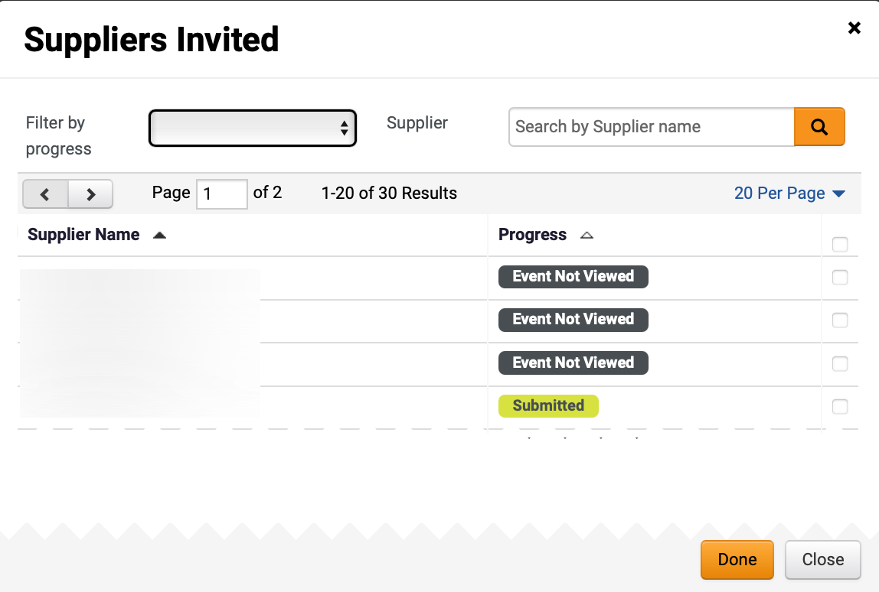
Managing Sourcing Event Question and Answer (Q&A) Board (Part 7 of 11)
INSTRUCTIONS
Click Edit to add Send To* supplier.
Check the applicable Supplier box(s).
Click Done.
20
21

Slide 9
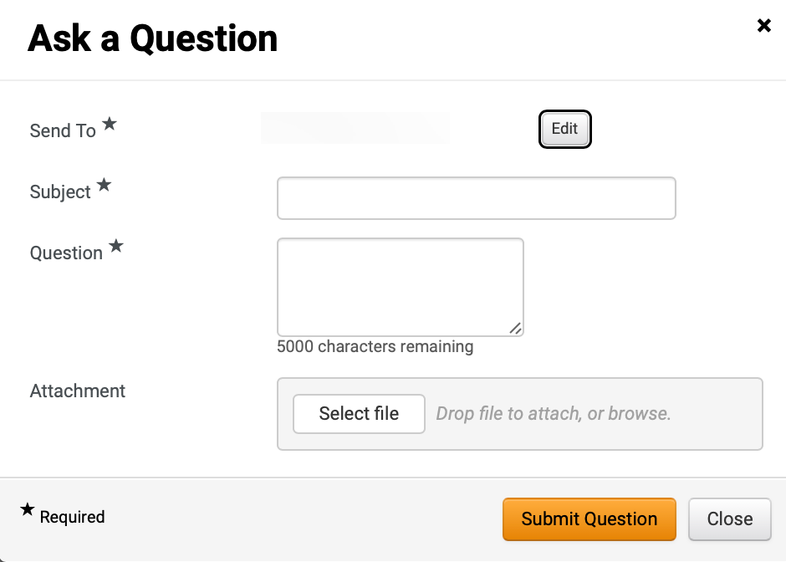
Managing Sourcing Event Question and Answer (Q&A) Board (Part 8 of 11)
INSTRUCTIONS
The Send To* field will auto-populate with selected supplier.
Enter Subject*.
Enter Question*.
Click Select file to add Attachment, as applicable.
Click Submit Question.
22
23
24
25
26

Slide 10
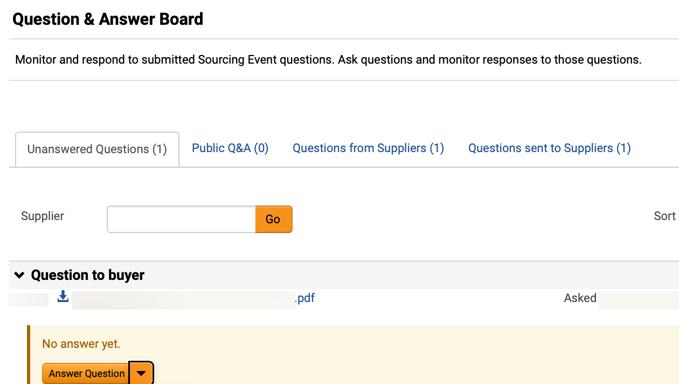
Managing Sourcing Event Question and Answer (Q&A) Board (Part 9 of 11)
INSTRUCTIONS
Click Unanswered Questions to answer submitted questions.
Click Answer Question.
27
28

Slide 11
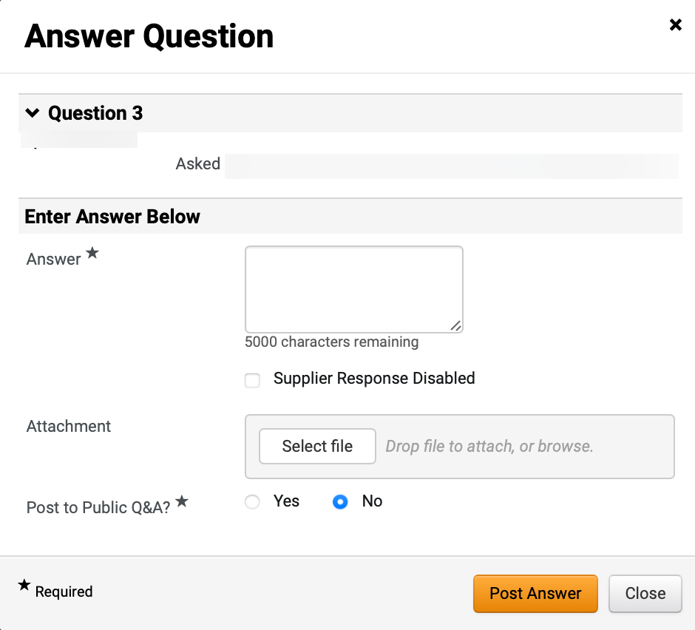
Managing Sourcing Event Question and Answer (Q&A) Board (Part 10 of 11)
INSTRUCTIONS
Enter Answer*.
Click Select file to add Attachment (Optional).
Select Post to Public Q&A?*.
Note: If selecting Post to Public Q&A*, question and answer will be visible to other suppliers and internal stakeholders.
Click Post Answer.
29
30
31
32

Slide 12
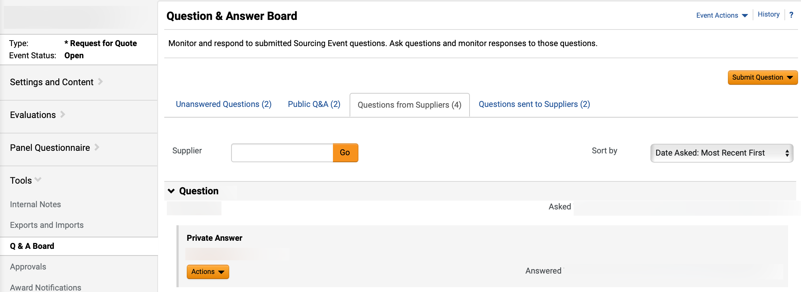

Managing Sourcing Event Question and Answer (Q&A) Board (Part 11 of 11)
INSTRUCTIONS
Click Questions from Suppliers to review Answer.
You have successfully managed a sourcing event question and answer (Q&A) board.

