Slide 1
Extend a Sourcing Event
DESCRIPTION
This guide will show Buyers how to Extend a Sourcing Event only.
OVERVIEW
The key steps in the process are below:
Access the Sourcing module.
Select Event to extend.
Enter Extend Event data.
Event is Extended.
Business Process:
Access Sourcing Module
Select Event to Extend
Enter Extend Event data
Event is Extended

Slide 2

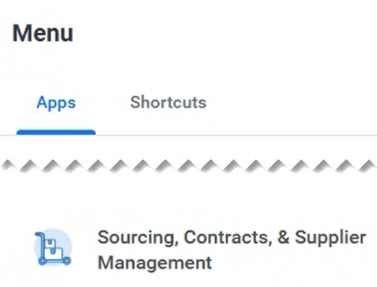
Extend a Sourcing Event (Part 1 of 6)
INSTRUCTIONS
Click the Global Navigation Menu.
Note: University System of Georgia (USG) and GDOT users complete local logon and then proceed to Step 4.
Click Sourcing, Contracts & Supplier Management.

Slide 3
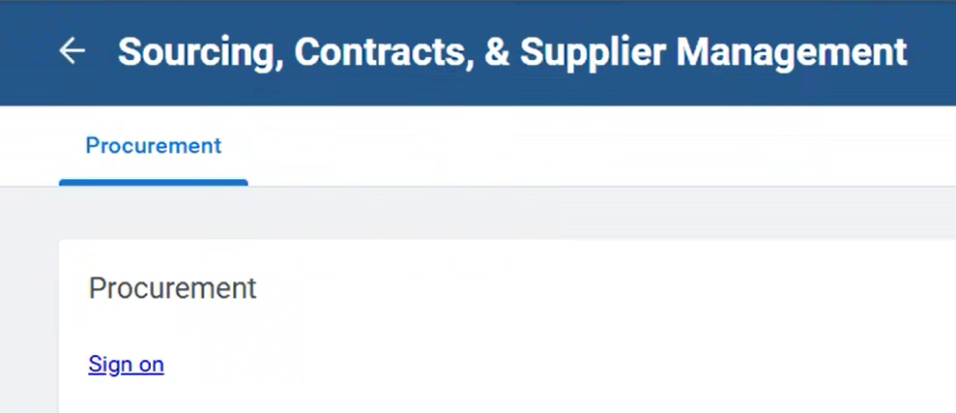
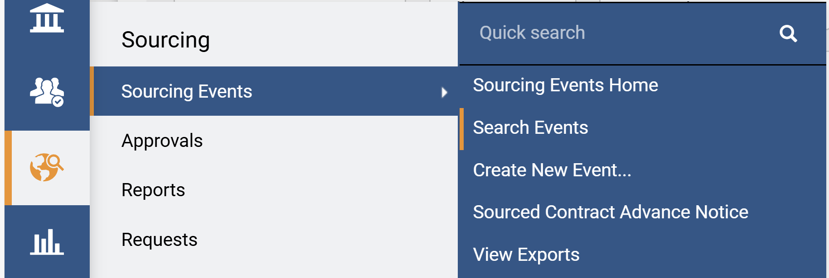
Extend a Sourcing Event (Part 2 of 6)
INSTRUCTIONS
Click Sign On.
Note: The system utilizes Single Sign-On (SSO) capabilities
and no log in information is required.
Access the Sourcing module.
Click Sourcing Events.
Click Search Events.
5
6
4

Slide 4
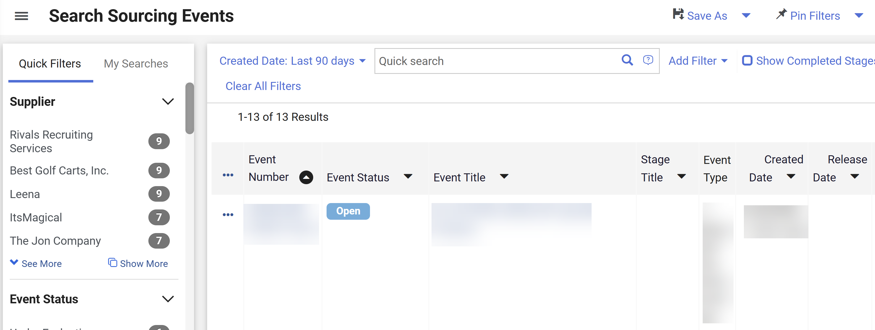
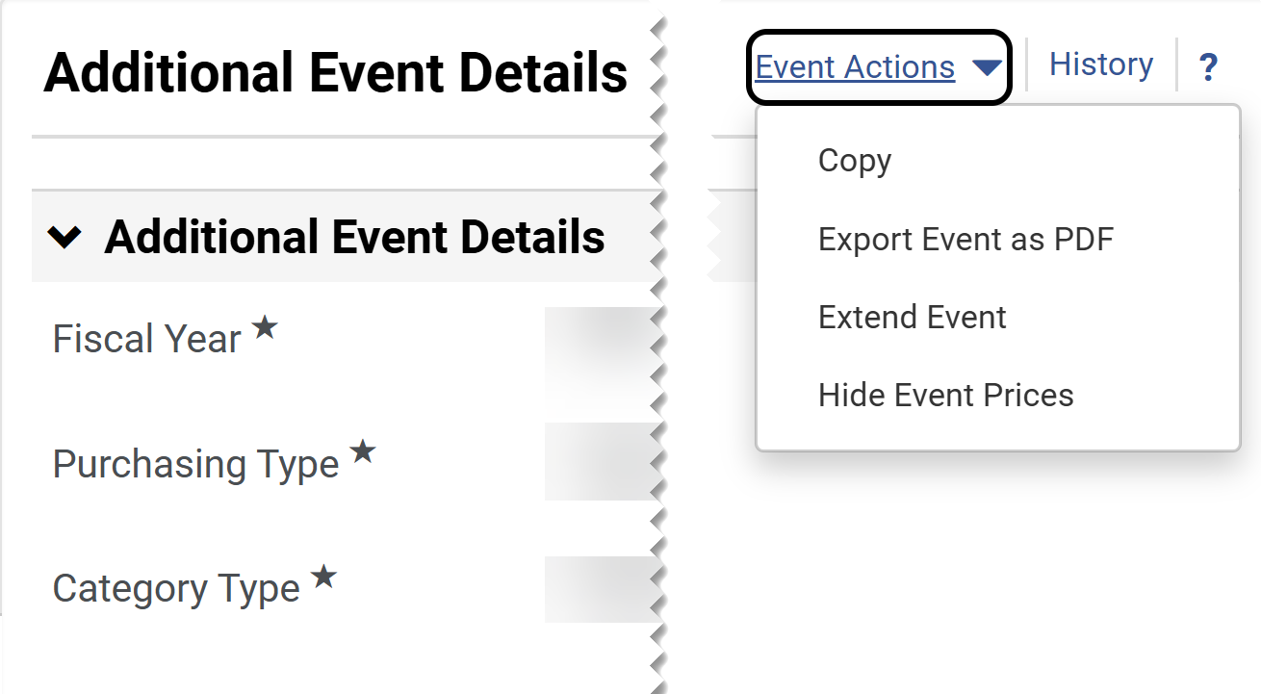
Extend a Sourcing Event (Part 3 of 6)
INSTRUCTIONS
Click the Event Number hyperlink.
Note: Use Filters to find the Sourcing Event. Ensure the Event Status is Open.
Click Event Actions.
Select Extend Event.
8
9

Slide 5
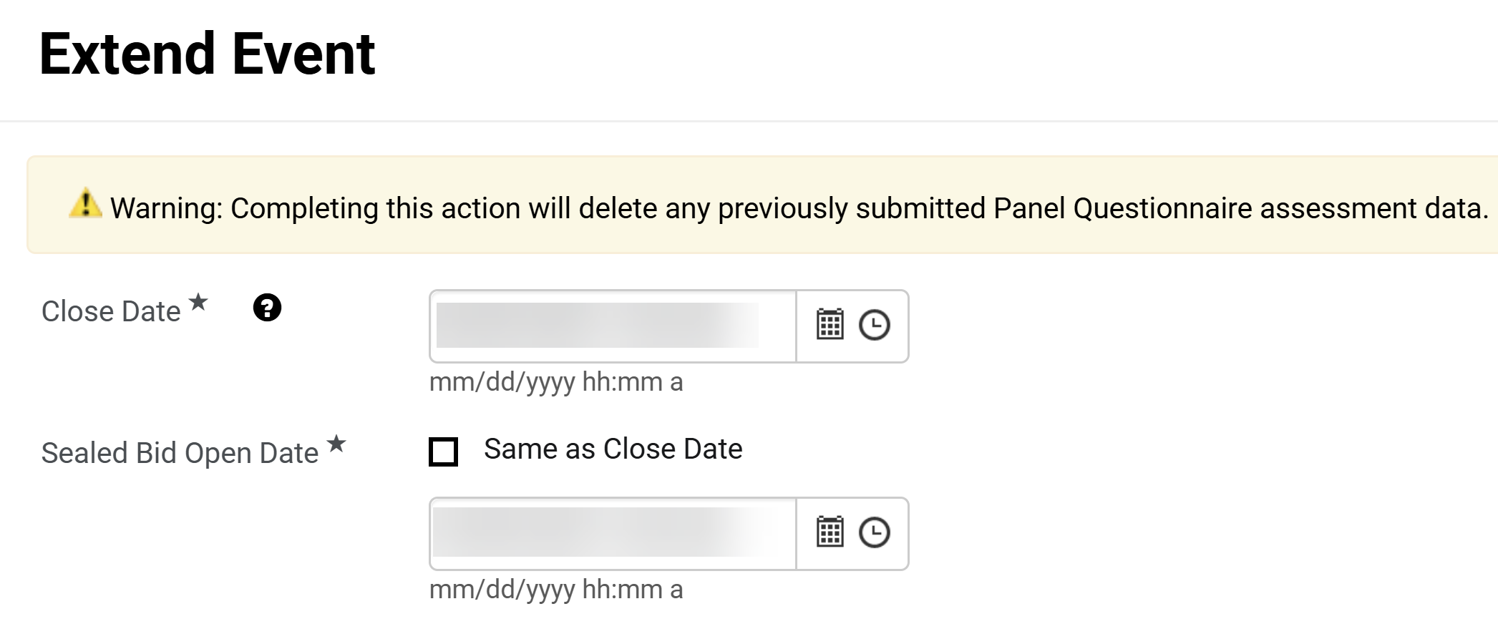
Extend a Sourcing Event (Part 4 of 6)
INSTRUCTIONS
Select Close Date*.
Note: Complete all required fields marked with a star *.
Select Sealed Bid Open Date*.
10
11

Slide 6
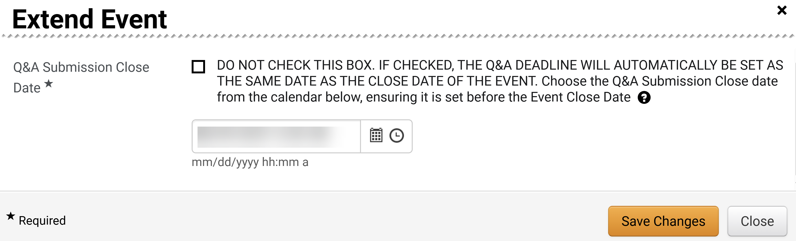
Extend a Sourcing Event (Part 5 of 6)
INSTRUCTIONS
Select Q&A Submission Close Date*.
Note: When extending an open event, if the original Q&A period has ended and the Sourcing Event Buyer does not plan to have another, leave date as is.
Click Save Changes.
12
13

Slide 7
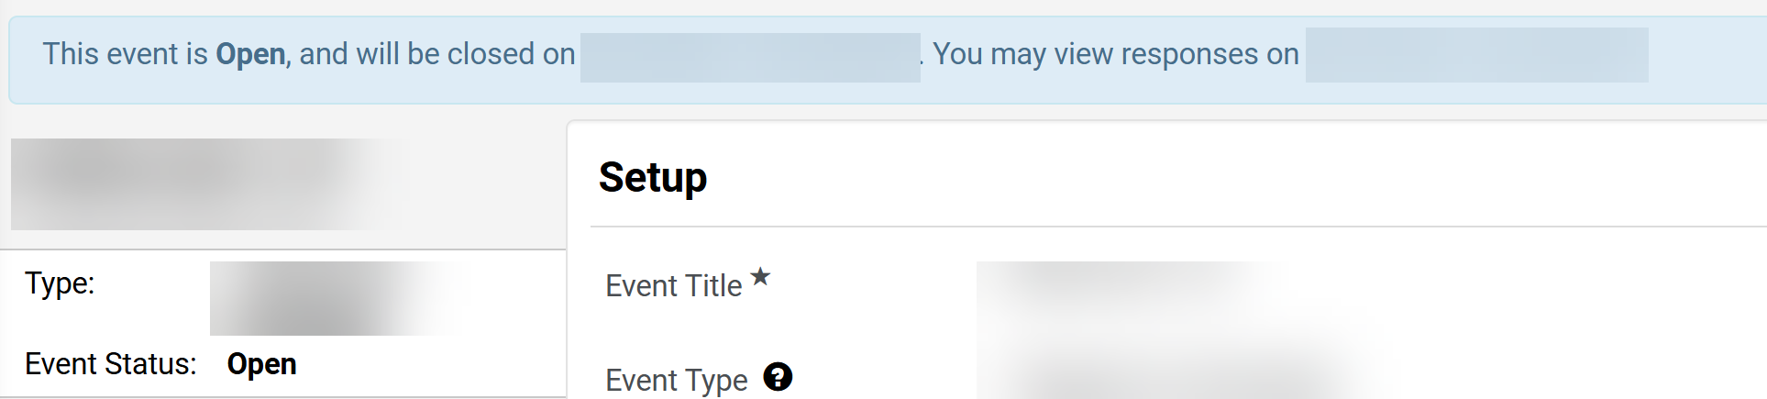
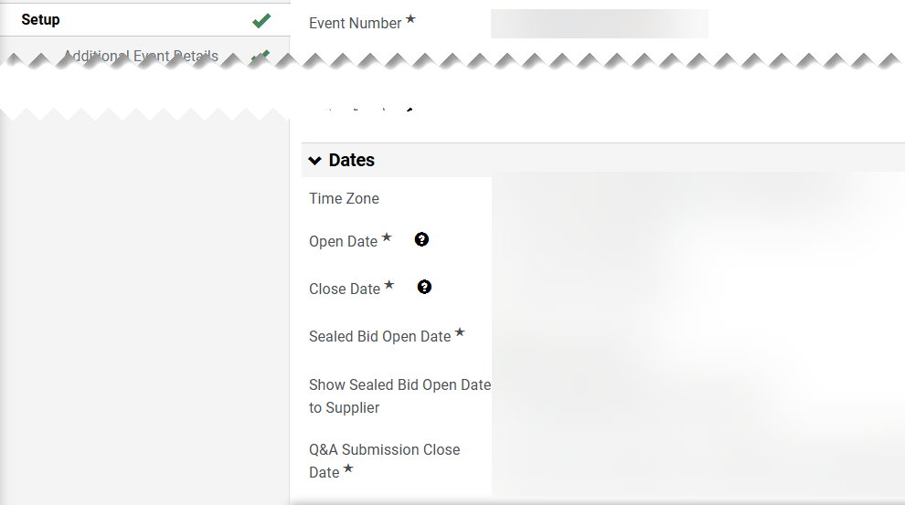

Extend a Sourcing Event (Part 6 of 6)
INSTRUCTIONS
Review the Date change.
Note: The information is visible in the Sourcing Event banner.
Click Setup.
Review Date information.
15
16
You have successfully extended a sourcing event.

