Slide 1
Create a Sourcing Event with a Proforma Contract
DESCRIPTION
This guide will show Sourcing Event Buyers how to Create a Sourcing Event with a Proforma Contract only.
Note: Review Create a Proforma Contract Template for guidance on creating a Proforma Contract.
OVERVIEW
The key steps in the process are below:
Access the Sourcing module.
Attach Proforma File.
Access Supplier Responses.
The Sourcing Event is created.
Business Process:
Access Sourcing Module
Attach Proforma File
Access Supplier Responses
Sourcing Event is created

Slide 2

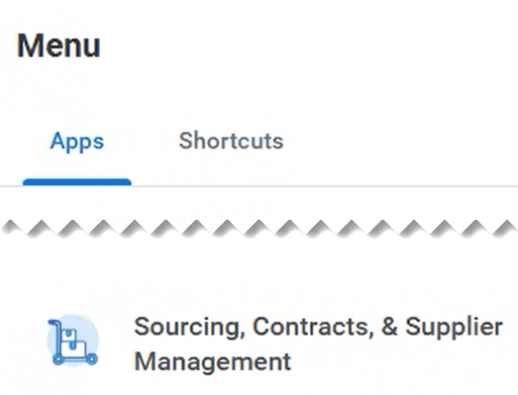
Create a Sourcing Event with a Proforma Contract (Part 1 of 23)
INSTRUCTIONS
Click the Global Navigation Menu.
Note: University System of Georgia (USG) users complete local login and then proceed to Step 4.
Click Sourcing, Contracts & Supplier Management.

Slide 3
Create a Sourcing Event with a Proforma Contract (Part 2 of 23)
INSTRUCTIONS
To create the Sourcing Event with a Proforma Contract, follow the information below.
Step | Step Information
 | ​
 | ​
Create Sourcing Event
5 - 13
Selecting a Proforma Contract
14 - 23
Uploading a Proforma File
24 -32
Using the Proforma Contract for awarding
33 -41

Slide 4
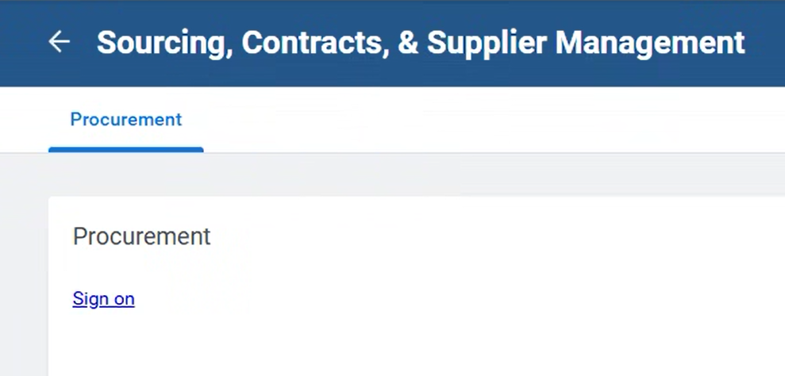
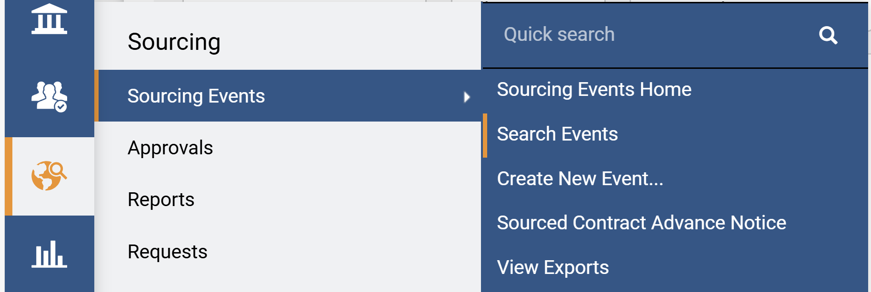
Create a Sourcing Event with a Proforma Contract (Part 3 of 23)
INSTRUCTIONS
Click Sign On.
Note: The system utilizes Single Sign-On (SSO) capabilities
and no log in information is required.
Access the Sourcing module.
Click Sourcing Events.
Click Create New Event.
6
5
7

Slide 5
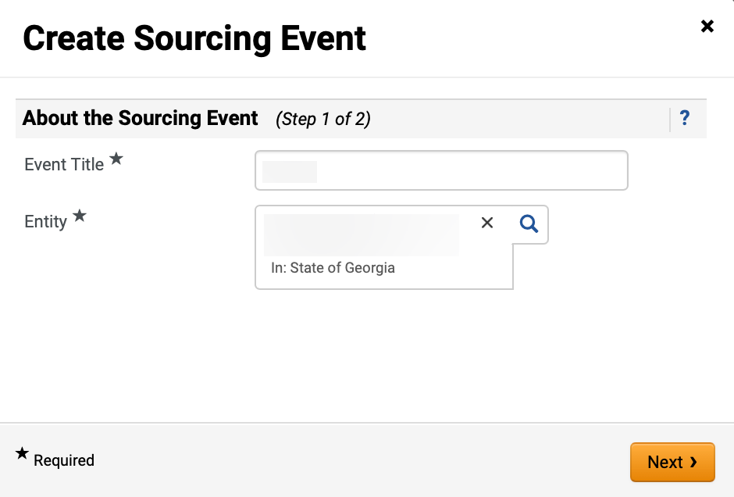
Create a Sourcing Event with a Proforma Contract (Part 4 of 23)
INSTRUCTIONS
Enter Event Title*.
Select Entity*.
Note: Entity must match the Entity selected in Create a Proforma Contract Template. Complete all required fields marked with a black star *.
Click Next.
8
9
10

Slide 6
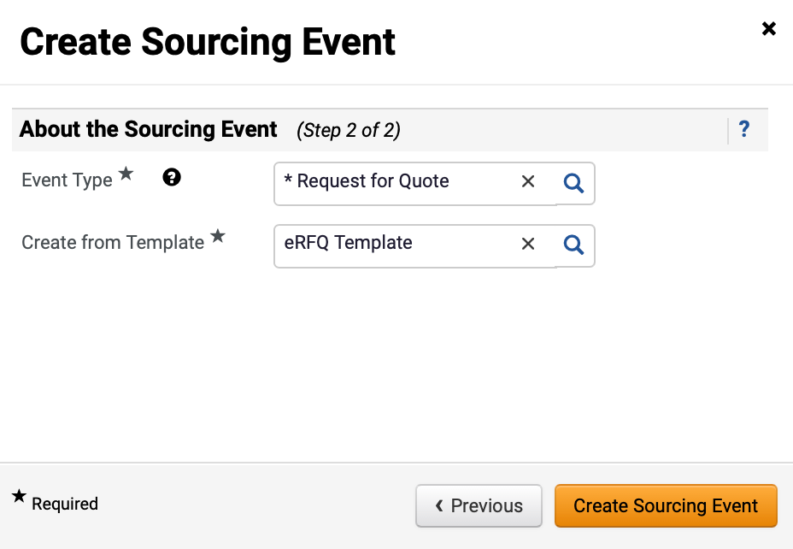
Create a Sourcing Event with a Proforma Contract (Part 5 of 23)
INSTRUCTIONS
Select Request for Quote as Event Type*.
Select Create from Template*.
Note: The field will auto-populate based on the Event Type selected.
Click Create Sourcing Event.
11
12
13

Slide 7
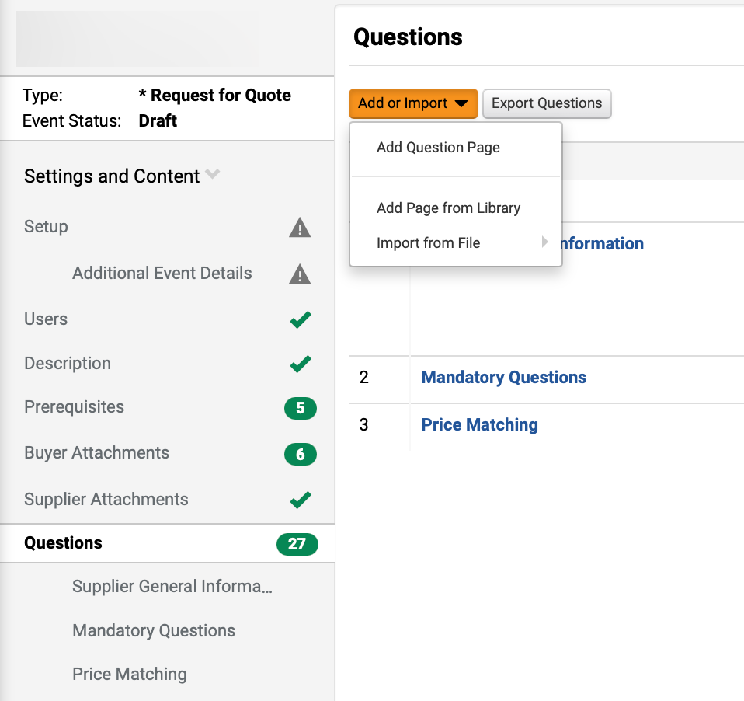
Create a Sourcing Event with a Proforma Contract (Part 6 of 23)
INSTRUCTIONS
Click Questions.
Click Add or Import.
Select Add Question Page.
15
16
14

Slide 8
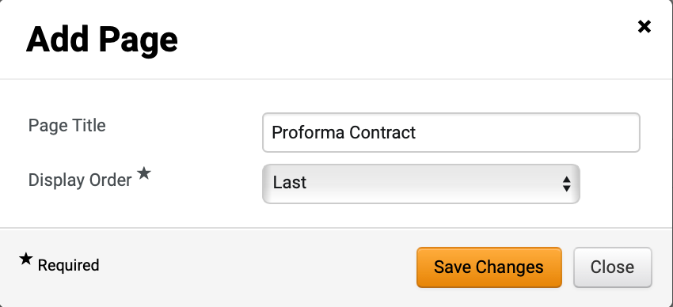
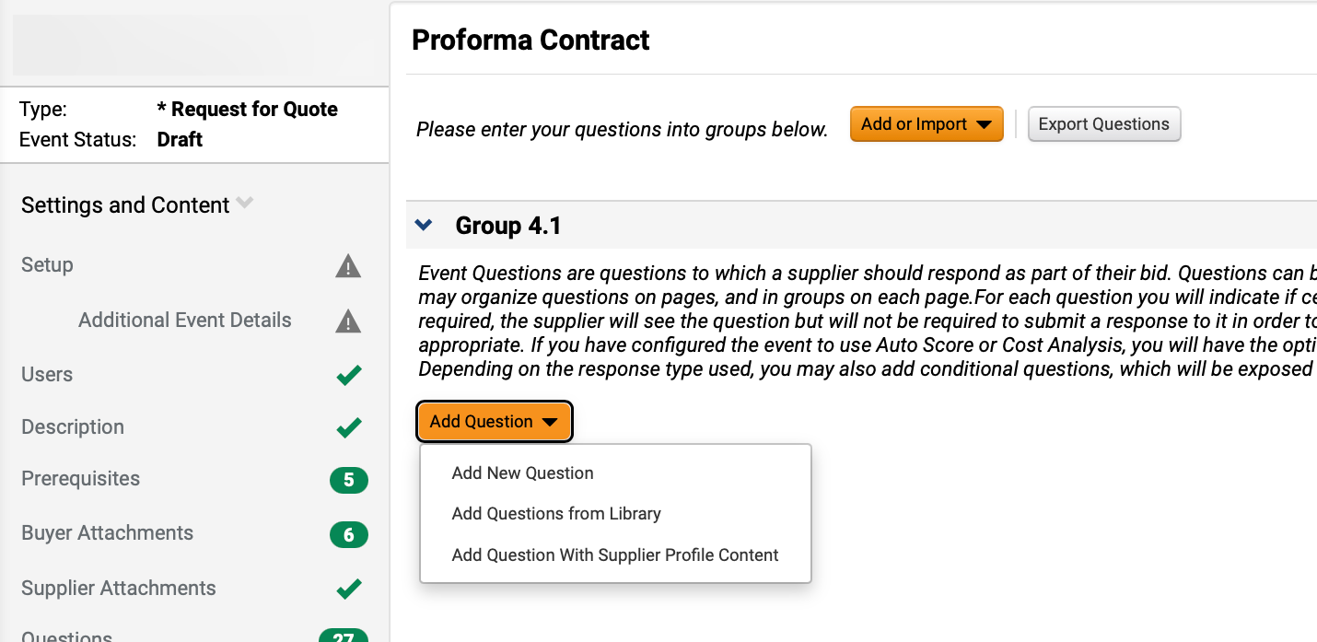
Create a Sourcing Event with a Proforma Contract (Part 7 of 23)
INSTRUCTIONS
Enter Page Title.
Select Display Order*.
Click Save Changes.
17
18
19
Click Add Question.
Select Add New Question.
20
21

Slide 9
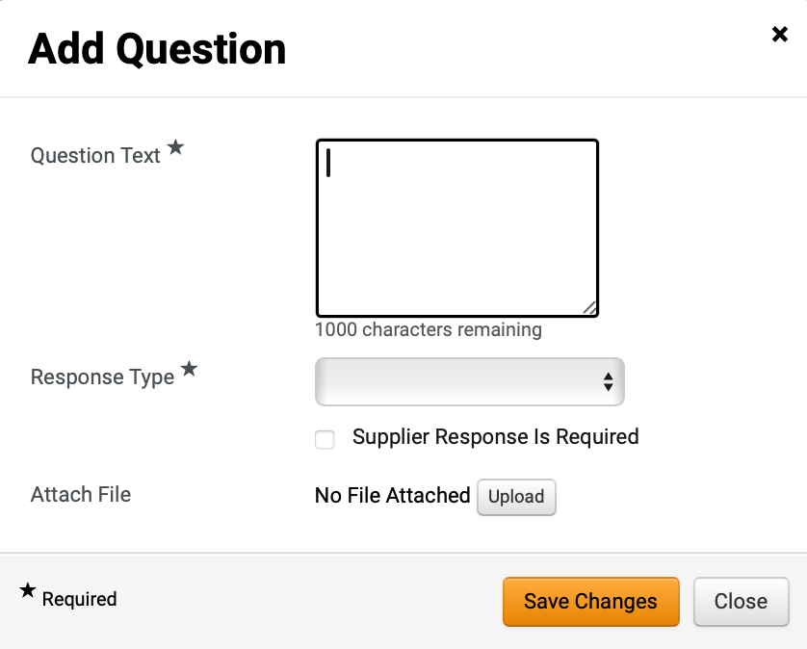
Create a Sourcing Event with a Proforma Contract (Part 8 of 23)
INSTRUCTIONS
Enter Question Text*.
Select Proforma Contract as Response Type*.
Note: The next fields will populate once Proforma Contract is selected. Attaching a Proforma File is mandatory to Add Question.
22
23

Slide 10
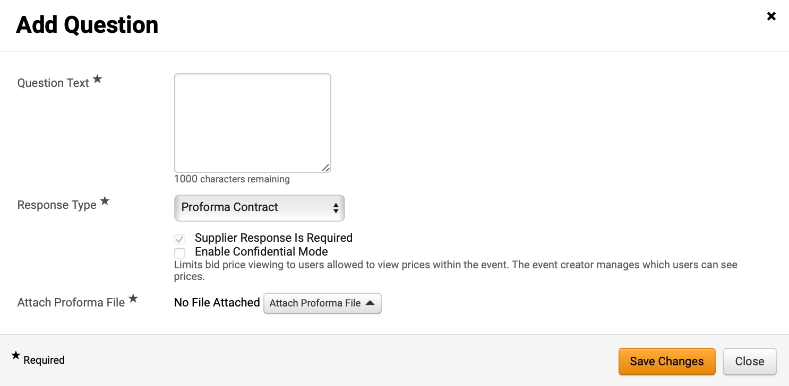
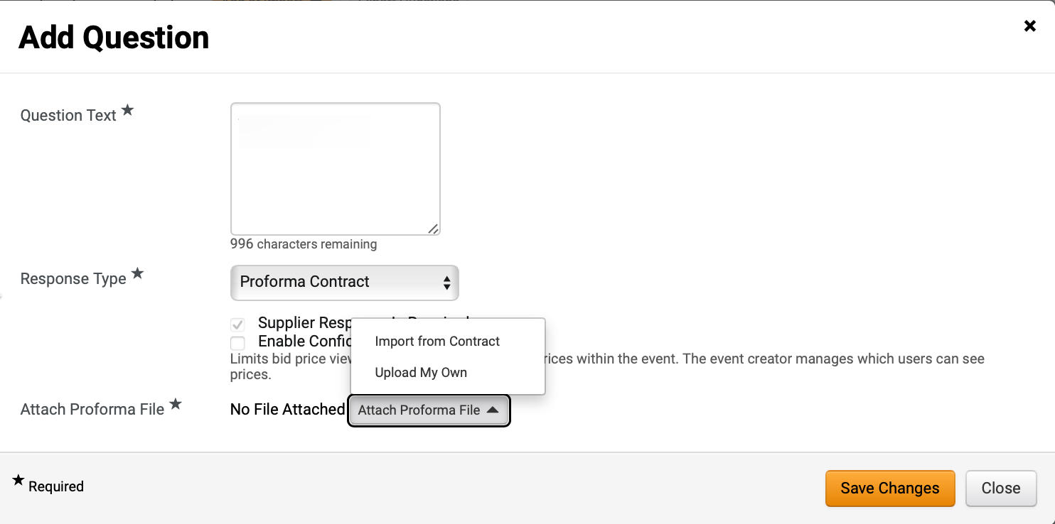
Create a Sourcing Event with a Proforma Contract (Part 9 of 23)
INSTRUCTIONS
Click Attach Proforma File*.
Note: To Import from Contract, follow steps 25 – 32, and skip to step 40. To Upload My Own, skip to step 33.
Click Import from Contract.
Note: Import from Contract is the preferred method.

Slide 11
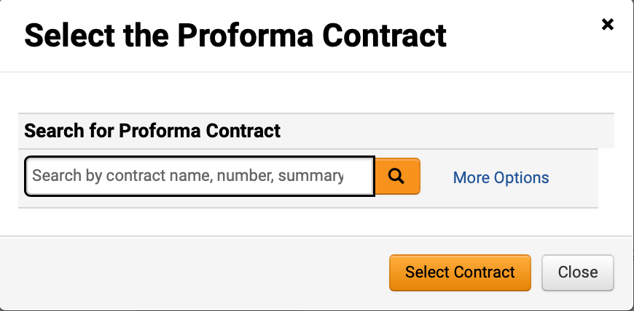
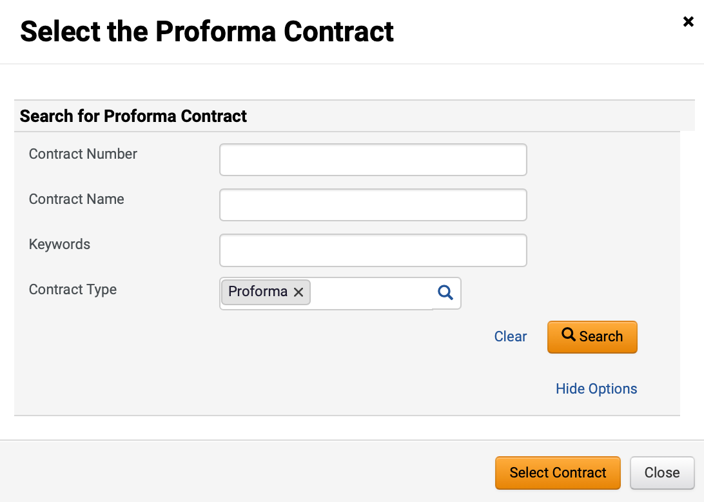
Create a Sourcing Event with a Proforma Contract (Part 10 of 23)
INSTRUCTIONS
Enter to Search for Proforma Contract.
Note: Click More Options or magnifying glass to search. If entering in a field or using magnifying glass, skip to step 27.
Enter to Search for Proforma Contract.
Note: Select Proforma as Contract Type to filter search results.
Click Search.
27
28

Slide 12
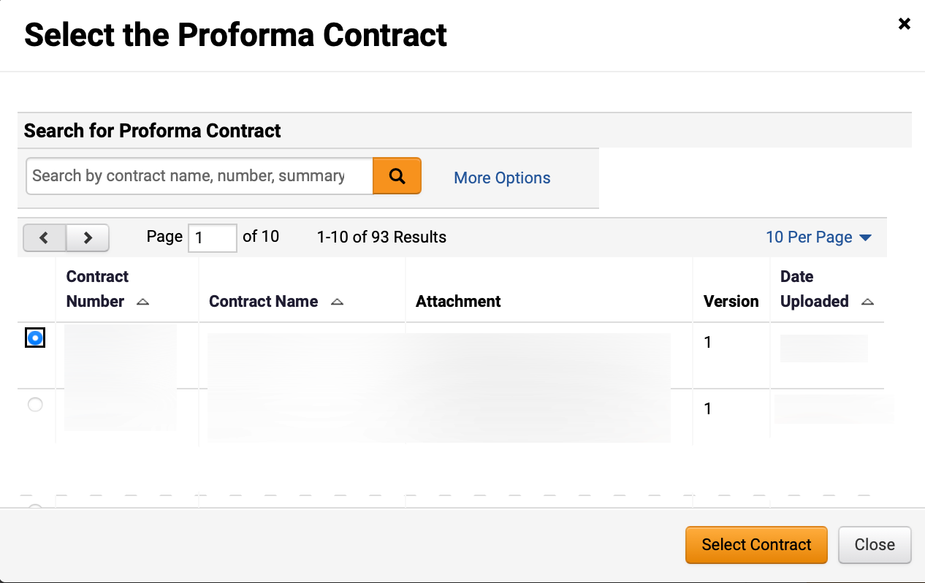
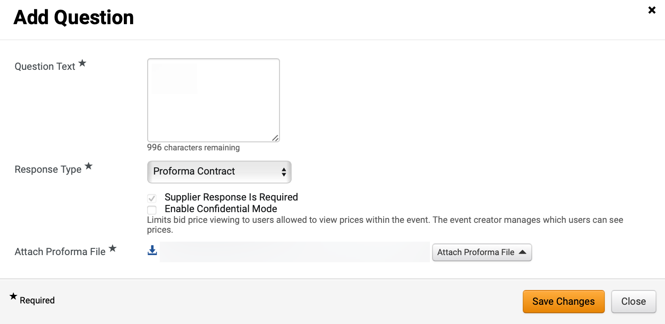
Create a Sourcing Event with a Proforma Contract (Part 11 of 23)
INSTRUCTIONS
Check Proforma Contract box.
Click Select Contract.
29
30
Review Attached Proforma File*.
Click Save Changes.
31
32

Slide 13
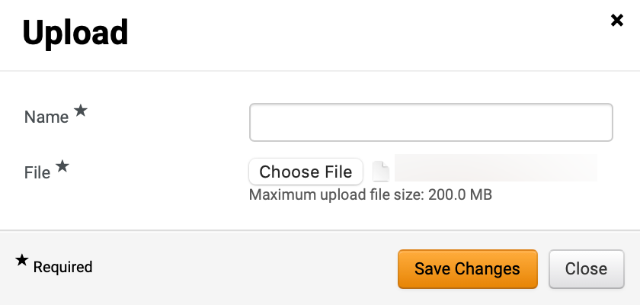
Create a Sourcing Event with a Proforma Contract (Part 12 of 23)
INSTRUCTIONS
To upload a contract, click Upload My Own.
Enter Name*.
Click Choose File to upload File*.
Note: Select contract from your desktop computer.
34
35

Slide 14
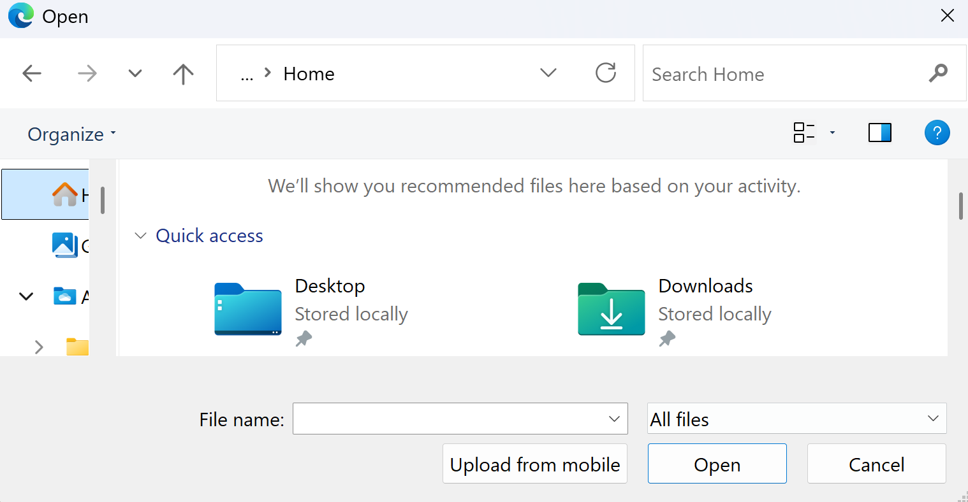
Create a Sourcing Event with a Proforma Contract (Part 13 of 23)
INSTRUCTIONS
Select a File from local computer.
Click Open.
36
37
Review uploaded File*.
Click Save Changes.
38
39

Slide 15
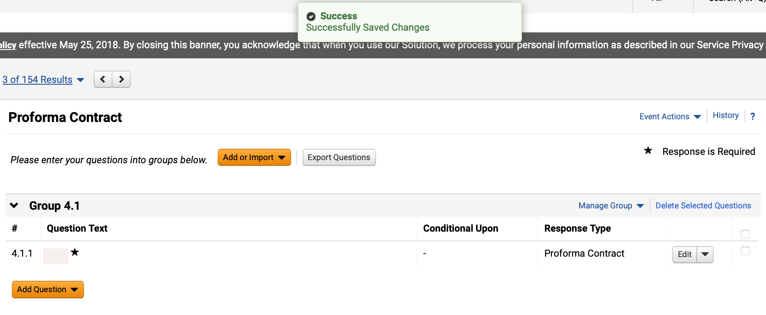
Create a Sourcing Event with a Proforma Contract (Part 14 of 23)
INSTRUCTIONS
Review Successfully Saved Changes notification.
Review added Question.
40
41

Slide 16
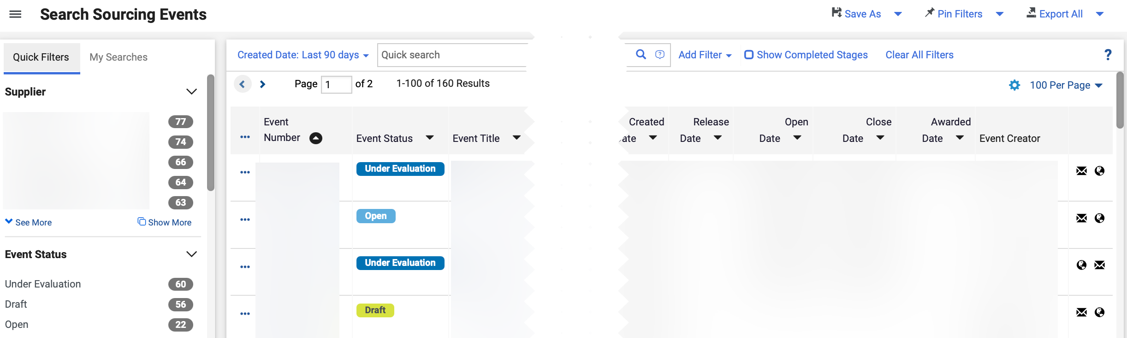
Create a Sourcing Event with a Proforma Contract (Part 15 of 23)
INSTRUCTIONS
To initiate a Contract, access the Sourcing module.
Click Sourcing Events.
Click Search Events.
43
44
42
To view a Sourcing Event, click Event Number hyperlink.

Slide 17
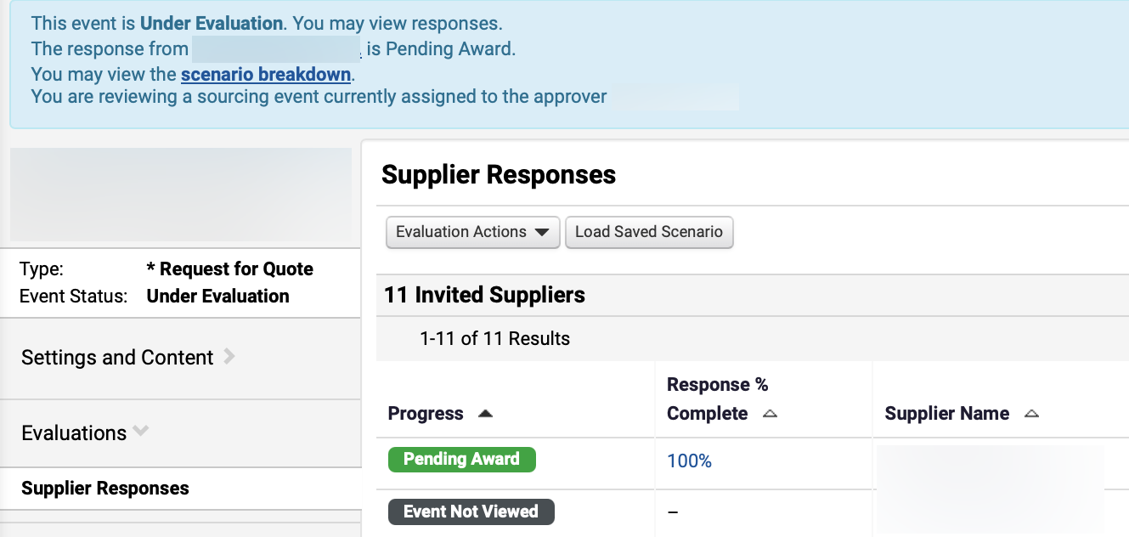
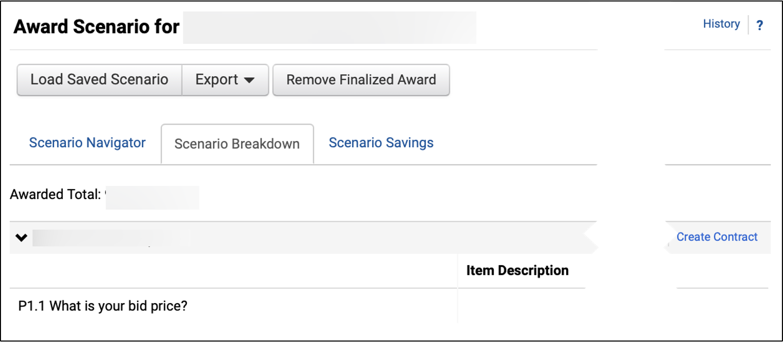
Create a Sourcing Event with a Proforma Contract (Part 16 of 23)
INSTRUCTIONS
Click Evaluations > Supplier Responses.
Click Scenario Breakdown hyperlink.
47
46
Click Create Contract.
Note: For Create Contract to be visible, the buyer must have an award scenario saved and finalized first. Refer to the Award a Sourcing Event Job Aid for instructions.

Slide 18
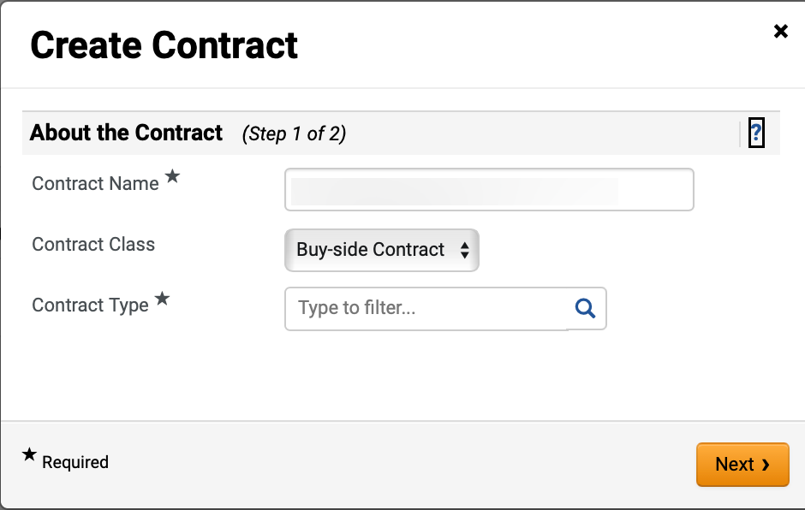
Create a Sourcing Event with a Proforma Contract (Part 17 of 23)
INSTRUCTIONS
Enter Contract Name*.
Note: Contract Name will auto-populate but can be edited.
Enter Contract Class.
Note: Contract Class will auto-populate but can be edited.
Enter Contract Type*.
Note: Use magnifying glass to filter search.
49
50
51

Slide 19
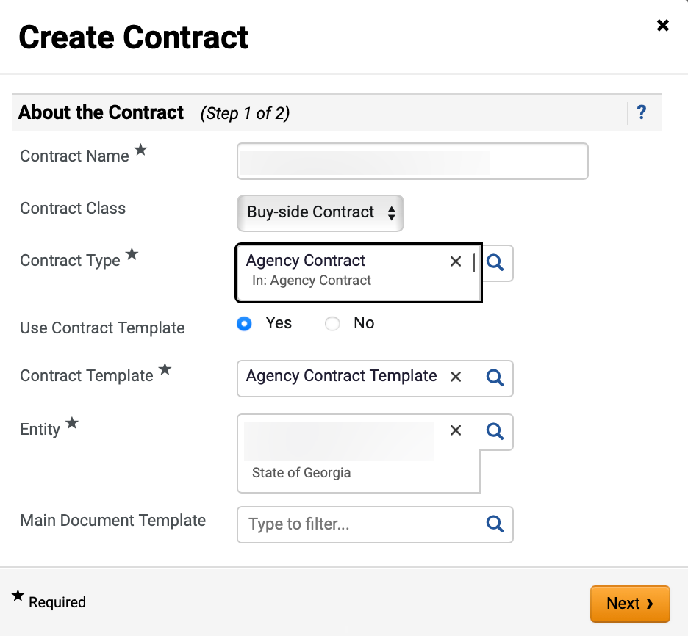
Create a Sourcing Event with a Proforma Contract (Part 18 of 23)
INSTRUCTIONS
Select Use Contract Template.
Note: If selecting Yes, follow step 53-55, if selecting No, skip to step 56.
Select Contract Template*.
Note: Contract Template will auto-populate but can be edited.
Select Entity.
Note: Entity will auto-populate but can be edited.
Select Main Document Template.
Click Next.
52
53
54
55
56

Slide 20
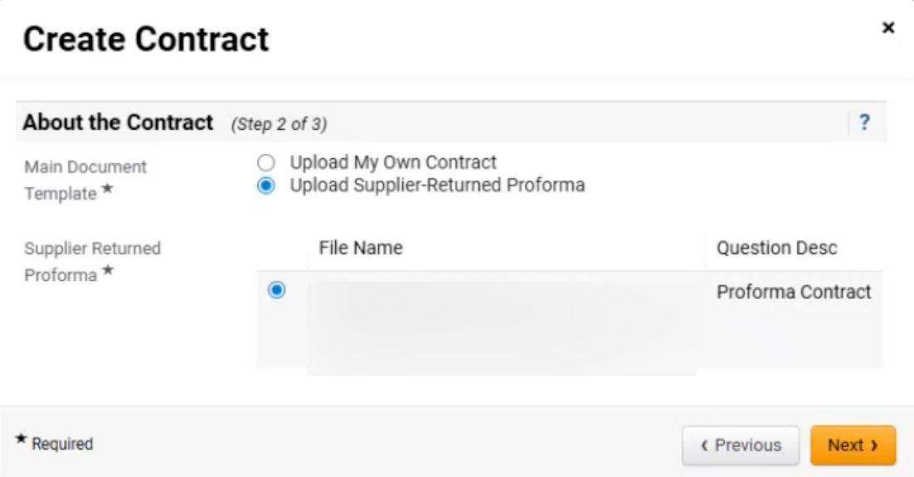
Create a Sourcing Event with a Proforma Contract (Part 19 of 23)
INSTRUCTIONS
Select Upload Supplier-Returned Proforma as Main Document Template*.
Click checkbox to select Supplier Returned Proforma*.
Click Next.
57
58
59

Slide 21
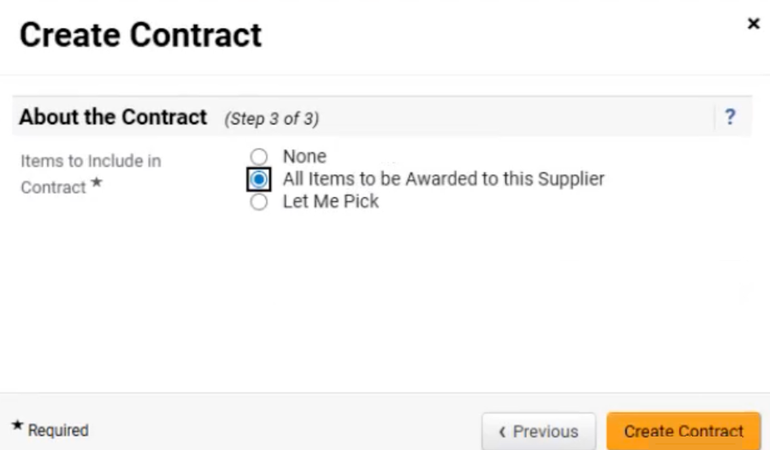
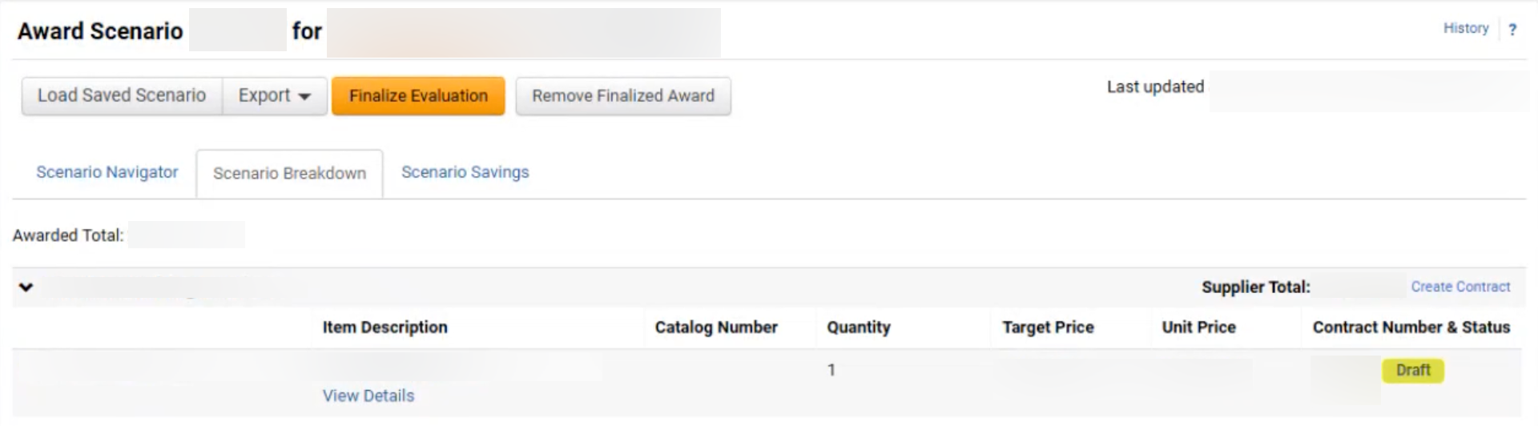
Create a Sourcing Event with a Proforma Contract (Part 20 of 23)
INSTRUCTIONS
Select Items to include in Contract*.
Click Create Contract.
60
61
Click Contract Number hyperlink.

Slide 22
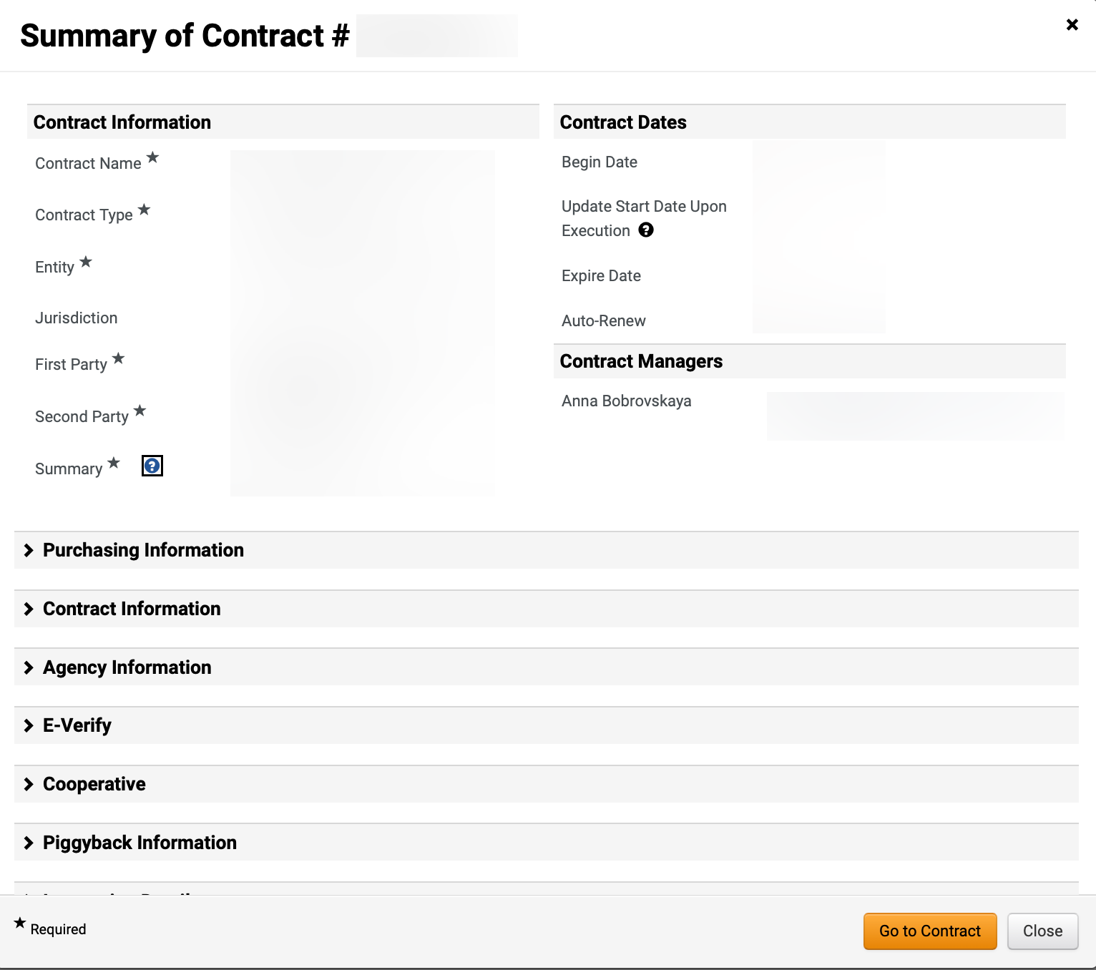
Create a Sourcing Event with a Proforma Contract (Part 21 of 23)
INSTRUCTIONS
Review Contract Summary.
Click Go to Contract.
63
64

Slide 23
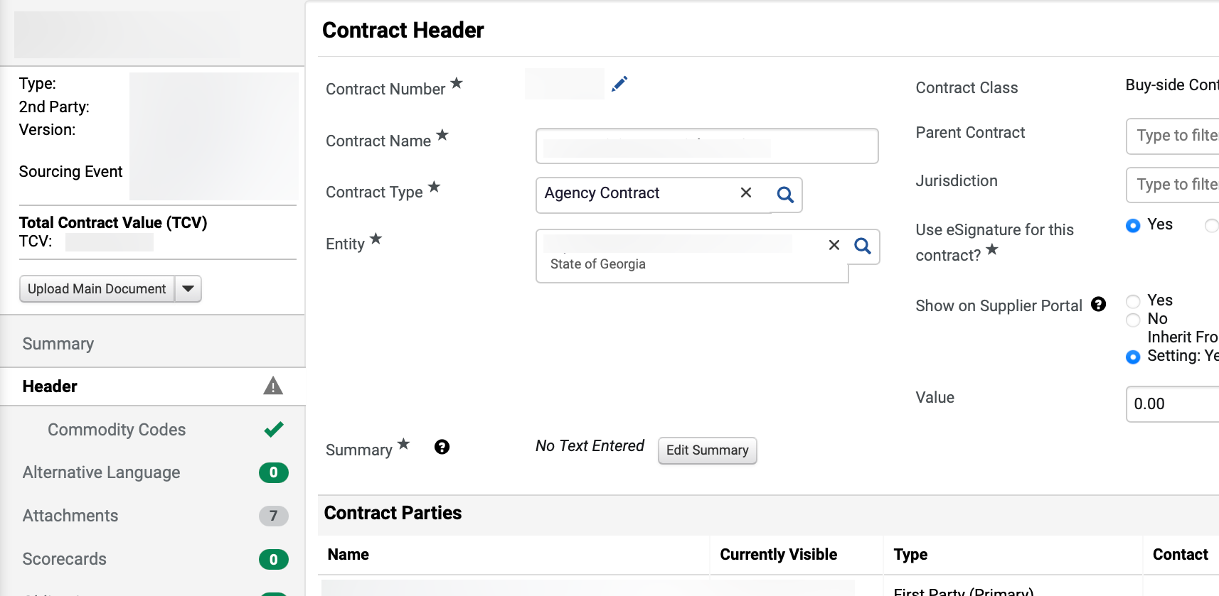
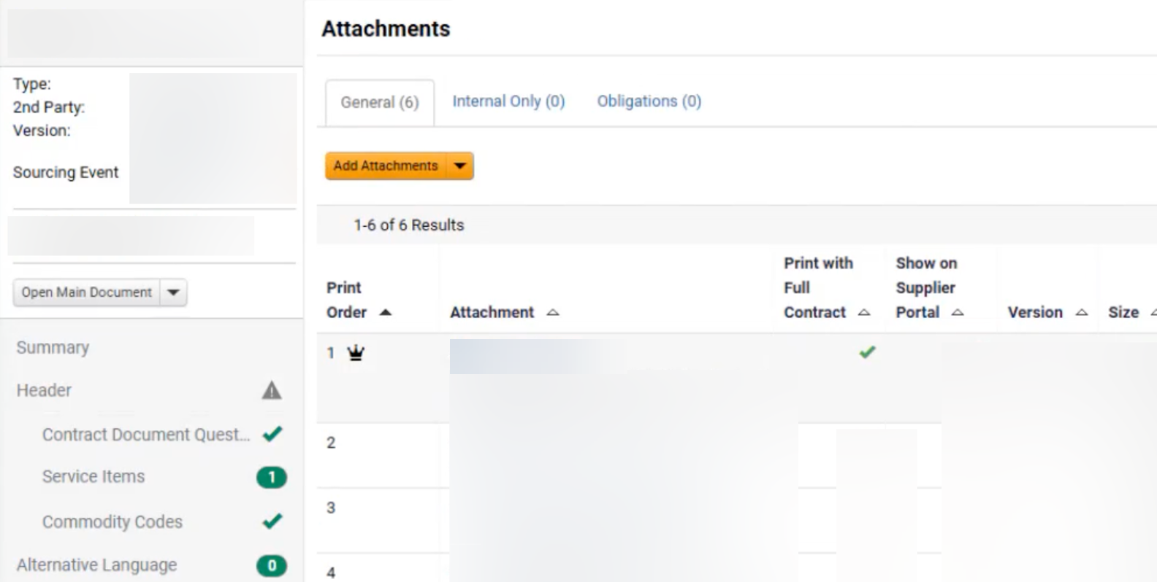
Create a Sourcing Event with a Proforma Contract (Part 22 of 23)
INSTRUCTIONS
The Contract Header is open for editing.
Click Attachments.
65
66
Click Attachment hyperlink.
Note: The uploaded and returned Proforma Contract would be the uploaded and available document.

Slide 24
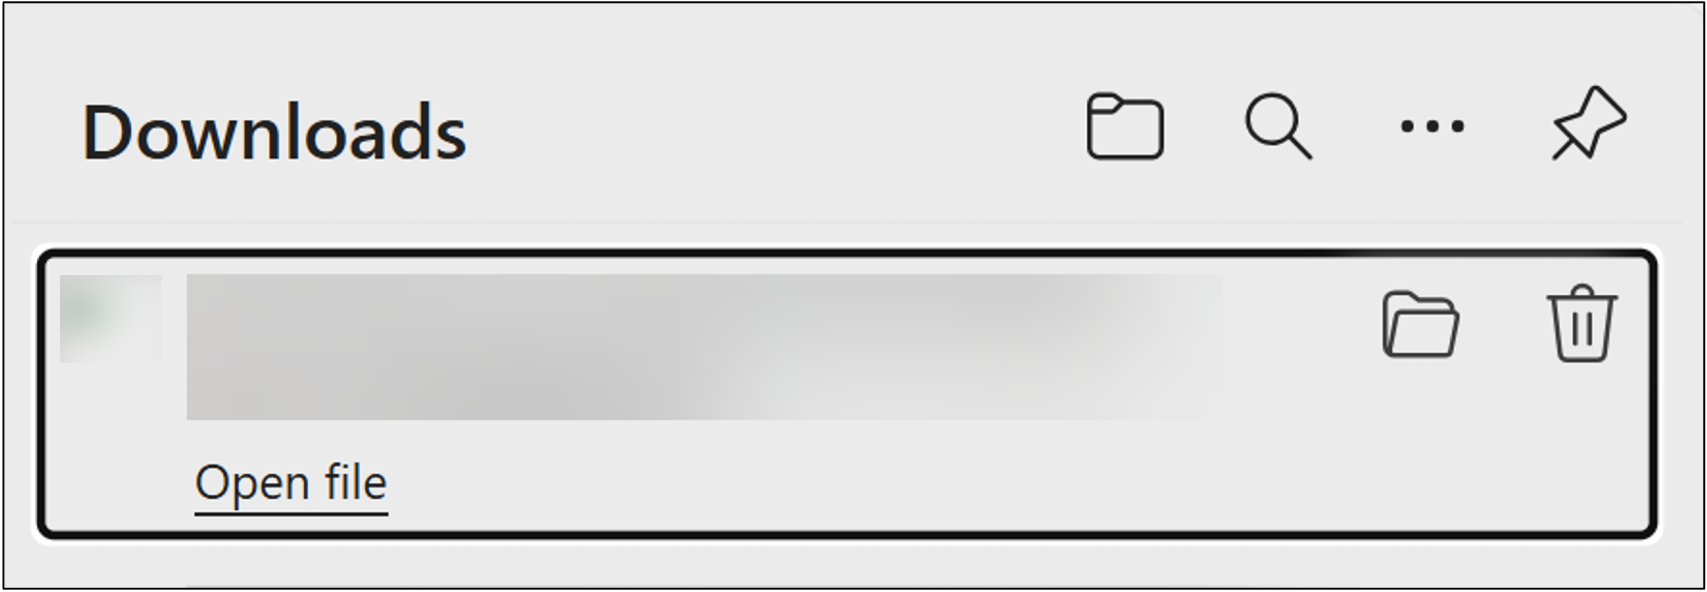
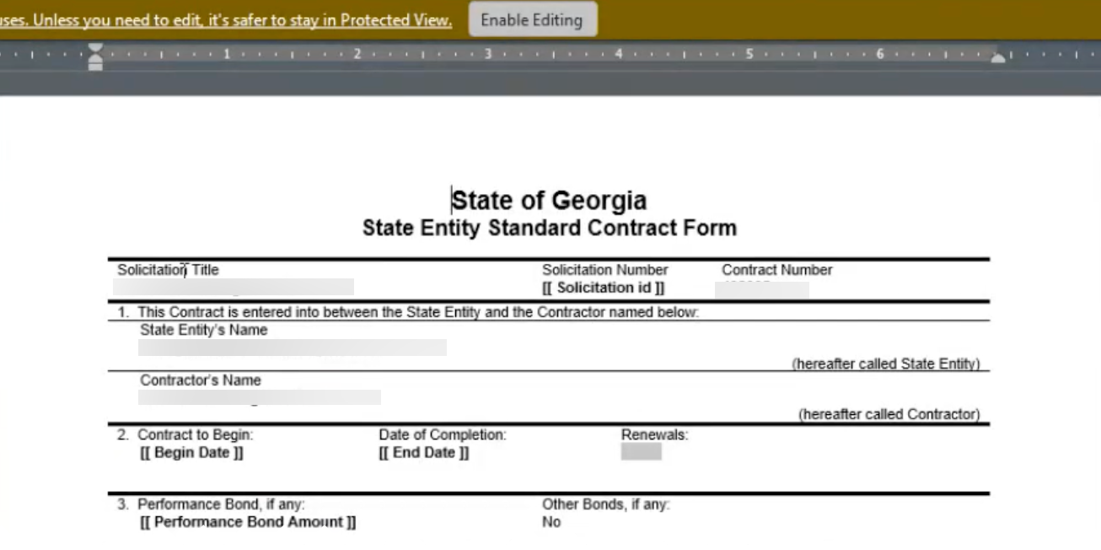

Create a Sourcing Event with a Proforma Contract (Part 23 of 23)
INSTRUCTIONS
Click Open file.
Review the downloaded Contract.
You have successfully created a Sourcing Event with a Proforma Contract.

