Slide 1
Mass Reopen
Procurement Documents
DESCRIPTION
This guide will show the Procurement Operations Lead how to Mass Reopen Procurement Documents.
OVERVIEW
The key steps in the process are below:
Enter Mass Reopen Procurement Documents in the Search field.
Click the Mass Reopen Procurement Documents task.
Enter and select the required information.
Click OK.
Note: Reopening POs will re-obligate the PO impacting available budget.
Business Process:
Select Mass Procurement Documents
Mass Reopen Procurement Documents
Verify Reopen Status

Slide 2
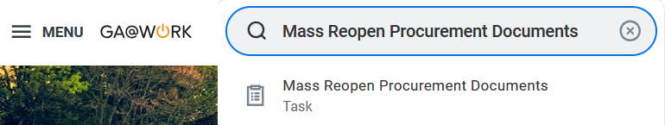
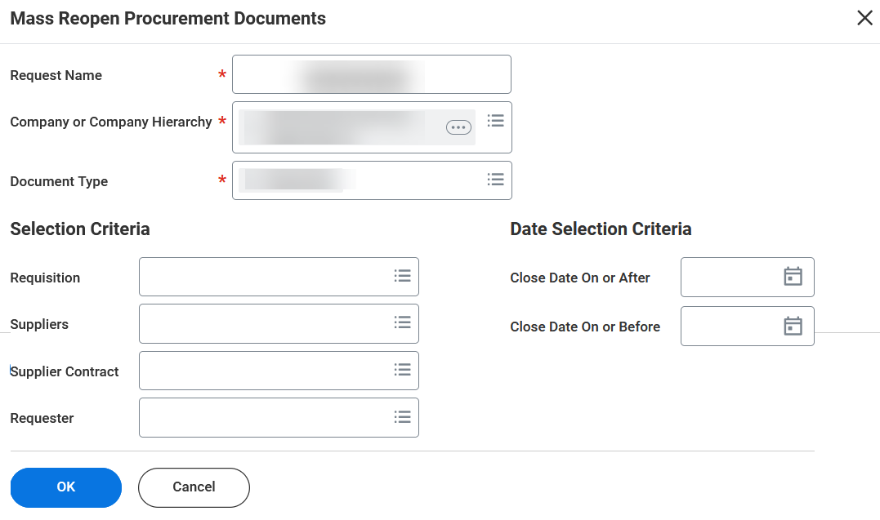
Mass Reopen Procurement Documents
(Part 1 of 3)
INSTRUCTIONS
Enter Mass Reopen Procurement Documents in the Search field.
Select the Mass Reopen Procurement Documents task.
1
2
Enter the Request Name* and select Company or Company Hierarchy*, and Document Type*.
Enter the applicable selection criteria, then click OK.
3
4

Slide 3
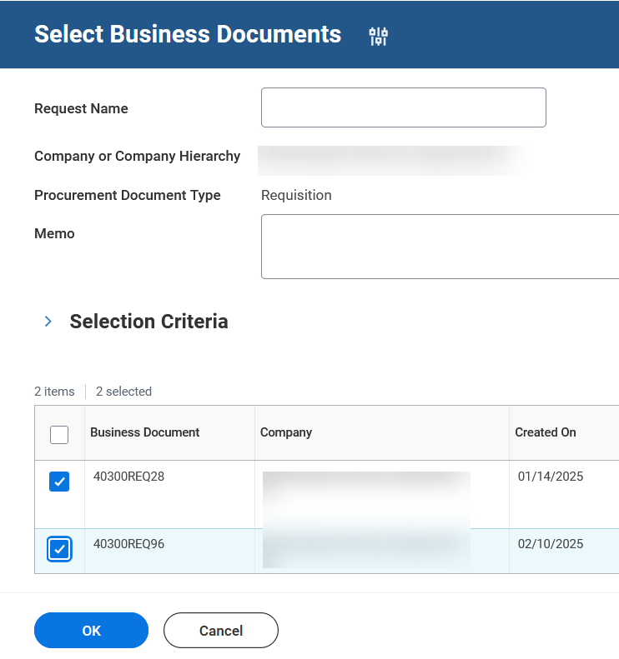
Mass Reopen Procurement Documents
(Part 2 of 3)
INSTRUCTIONS
Enter reason for mass reopen in Memo field.
Check the applicable Business Documents box(s) to reopen.
Click OK.
5
6
7

Slide 4
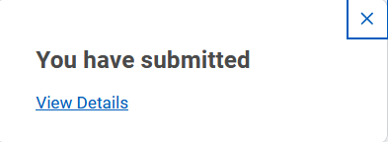

Mass Reopen Procurement Documents
(Part 3 of 3)
INSTRUCTIONS
View the confirmation of Submission. Once submitted, this request will go to APO/CUPO for approval.
Note: Click View Details for more information about the submission.
You have successfully completed mass reopen procurement documents.

