Slide 1
Issue Purchase Orders
DESCRIPTION
This guide will show PO Buyers how to Issue Purchase Orders.
OVERVIEW
The key steps in the process are below:
Click the Global Navigation Menu and click Buyer Hub.
Click the Navigation Pane to access Purchase Orders.
Navigate to the Purchase Order to Issue section.
Select Issue Purchase Order.
Click Finish.
Business Process:
Navigate to Buyer Hub
Select Purchase Order to Issue
Issue Purchase Order and Click Finish

Slide 2

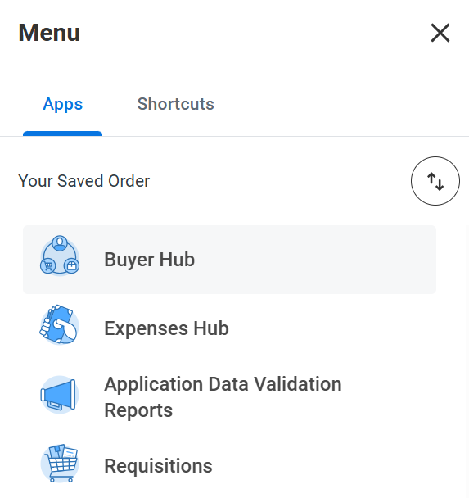
Issue Purchase Order (Part 1 of 6)
INSTRUCTIONS
Click the Global Navigation Menu.
Note: Type Issue Purchase Order in the Search field for alternative search or issue Purchase Order from Related Actions (…).
Click Buyer Hub.

Slide 3
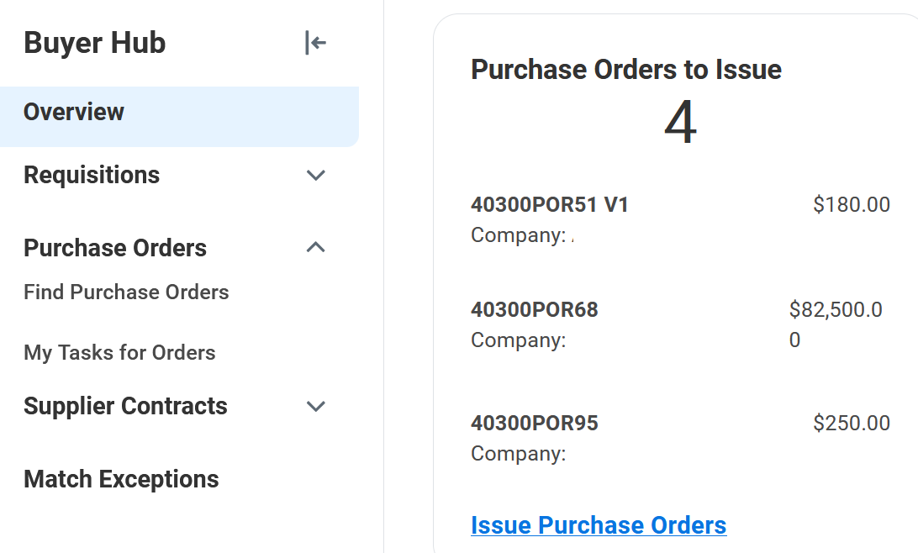
Issue Purchase Order (Part 2 of 6)
INSTRUCTIONS
Scroll down to Purchase Orders to Issue and click Issue Purchase Orders.
Note: You can also click on the Purchase Order listed to issue a Purchase Order.

Slide 4
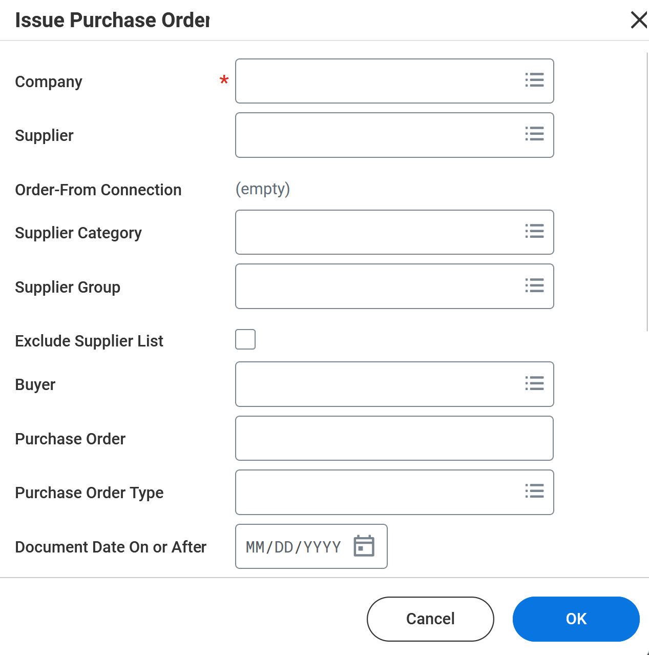
Issue Purchase Order Part (3 of 6)
INSTRUCTIONS
Select the Company*.
Note: Enter additional information to refine your search.
Click OK.
4
5

Slide 5
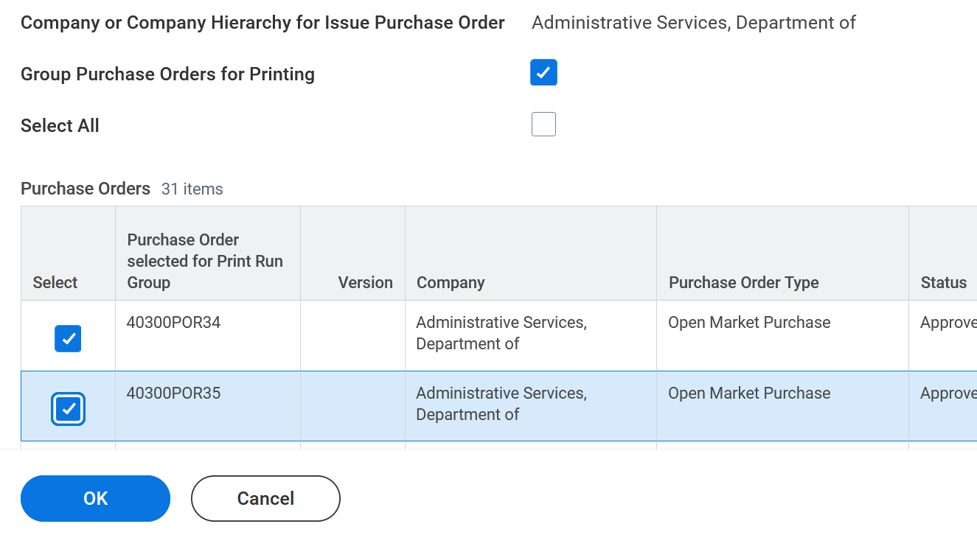
Issue Purchase Order Part (4 of 6)
INSTRUCTIONS
Check the applicable Purchase Order(s) to issue.
Note: Check the Select All box to issue all the Purchase Orders.
Click OK.
6
7

Slide 6
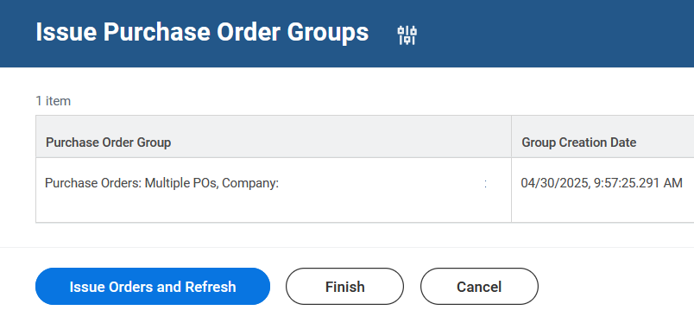
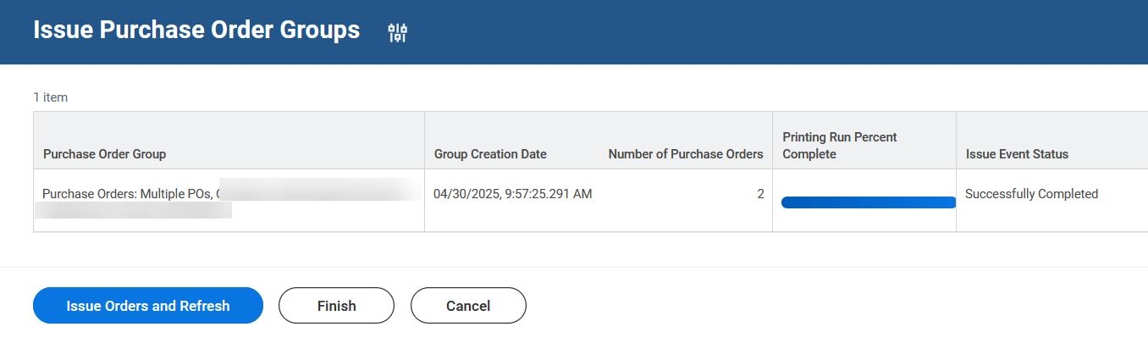
Issue Purchase Order (Part 5 of 6)
INSTRUCTIONS
Click Issue Orders and Refresh.
Note: Click Issue Orders and Refresh until the Successfully Completed is displayed in the Issue Event Status.
Confirm the Issue Event Status reads Successfully Completed.
Click Finish.
10
9

Slide 7
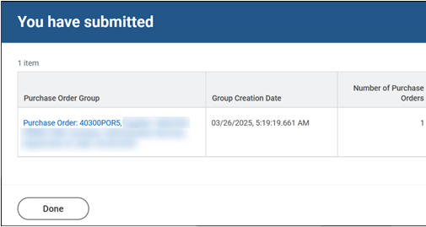

Issue Purchase Orders Part (6 of 6)
INSTRUCTIONS
Click Done.
Note: Click on the blue link under Purchase Order Group to view PDF of issued purchase order.
You have successfully completed issue purchase orders.

