Slide 1
Create Requisition Using P-Card
DESCRIPTION
This guide will show GA@WORK Requesters how to Create a Requisition Using a P-Card for payment. The cardholder of the card will be specified as the Requester on the Requisition.
OVERVIEW
The key steps in the process are below:
Click the Create Requisition task and select Requisition defaults, select cardholder as Requester.
Complete Good Request Details, click Add to Cart.
Click My Cart to review contents, click Checkout.
Complete Requisition Information and review Goods Lines, add Service Lines, if applicable.
Add Attachments, Category and Comments, as needed.
Click Submit.
Business Process:
Create Requisition
Add Requisition Lines
Select Credit Card for Payment
Submit Requisition

Slide 2
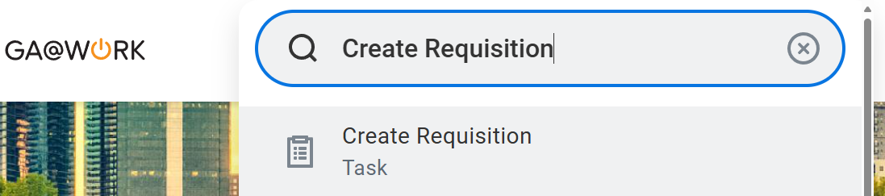
Create Requisition Using P-Card
(Part 1 of 13)
INSTRUCTIONS
Enter Create Requisition in the Search field.
Click the Create Requisition task.
Note: Requesters can opt to use the Requisition App. If you choose to do so, you must click on Edit Details and specify a Requesting Entity. If not populated, an error will occur, requiring the requisition be canceled and recreated.​
1
2

Slide 3
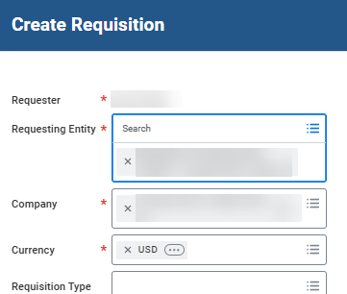
Create Requisition Using P-Card
(Part 2 of 13)
INSTRUCTIONS
Verify the Requester is the Cardholder, update as needed.
Note: The Requester will default to the user creating the requisition and unavailable to edit. The cardholder for the credit card being applied on the requisition should be the Requester. To update, first clear the Requesting Entity field, then change the Requester, and select the appropriate Requesting Entity.
Confirm Company is correct and Currency* is USD.
3
4

Slide 4
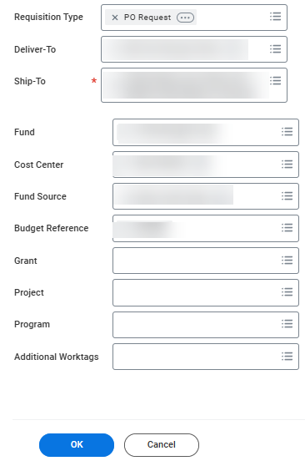
Create Requisition Using P-Card
(Part 3 of 13)
INSTRUCTIONS
Select appropriate Requisition Type.
Note: Credit Cards are intended for use on (non-catalog) PO Request and (Amazon) Catalog Purchase-OMP Requisition Types only.
Verify the Deliver-To location and Ship-To* address.
Verify appropriate default Worktag values are populated, including Fund, Cost Center, Fund Source, Budget Reference, Grant, Project, Program, and Additional Worktags, as applicable.
Click OK.
5
6
7
8

Slide 5
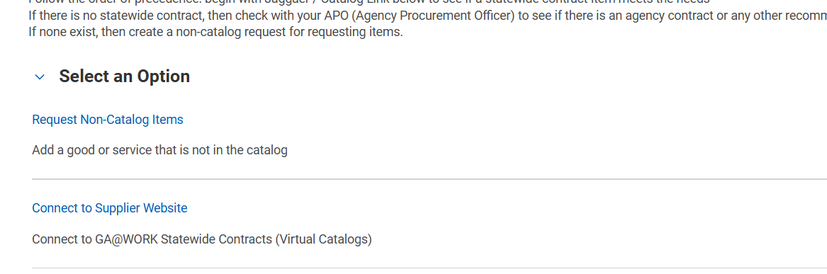
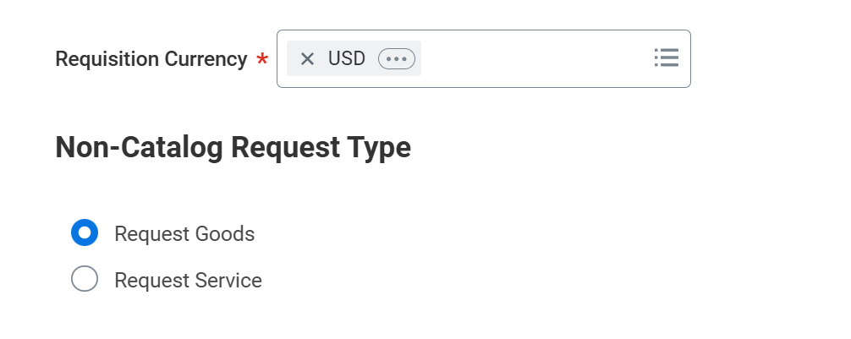
Create Requisition Using P-Card
(Part 4 of 13)
INSTRUCTIONS
Select Request Non-Catalog Items.
Note: You may select Connect to Supplier Website for creating Amazon POs eligible for XML issue. Reference Job Aid: Create Catalog Requisitions.
Select a Non-Catalog Request Type.
Note: For the purposes of this guide, Request Goods was selected. If Request Services is selected, fields will vary. Purchase Order Service Lines liquidate by Amount and, therefore, do not contain Quantity or Unit Cost fields.

Slide 6
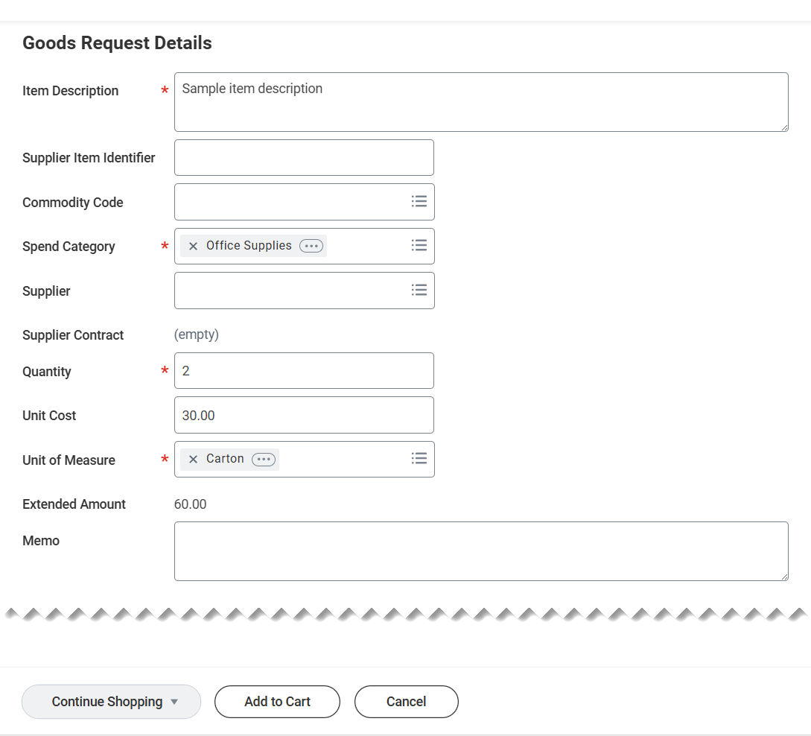
Create Requisition Using P-Card
(Part 5 of 13)
INSTRUCTIONS
Enter an Item Description* (Required) and Supplier Item Identifier (Optional).
Enter Commodity Code, if applicable and verify the default Spend Category*, update as needed.
  Note: If specified on Goods lines, the Spend Category will default based on Commodity Code. However, the Spend Category will not default on Service lines.
Enter a Quantity*, Unit Cost (Required), Unit of Measure* and line Memo, if needed.
Click Add to Cart.
Note: Repeat Steps 11-14 to add all Goods and Services line items being requested.
11
12
13
14

Slide 7
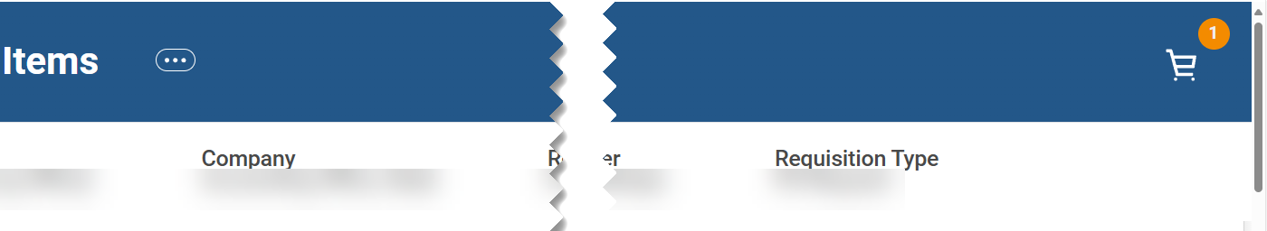
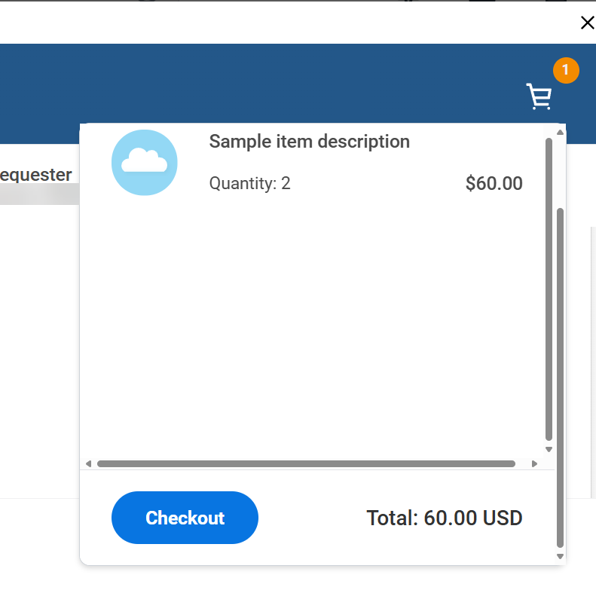
Create Requisition Using P-Card
(Part 6 of 13)
INSTRUCTIONS
Click the Shopping Cart when all line items are added.
Note: If line items require modification, click View Cart in My Cart. Select the item you wish to modify. If fields that require change are not open for edit, the line can be deleted. Click Continue Shopping to add the line item again. Select Request Non-Catalog Items option and repeat Steps 11-14.
Click Checkout when your cart contents are accurate and complete.

Slide 8
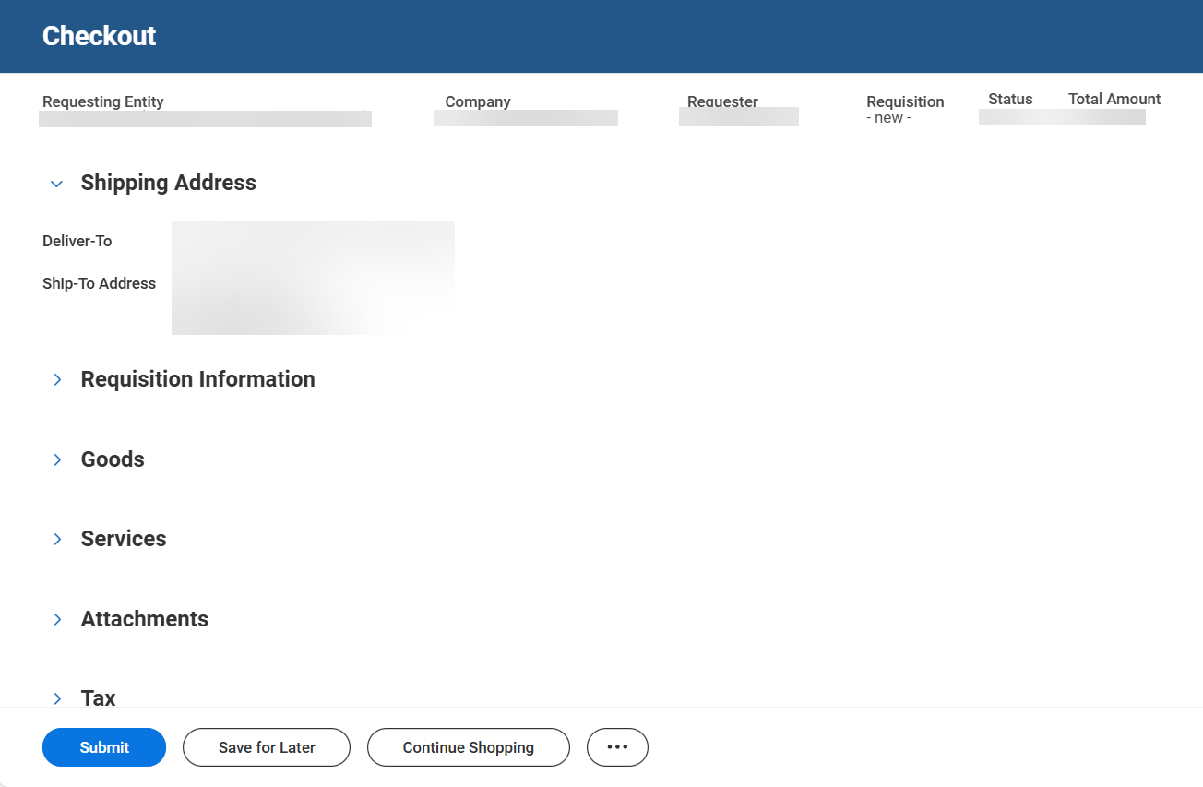
Create Requisition Using P-Card
(Part 7 of 13)
INSTRUCTIONS
Review the Requisition Header Deliver-To Location and Ship-To Address.
Note: Click Related Actions (…) and Edit Address to update. These values can differ on each requisition line. Both values must be a valid GA@WORK Location and Address. Do not select Use Alternate Address. Instead, contact your Procurement Officer to request addresses be created if they do not exist.

Slide 9
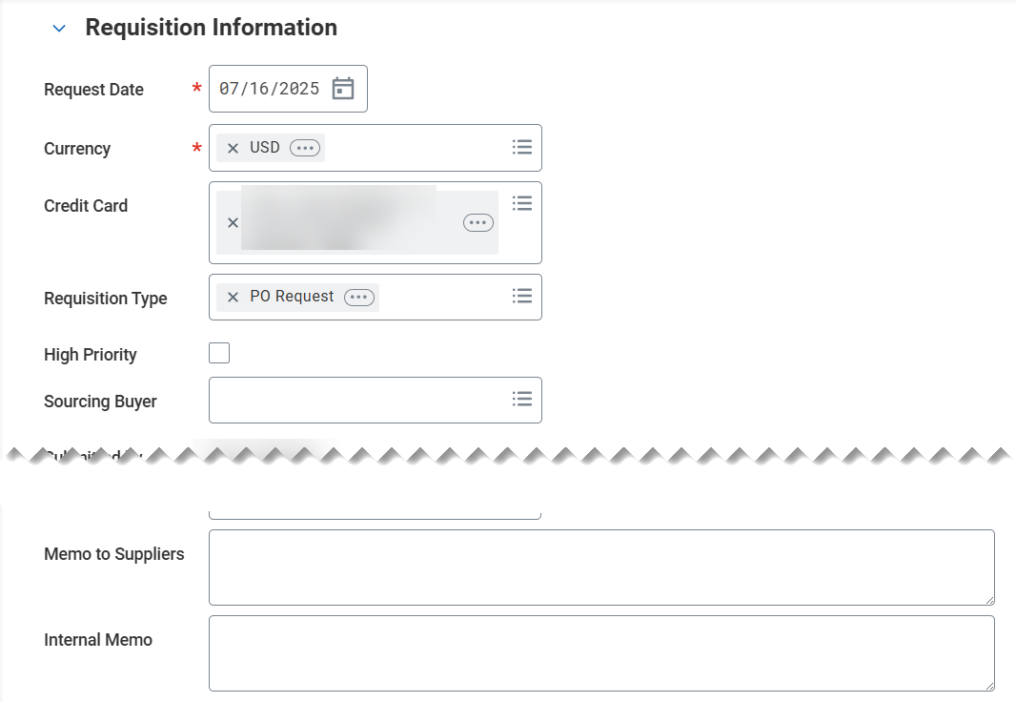
Create Requisition Using P-Card
(Part 8 of 13)
INSTRUCTIONS
Select the Credit Card issued to the Requestor.
Note: Optionally, check the High Priority box, enter a Memo to Suppliers (prints on PO) and enter Internal Memo, as needed.
Select PO Request in Requisition Type.
  Note: Comments entered in Memo to Suppliers will appear on Sourced PO. Memos are optional.
18
19

Slide 10
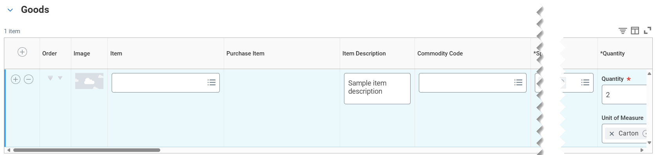
Create Requisition Using P-Card
(Part 9 of 13)
INSTRUCTIONS
Review the Goods Line or Service Line for completeness and accuracy for each line type. Review the following required fields for each line type:
  Spend Category
  Quantity
  Unit of Measure
  Ship-To Address
  Fund
  Cost Center
  Fund Source
  Budget Reference
Review all Goods or Services Requisition Lines for completeness and accuracy. Adjust values, if needed.
  Note: Alternatively, click Continue Shopping action option.
20
21

Slide 11
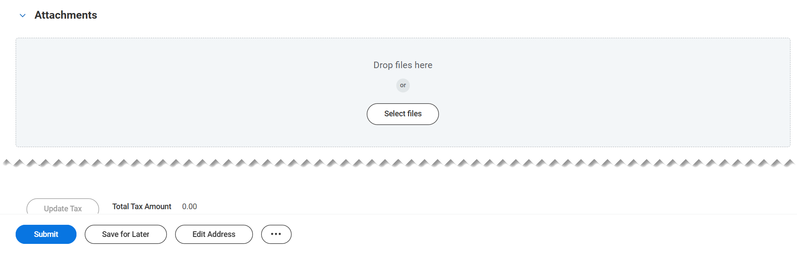
Create Requisition Using P-Card
(Part 10 of 13)
INSTRUCTIONS
​Drop files here or click Select files to Attachments, if applicable.
  Note: There are pre-defined categories available to select from for each Attachment. A (optional) comment field is also available for providing an attachment description.

Slide 12
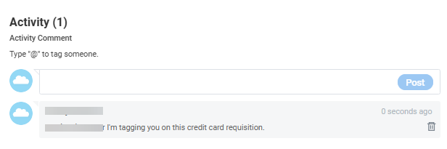
Create Requisition Using P-Card
(Part 11 of 13)
INSTRUCTIONS
​The Activity (comment) section is available on Requisition and Purchase Order transactions. It is utilized to communicate, internally, with other GA@WORK users regarding a specific transaction. The 'tagged' user will receive a GA@WORK Notification.
Note: To post comments or tag someone in the process, utilize the Activity section. This option is available on Requisition and Purchase Order transactions.

Slide 13
Create Requisition Using P-Card
(Part 12 of 13)
INSTRUCTIONS
​Click Related Actions (…), if applicable.
  Click Edit Address – to update the Requisition header and line Deliver and Ship-To Addresses.
  Click Edit Requisition Defaults - to mass update various values onto existing lines and default the same values onto newly added requisition lines, including mass Worktags and splits.
  Note: Clicking Cancel from other actions using the related actions icon at bottom of page returns user to the View Requisition page and will not cancel the transaction. However, any unsaved data will be lost. If unsaved data exists, use the Save for Later action option instead.

Slide 14

Create Requisition Using P-Card
(Part 13 of 13)
INSTRUCTIONS
​Click Submit.
You have created a P-Card Requisition.

