Slide 1
Renew an Agency Contract
DESCRIPTION
This guide will show Contract Administrator how to Renew an Agency Contract only.
OVERVIEW
The key steps in the process are below:
Access the Contracts module.
Select Contract for renewal.
Renew Contract.
Contract is saved.
Business Process:
Access Contracts Module
Select Contract
Renew or Extend Contract
Contract is Renewed or Extended

Slide 2
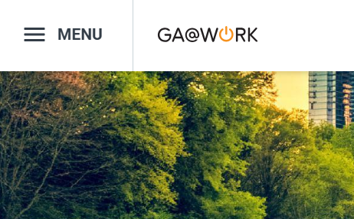

Renew an Agency Contract
(Part 1 of 13)
INSTRUCTIONS
Click the Global Navigation Menu.
Note: University System of Georgia (USG) users complete local logon and then proceed to Step 4.
Click Sourcing, Contracts & Supplier Management.

Slide 3

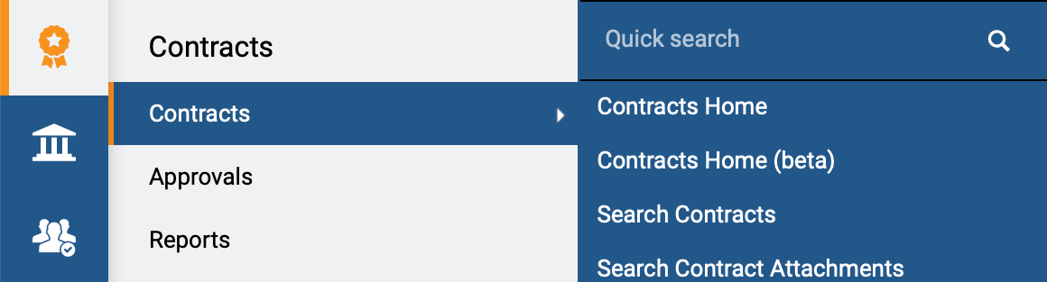
Renew an Agency Contract
(Part 2 of 13)
INSTRUCTIONS
Click Sign On.
Note: The system utilizes Single Sign-On (SSO), no log in information is required.
Access the Contracts module.
Click Contracts.
Click Search Contracts.
4
5
6

Slide 4
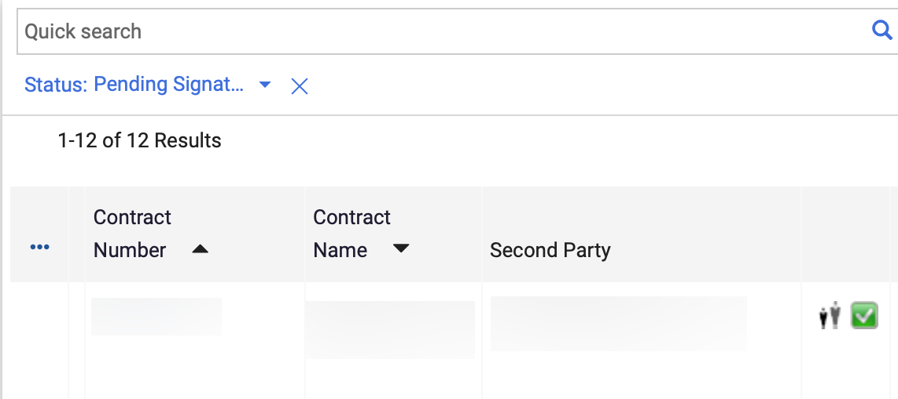
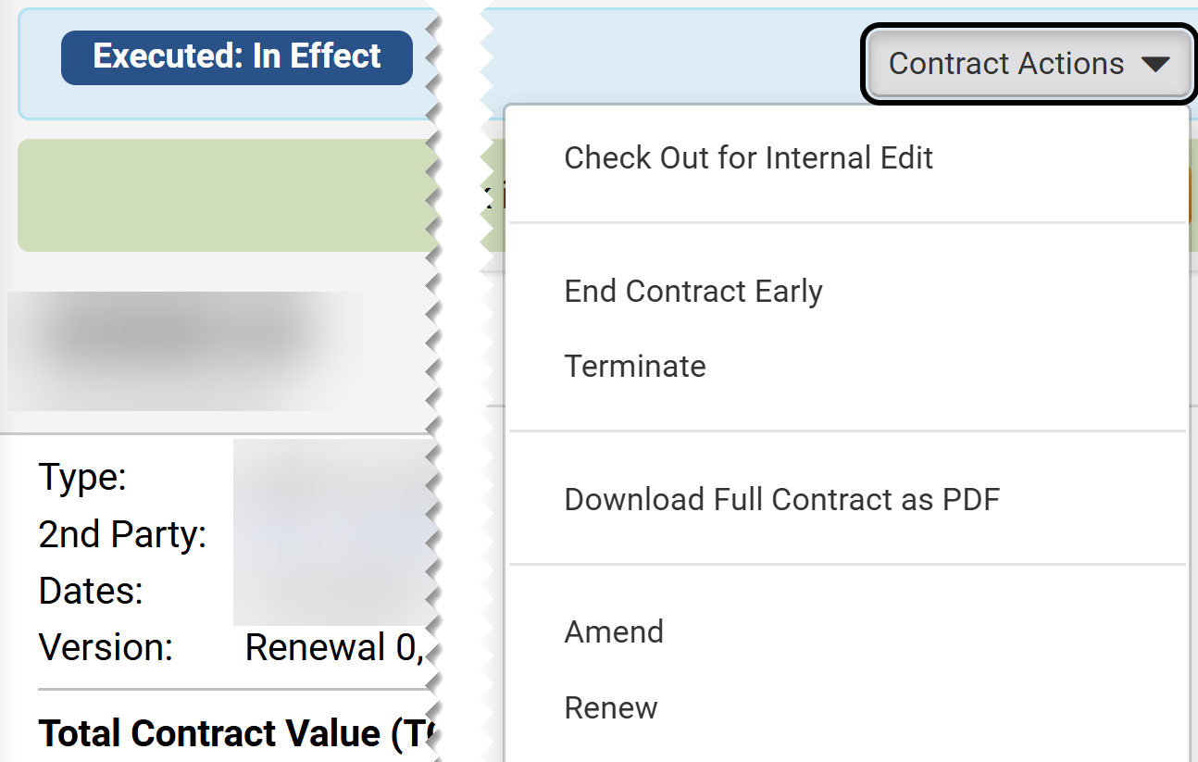
Renew an Agency Contract
(Part 3 of 13)
INSTRUCTIONS
Click Contract Number.
Note: Use the Quick Search and Filters to find the contract.
Click Contract Actions.
Click Renew.
Note: Renew is only visible if the contract has Renewals Remaining.
8
9

Slide 5
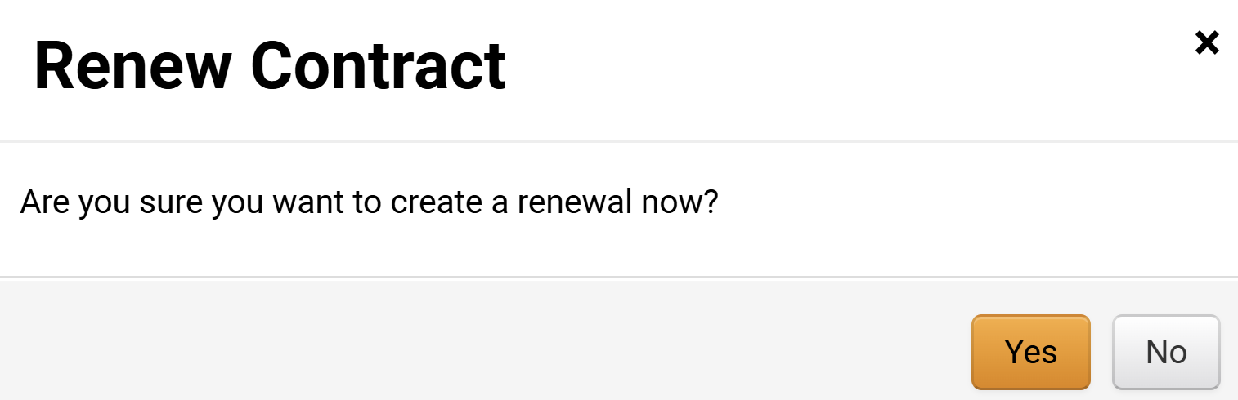
Renew an Agency Contract
(Part 4 of 13)
INSTRUCTIONS
Click Yes.
Note: The Contract Renewal will open only after clicking Yes.

Slide 6
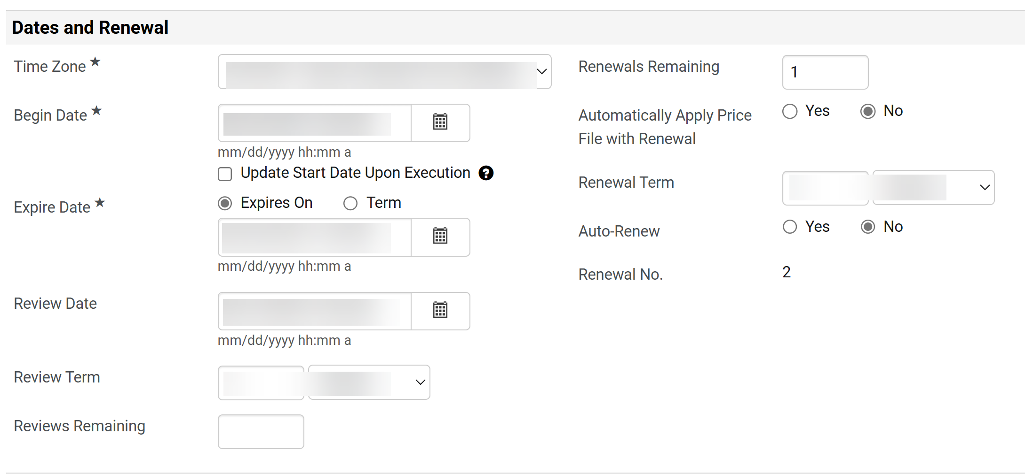
Renew an Agency Contract
(Part 5 of 13)
INSTRUCTIONS
Review the Dates and Renewal data auto populated from the Contract.
Confirm Renewals Remaining.
Note: To Extend a Contract change the expire and renewal information. Renewals Remaining will decrease down to the number of remaining renewals.
Confirm Renewal No. read-only field of running renewals.
12
11
13

Slide 7
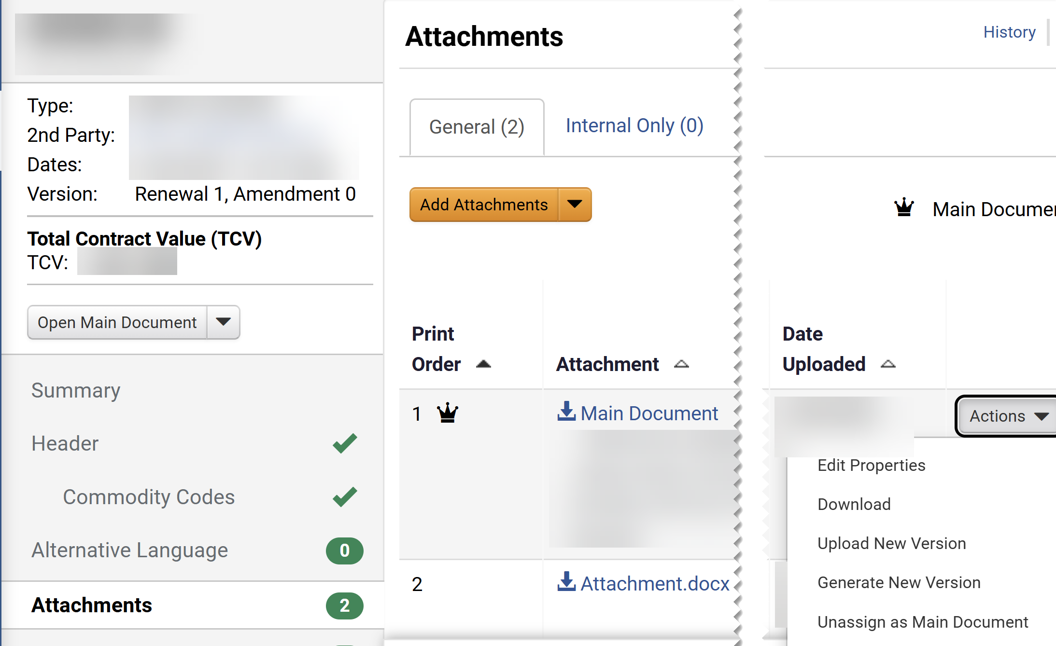
Renew an Agency Contract
(Part 6 of 13)
INSTRUCTIONS
Click Attachments.
Click Actions on the Main Document.
Select Unassign as Main Document.
Note: This step is required for the renewal actions to be visible.
15
14
16

Slide 8
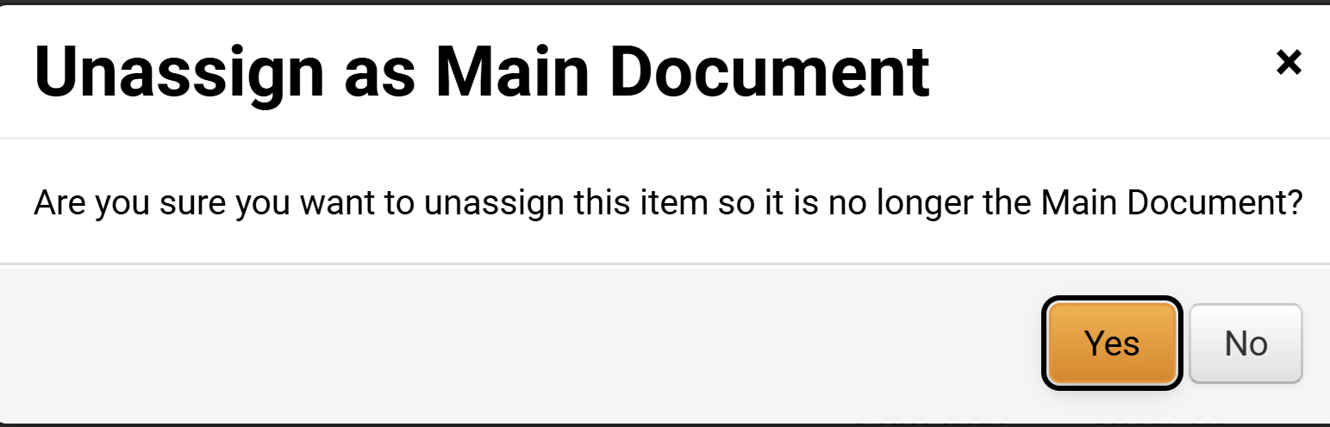
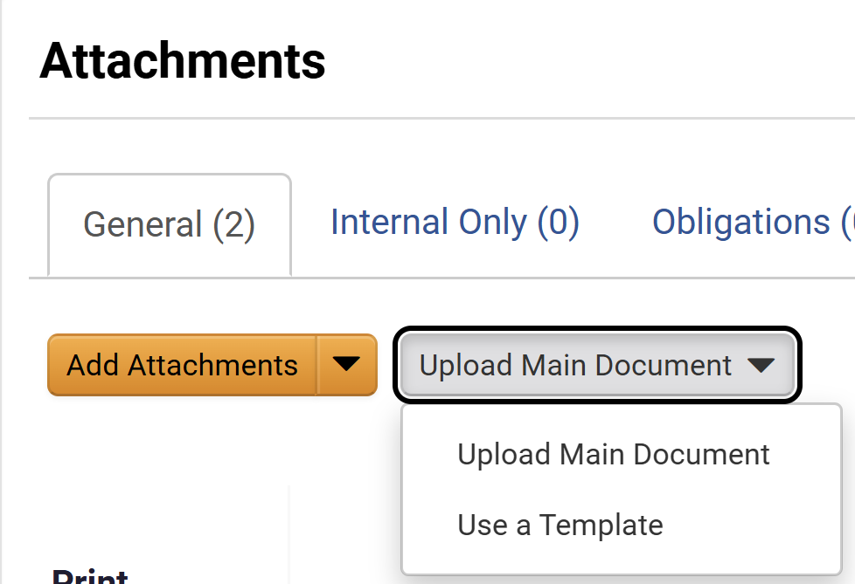
Renew an Agency Contract
(Part 7 of 13)
INSTRUCTIONS
Click Yes.
Click Upload Main Document.
Click Use a Template.
18
19

Slide 9
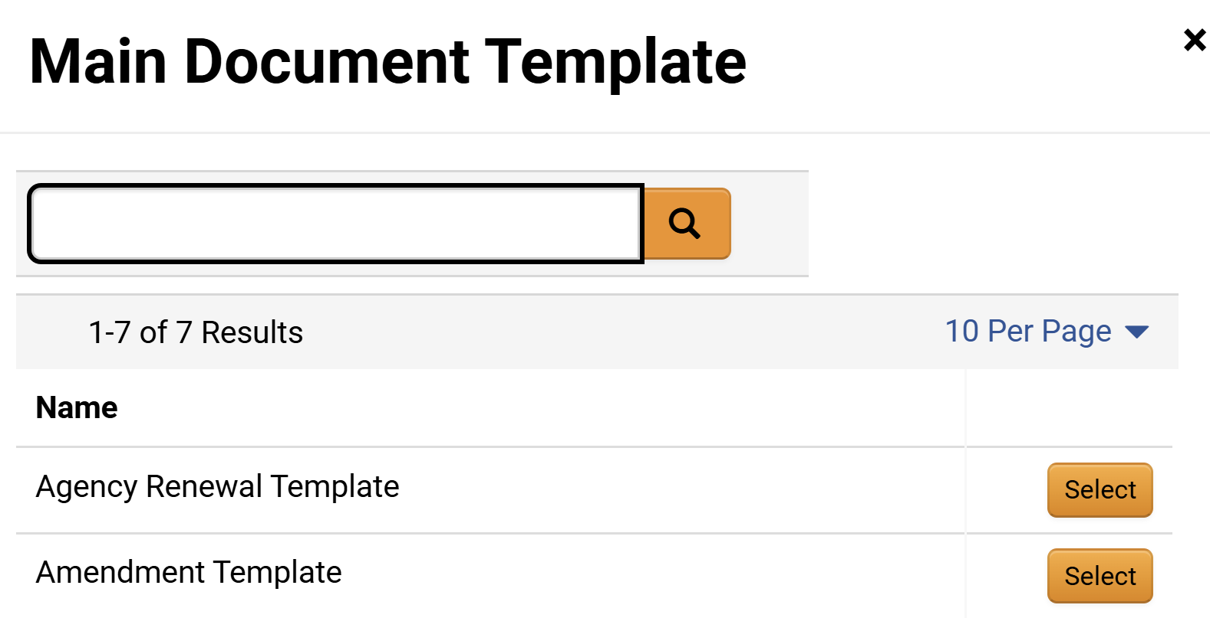
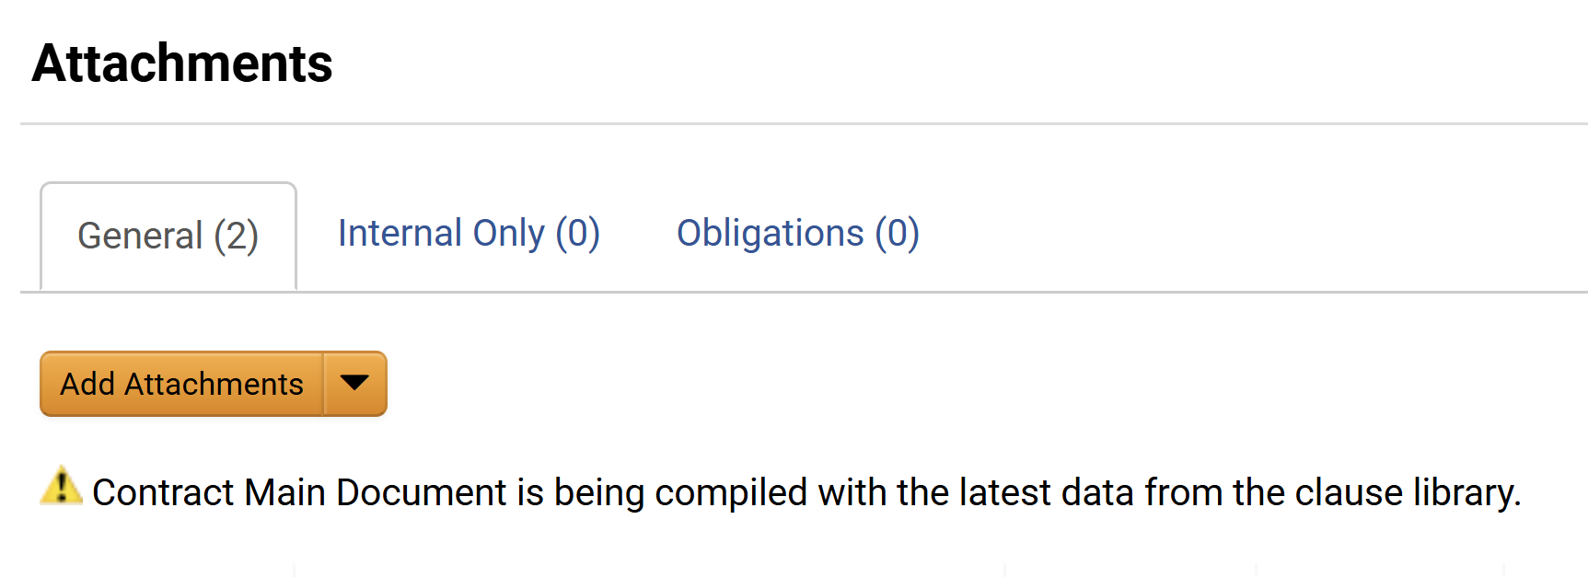
Renew an Agency Contract
(Part 8 of 13)
INSTRUCTIONS
Click Select on the Agency Renewal Template.
Confirm the message Contract Main Document is being compiled with the latest data from the clause library.
Note: It may take a short time for the compiling to complete.

Slide 10
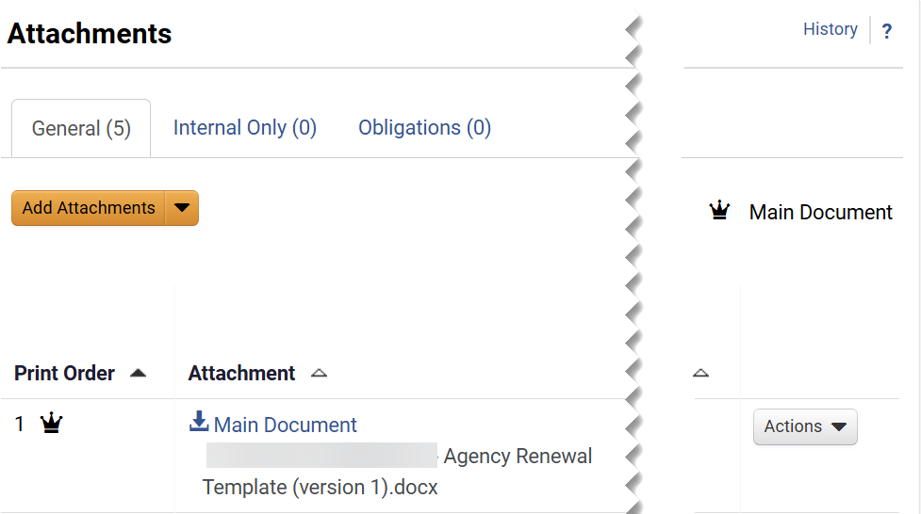
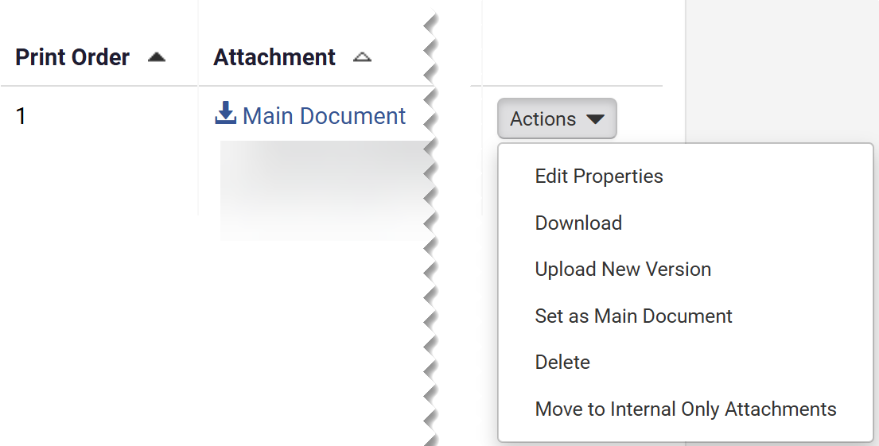
Renew an Agency Contract
(Part 9 of 13)
INSTRUCTIONS
Confirm that the Agency Renewal Template document is marked as the Main Document.
Select Download from the Actions menu

Slide 11
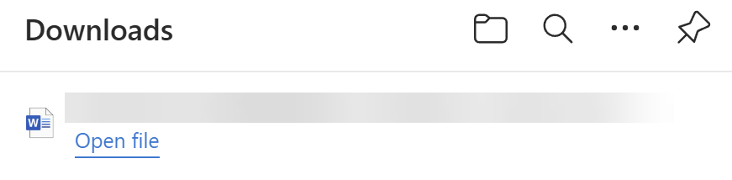
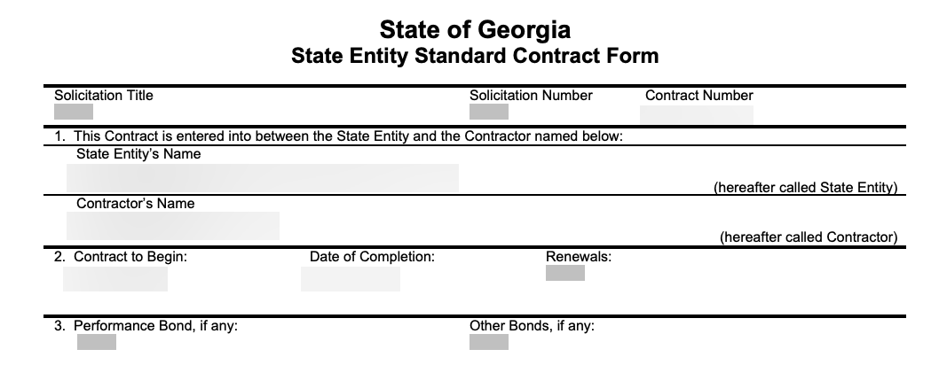
Renew an Agency Contract
(Part 10 of 13)
INSTRUCTIONS
Click Open File.
Note: The file should open in Microsoft Word.
Review the Contract and make required changes.
Note: Save the document on your desktop where you can find it to upload.

Slide 12
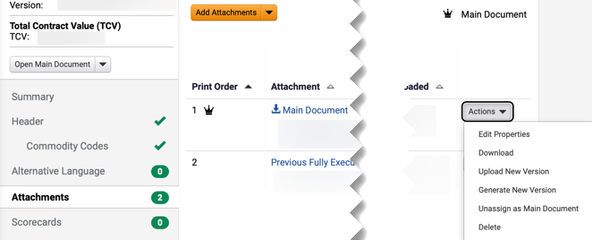
Renew an Agency Contract
(Part 11 of 13)
INSTRUCTIONS
Click Attachments on the Contract menu.
Click Actions.
Select Upload New Version. Use the table below to learn more about each Actions tab in this section.
27
28
26
Action Tab Field | Description
Actions
Open main document actions
Actions > Edit Properties
Able to change the document name, printing order, printing properties, and supplier visibility.
Actions > Download
Download the document.
Actions > Upload New Version
Able to upload new version of the document and include comments.
Actions > Generate New Version
Able to change version of the document.
Actions > Unassing as Main Document
Unassing current document as the main document. The crown icon would be removed as well.
Actions > Delete
Remove document from attachment list.

Slide 13
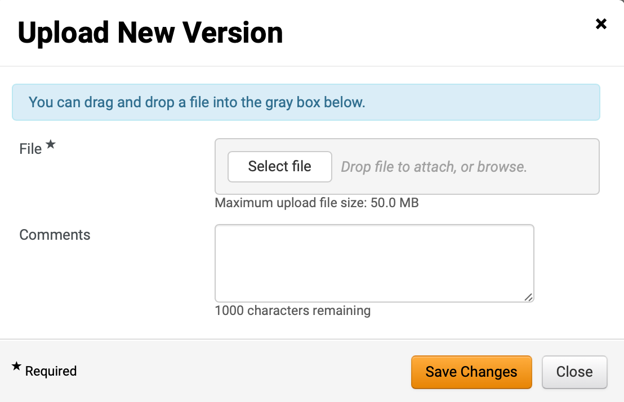
Renew an Agency Contract
(Part 12 of 13)
INSTRUCTIONS
Click Select file.
Note: Upload the Word document you saved in step 25 by clicking Select file or dragging and dropping the file.
Enter Comments (optional).
Click Save Changes.
29
30
31

Slide 14
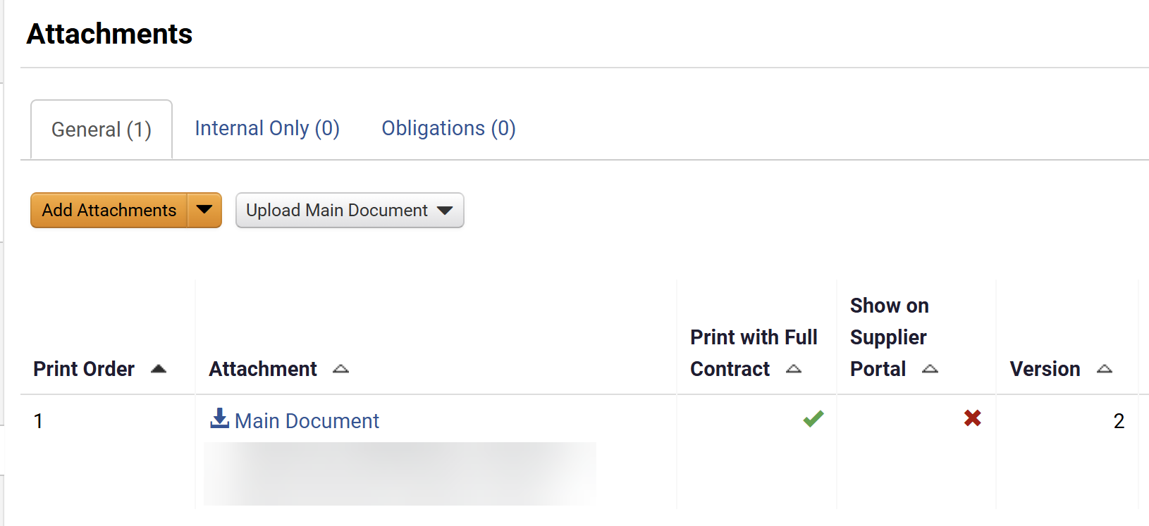
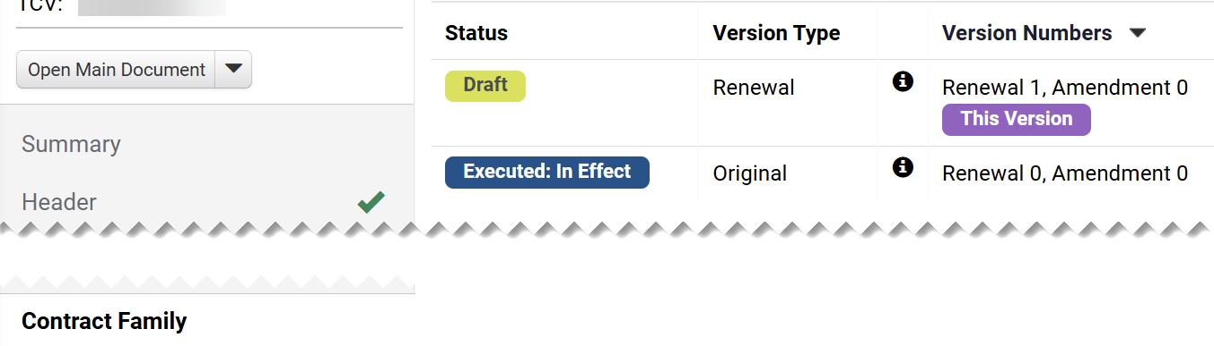
Renew an Agency Contract
(Part 13 of 13)
INSTRUCTIONS
Confirm that the Main Document is on the next Version.
Note: The the renewal can be approved, routed for Internal and External review (if applicable) and then sent for electronic signature (if applicable).
To review the renewal version, click Contract Family.
Note: The Contract Versions displays the Status, Version Type, and Version Numbers information. Version will remain on Draft Status until is routed for approval and signature collections. Review the required job aids for those activities.
You have successfully Renew or Extended an Agency Contract.

