Slide 1
Amend an Agency Contract
DESCRIPTION
This guide will show Contract Administrator how to Amend an Agency Contract.
OVERVIEW
The key steps in the process are below:
Access the Contracts module.
Select Contract to amend.
Amend Contract.
Contract is saved.
Business Process:
Access Contracts Module
Select Contract
Amend Contract
Contract is Amended

Slide 2
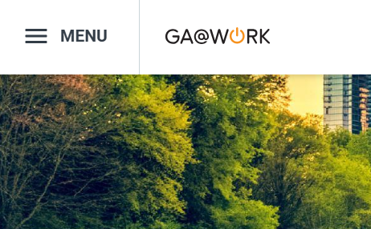

Amend an Agency Contract (Part 1 of 9)
INSTRUCTIONS
Click the Global Navigation Menu.
Note: University System of Georgia (USG) users complete local logon and then proceed to Step 4.
Click Sourcing, Contracts & Supplier Management.

Slide 3

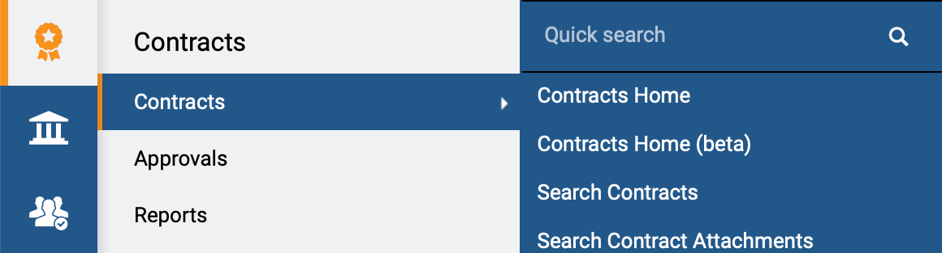
Amend an Agency Contract (Part 2 of 9)
INSTRUCTIONS
Click Sign On.
Note: The system utilizes Single Sign-On (SSO), no log in information is required.
Access the Contracts module.
Click Contracts.
Click Search Contracts.
4
5
6

Slide 4
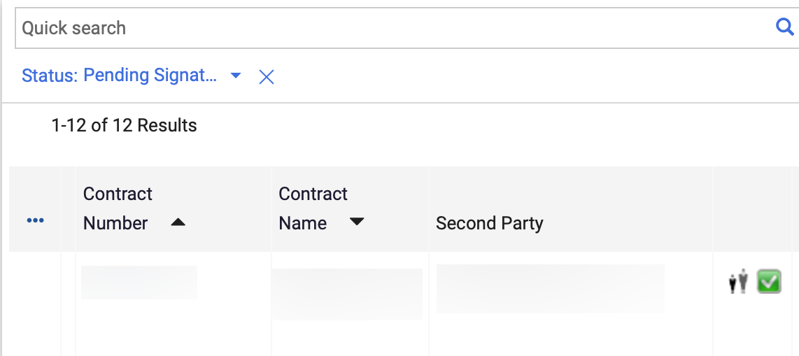
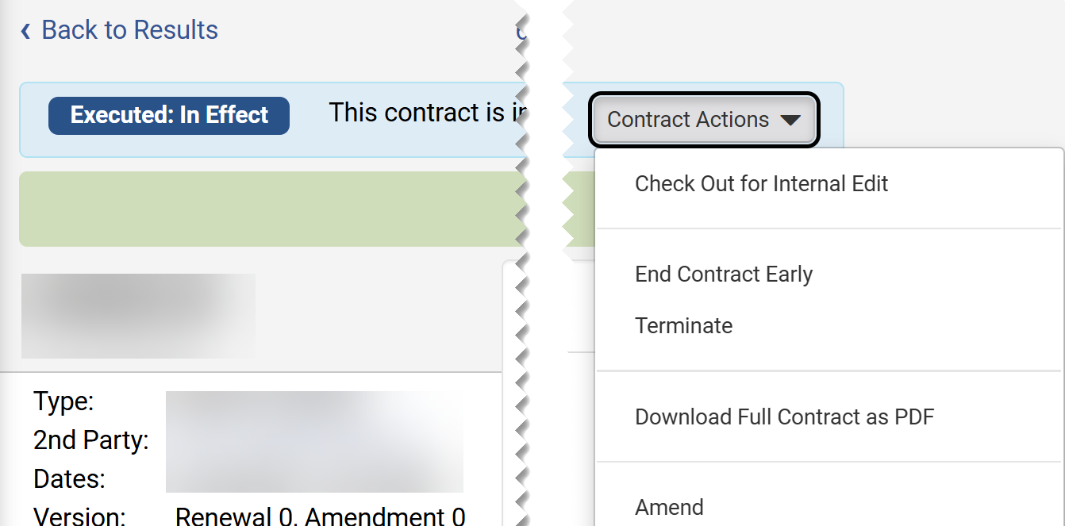
Amend an Agency Contract (Part 3 of 9)
INSTRUCTIONS
Click the Contract Number.
Note: Use the Quick Search and Filters to find the contract.
Click Contract Actions.
Click Amend.
Note: Amend is only visible if the contract is Check In.
8
9

Slide 5
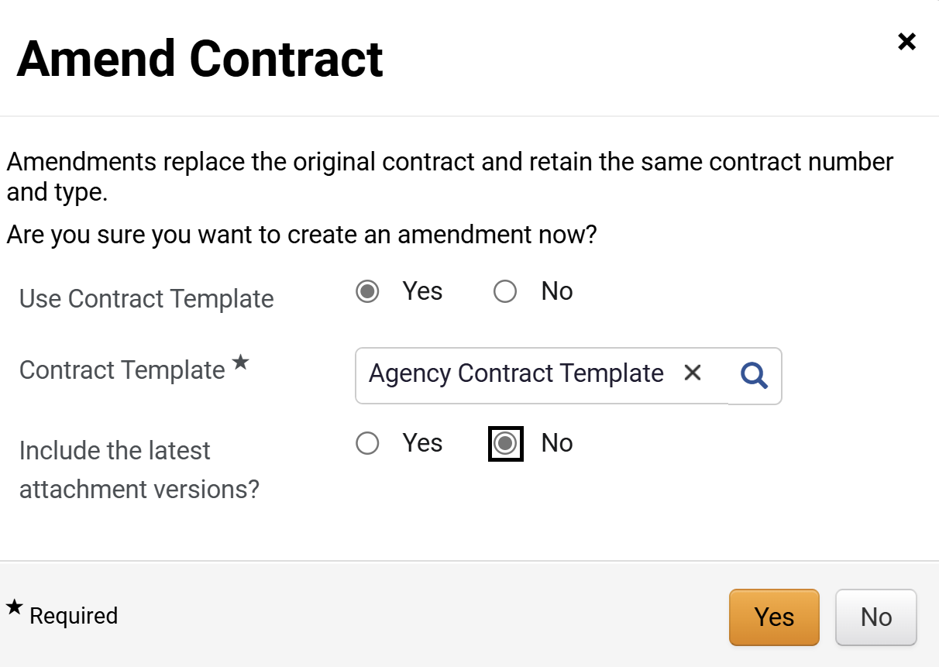
Amend an Agency Contract (Part 4 of 9)
INSTRUCTIONS
Select an option for Use Contract Template.
Note: If Yes is selected, proceed to step 11 (Contract template) --. If No is selected, skip to step 12 (Include the latest attachment versions). Recommendation to select No, so the Template used to create the original contract is retained.
Select a Contract Template*.
Note: Complete all required fields marked with a black star*.
Select an option for Include the latest attachment versions?.
Click Yes.
10
11
12
13

Slide 6
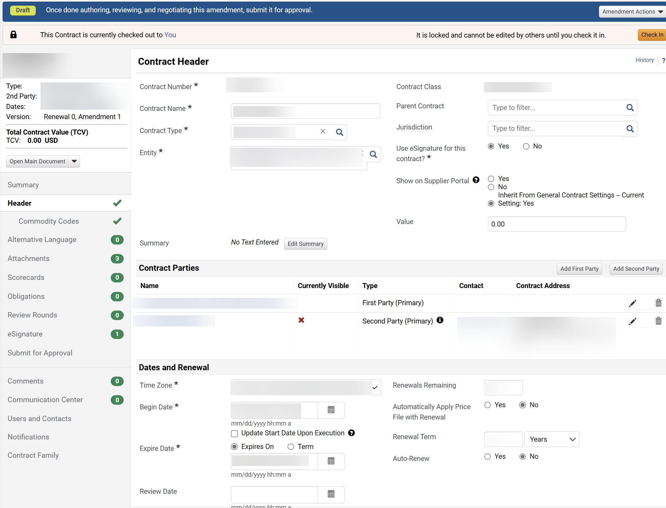
Amend an Agency Contract (Part 5 of 9)
INSTRUCTIONS
The Contract Header is open for editing.
  Note: Changes can be made to fields open for editing while the contract is Checked Out. When enabled for the contract type, users can enter a value on the contract header of their contracts. The entered value on an original contract becomes the total contract value, and each amendment or renewal of that contract increases or decreases the total contract value.

Slide 7
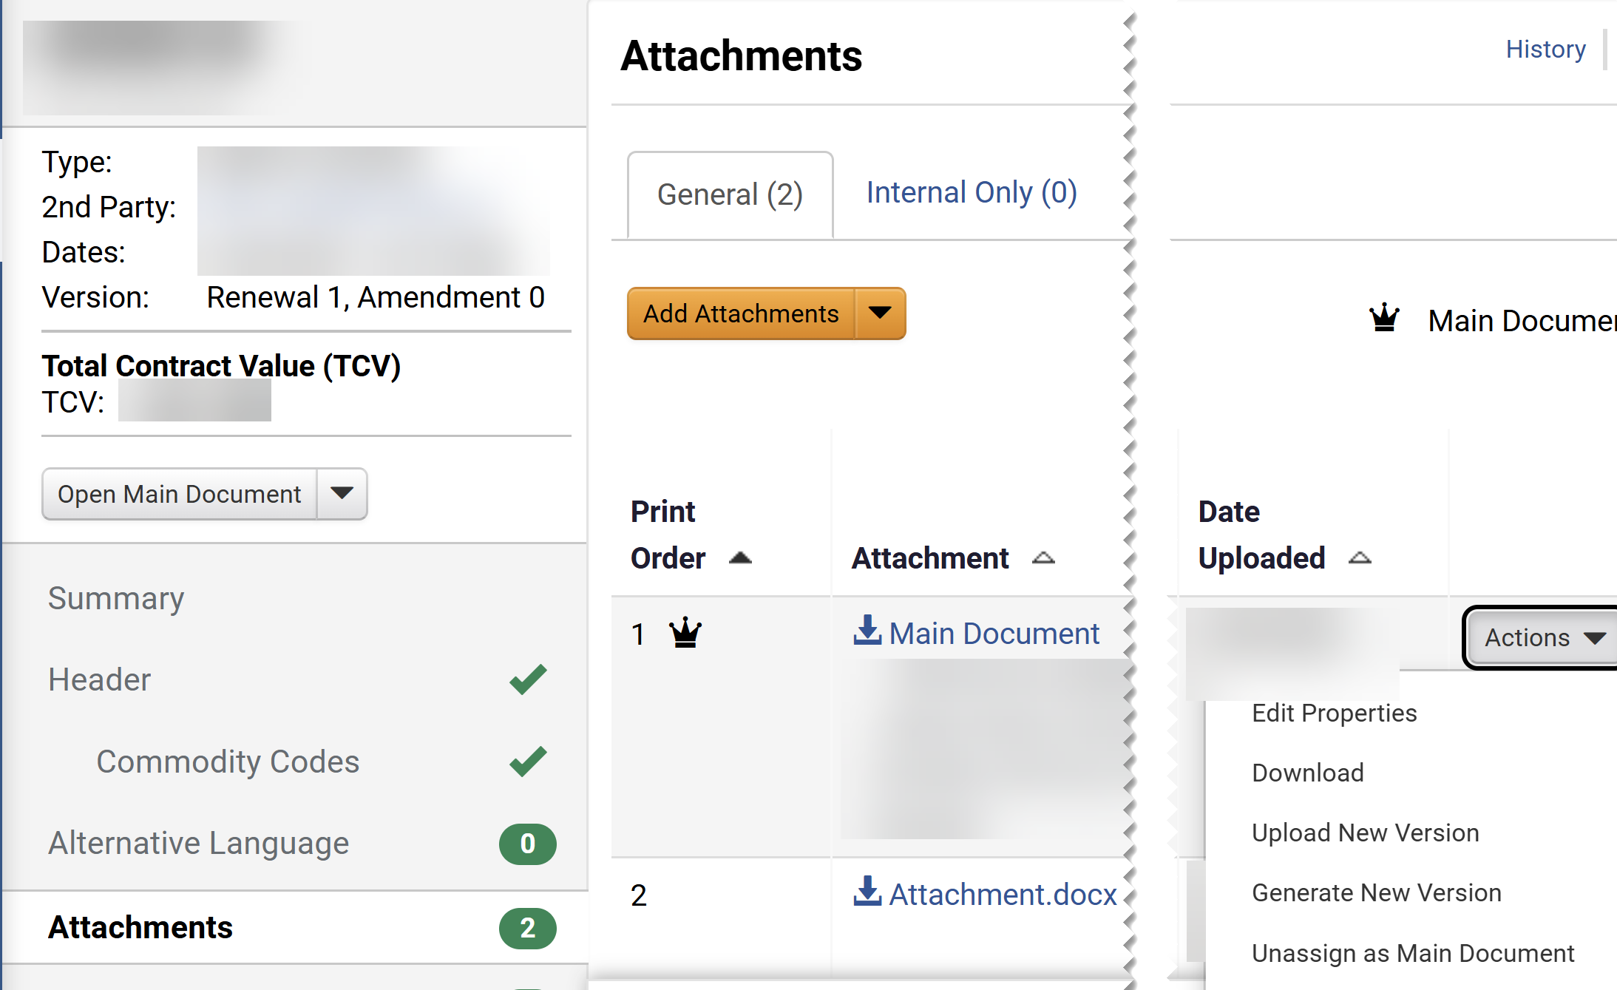
Amend an Agency Contract (Part 6 of 9)
INSTRUCTIONS
Click Attachments.
Click Actions on the Main Document.
Click Unassign as Main Document.
Note: This action is required for the amend actions to be visible.
16
15
17

Slide 8
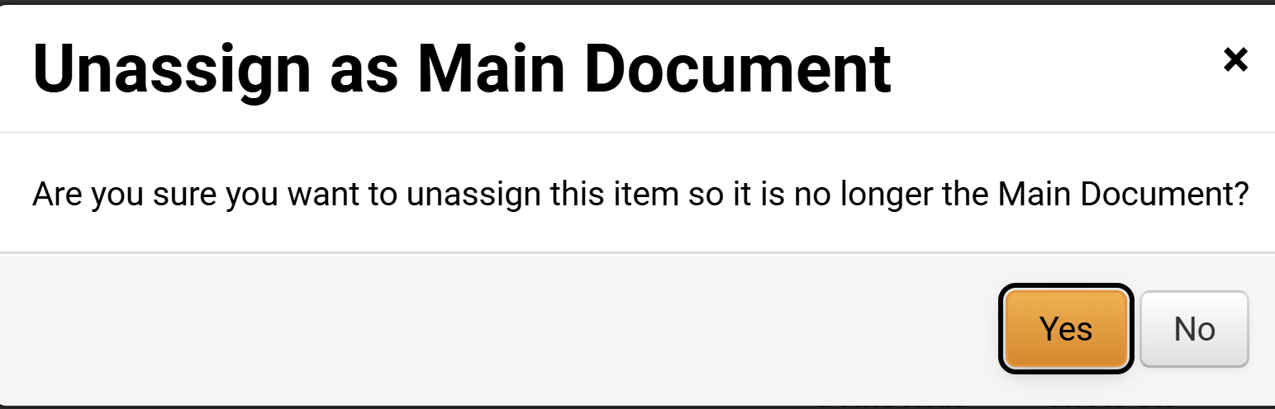
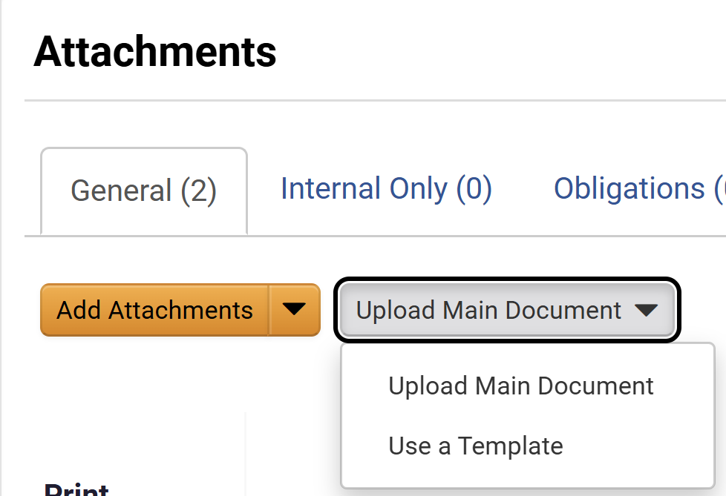
Amend an Agency Contract (Part 7 of 9)
INSTRUCTIONS
Click Yes.
Click Upload Main Document.
Click Use a Template.
19
20

Slide 9
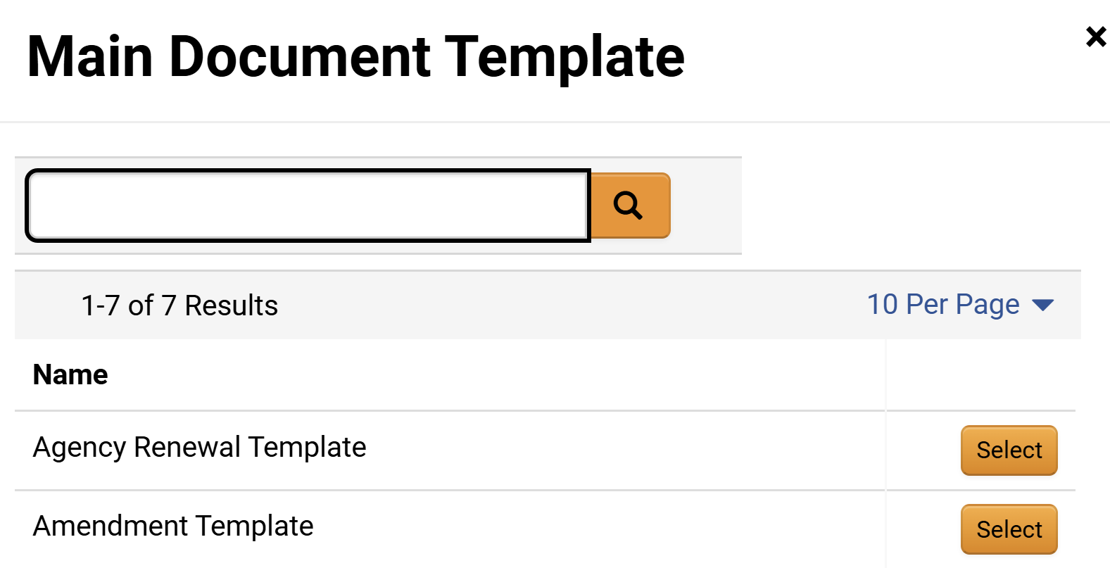
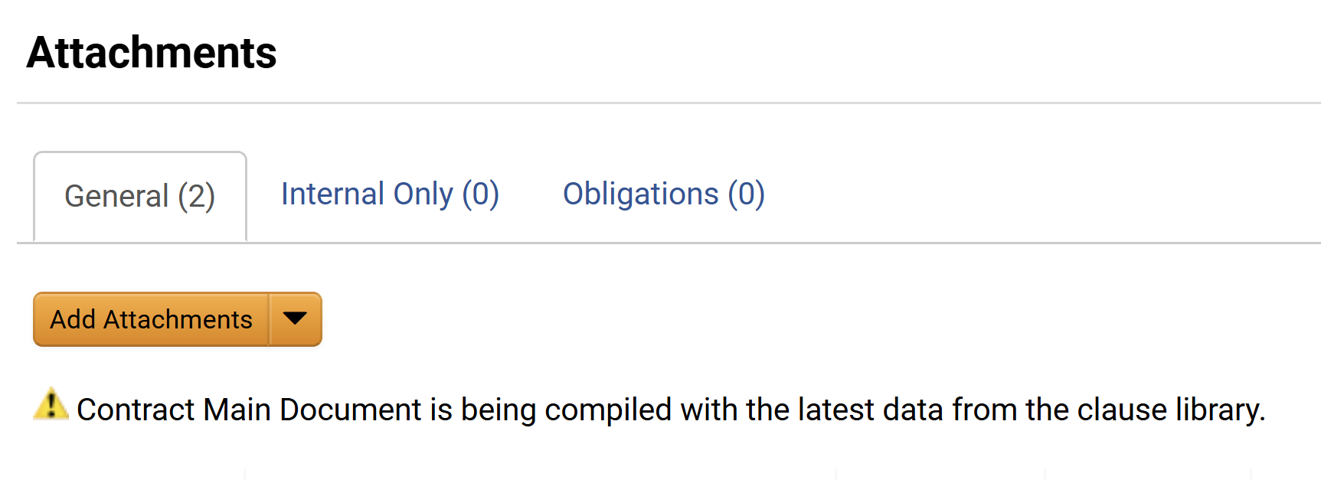
Amend an Agency Contract (Part 8 of 9)
INSTRUCTIONS
Click Select next to Amendment Template.
Note the message confirmation of Contract Main Document is being compiled with the latest data from the clause library.

Slide 10
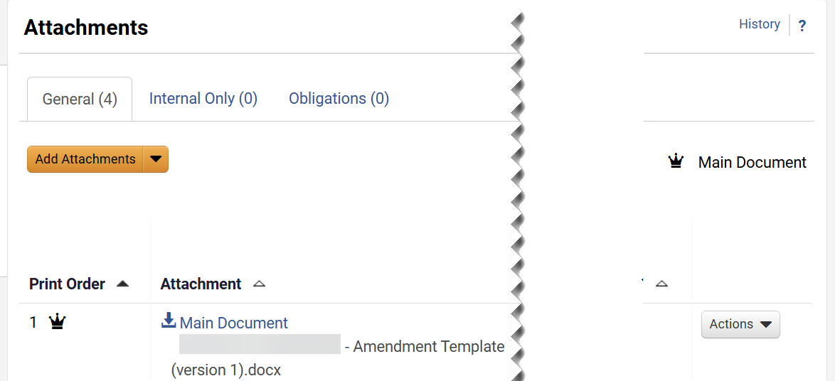
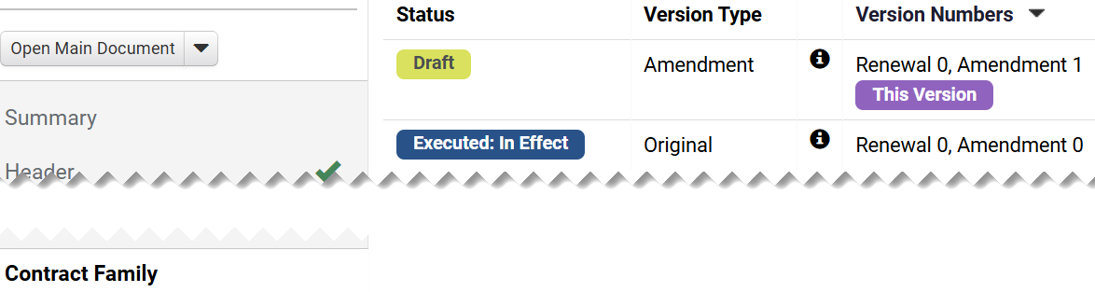
Amend an Agency Contract (Part 9 of 9)
INSTRUCTIONS
Note that the Amendment Template document is marked as the Main Document.
Click Contract Family to review the amendment version, .
Note: The Version displays the Amendment count information.
You have successfully Amend an Agency Contract.

