Slide 1
Approve, Close & Correct P-Card Prior Approval Request for Cardholder Managers
DESCRIPTION
This guide will show cardholder Managers how to Approve, Close, Correct, and Manage Attachments, as appropriate, on P-Card Prior Approval Requests.
OVERVIEW
The key steps in the process are below:
Click My Tasks to access P-Card Prior Approval Request.
Review, approve, and close the request.
Manage attachments prior to closing the request, as applicable.
Run CRPROC – PCARD – All P-Card Prior Approval Request report.
Correct or manage attachments on a closed request.
Click OK.
Business Process:
Locate Prior Approval Request
Approve & Close Prior Approval Request
Correct a Closed Request

Slide 2

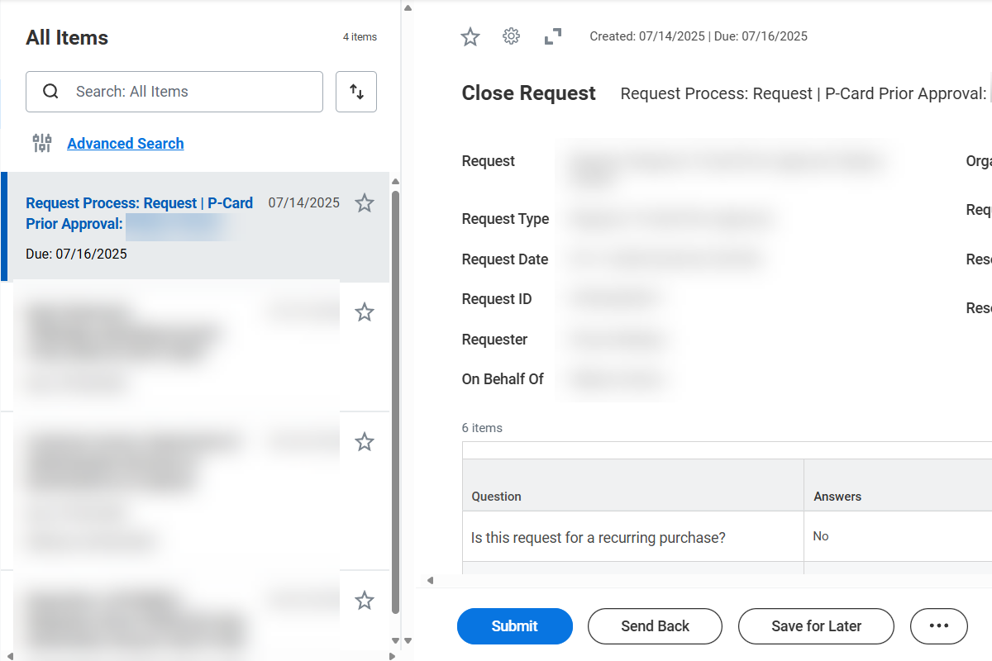
Approve and Close a P-Card Prior Approval Request for Cardholder Managers (Part 1 of 3)
INSTRUCTIONS
To locate a Review or Close Request task, click My Tasks in the top-right corner of your Homepage.
Review and Close Request.
Note: Manager approval required for the PCPA to close.

Slide 3
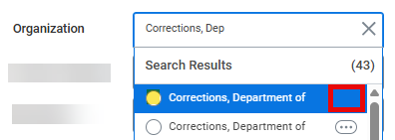
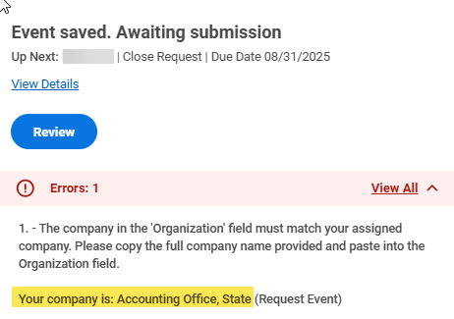
Approve and Close a P-Card Prior Approval Request for Cardholder Managers (Part 2 of 3)
INSTRUCTIONS
Select the manager’s Organization (Company) by typing the Company name and selecting that option listed without Related Actions (...).
Note: If selection does not match your assigned Company, the error below will appear. Please follow instruction provided in error to copy Company Name provided and paste it into the Organization field.

Slide 4
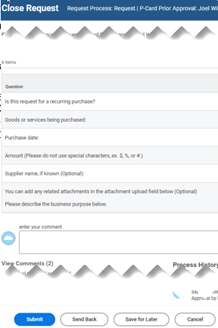
Approve and Close a P-Card Prior Approval Request for Cardholder Managers (Part 3 of 3)
INSTRUCTIONS
Select the appropriate Resolution for the Request, enter your comment, and add attachments as applicable.
Note: Send Back action is only available prior to a request closure. Therefore, it's important to be sure that no further review or revision is necessary prior to clicking Submit to close a request. If you need to manage attachments as an alternative to Send Back prior to a request closure, refer to the next page.
The only resolutions allowing successful submit action are: Approved, Denied, or Cancelled. If Hold or Incomplete selected, the request will not submit and remain 'in progress', pending final resolution to close request.
Click Submit.
4
5

Slide 5
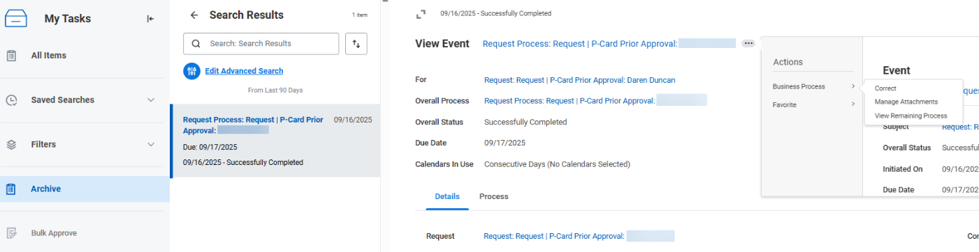
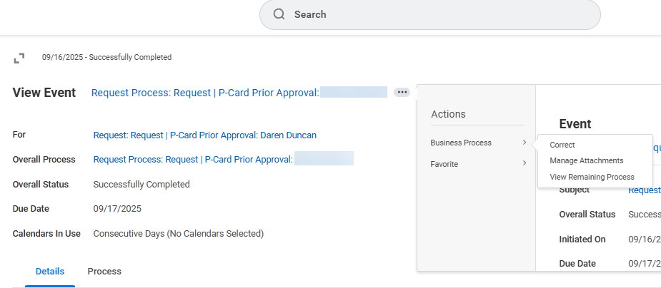
Manage Attachments Prior to Closing the Request (Part 1 of 3)
INSTRUCTIONS
To manage attachments as a Manager, before or after closure, locate the request either in My Tasks, Archive, or by running the CRPROC – PCARD – All P-Card Prior Approval Request report.
  Note: This example shows manage attachments from the Archive folder.
Click Related Actions (…).
Select Manage Attachments.
2
3

Slide 6
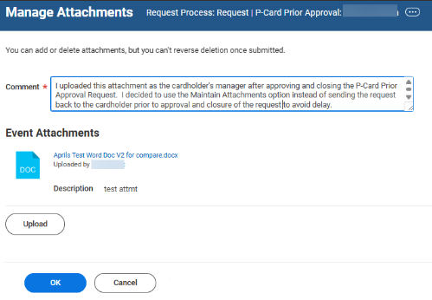
Manage Attachments Prior to Closing the Request (Part 2 of 3)
INSTRUCTIONS
Enter your Comment*.
Click Upload to add Attachments, as needed.
Enter a Description of the attachment, if desired.
Click OK.
4
6
5
7

Slide 7
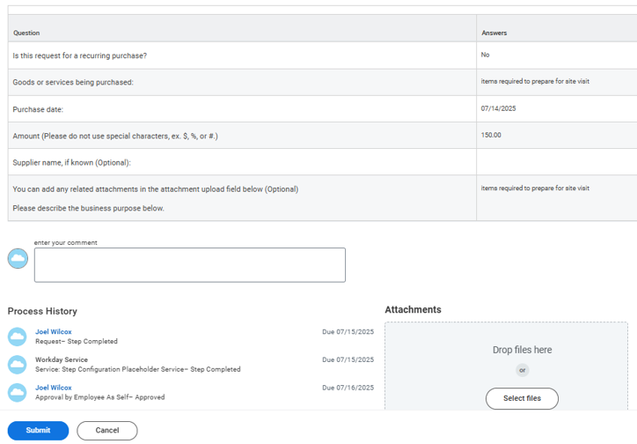
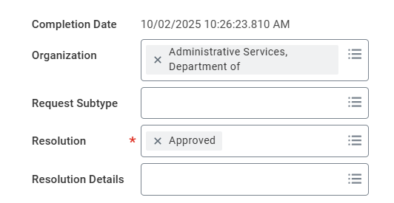
Manage Attachments Prior to Closing the Request (Part 3 of 3)
INSTRUCTIONS
There are only (3) changes allowed when you Correct a Closed P-Card Prior Approval Request.
  Modify Resolution.
    ​Add Attachments.
    You may enter your comment.
    Note: The Correct action is only required for modifying the Resolution. If there is only a need for adding a Comment or uploading an attachment on a closed request, the Manage Attachments option can be used instead.

Slide 8
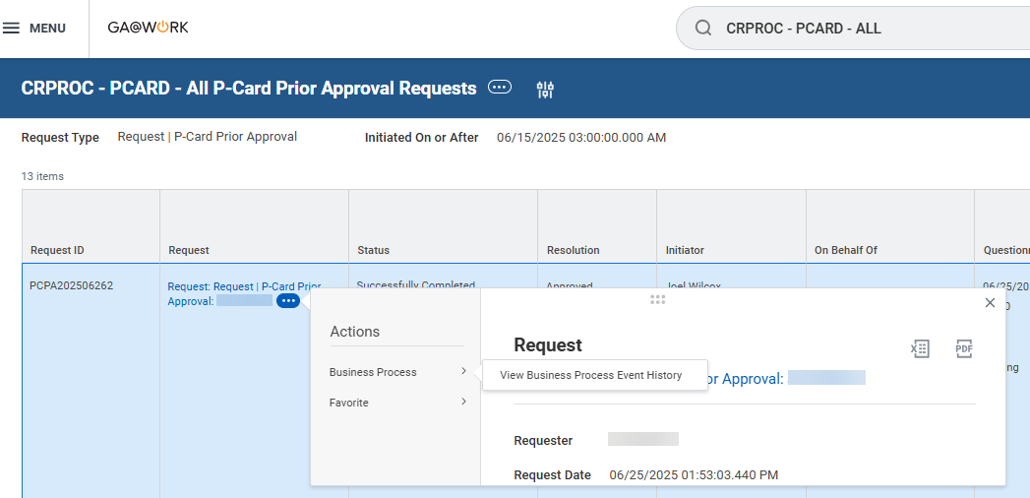
Correct Action and Manage Attachments on a Closed Request (1 of 6)
INSTRUCTIONS
To locate and access any closed request, run the CRPROC – PCARD – All P-Card Prior Approval Request report.
  Note: You can also locate closed requests within the last 90 days by accessing the Archive folder in My Tasks.
Click Related Actions (…) under the Request column.
Hover over Business Process.
Select View Business Process Event History.
1
2
3
4

Slide 9
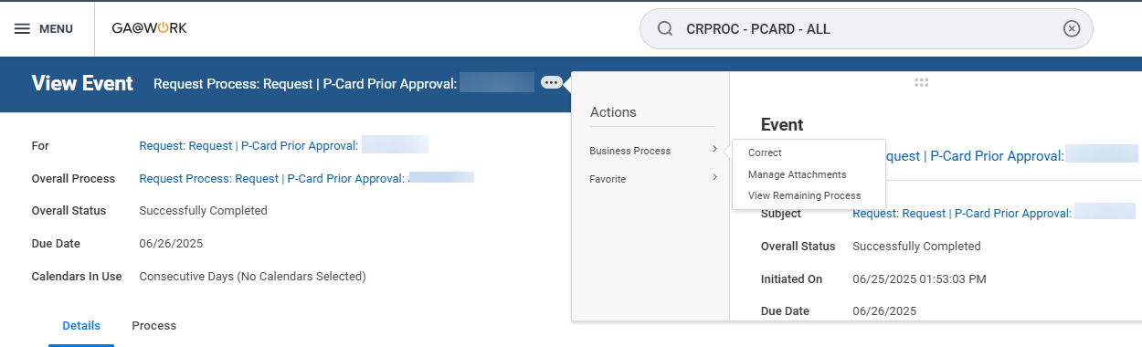
Correct Action and Manage Attachments on a Closed Request (2 of 6)
INSTRUCTIONS
Click Related Actions (…) next to Request Process: Request | P-Card Prior Approval event.
Hover over Business Process.
Select Correct or Manage Attachments, as applicable.
  Note: To Correct a closed P-CARD Prior Approval Request, skip to Step 8. To Manage Attachments, skip to Step 13.
6
7

Slide 10
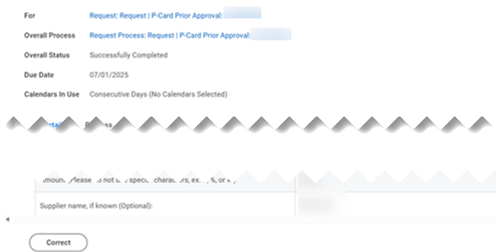
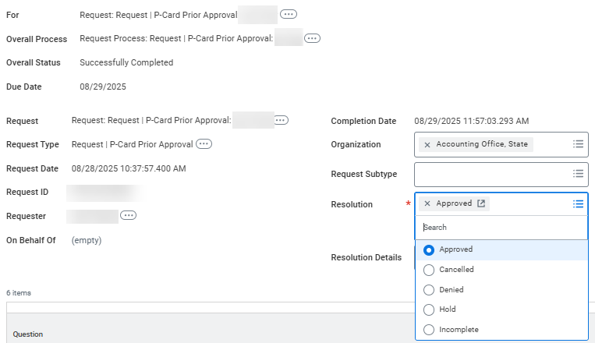
Correct Action and Manage Attachments on a Closed Request (3 of 6)
INSTRUCTIONS
To correct a closed P-CARD Prior Approval Request, click Correct directly from the View Event page.
  Note: The Correct action option will only be available on Requests with an Overall Status of Successfully Complete and Resolution populated​.
Correct the Request by changing the Resolution*, if needed.

Slide 11
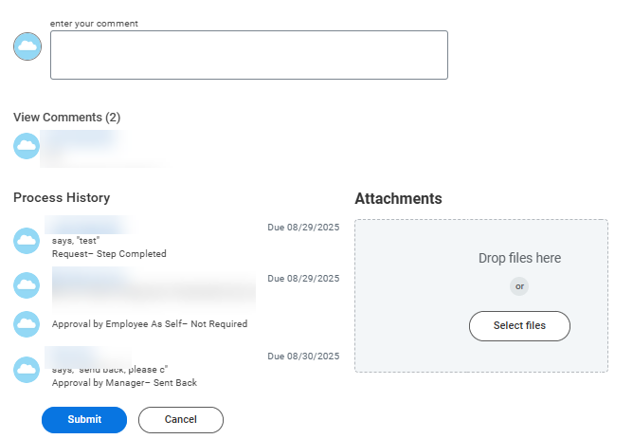
Correct Action and Manage Attachments on a Closed Request (4 of 6)
INSTRUCTIONS
You may enter your comments, as applicable.
Click Select files or Drop files here to add Attachments, if needed.
Click Submit.
10
11
12

Slide 12

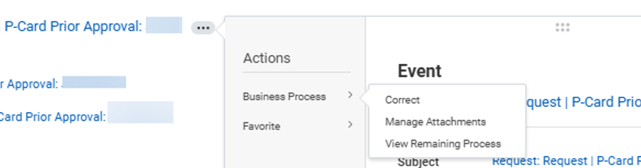
Correct Action and Manage Attachments on a Closed Request (5 of 6)
INSTRUCTIONS
If you would like to Manage Attachments without taking the Correct action, click Related Actions (…) next to Request Process: Request | P-Card Prior Approval.
Hover over Business Process.
Click Manage Attachments.
14
15

Slide 13
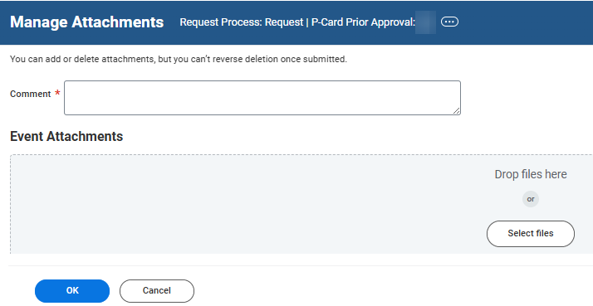

Correct Action and Manage Attachments on a Closed Request (6 of 6)
INSTRUCTIONS
Enter a Comment* for the Attachment.
Click Select files or Drop files here to include an Attachment.
Click OK.
16
17
18
20
You have successfully taken the Close, Correct, and Manage Attachments action options on a P-Card Prior Approval Request.

