Slide 1




DOAS HRA – POLICY TEAM
REASONABLE
SUSPICION
Notes:
Hello and welcome to our presentation on Reasonable Suspicion. This presentation is brought to you by the DOAS HRA Policy Team.

Slide 2
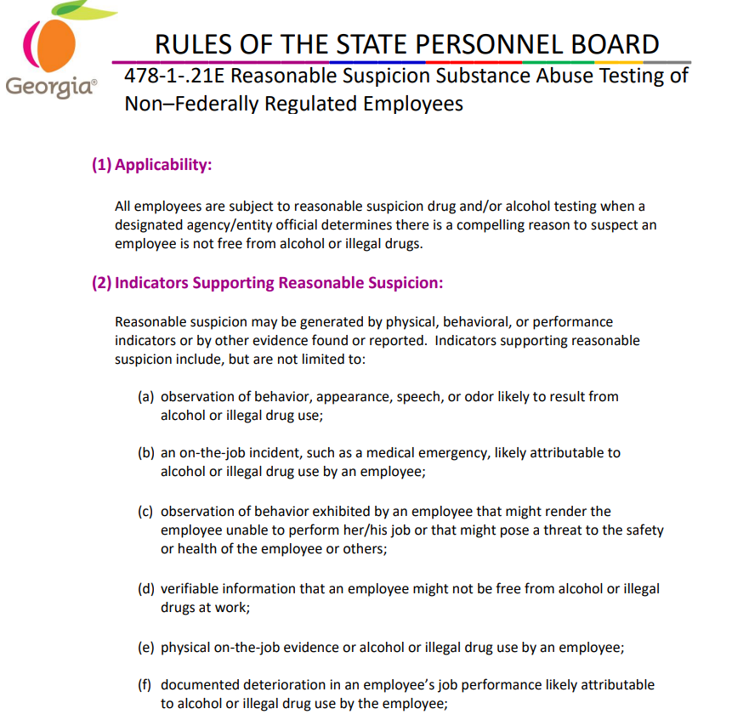
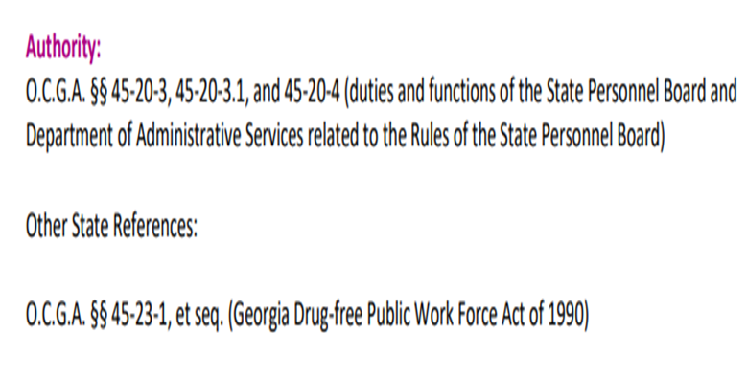
Notes:
In accordance with Georgia law and State Personnel Board Sub-Rule 21-E, employees may be subject to reasonable suspicion testing. Reasonable suspicion testing is also referenced near the end of subrule 21D for federally regulated positions. Leaders are encouraged to familiarize themselves with this information. The U.S. Department of Transportation requires supervisors managing federally regulated positions to take a two-hour course titled US DOT Reasonable Suspicion Training for Supervisors. This training is offered through our vendor, Vault Health.

Slide 3

WHAT IS REASONABLE SUSPICION?
Notes:
What is reasonable suspicion? Reasonable suspicion drug or alcohol testing of an employee occurs when a designated agency or entity official determines that there is a compelling reason to suspect an employee is not free from alcohol or drugs. The designated official may be a manager, supervisor, human resources representative, or other agency or entity staff assigned responsibility for determining whether reasonable suspicion exists. These compelling reasons are usually based on observed indicators and are covered in the slides that follow.

Slide 4





Physical
Behavioral
Speech
Performance
Body Odor
INDICATORS OF PROBABLE DRUG AND ALCOHOL MISUSE
Notes:
There are five primary indicators of probable drug and alcohol misuse. They are listed on the slide and include: Physical, Behavioral, Speech, Performance, and Body odor.

Slide 5



PHYSICAL INDICATORS
Notes:
Starting with some of the Physical Indicators, you may observe an employee blacking out, having poor coordination, and lacking motor skills such as staggering or unusual clumsiness.

Slide 6


BEHAVIORAL & SPEECH INDICATORS
Notes:
Changes in behavior can often be the most noticeable indicator of drug or alcohol use. Behavioral indicators may involve an employee having a sudden mood swing. Displaying unusual aggression or having outbursts. When evaluating an employee for reasonable suspicion, listen for speech that may be slurred, incoherent, repetitive, or otherwise inconsistent with their normal communication.

Slide 7

PERFORMANCE INDICATORS
Notes:
Performance indicators usually include the inability to concentrate, or the employee may struggle with completing their regular work responsibilities. They may even have an increased number of absences.

Slide 8



ODOR INDICATORS
Notes:
Lastly, odor indicator: The employee may smell like rubbing alcohol or use Listerine to disguise the odor of the alcohol or drug used, or they may smell like marijuana from their hair or clothes.

Slide 9


Is it reasonable suspicion if you’re having a meeting on Teams/Zoom and notice an employee has a wine bottle or beer can on his desk?
Notes:
Here is a question to consider: Is it reasonable suspicion if you’re having a meeting on Teams/Zoom and notice an employee has a wine bottle or beer can on his desk? If your response to this question is yes, then you are on the right track. If such a situation arises, the supervisor or other designated official would want to also determine if any of the indicators touched on in earlier slides are present. For example: Are there behavioral indicators such as having outbursts, giggling or saying things that are out of place OR are there speech indicators such as slurred speech?
We will cover information in the next two slides to help with understanding required action in incidents involving reasonable suspicion.

Slide 10

DECISION TO TEST
Notes:
The designated official may be a manager, supervisor, human resources representative, or other agency or entity staff assigned responsibility for determining whether reasonable suspicion exists.

Slide 11

ALWAYS
Consult with their Human Resources Office first.
Notes:
The designated agency or entity official should always consult with their Human Resources Office first when there’s reasonable suspicion. We strongly emphasize the importance of contacting Human Resources rather than the official attempting to handle on their own. HR will provide the appropriate paperwork to document the behavior.

Slide 12
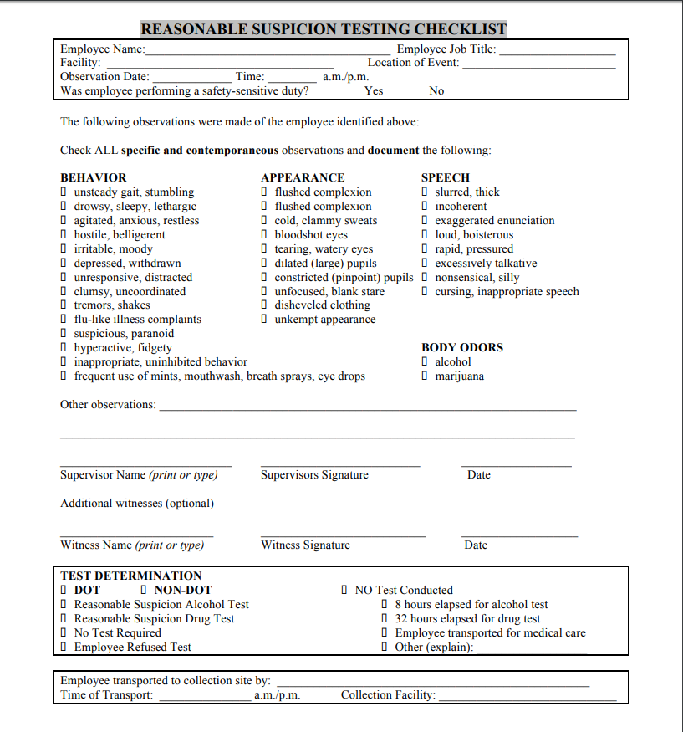
Reasonable Suspicion Testing
Reference: Reasonable Suspicion Checklist (Final).docx
Notes:
In incidents involving reasonable suspicion, this office encourages HR to provide the Reasonable Suspicion Checklist to the employee’s supervisor or other designated agency/entity official who directly observed the indicators pointing to possible drug or alcohol use. This checklist can be found at the link listed on the slide and includes the indicators we previously touched on, such as behavior, speech, and body odor.

Slide 13

Meeting with The Employee
Notes:
After direct observation of the indicators and completion of the reasonable suspicion checklist, HR, the supervisor, and or other designated agency or entity official are to privately address the information with the employee. If, after this discussion, it is determined that the employee should undergo drug testing, the employee should be given a directive to report to the identified collection site, along with instructions to follow while at the collection site.

Slide 14
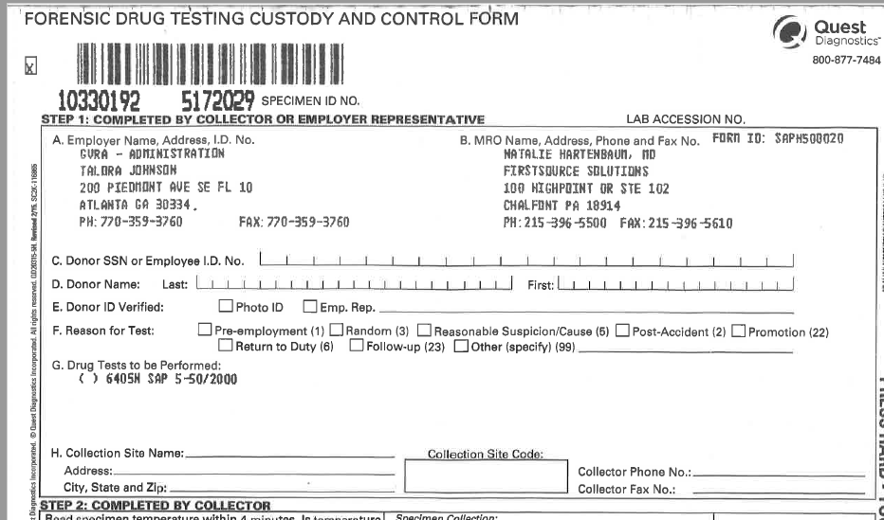
Chain of Custody Form (CCF)
Notes:
If an employee is sent for reasonable suspicion testing, the Chain of Custody form, like the one on the slide, will also be given to the employee and the designated official.

Slide 15

Transportation
Notes:
Let’s talk about transportation and who drives an employee to the collection site when there is reasonable suspicion of possible drug or alcohol use. In the past, we have had many challenges surrounding this issue. We’ve had some state agencies initially use their law enforcement, but later determine that this was not appropriate.
Other agencies attempted to assign this responsibility to supervisors who complained that they were uncomfortable with this responsibility, especially if the supervisor is the person who first suspected the employee of being under the influence.

Slide 16

Transportation
Notes:
A solution that some agencies devised to solve this issue involved having a designated person with an agency vehicle drive employees to the collection site when there is reasonable suspicion of alcohol or drug use. However, if this solution is not feasible, we recommend that agencies set up an Uber or Lyft account or even a taxi service.
The supervisor can ride in the Lyft or Uber with the employee to the collection site, or if the supervisor is uncomfortable being in the same car with the employee, they can be sent in separate cars.
Please note that transportation is only provided when there is reasonable suspicion for liability reasons.

Slide 17
The Process – Reasonable Suspicion
1. Designated official observes the employee’s suspicious behavior
2. The designated official contacts the Human Resources office, which will provide the relevant paperwork.
3. Designated official and HR address the employee in private
4. HR will arrange for the employee to be driven to the collection site and back
DO NOT allow employee to drive to or from
the collection site.
Notes:
To conclude, there are 4 steps that should be taken when a designated official suspects an employee of abusing alcohol or drugs.
1. The designated official observes the employee’s suspicious behavior.
2. The designated official contacts the Human Resources office, which will provide the relevant paperwork.
3. The designated official and HR address the employee in private.
4. HR will arrange for the employee to be driven to the collection site and back.
Remember that you do not want the employee to drive to or from the collection site.
We will cover information in the next two slides to help with understanding required action in incidents involving reasonable suspicion.

Slide 18
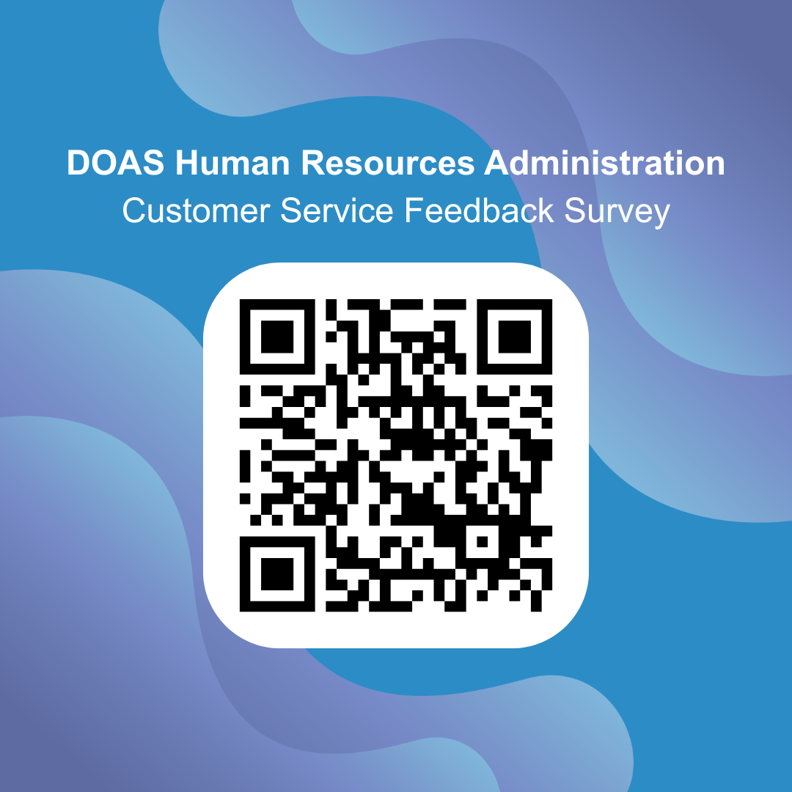

Use the QR Code above or click on the link below:
Take the survey
Notes:
Before we conclude this presentation, we ask that you please take a moment to complete our feedback survey by scanning the QR code or clicking on the link found at the bottom of the slide. Your feedback is extremely valuable to us and helps ensure that our training materials continue to meet the needs of agencies across the State. We appreciate your participation and commitment to maintaining a safe, compliant, and drug-free workplace.

Slide 19

THANK YOU!
PLEASE EMAIL US AT: POLICY@DOAS.GA.GOV
Martha Allen
Statewide Drug Testing Coordinator
HRA – Policy 404-657-4277
Martha.Allen@doas.ga.gov
Gail Stowers
Statewide Drug Testing Coordinator
HRA – Policy 404-463-7060
Gail.Stowers@doas.ga.gov
Notes:
Thank You! This concludes the Reasonable Suspicion educational resource. If you have questions or need further assistance, please contact the HR-Policy unit or one of the Policy Analysts listed on the screen.

