Slide 1


Applicant Verification Portal
(AVP)
Presented by
DOAS HRA - Policy Team
Notes:
Hello and welcome to the Applicant Verification Portal (AVP) training.
This training is being presented to you by the DOAS HRA Policy Team

Slide 2

What is the Applicant Verification Portal and Why is it necessary that agencies use it?
Notes:
The Applicant Verification Portal (also known as the AVP) is a centralized platform that lists all state employees who have tested positive or refused drug testing in the last two years. The portal is located inside the Vault Health database.
It is necessary that agencies use AVP. Once an offer for employment has been made, agency-designated personnel can open the AVP, enter the applicant’s social security number or CDL number, and the portal will show whether the applicant has tested positive for drugs in the past two years and whether the agency can move forward with the hiring process.

Slide 3

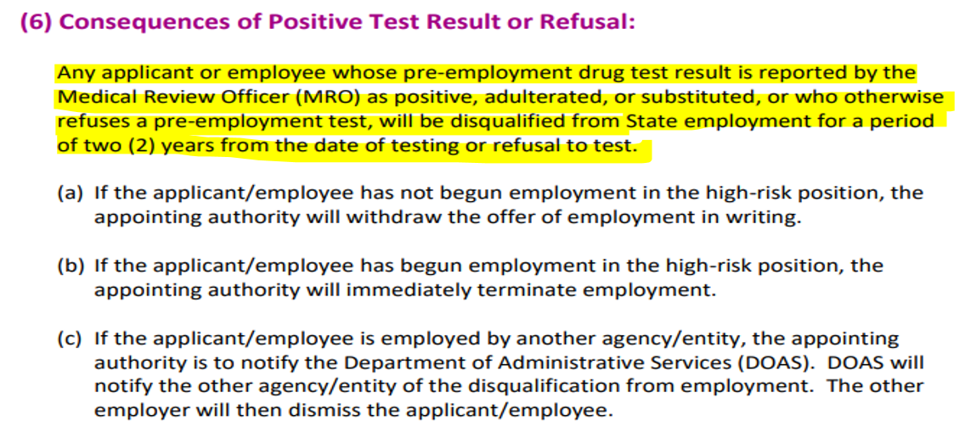
Notes:
Notice on the screen shot from sub-rule 21B– An employee/applicant who tests positive for a drug test or refuses to test will be disqualified from working for State government for a period of two years. Similar text about disqualification can be found in other sub-rules.
Note that A Refusal means one of the following:
~ The employee/applicant refused to take the drug test.
~ The employee/applicant left the collection site without taking a drug test.
~ The employee/applicant attempted to substitute their urine with synthetic urine or urine from an animal or
another human being which is referred to as ”substituted” on your results page, or
~ When an employee/applicant added something to their urine to disguise the drugs in their system, such as
bleach, salt, or detergent. This is referred to as an “Adulterated” result.

Slide 4





Notes:
The image on this slide shows text from State Personnel Board Rule 6, Recruiting, Screening and Hiring. This rule speaks to the importance of proper screening to ensure effective hiring.

Slide 5
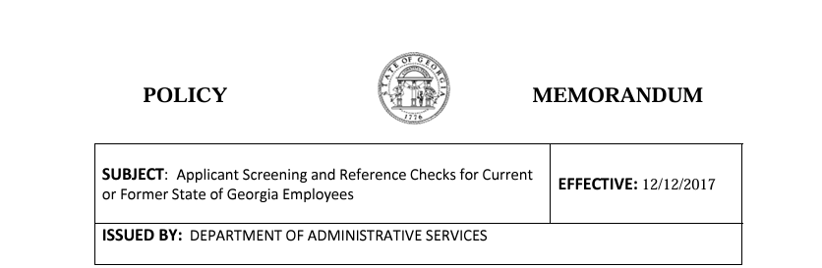
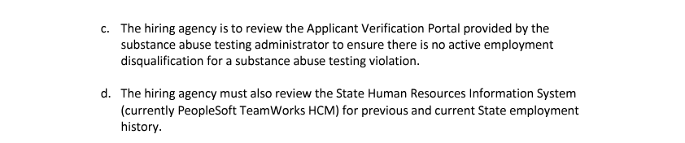

Link to policy: https://doas.ga.gov/sites/default/files/assets/Human%20Resources%20Administration/NEADocumentLibrary/Screening%20and%20Ref%20Check.pdf
Path to policy: Go to the doas.ga.gov website; Click on Divisions, then Human Resources Administration; At the next screen, click on Rules, Policies and Compliance; then click on Statewide policies in the menu on the side of the screen. At the final screen, the statewide policy is the seventh in a list of eight.
Notes:
This slide shows a screenshot of the statewide policy titled “Applicant Screening and Reference Checks for Current or Former State of Georgia Employees.” This statewide policy can be found on the DOAS website at the link listed at the bottom of the slide. The specific path for locating the policy is also listed on the slide. Notice that the highlighted text on the screen explains the hiring agency’s responsibility to use the AVP to ensure that there is not an active disqualification.

Slide 6
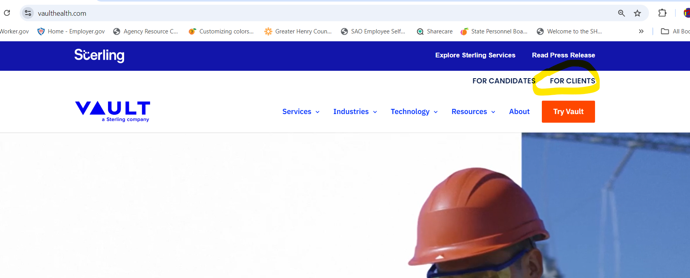
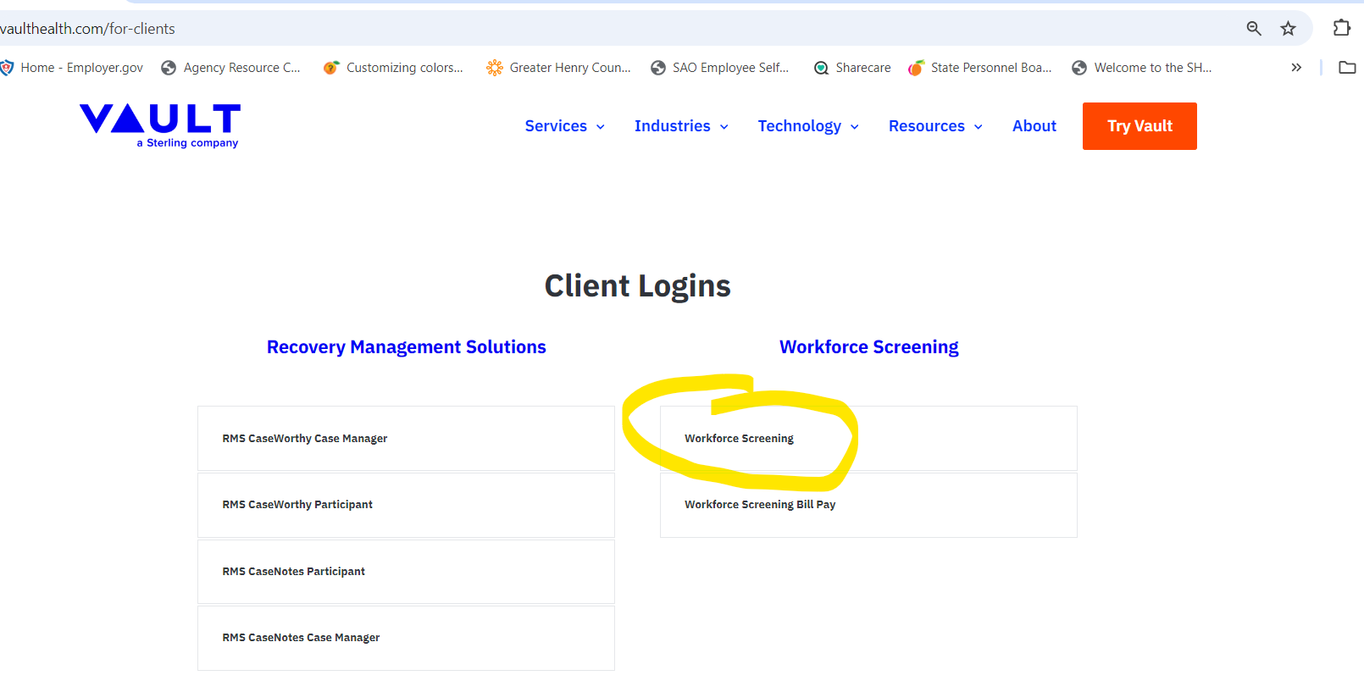
Logging Into Vault Health
Notes:
First, type Vaulthealth.com into your web browser. From the home screen, click on FOR CLIENTS. Next, you’ll click on “Workforce Screening” to access the Applicant Verification Portal (AVP).

Slide 7

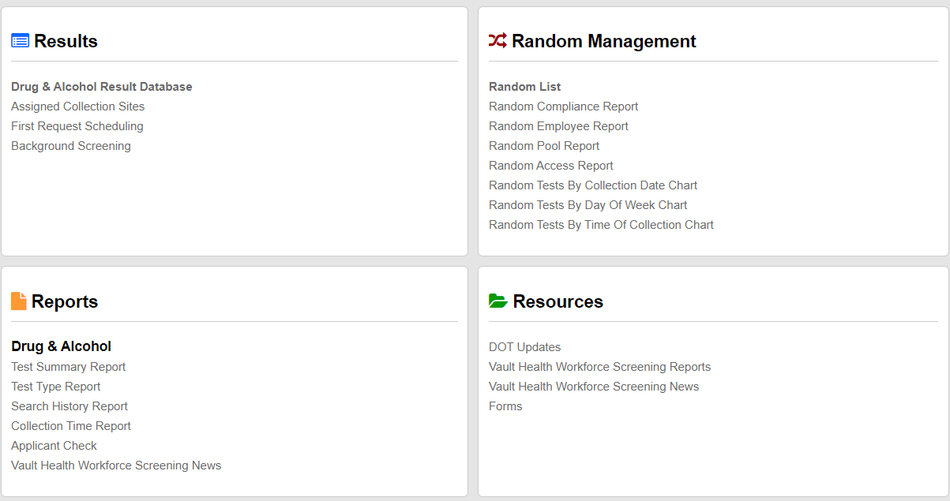
Applicant Verification Portal
Located in the Vault Health Database
Notes:
This is a screenshot of the first page of the Vault Health database. There are four quadrants here.
To get to the Applicant Verification Portal, look at the bottom quadrant on the left-hand side.
Notice that there’s a red arrow indicating where the AVP link is located.
You will click this link to go to open the AVP.
Also noticed that the content title of the AVP here is “Applicant Check.”

Slide 8
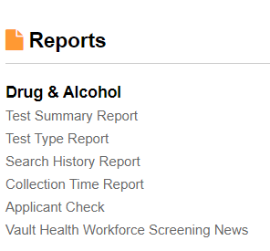
Notes:
This is an enlarged screenshot of the quadrant showing the location of the AVP.

Slide 9
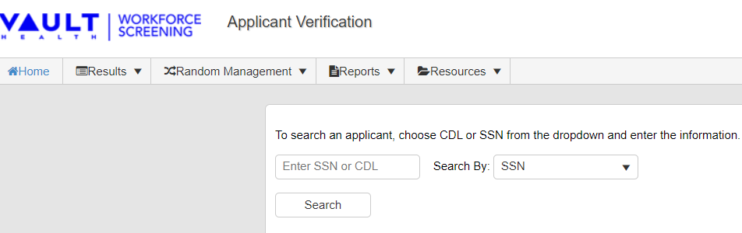
Notes:
When you click on the link for “Applicant Check,” the following screen will appear. You'll be asked to enter a social security number or CDL number. Either number will work. Most agencies enter the employee/applicant’s social security number.

Slide 10
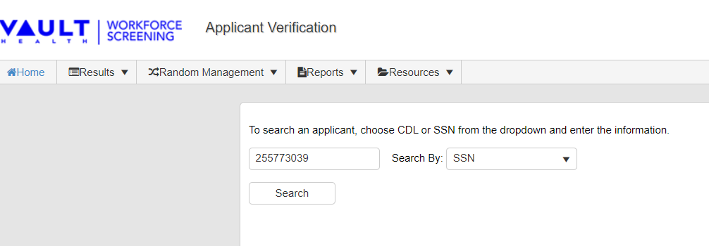
Notes:
Once you click and enter the social security number, you will click the search button as demonstrated on the above slide.

Slide 11
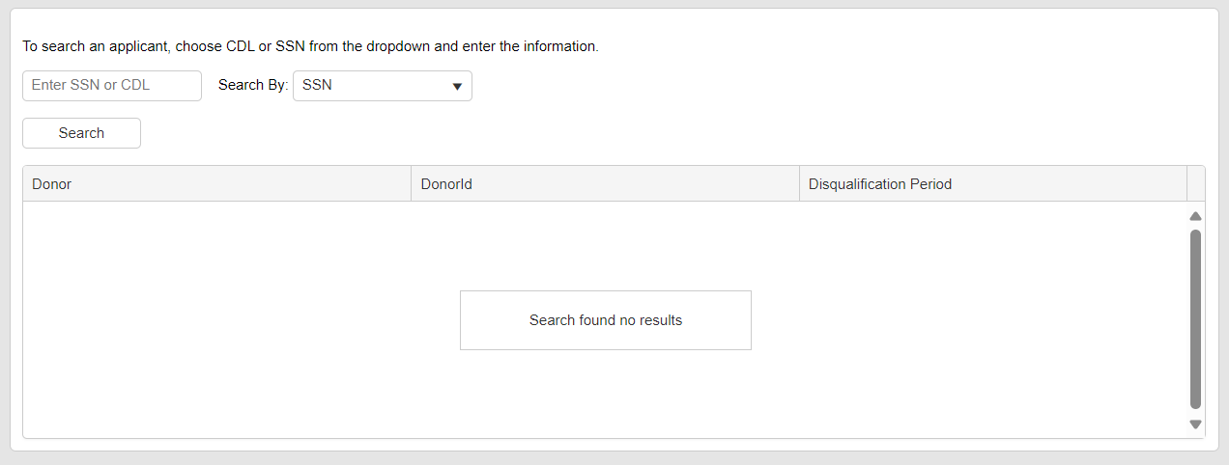
Notes:
If a blank screen shows like the one on the slide, this means that the applicant has not had a positive drug test or refusal in the past two years.

Slide 12
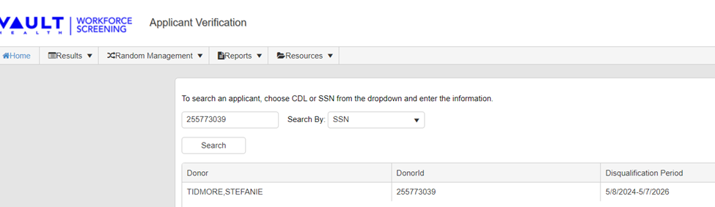
Notes:
If the applicant has tested positive in the past two years, you will receive a report similar to the one shown on the slide. It will display the donor's name and the donor ID number (based on whether you entered the social security number or CDL number), and the final column will indicate the disqualification period during which the applicant cannot work for the State of Georgia.
Please note: Once the disqualification period ends, which is two years, the applicant's name and information will automatically be removed from the system.
Again, If nothing shows up on this report, this means that the applicant has not tested positive for any drugs and is eligible to work.

Slide 13
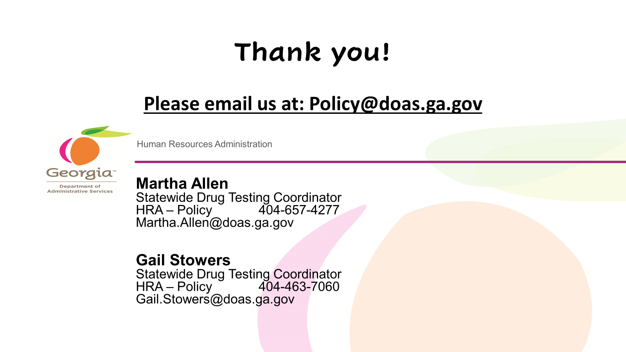
Notes:
Thank You! This concludes the AVP training. If you have questions or need further assistance, please contact the HR-Policy unit or one of the Policy Analyst listed on the screen.

