Slide 2
FY 2023 Workforce Preliminary-Report

Slide 3
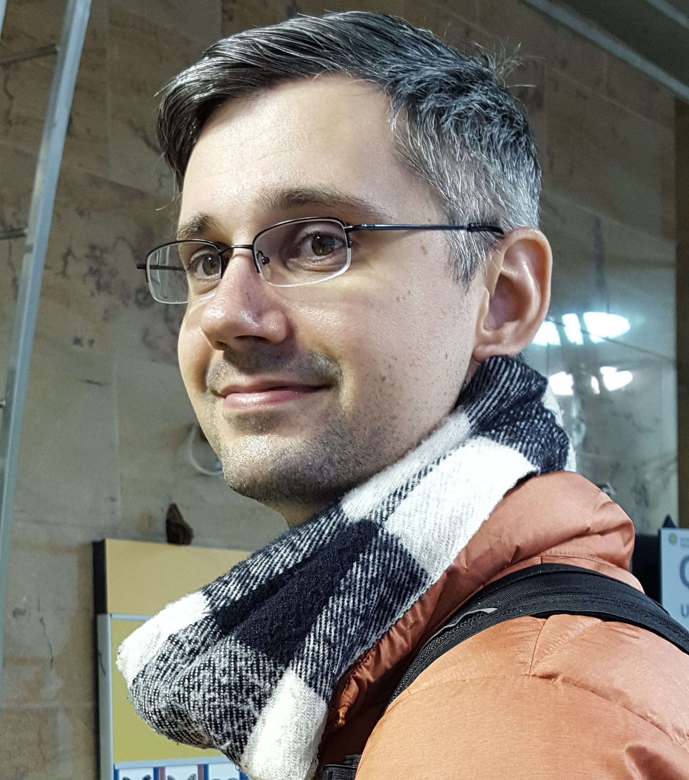
Patrick McKeon
Department of Administrative Services
Planning and Performance Manager
Georgia Institute of Technology (Biochemistry, Public Policy)
Former intern! (Thanks to General Assembly and Governor’s Office)
11 years of service with DOAS, mostly around data, process improvement, and planning
Supported or led the development of the annual workforce reporting since FY 2013

Slide 4
Topics of Interest
Employee Counts
Separations and Turnover Rate
Generations and Tenure
Recruitment
Educational Levels
Compensation Rates

Slide 5
Employee Records by Fiscal Year

Slide 6
Hires vs. Separations by Fiscal Year

Slide 7
Separations by Type

Slide 8
Turnover Rate by Fiscal Year

Slide 9
Voluntary Turnover Rate by Generation by Fiscal Year

Slide 10
Age by Separation Type

Slide 11
Tenure by Separation Type

Slide 12
Employees by Tenure

Slide 13
Employees by Generation

Slide 14
Age at Hire

Slide 15
Team Georgia Careers Recruitment

Slide 16
Employees by Education Level

Slide 17
Hires by Education Level

Slide 18
Compensation Rates

Slide 19
Recap
Employee counts are rebounding simply as hiring is outpacing separations
Turnover Rate is trending lower, even in all separation types
Separations are trending lower across all generational groups (although each younger generation leaves much more quickly)
Age and tenure at time of separation continue to decline
Half of the workforce has 5 years tenure or less, and half of those leaving have 2 years tenure or less
Generation X is now less than 40% of the workforce and younger cohorts are more than 40%
Millennials are nearly 50% of the hires, Generation Z about 17%
Recruitment activity for job postings and applicant submissions has rebounded as well
Educational Levels are showing minor increases for those with high school or equivalency as well as those with a 4-year college degree
Median compensation rates have increased in recent years, and seems to boost recruitment

Slide 20
For questions contact,
Patrick McKeon Patrick.McKeon@doas.ga.gov

