Slide 1



Shared Applications:
Current & Future Capabilities

Slide 2
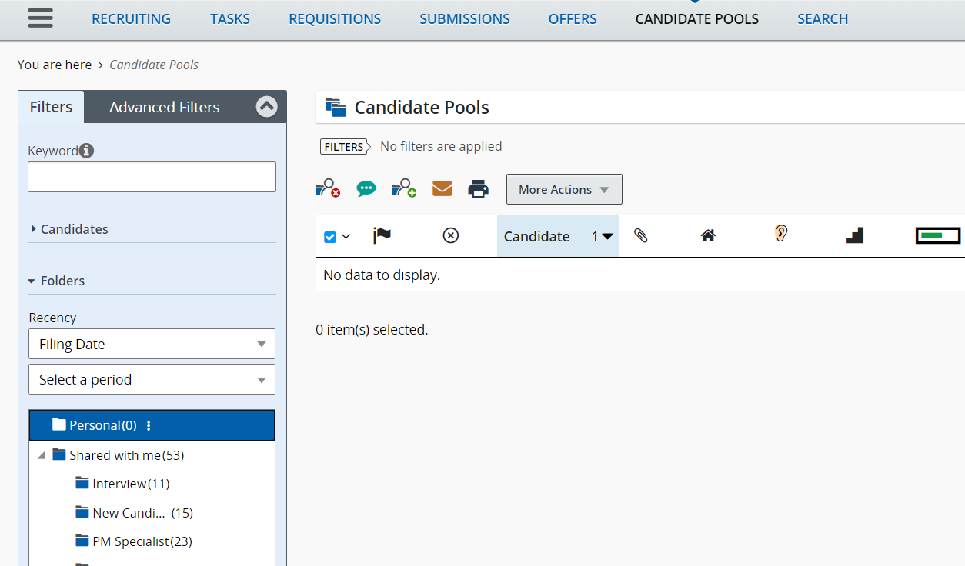
SHARED CANDIDATE POOLS
Recruiters can create a candidate pool by adding the list of candidates to personal folder.
Recruiters will be able to share the candidate pool folder to other recruiters within Taleo.
Candidate pools can be shared between different agencies as long as they have presence in Taleo.

Slide 3
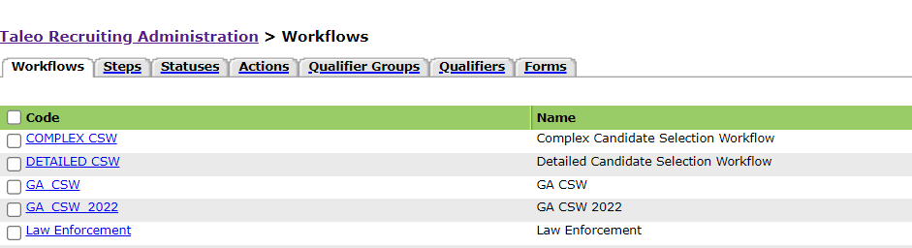
JOB POSTING TEMPLATE - Example

Slide 4
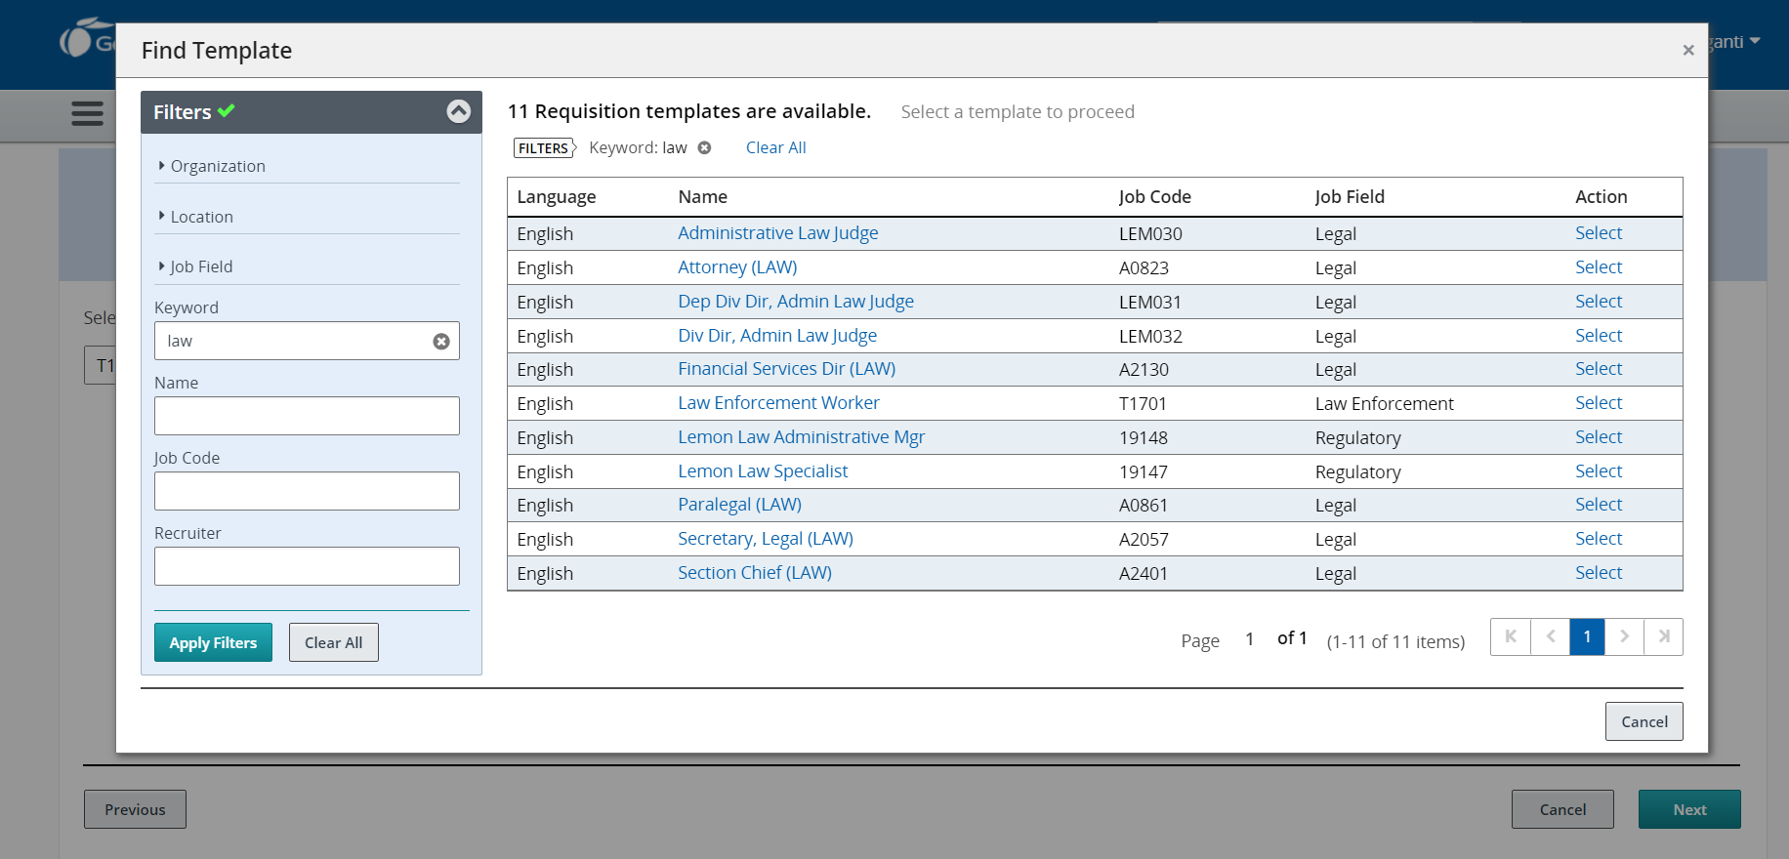
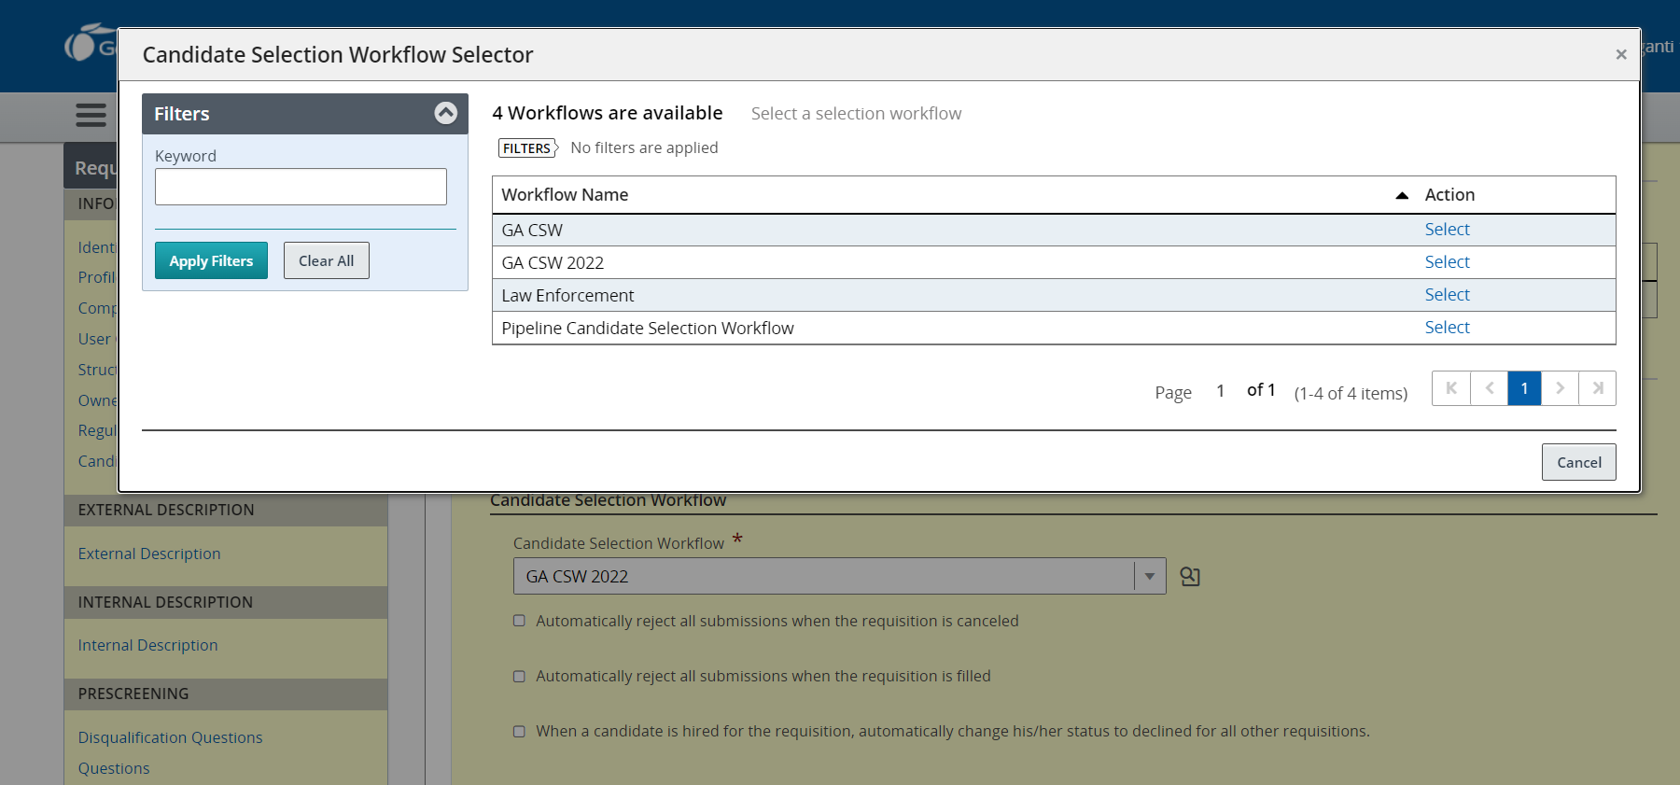
SHARED REQUISTION
Would allow for a standardized requisition template for specific job family.
Recruiters would create the requisition by choosing professional requisition type.
Then they would select the appropriate job family template (i.e., Law enforcement).
Would allow for recruiters to access all candidate submissions to the requisitions.

Slide 5
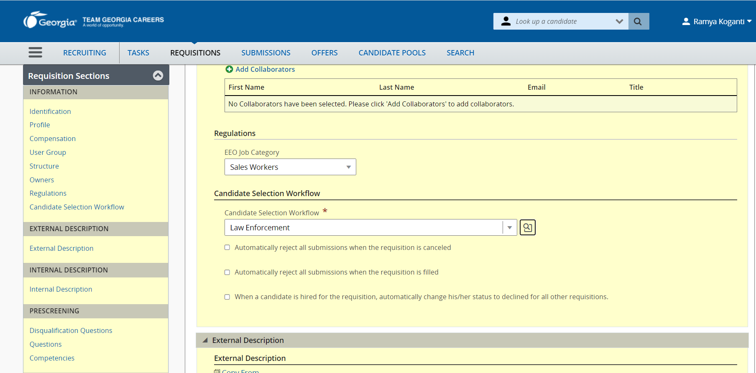
SHARED CSW
Would standardize Candidate selection workflow (CSW) for appropriate job family.
Recruiters would select the appropriate workflow when created the requisition.
Would allow agency recruiters to understand the screening process a candidate has experienced.

Slide 6
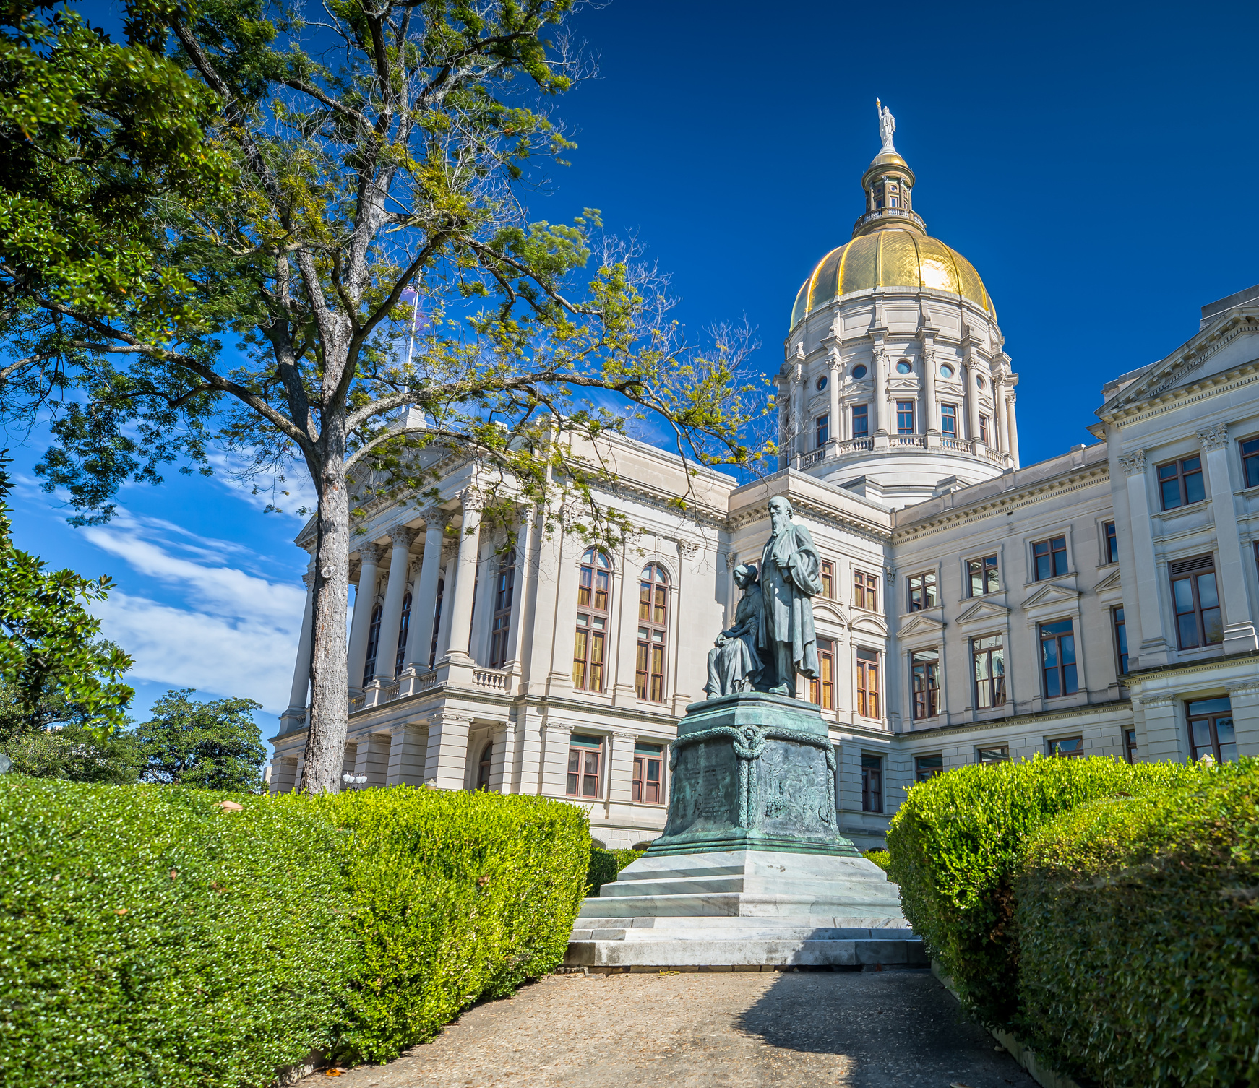
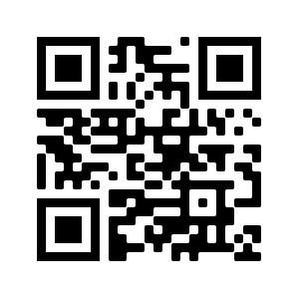




FOLLOW US ON SOCIAL MEDIA
@TeamGacareers
@Team Georgia Careers
@ teamgeorgiacareers
@TeamGacareers

Slide 7

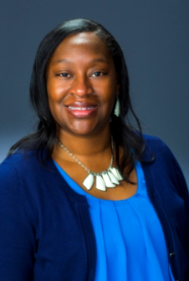
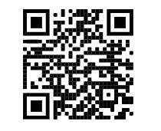

For questions contact,
Monique Jenkins, SHRM-SCP, PHR, MBA
Senior Manager, Enterprise Talent Management Services
404-463-7044
monique.jenkins@doas.ga.gov
CONNECT ON
LINKEDIN
www.careers.georgia.gov

