Slide 1



GEORGIA STATE GOVERNMENT
Internship Program
Overview

Slide 2
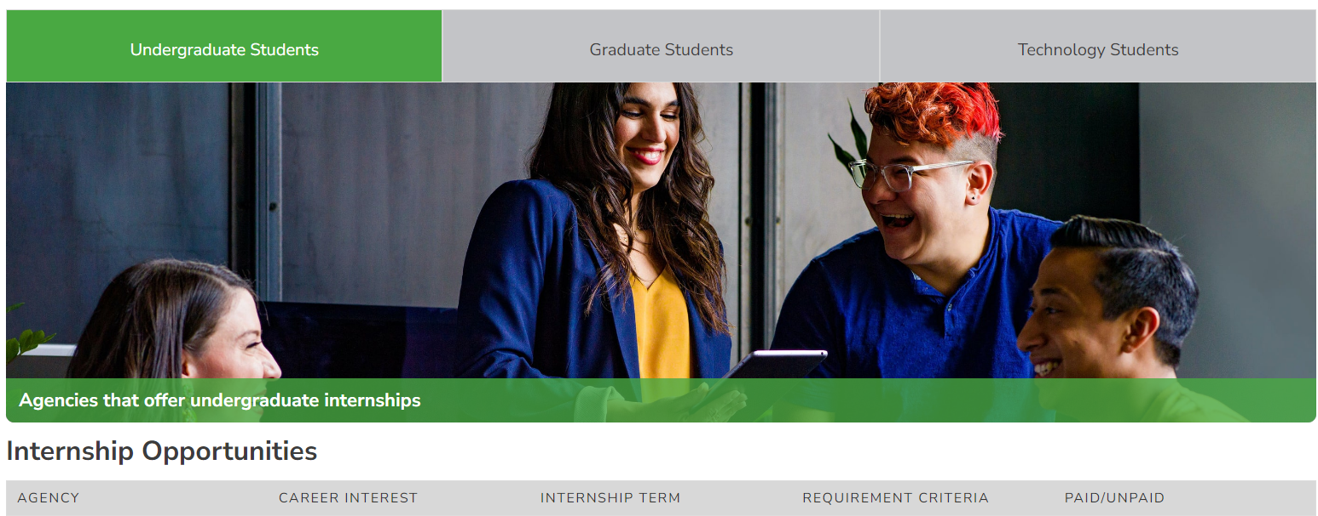
INTERNSHIP PIPELINE INITIATIVE

Slide 3

PROGRESS TO DATE
DOAS Strategic Initiative
Three Phase Project:
Created Internship Job Codes - 2022
  Paid, Unpaid, Graduate
  School Year 22-23 Tracking
    85 paid interns hired
Published Internship Guidelines - 2022
Up Next:
  Finalize and Publish Internship Toolkit
  Expand to 20 partner universities

Slide 4
PARTNER SCHOOL LIST
Georgia State
Kennesaw State
Georgia Gwinnett
Clayton State
University of North Georgia
University of West Georgia
Gordon State
Mercer University
Middle Georgia State
Chattahoochee Tech
Columbus State
Fort Valley State

Slide 5

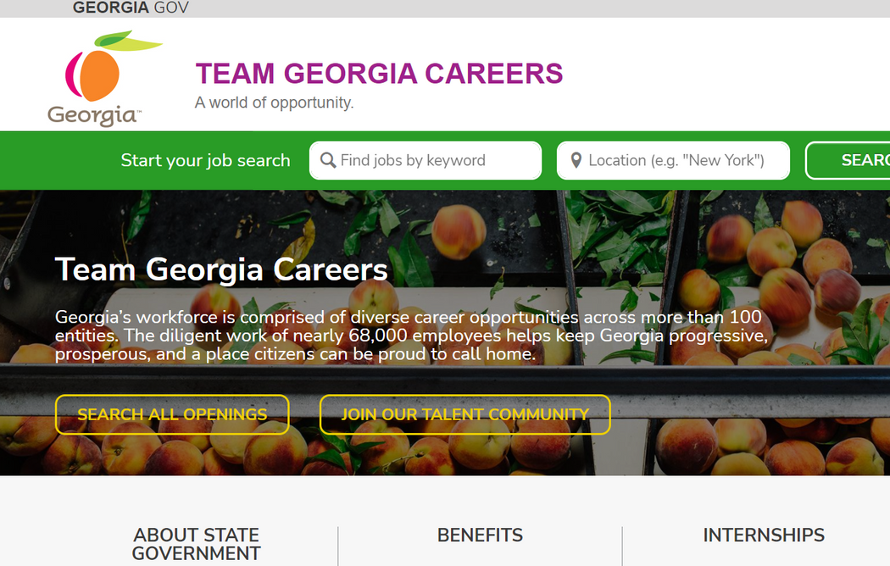
HANDSHAKE
Implemented January 2023
Connected to all Georgia universities using the platform
Piloted Two Spring Internship Opportunities
  2 Agencies; 3 internships
  Paid internships
  Five hires from four different schools
Encouraging all agencies to use platform for entry-level hires

Slide 6
INTERNSHIP PAGE

Slide 7

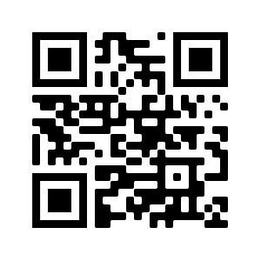




FOLLOW US ON SOCIAL MEDIA
@TeamGacareers
@Team Georgia Careers
@ teamgeorgiacareers
@TeamGacareers

Slide 8


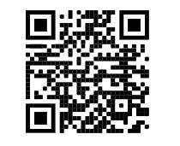

For questions contact,
Monique Jenkins, SHRM-SCP, PHR, MBA
Senior Manager, Enterprise Talent Management Services
404-463-7044
monique.jenkins@doas.ga.gov
CONNECT ON
LINKEDIN
www.careers.georgia.gov

