Slide 1
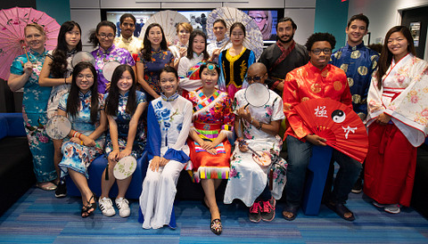



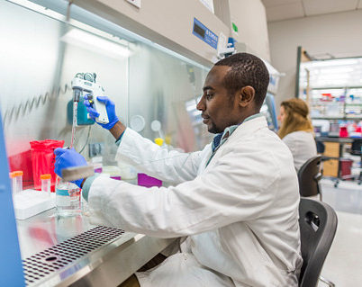

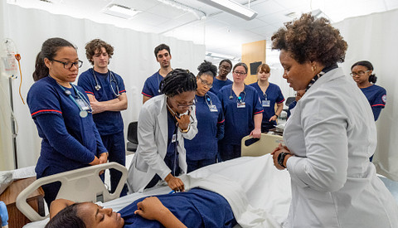
Recruiting at Georgia State University

Slide 2


Why Georgia State?
#1 Public or nonprofit university in Georgia to confer undergraduate and graduate degrees to
African American, Asian, and Latinx students​
#1 Public university in the country for an unusually strong commitment to undergraduate teaching​
#2 Most innovative university in the U.S.​

Slide 3


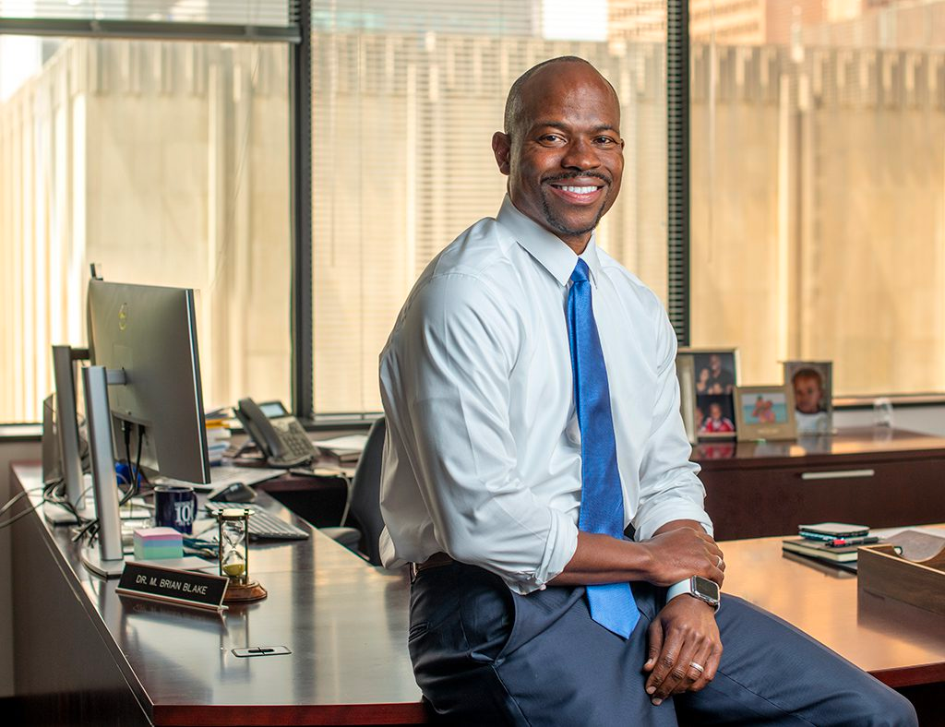





From the President's Desk
From the President's Desk
IDENTITY AND PLACEMAKING& BELONGING
BEYOND COLLEGE
TO CAREERS
STUDENT
SUCCESS 2.0
INNOVATING RESEARCH, SCHOLARSHIP AND CREATIVE ACTIVITY
Dr. M. Brian Blake
Strategic Plan
president.gsu.edu
mbrianblake
mbrianblake

Slide 4
The Student Body at Georgia State University
NO RESPONSE
3.6%
With an enrollment of more than 52,000, we've proven that students from all backgrounds can succeed at the same level.
55% bachelor's degree students
  30% associate degree students
  15% graduate and law students
Students from every county in Georgia, every state in the nation and 130 countries
More than 3,600 international students
MULTIRACIAL
5.5%
ASIAN
10.9%
BLACK
50.9%
WHITE
29.1%

Slide 5








Save the Dates
  Employer & Faculty Breakfast
  On-Campus Job Fair
  Who What Wednesday
  Experience Pays Fireside Chats
  ASPIRE/NACE Career Challenges
  Tech Talent Virtual Career Fair
  Fall 2023 Co-op and Internship Fair
  Part-time Job Fair
  Virtual Who What Wednesday
  Experience Pays (Micro Internships)
  Computer Science Capstone Projects
  Holiday Hiring Event
  Next Steps Job Fair:
College of Education
  Let’s Talk Talent (2024 Events)
  Holiday Hiring Event

Slide 6
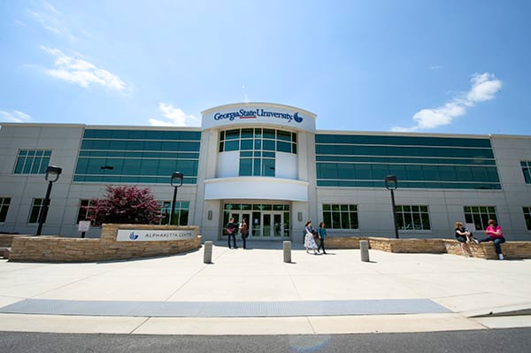
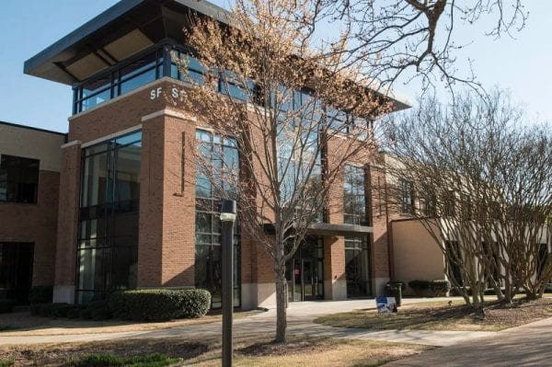
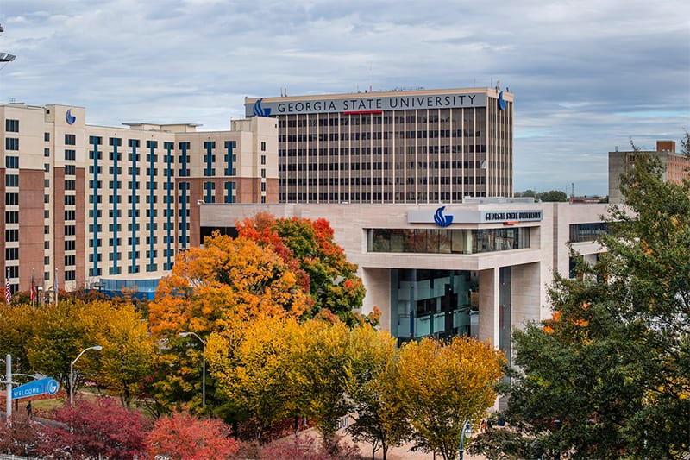
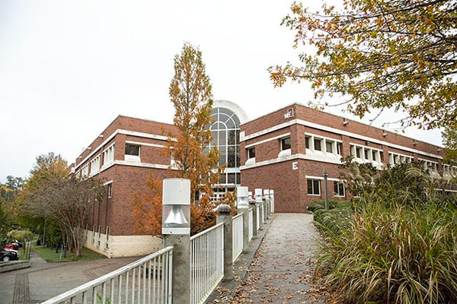
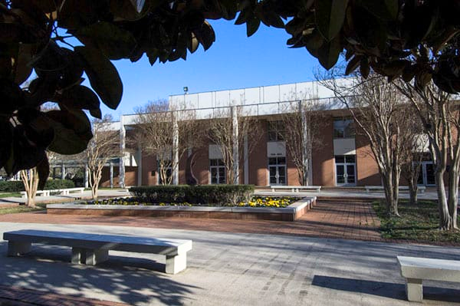
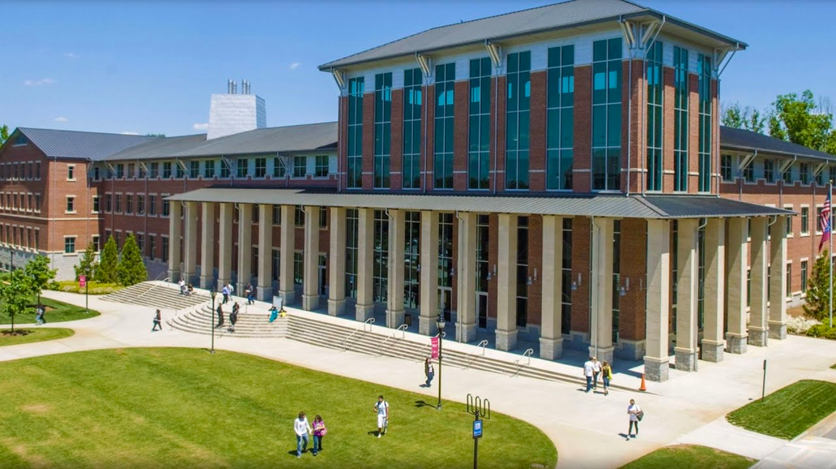
Six Metro-Atlanta Campuses
  Alpharetta
  Atlanta
  Clarkston
  Decatur
  Dunwoody
  Newton

Slide 7


