Slide 1
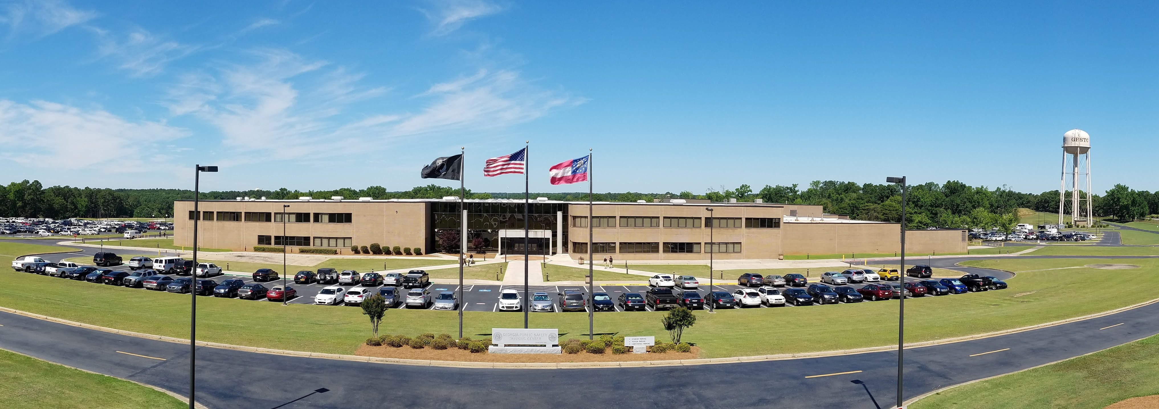
Georgia Public Safety Training Center
Chris Wigginton, Director

Slide 2
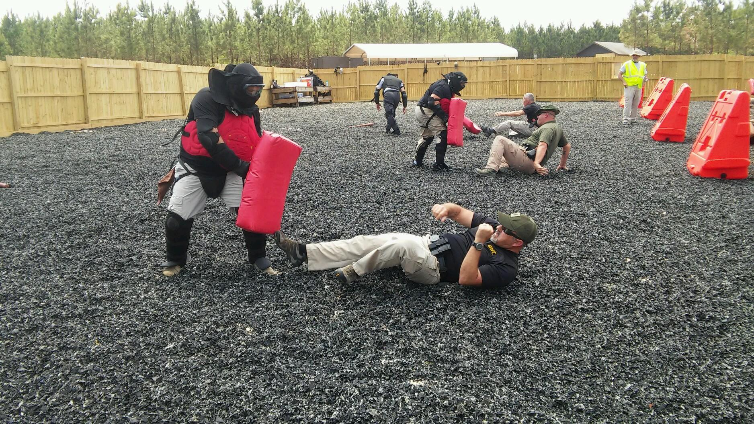
GPSTC Workforce Challenges
Not entry-level Law Enforcement job
Minimum 3-5 years of law enforcement experience
Requires POST General Instructor certification
Often requires POST Specialized Instructor certifications
Some recruits paid higher salary than some mandate academy instructors

Slide 3
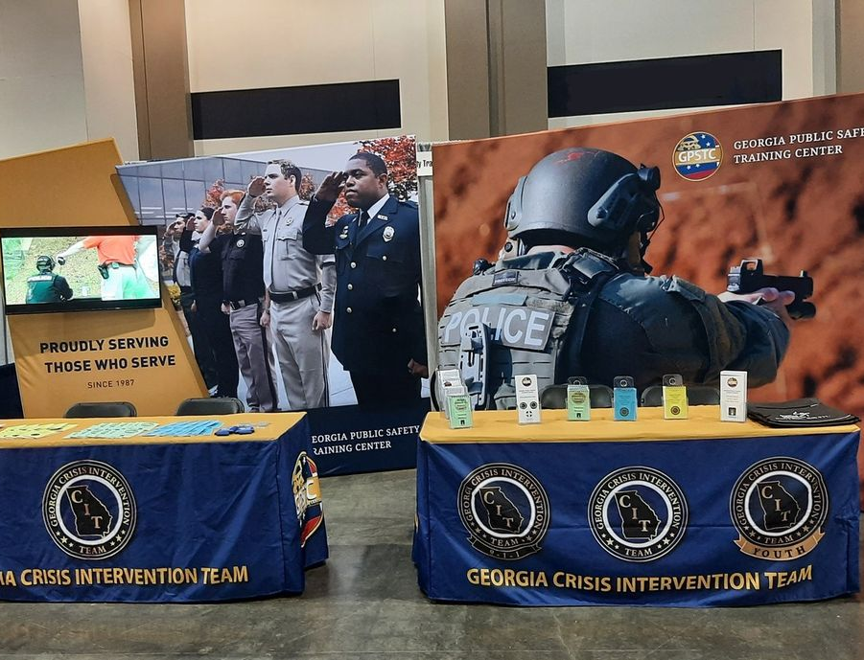
GPSTC Recruiting
Standard channels (Team GA, website)
Staff recruiting efforts
Digital advertising in local businesses
Social media
“We are hiring!” business cards and posters
Showcasing booth at public safety association conferences/events
Currently 10% of positions vacant

Slide 4
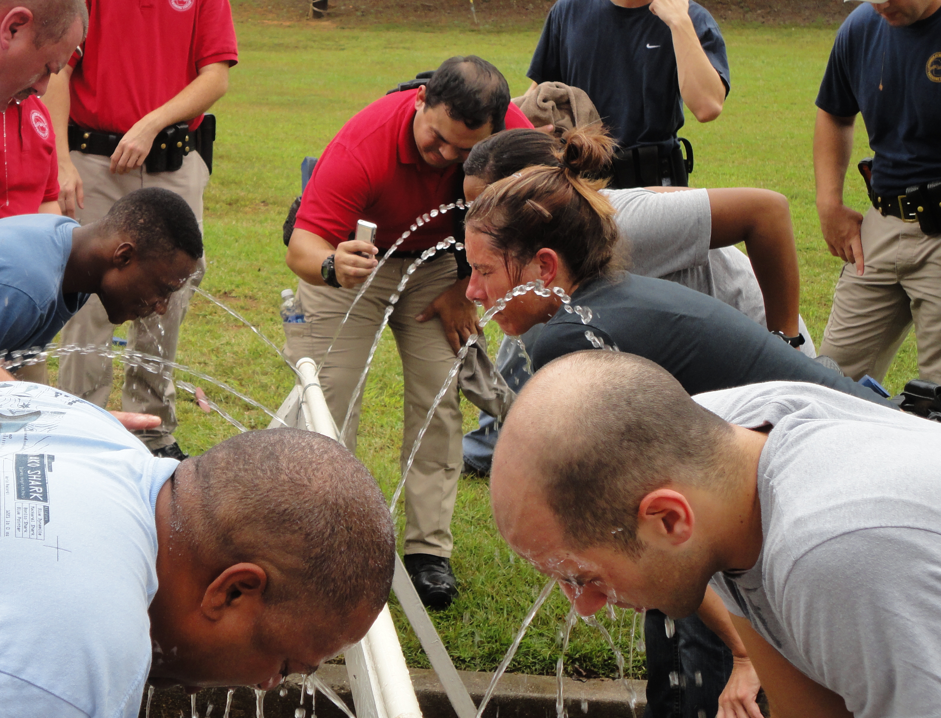
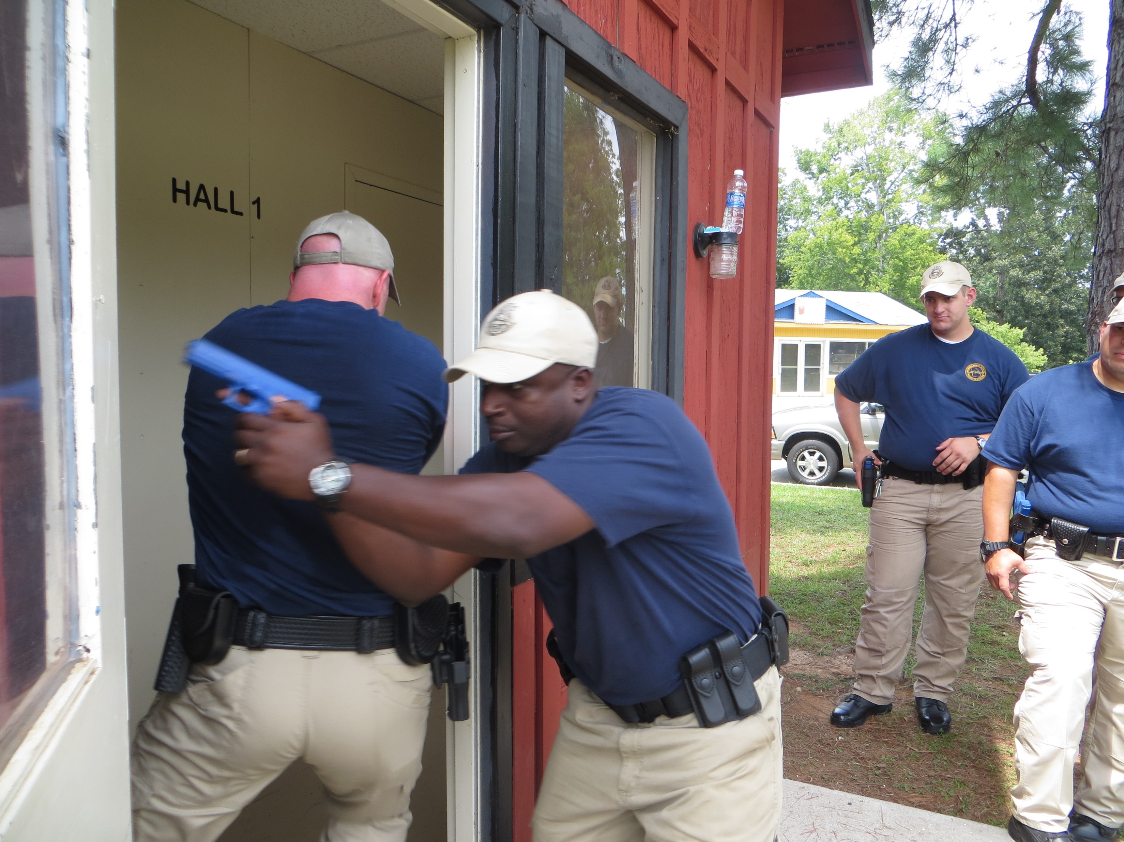
GPSTC Disqualifiers
Facial Hair
Must be neat, well maintained and not put employee at safety risk.
Visible Tattoos
Any visible must be in keeping with a professional and non-offensive appearance.

Slide 5
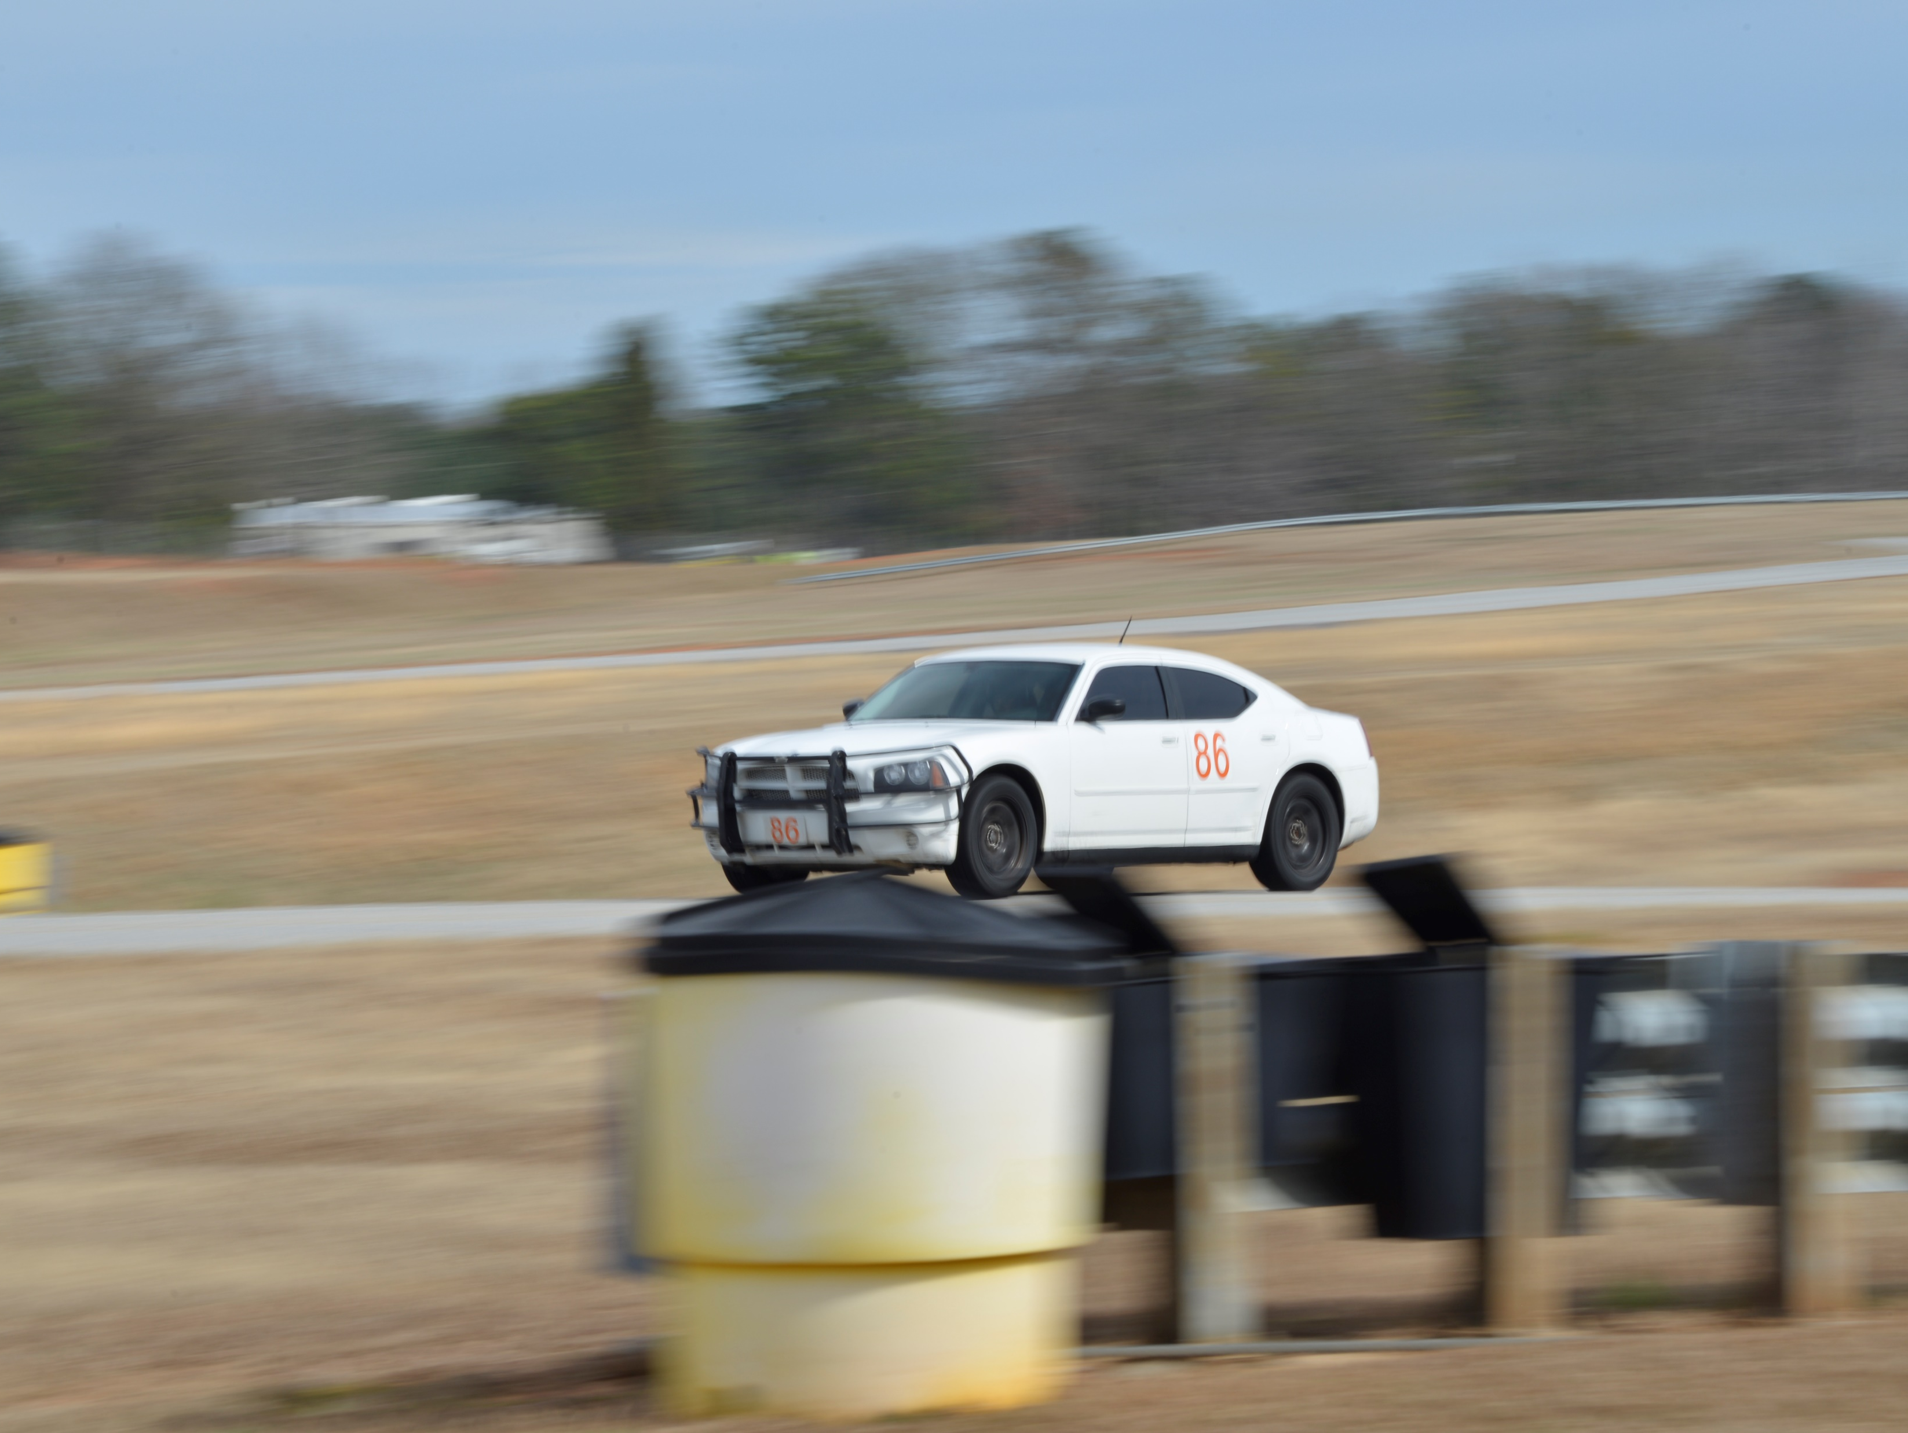
GPSTC Disqualifiers
Drug Use
Disqualified from working for any state agency/entity for three (3) months from the date of first conviction and five (5) years from the most recent date of conviction if there have been multiple illegal drug convictions since July 1, 1990.
Selected candidates testing positive or refusing to complete a pre-employment substance abuse test are disqualified.

Slide 6
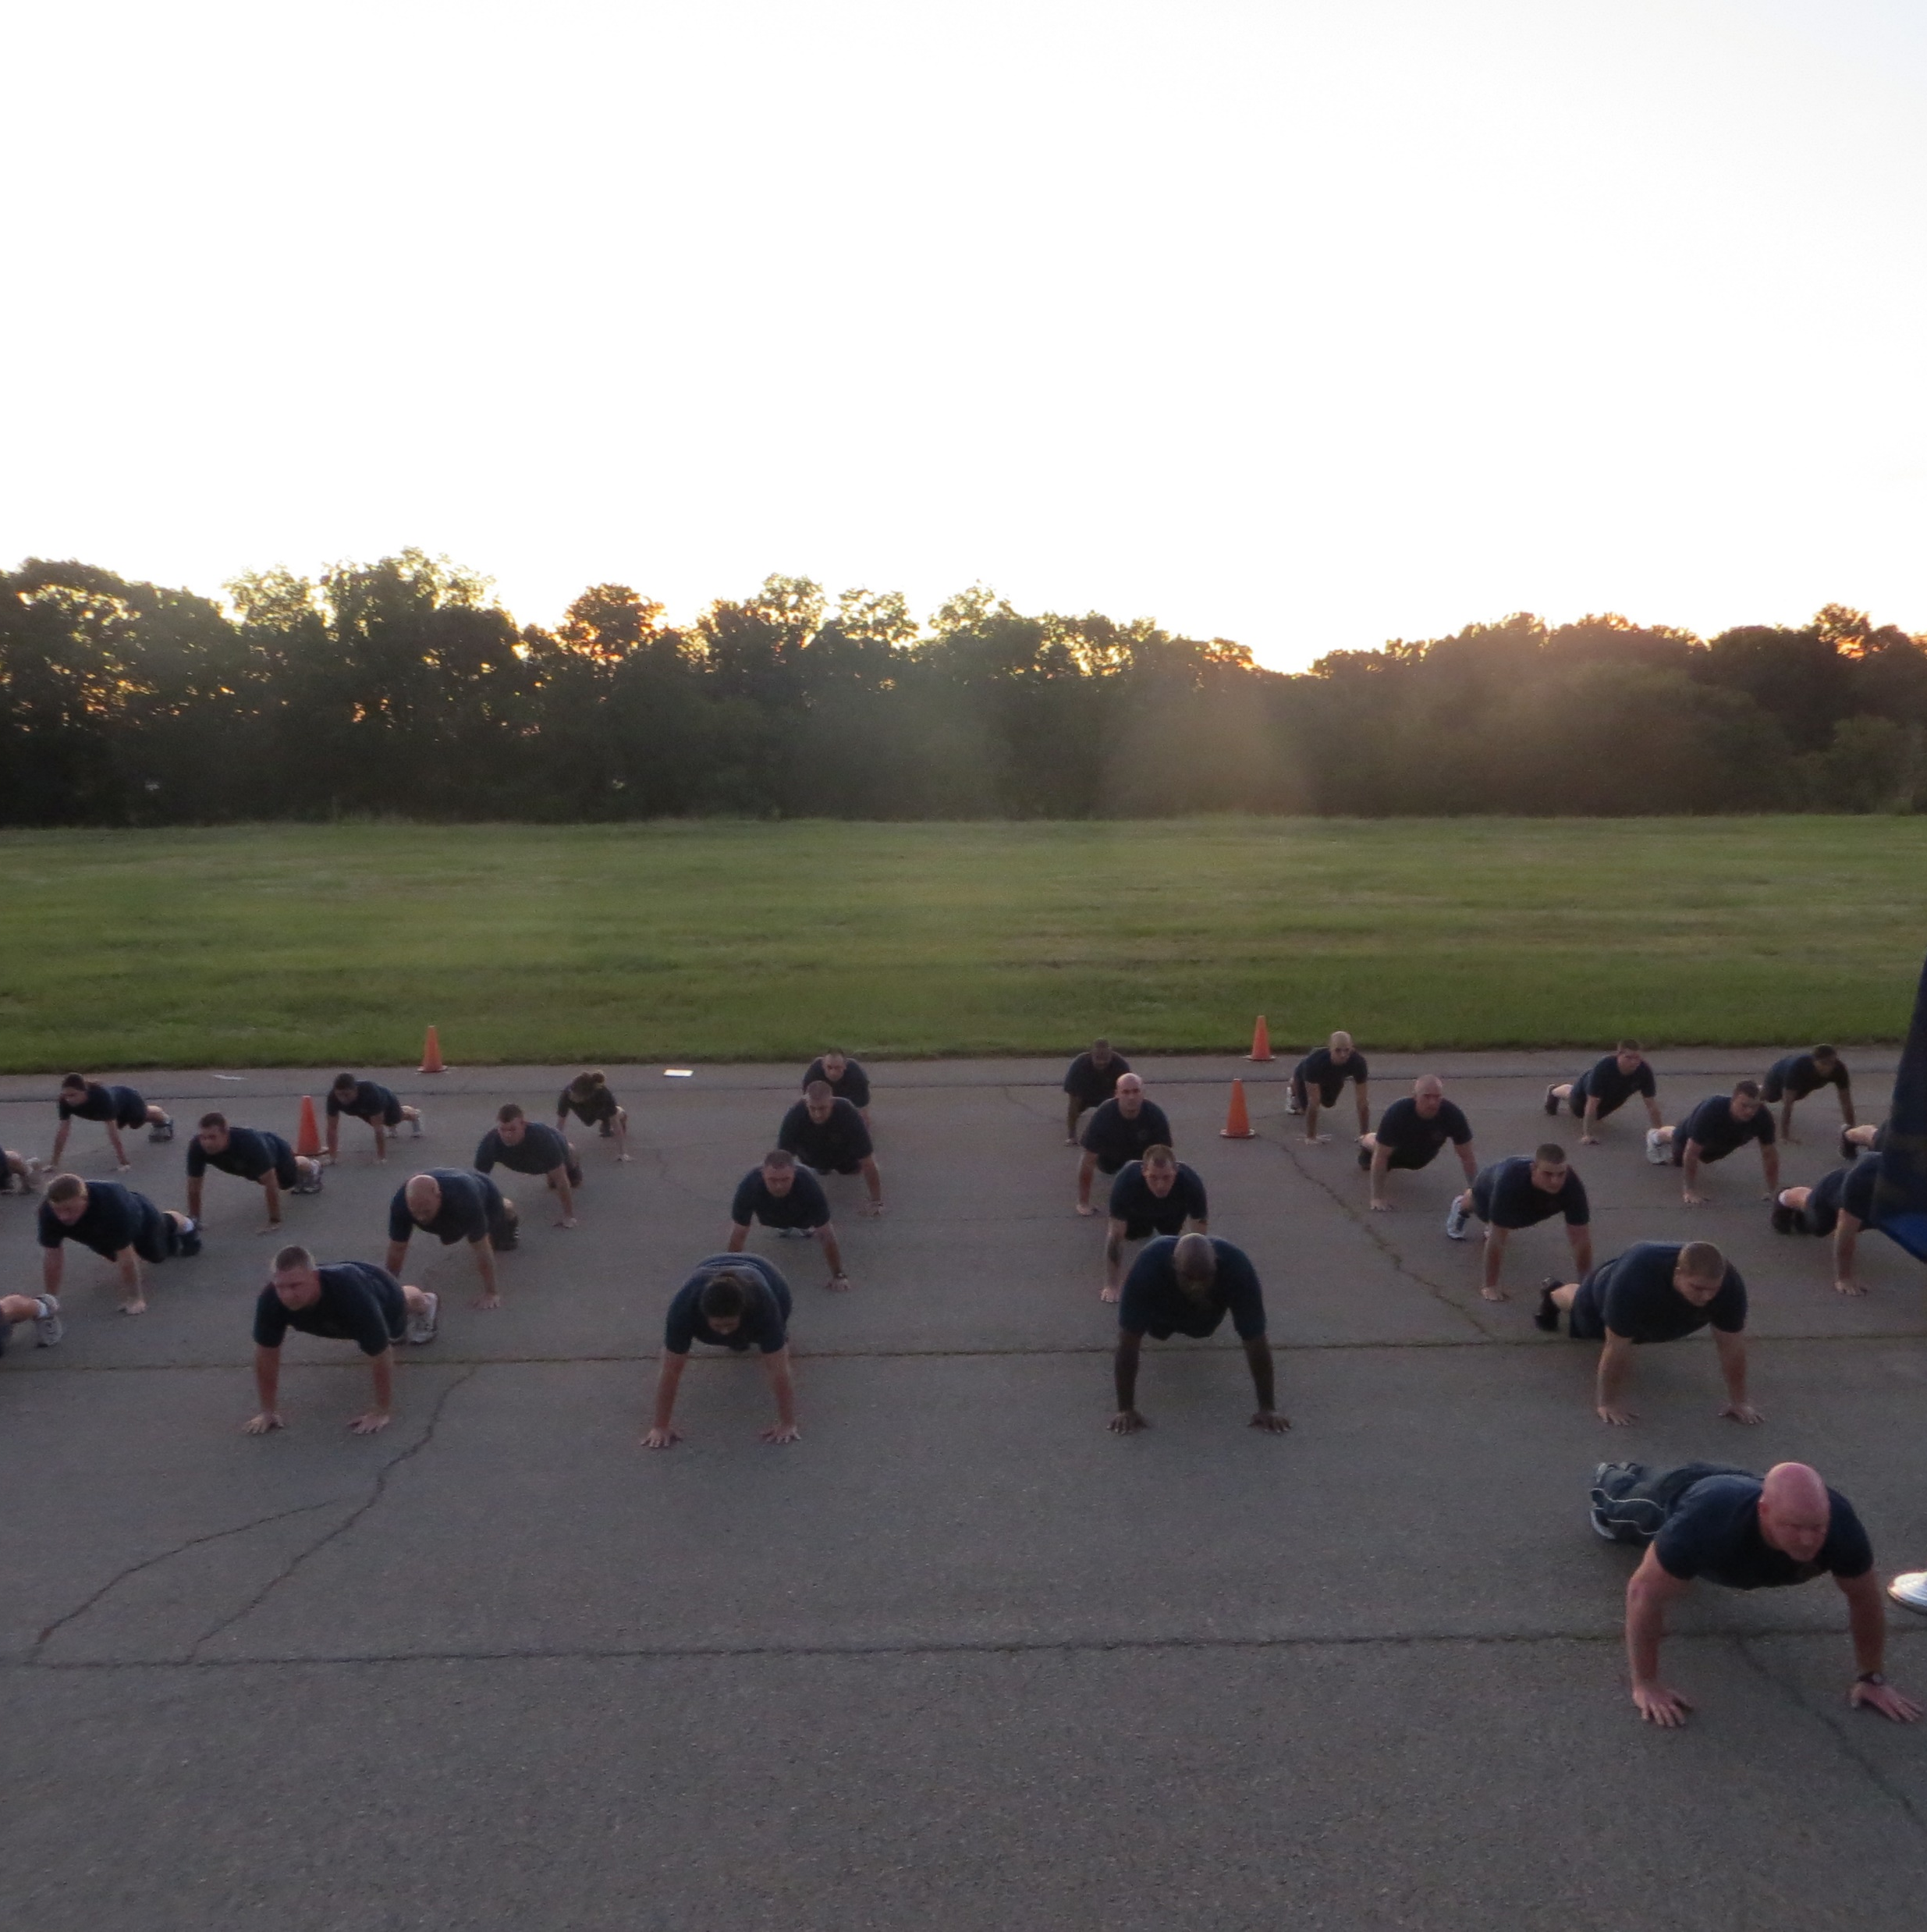
GPSTC Disqualifiers
Physical Fitness
Applicants selected for interview who have not obtained the Defensive Tactics Instructor Certification or who were certified prior to 2019, will be required to complete 4 PT assessments on day of interview:
25 push-ups (full body) in 1min; and
30 sit-ups in 1min; and
Bench Press (75% body weight) – 1 rep;
1.5 mile run (16:00) OR
a 300m sprint (<64 seconds)

