Slide 1

Georgia Military College
Serve With Fidelity

Slide 2
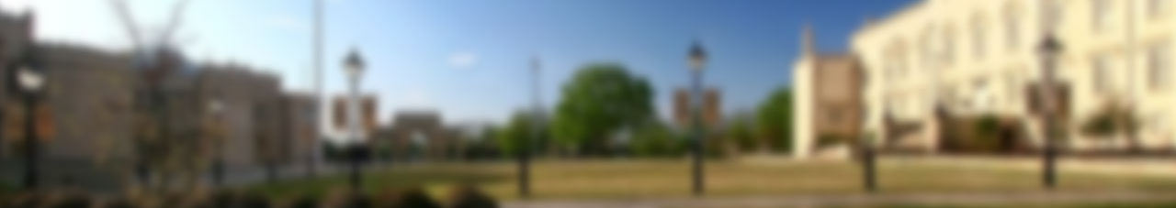


GMC Mission
“Georgia Military College builds on our military heritage grounded in our core values of Duty, Honor, and love of Country to provide hope and opportunity through individual growth and education of our students to develop their intellect and character as authentic servant leaders in an environment focused on elevating civility and respect for others. ”
Start Here…Go Anywhere!

Slide 3





GMC Pathways of Opportunity
Grades K – 12
Junior College
4-Year College
Preparatory School
Main Campus
11
Satellite
Locations
GMC Global Online
Leadership College
(GOLC)
GMC Leadership
Institute
NewDay USA Center for Leadership and Speaker Series
Georgia Leadership
Development Program
Develop the Intellect
&
Elevate the Character
Georgia Public Safety Leadership Institute (GPSLI)
Leadership is Our Legacy…and Your Future!

Slide 4
One Team – Corps of Cadets
GMC Corps of Cadets
Preparatory School
K- 12
Junior College
One Corps under direction of Commandant of Cadets (4 Battalions)
  1st Battalion – Junior College Cadets (Plebe Battalion)
  2nd Battalion – High School Prep Cadets (9-12 grades)
  3rd Battalion – Middle School Prep Cadets (6-8 grades)
  4th Battalion – Junior College Cadets (Returner Battalion)
Develop the Intellect
&
Elevate the Character
Character Above All!
2021-2022

Slide 5









Junior College Cadet Pathways of Opportunity
State Service
Army ROTC
US Service Academy Prep
Civic Leader
GPSLI
Army & Air
National Guard
Return With Honor!

Slide 6
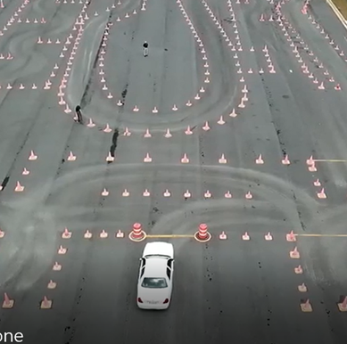
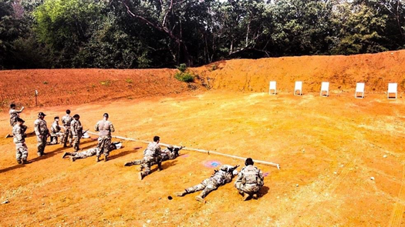
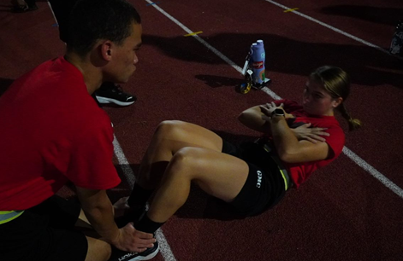
GEORGIA PUBLIC SAFETY LEADERSHIP INSTITUTE
Georgia Public Safety Leader Program
Public Safety cadets will spend their time training in-depth on career relevant topics to help them excel at Basic Mandate, and in their future career. They will receive extensive training in Leadership, Fitness, Investigations, Emergency Vehicle Operation, Firearms, Defensive Tactics, and Officer Resiliency.
Receive certification to become a mandated officer, educate them with their college degree in Criminal Justice or Homeland Security, and give them the tools necessary to be a successful Peace Officer in Georgia
Program entrance requirements:
  2.0 High School Grade Point Average or GED equivalent, or be in good academic standing at the college you may transfer from.
  Be capable of participating fully in the structured cadet physical fitness and activities program, including passing the Physical Ability Test before going to Basic Mandate
  Must possess good moral character
  Minimum of 18 years old, and no more than 23 years old
  Criminal background investigation
  Must meet all Georgia Peace Officer Standards and Training requirements for Basic Mandate

Slide 7

Questions
GEORGIA PUBLIC SAFETY LEADERSHIP INSTITUTE

