Slide 1
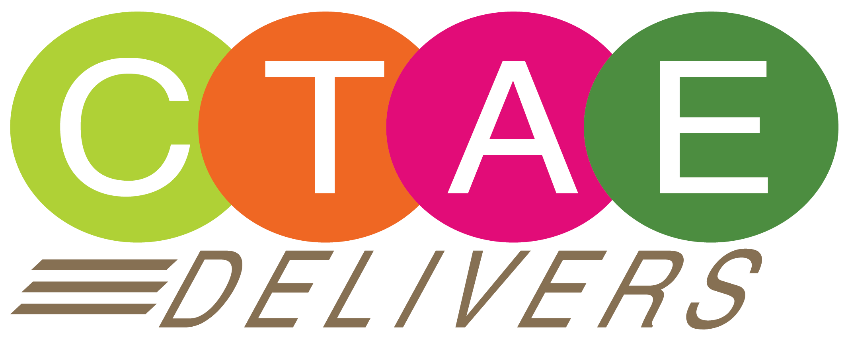
Career, Technical, and Agricultural
Education (CTAE)
Building Georgia's Future Talent Pipeline

Slide 2
To educate Georgia’s future workforce by providing experiences for Georgia students that will prepare them for workplace success.
Mission of Georgia CTAE
Reality:
CTAE delivers for Economic Development by training the future talent pipeline of Georgia.
Notes:
- The mission of CTAE in Georgia is to build the future talent pipeline of GA. For business and industry, CTAE programs enables companies to have early and direct access to their future workforce.

Slide 3
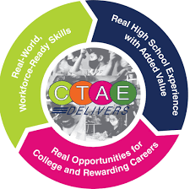
CTAE Key Performance Indicators (KPIs): The Numbers Tell The Story
Number of Middle School students enrolled in CTAE classes (2022)
292,028
Number of High School students enrolled in CTAE pathways / courses (2022) 403,035
Number of Georgia students who are members of at least one CTSO (2022)
183,911
Number of pathways Georgia offers (2022) 144+
Notes:
Clarify what CTSO stands for. Mention FFA, FBLA, SKILLS USA, and HOSA as examples.
Clarify a pathway as 3 classes in a specific skill(s)- welding, automotive, culinary, construction, Ag, nursing, etc.
-Every day in every school district in Georgia, students are being trained for in-demand jobs in Georgia through CTAE programs and pathways.

Slide 4
Examples of CTAE Workforce Innovation
CTAE Jekyll Island Workforce Development Plan (Targeted Industry Sector Workforce Solutions)
Work-Based Learning- WBL (Talent Pipeline Generation)
In-Demand Pathways (Addressing Labor Market Needs)
SME Manufacturing Equipment Grants
(Enriching Training Programs)
Economic Development Partnership (EDP) Designation
(Creating Workforce Development Ecosystems)
Notes:
- We work on the state and local level to deliver innovative workforce solutions for our industry and economic development stakeholders.

Slide 5
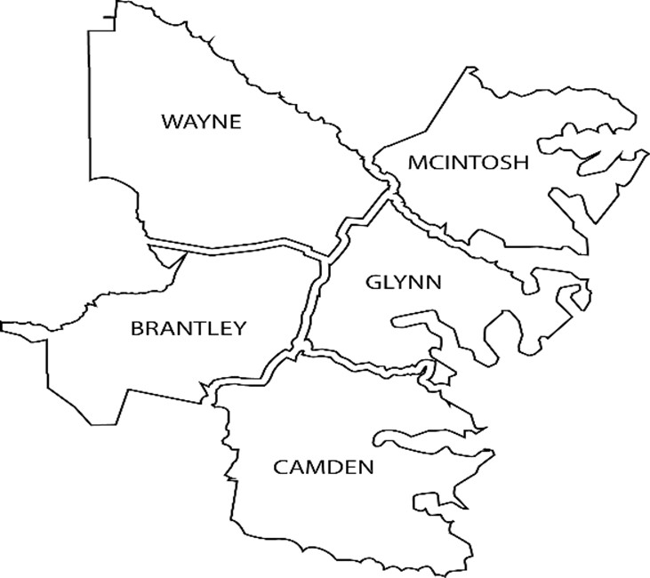
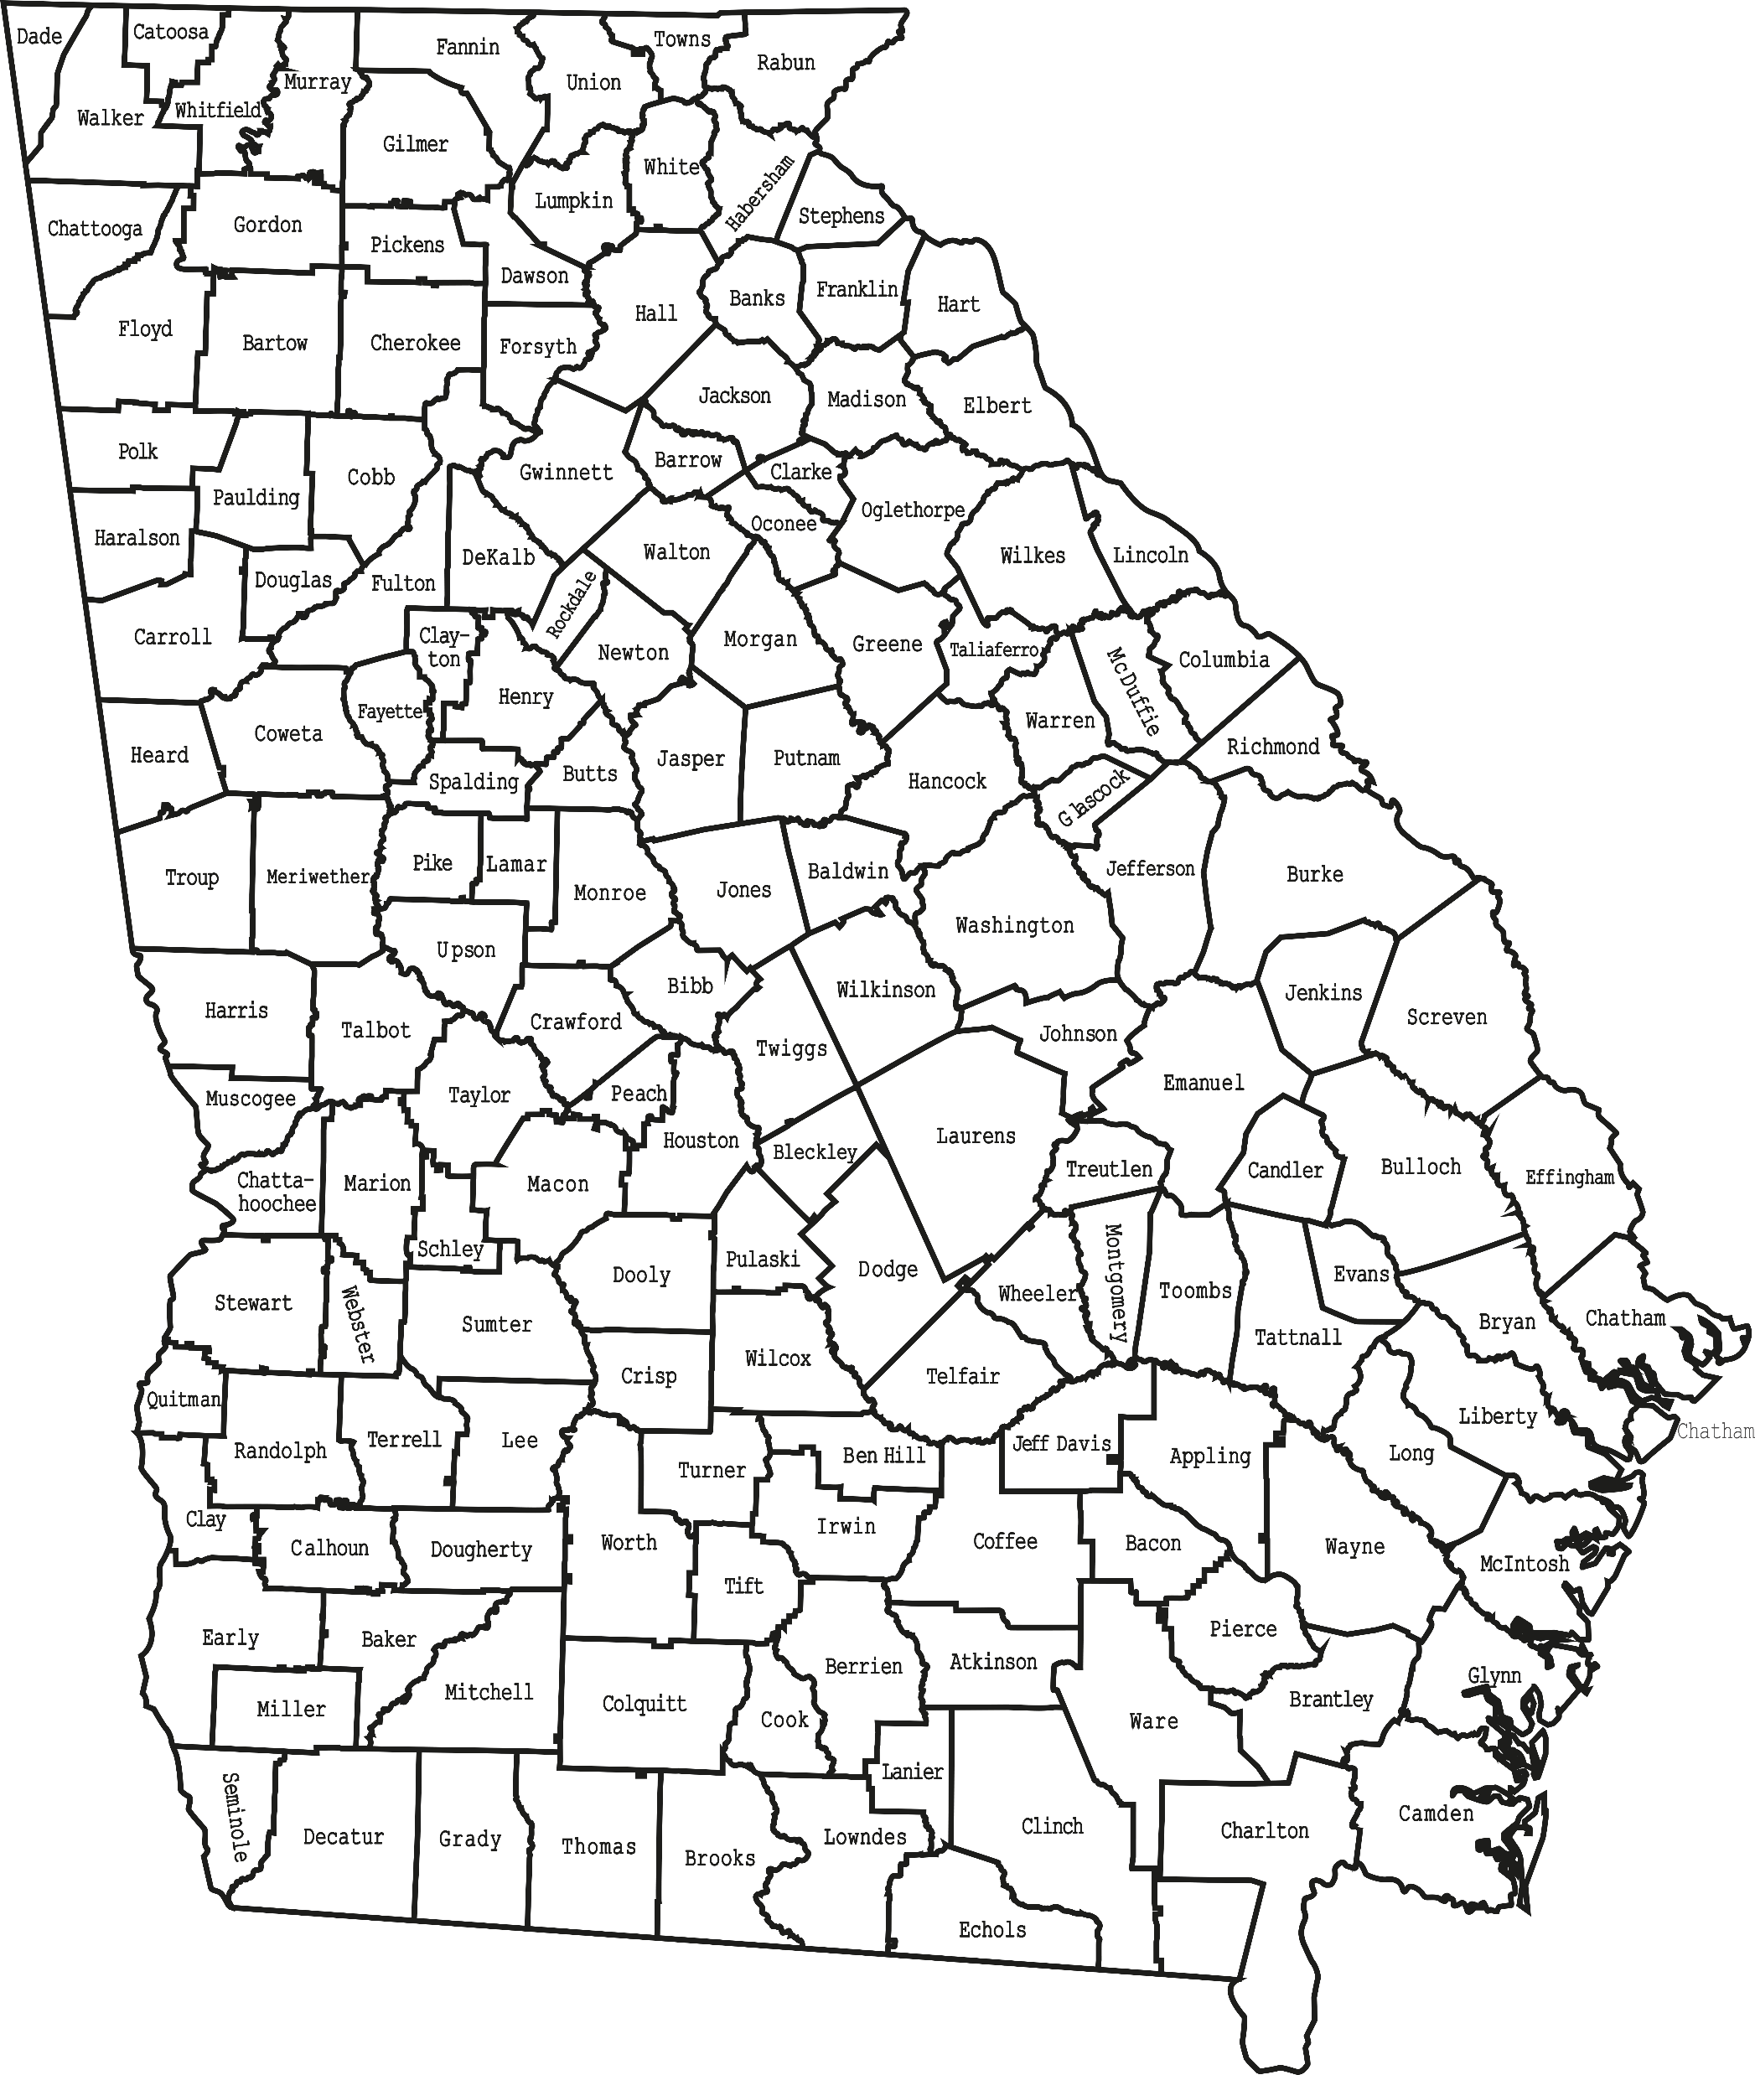
Jekyll Island CTAE Workforce Development Plan
Notes:
- In partnership with the Jekyll Island Hospitality Association and 5 area school systems, a Jekyll Island workforce development plan was developed and implemented to meet the needs of the hospitality, tourism, and culinary industry on Jekyll.

Slide 6
Workforce Strategies & Solutions

Slide 7
Georgia’s Work-Based Learning Program
A Cost-Effective Talent Solution

Slide 8
2021-2022 Work-Based Learning KPIs Georgia Data**
350: Work-Based Learning Coordinators
25,207: Students Served
16,653: Participating Employers
$69,560,084.00: 2022 Student Wages
7,714,801: Student Hours Worked
**As reported in CTAE Resource Network, C-NET Database and
includes all 5 placement categories.
Notes:
The impact is in the numbers.

Slide 9
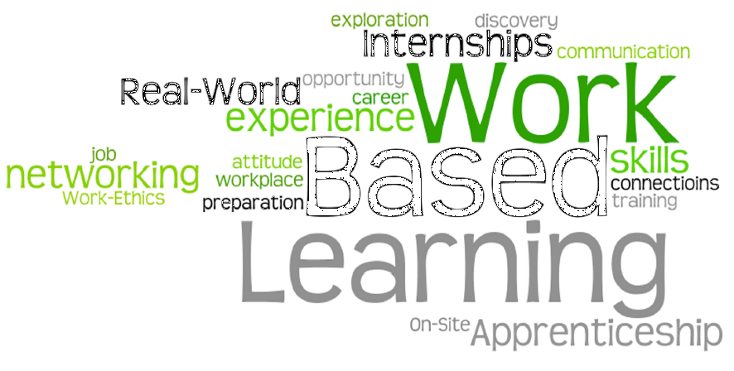
Employer Community Benefits
ROI
(Return on Investment)
Community Benefits
 | Increases realization of return on investment for K-12 funding.
 | Retention of local talent within the community.
 | Grows a viable workforce that is attractive to both new and existing industry.
 | Growth in tax base.
 | Strengthens community partnerships.
 | Makes education more relevant.
Employer Benefits
Reduces the cost of training & recruitment
Allows employers to communicate required job-specific proficiencies to educational personnel.
Creates entry-level workers already invested in the company - start first day of full-time employment knowing necessary skills and expectations.
Notes:
Summer WBL
WBL Entrepreneurship
Development of remote WBL framework

Slide 10
Innovative and Locally Developed Pathways
Pathways:
Heavy Equipment Operations – Toombs County
Poultry Science – Gilmer County
International Business – Troup County
Commercial Fishing Management – McIntosh County
Financial Technology (FinTech) – Statewide
USG & GaDOE CTAE
Artificial Intelligence – Gwinnett County
Animation and Digital Media – Fayette County
Unmanned Aircraft (Drones) – Griffin- Spaulding County
Local Pathways
Pathway Pipeline
Workforce Projects
Currently in the pathway pipeline:
Hospitality – Clarke County

Slide 11
Workforce Strategies & Solutions
Phoebe Health Science Pathway:
Health Science (Phase 1) - Dougherty County
Phoebe Putney Memorial Hospital, Inc.
Commodore Conyers College & Career Academy (4 C model)
Dougherty County School System
Baker County School System
Calhoun County School District
Terrell County Charter Schools
Albany State University
Albany Technical College
Georgia Board of Nursing
SREB
GaDOE CTAE
Health Science (Phase 2) – Lee & Sumter Counties
Phoebe Putney Memorial Hospital, Inc.
Lee County
Sumter County High School / Ignite College & Career Academy
South Georgia Technical College
Georgia Southwestern University

Slide 12
FY23 CTAE Manufacturing Equipment Grant Recipients Economic Development Crosswalk

Slide 13
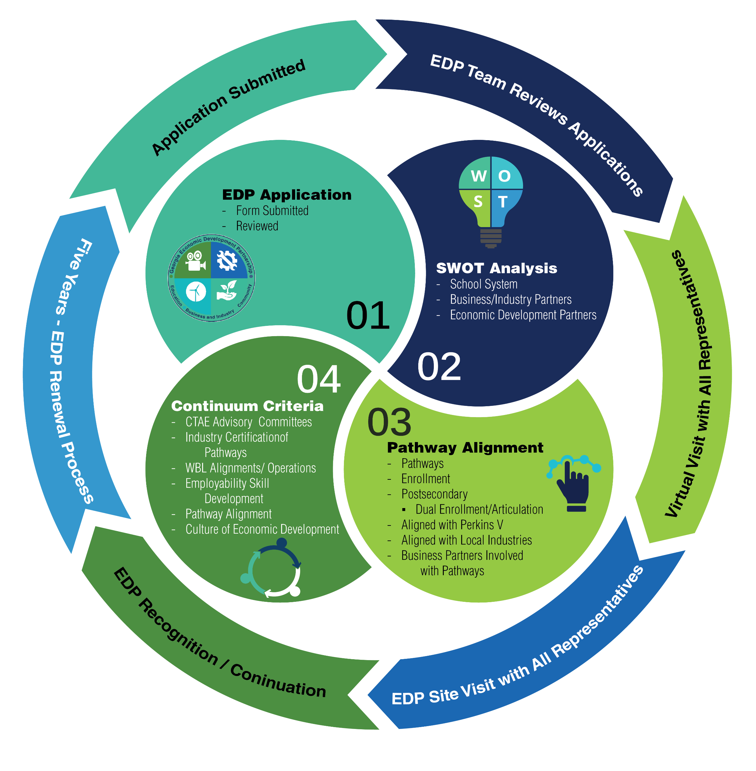
Economic Development Partnership (EDP)
A district wide certification process that prepares school districts to adopt best practices and behaviors that support economic development, strengthen their programs, and align education with key regional industries.

Slide 14
EDP Districts are evaluated with a Continuum Criteria in the following 6 areas:
CTAE Advisory Committees
Industry Certification of Pathway programs.
Alignment and operation of the Work-Based Learning program (WBL)
Evidence of Employability Skill development
and application.
Pathway alignment to local and regional economy.
Culture of Economic Development within the school district and community.
Launching
Advancing
Executing
Exceling

Slide 15
Economic Development Partnership (EDP) Designation
FY 18 Pilot
Newton County
Muscogee County
Whitfield County
Wayne County
Marietta City Schools
FY 22
Barrow County
Bulloch County
Fannin County
Floyd County
Hall County
Savannah-Chatham County
FY 23 (TBD)
Dawson County
Gordon County
Bibb County
Liberty County
Dublin City Schools
Calhoun City Schools
FY 24 (Pursuing)
Cartersville City Schools
Peach County
Social Circle City Schools
Twiggs County
Ware County

Slide 16
Workforce Strategies Initiative (WSI)
CTAE Rising To The Workforce Challenges of Georgia

Slide 17
Workforce Strategies Initiative (WSI)
Social Services/Law and Public Safety (LPS)
Connecting Students to Careers: Inviting State Partners to Exhibit at Various CTSO Events
Established Articulation Agreements with TCSG
Workshops and Conference Presentations for CTAE Educators and Administrators Statewide
Supporting Industry Certifications for Existing Pathways
New Pathways: Mental Health Pathway
IT (Information Technology)
Exploring Pathway Alignment to Industry Needs
Creating Connection Opportunities Between Industry and Existing Programs-career fairs, CTSO support, career readiness events.
Credentials of Value Review
Procurement
Supported adding procurement to existing related pathways as standards : marketing, business law, accounting, and logistics
Identify job fairs that procurement employees can attend with agency HR teams
Developed experiential activities for CTAE programs.
Establish Military Partnerships
Create a training portal to introduce non-state employees to procurement.
Accounting
Curriculum Review
Supported establishing a Governmental
Accounting Course
Develop a Governmental Accounting Pathway

Slide 18
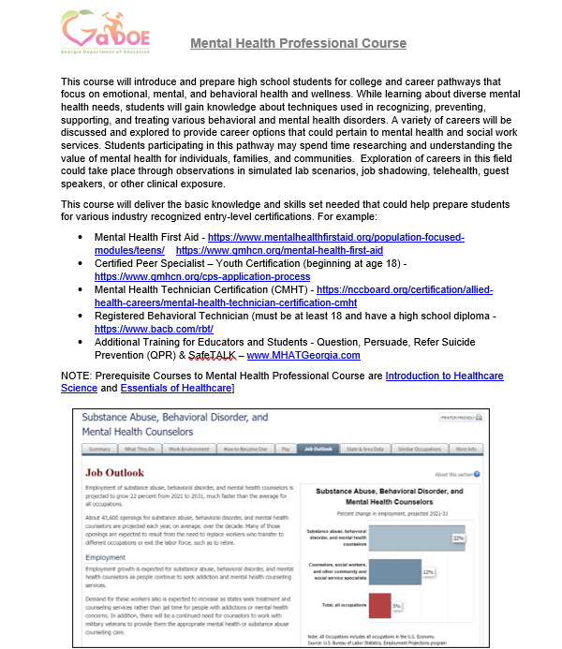
Workforce Strategies Success Highlight: Establishing an Ecosystem For a Talent Pipeline
Mental Health Professional Course
Introduce and prepare high school students for college and career pathways that focus on emotional, mental, and behavioral health and wellness
Exploration of careers in this field could take place through observations in simulated lab scenarios, job shadowing, telehealth, guest speakers, or other clinical exposure.

